Slide 1

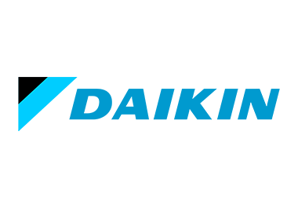

ENTITY-RELATIONSHIP DIAGRAM (ERD) FOR DAIKIN INDUSTRIES
Objective:
To design an ERD that effectively models Daikin’s internal data management framework, focusing on order processing, inventory tracking, supplier coordination, and employee interactions.
Name : Sweta Behera
Roll No. : 055051
Section: K

Slide 2

PROBLEM STATEMENT
During an industry visit to Daikin Industries, the objective was to gain insights into the company's internal operations and data management framework. A key challenge was to design an Entity-Relationship Diagram (ERD) that effectively represents the organization's data flow, covering aspects such as order processing, inventory management, supplier coordination, and employee interactions. By developing this ERD, the goal is to enhance data organization, improve operational efficiency, and ensure seamless information flow across departments. This structured approach will aid in identifying critical data relationships and optimizing business processes within Daikin Industries.

Slide 3
DATA AND ANALYSIS
The ERD consists of the following key entities:
Employee – Captures employee information, including ID, name, and position, facilitating role-based operations.
Customer – Stores customer details such as ID, name, and contact number for order processing and service management.
Order – Represents customer purchases, linking to order details and processing timelines.
OrderDetails – Contains specific product information related to each order.
Product – Stores details of items offered, categorized and linked to suppliers.
Supplier – Manages supplier records, ensuring a streamlined procurement process.
Inventory – Tracks stock levels and product availability, supporting efficient warehouse management.
ServiceRequest – Links customers to products requiring service or maintenance, improving after-sales support.
Relationships include one-to-many (1:M) and many-to-many (M:N) connections to accurately model Daikin’s business operations.

Slide 4
OBSERVATIONS
Comprehensive Order Processing: Seamless tracking from order placement to fulfillment.
Optimized Inventory Control: Accurate monitoring of stock levels reduces inefficiencies.
Enhanced Supplier Coordination: Direct supplier-product links ensure smooth procurement.
Integrated Employee Management: Employee roles are mapped to relevant business functions.
Customer-Centric Service Handling: Service requests are effectively linked to customers and products.

Slide 5
INSIGHTS AND RECOMMENDATIONS
Process Automation: Implementing automated order tracking can reduce delays and errors.
Real-Time Inventory Management: Enabling live stock updates prevents shortages and overstocking.
Supplier Relationship Optimization: Strengthening supplier collaboration ensures timely procurement.
Data Integrity Measures: Establishing validation rules improves data accuracy and system efficiency.
Scalability and Future Growth: The ERD design allows for easy expansion across departments.

Slide 6
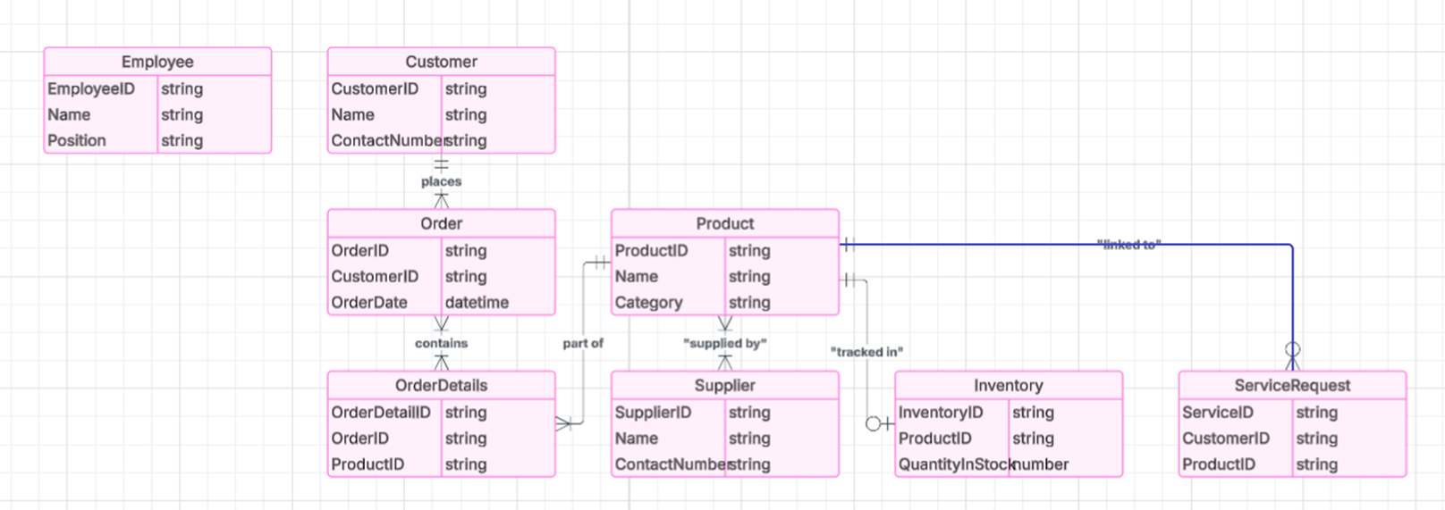
ENTITY-RELATIONSHIP DIAGRAM (ERD)

