Slide 1
Q1: Find out if the given number is an Armstrong number or not.
Description :-
An Armstrong number of three digits is an integer, where the sum of the cubes of its digits is equal to the number itself.
Consider the example: 371=> 3^3 + 7^3 + 1^3 = 371 ( If you add those all numbers, the final digit should be same as given number ).

Slide 2
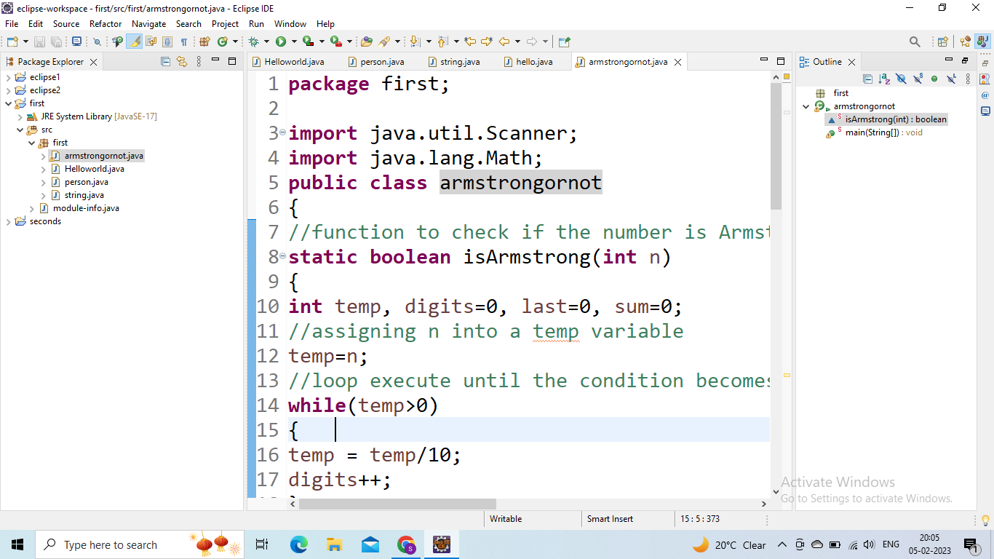

Slide 3
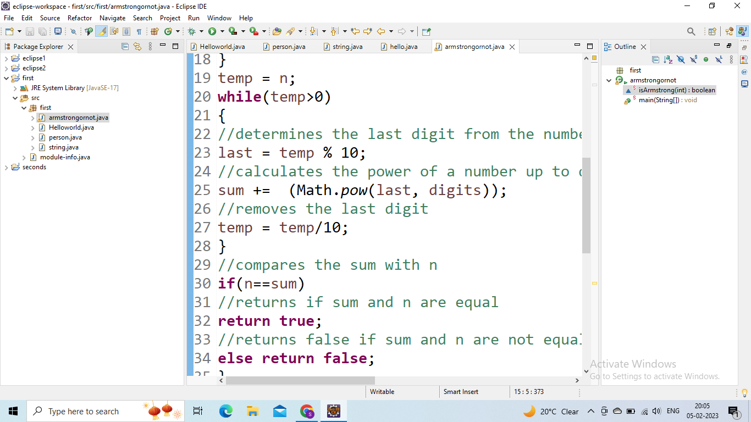

Slide 4
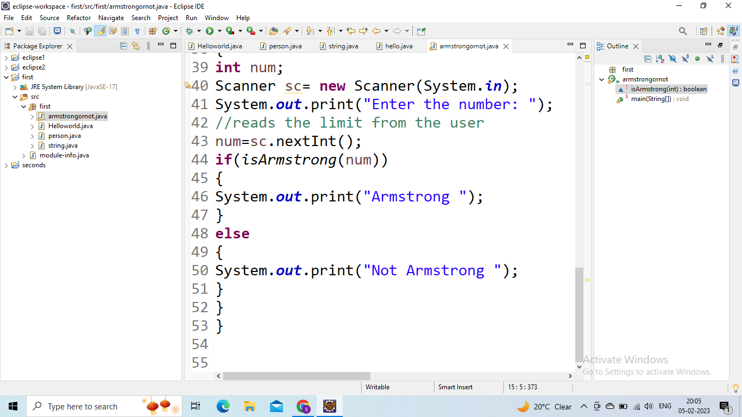
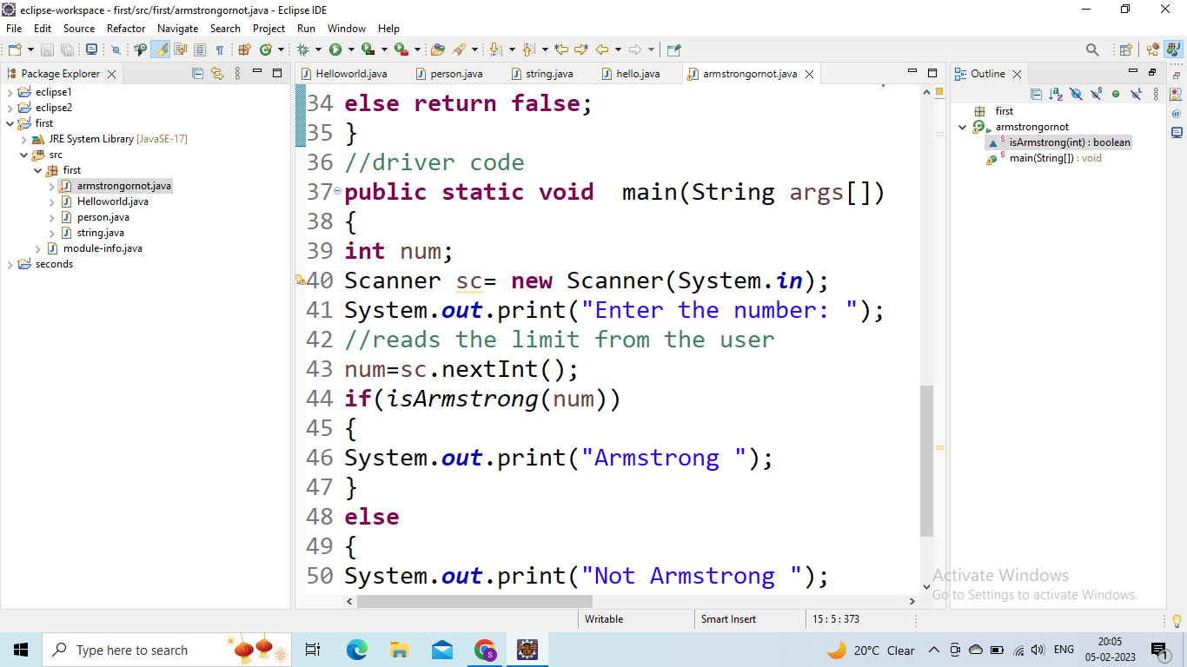

Slide 5
