Slide 1
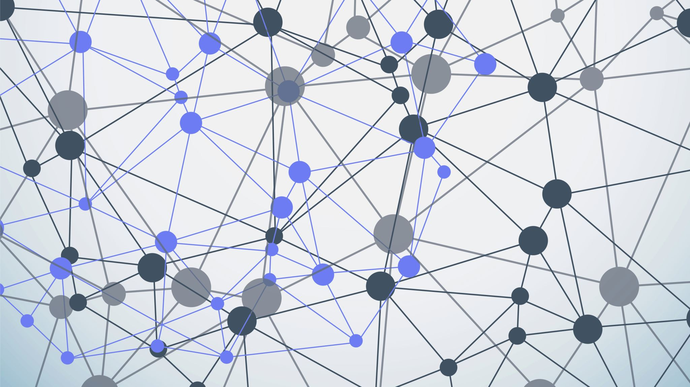

K-MEANS CLUSTERING ALGORITHM
BY
SWETA DAS
(40016932)

Slide 2
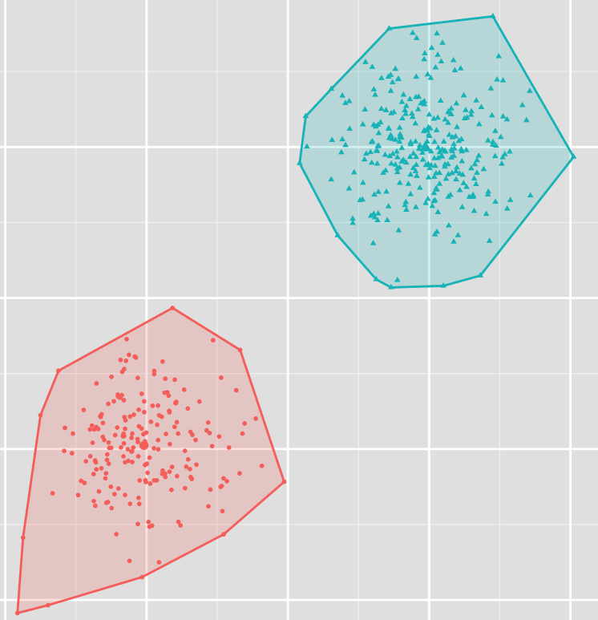
CLUSTERING:
Clustering is the classification of objects into different groups, or more precisely, the partitioning of a data set into subsets (clusters), so that the data in each subset (ideally) share some common trait - often according to some defined distance measure.

Slide 3
INTRODUCTION:
Type of unsupervised learning used for unlabeled data
The goal of this algorithm is to find groups in the data, with the number of groups represented by the variable K.
The algorithm works iteratively to assign each data point to one of K groups based on feature similarity.

Slide 4
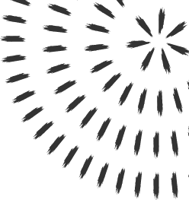
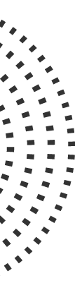
WHY K-MEANS?
One of the simplest clustering algorithms
Easy to implement
It does a very good job when the clusters have a kind of spherical shapes

Slide 5

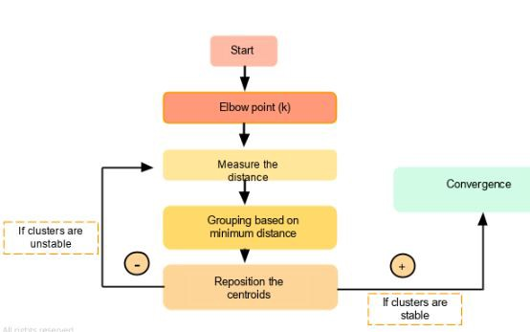
FLOWCHART OF THE ALGORITHM:

Slide 6
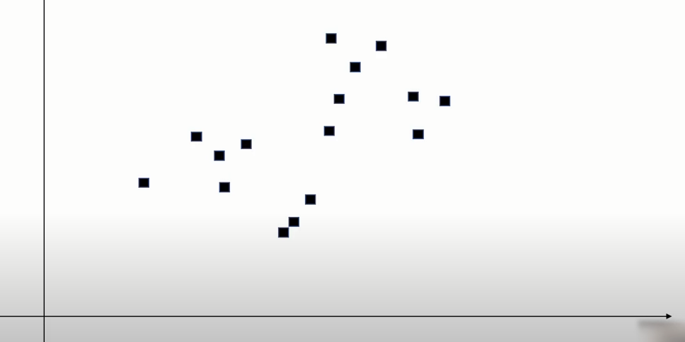
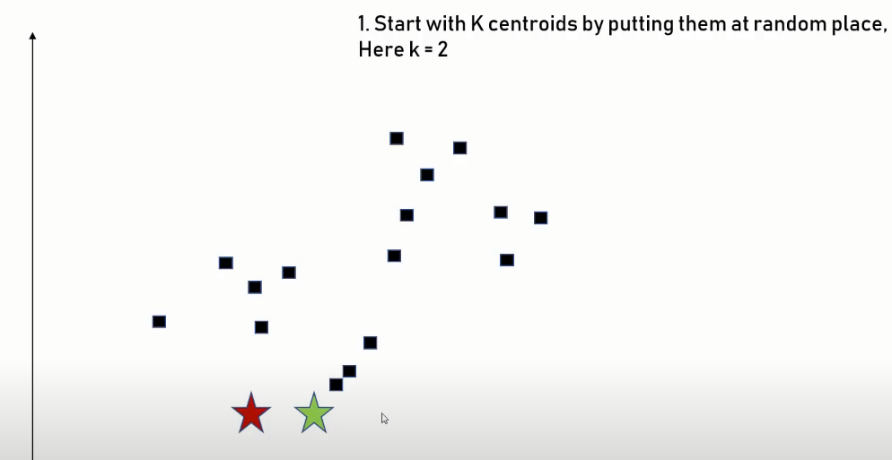
VISUALISATION OF THE ALGORITHM:

Slide 7
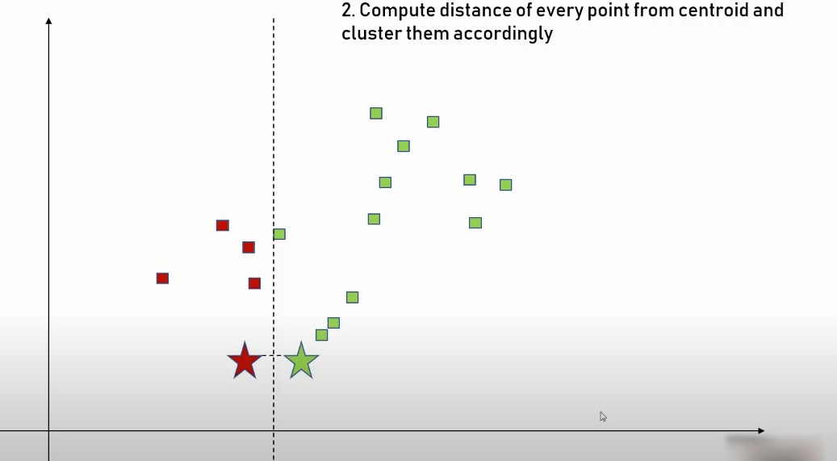
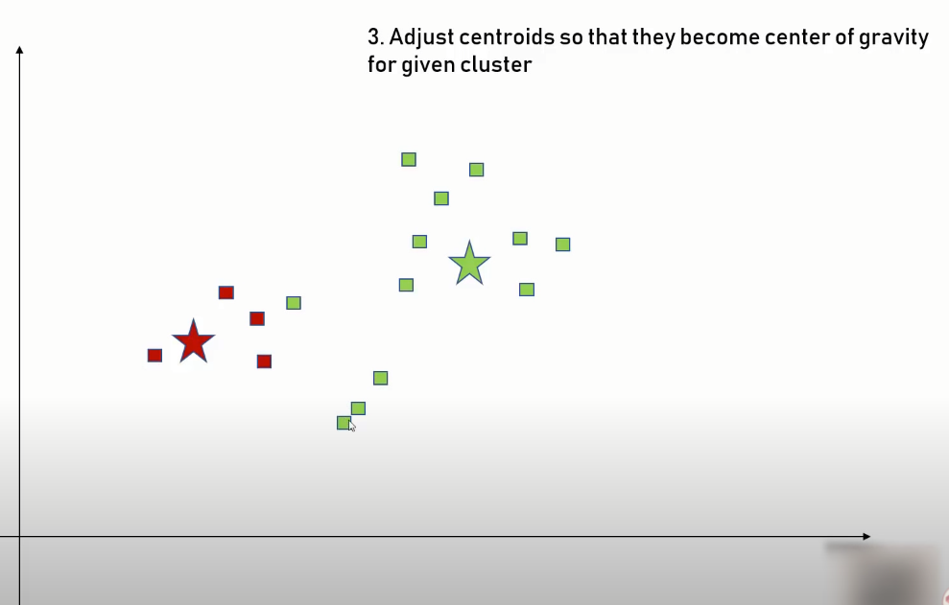
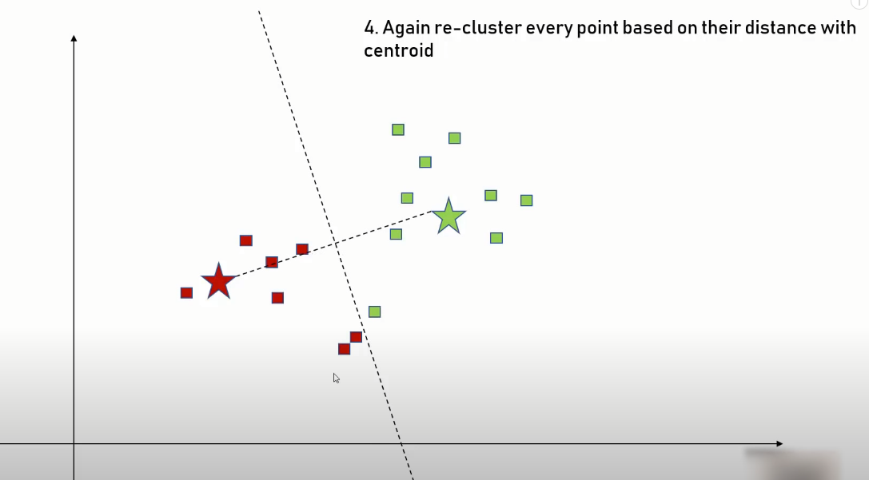
VISUALISATION OF THE ALGORITHM:

Slide 8
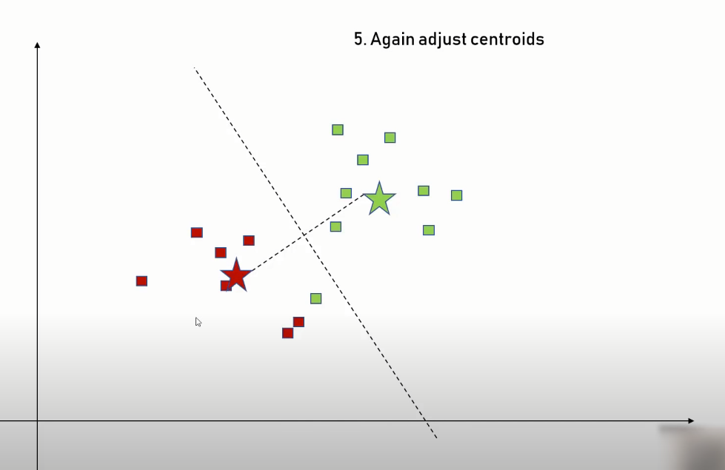
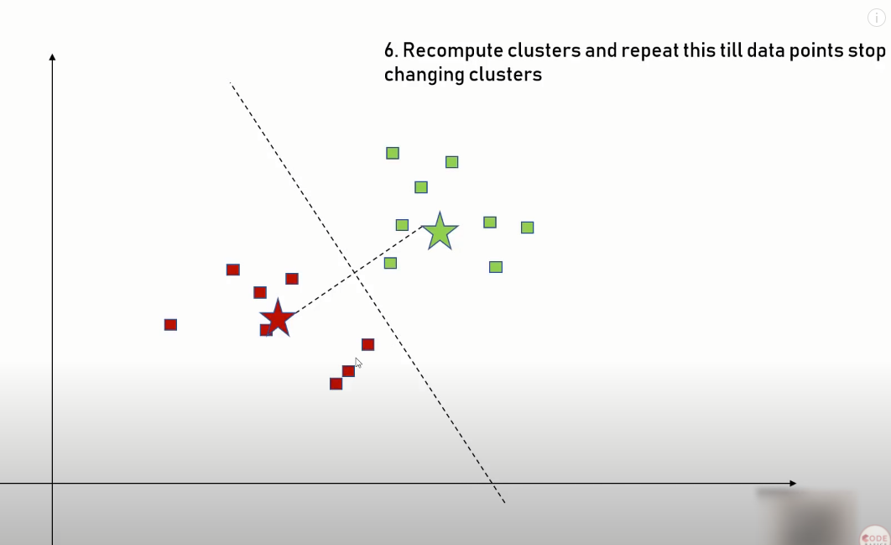
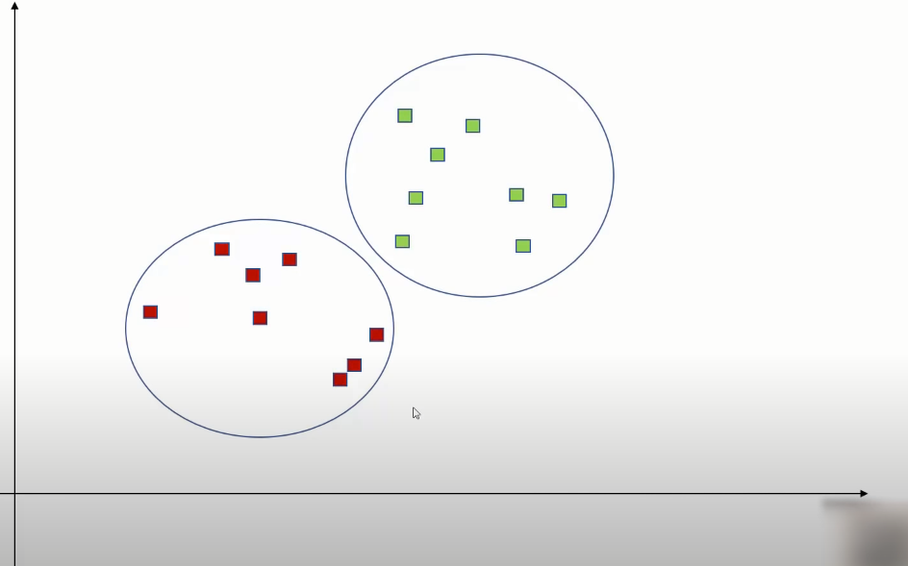
VISUALISATION OF THE ALGORITHM:

Slide 9
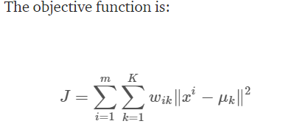
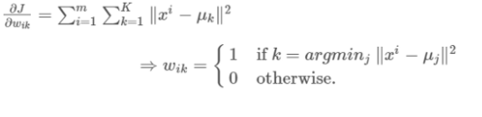
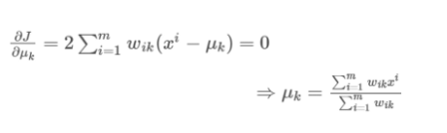
MATHEMATICAL EXPLANATION:
EXPECTATION MAXIMIZATION:
The E-step is assigning the data points to the closest cluster. The M-step is computing the centroid of each cluster
OBJECTIVE FUNCTION
E-STEP
M-STEP

Slide 10
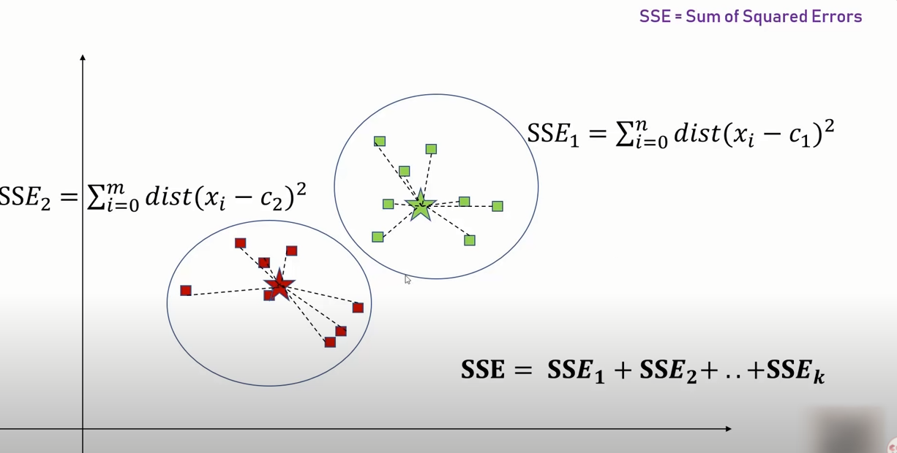
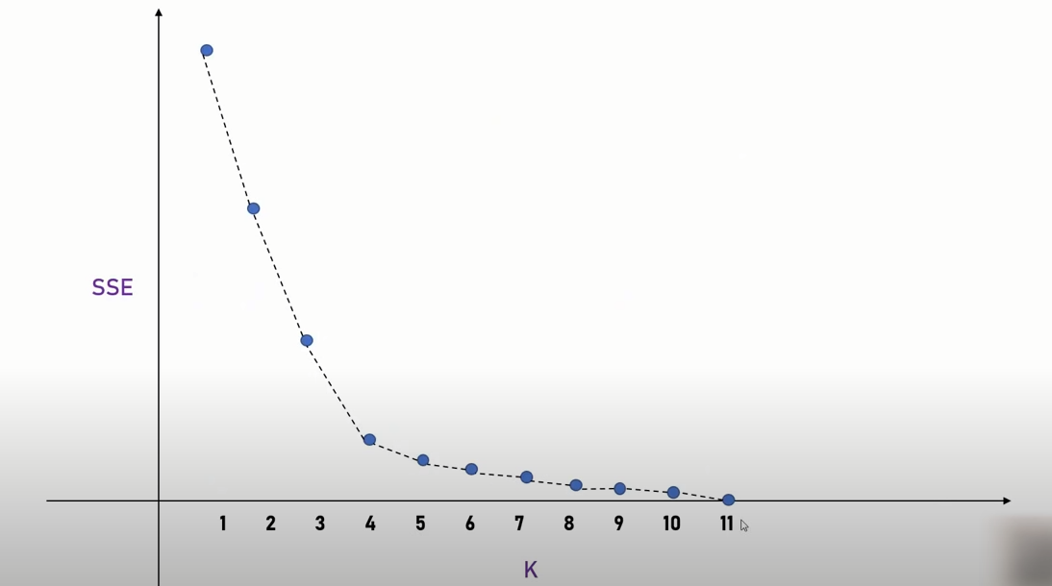
HOW TO DETERMINE K-CLUSTERS?
ELBOW TEST:

Slide 11

HOW TO DETERMINE K-CLUSTERS?
Silhouette analysis
used to determine the degree of separation between clusters. For each sample:
Compute the average distance from all data points in the same cluster (ai).
Compute the average distance from all data points in the closest cluster (bi).
Compute the coefficient:
If it is 0 –> the sample is very close to the neighboring clusters.
It it is 1 –> the sample is far away from the neighboring clusters.
It it is -1 –> the sample is assigned to the wrong clusters.
Therefore, we want the coefficients to be as big as possible and close to 1 to have a good clusters.

Slide 12
K- MEANS USE IN REAL LIFE APPLICATIONS:
Document Classification
Delivery Store Optimization
Identifying Crime Localities
Customer Segmentation
Fantasy league stats analysis
Insurance Fraud Detection
Rideshare Data Analysis
Cyber-profiling Criminals
Call Record Detail Analysis
Automatic Clustering Of It Alerts

Slide 13
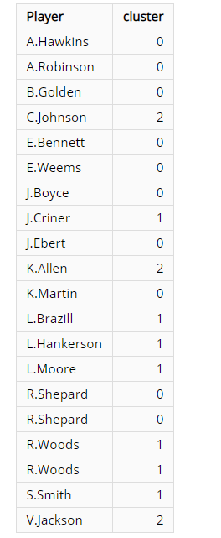
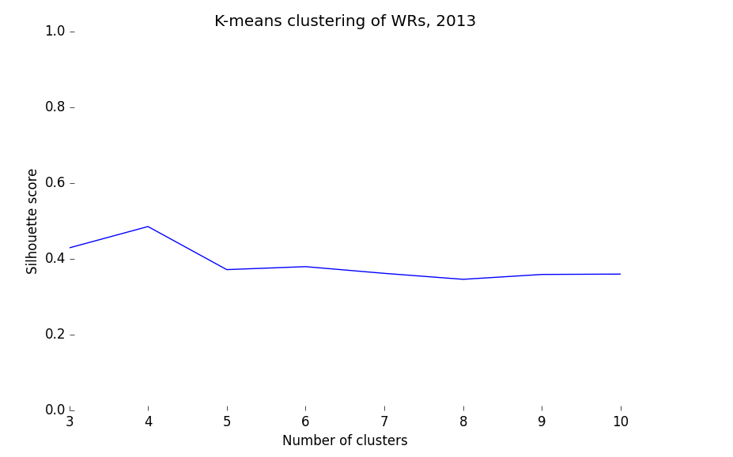
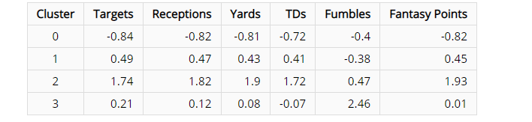
FANTASY LEAGUE STAT ANALYSIS:
TO PREDICT HIGH RECIEVERS:

Slide 14
DRAWBACKS:
Kmeans algorithm is good in capturing structure of the data if clusters have a spherical-like shape. It always try to construct a nice spherical shape around the centroid. That means, the minute the clusters have a complicated geometric shapes, kmeans does a poor job in clustering the data.
It requires to specify the number of clusters (k) in advance. It cannot handle noisy data and outliers.
It is not suitable to identify clusters with non-convex shapes.
It is sensitive to initial condition. Different initial condition may produce different result of cluster. The algorithm may be trapped in the local optimum.

Slide 15
CONCLUSION:
Kmeans clustering is one of the most popular clustering algorithms and usually the first thing practitioners apply when solving clustering tasks to get an idea of the structure of the dataset.
The goal of kmeans is to group data points into distinct non-overlapping subgroups.

Slide 16
THANK YOU

