Slide 1

Noida Institute of Engineering and Technology, Greater Noida
Theory of Computation
(BCSE0404X(TOC))
Module: 3
Context Free Grammar and Push Down Automata
Vivek Kumar Sharma
Assistant Professor
(CSE Department)
Course Details (B.Tech CSE 4th Sem)

Slide 2

Faculty Profile

Slide 3
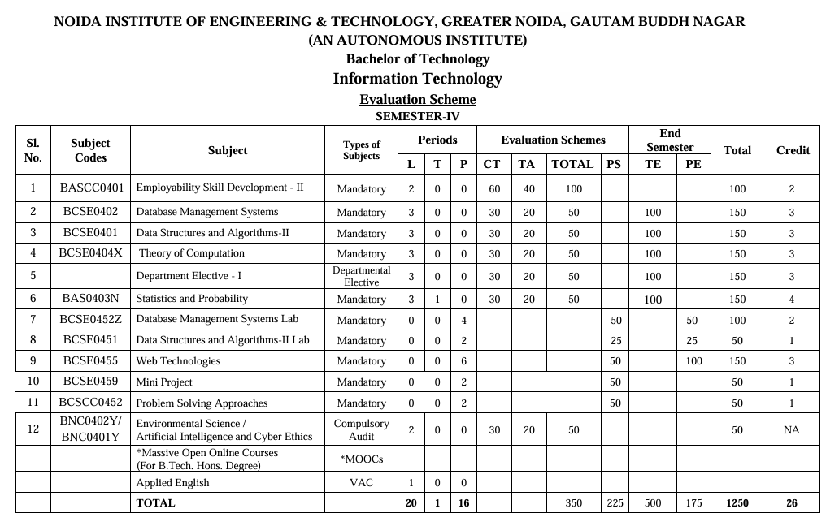
Evaluation Scheme

Slide 4
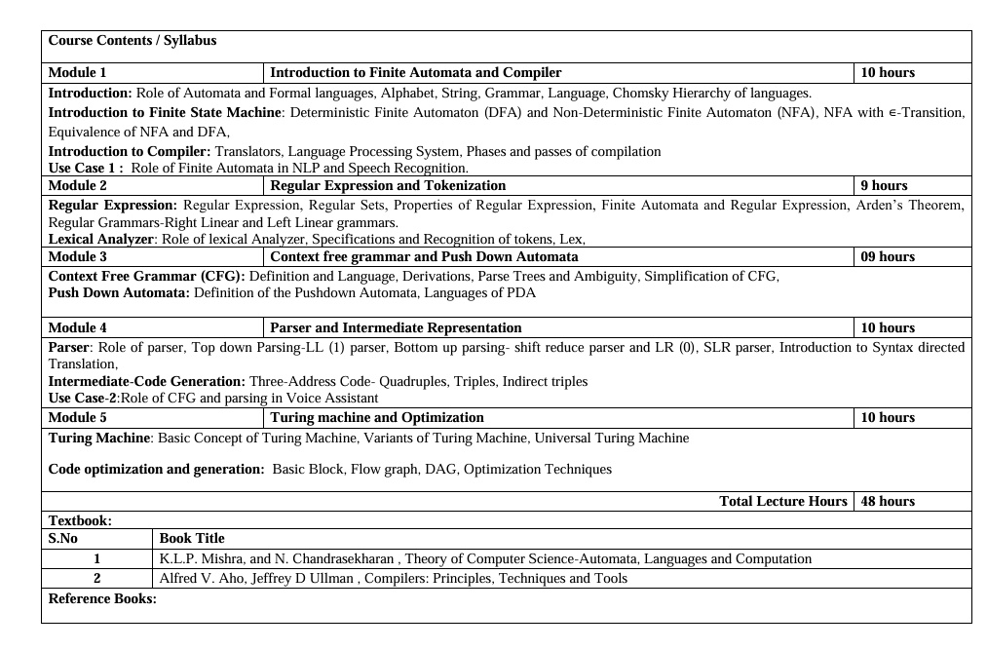
Syllabus

Slide 5
Branch Wise Applications
It can compute man-made problems as well as natural phenomena.
Automata theory has a lot of applications in real life as well, such that: Lambda calculus, Combinatory logic, Markov algorithm, and Register, Natural Language Processing ,Compiler Design and Lexical analysis and Semantic analysis. Also, the concept of Formal languages and automata theory can overlap with other subjects as well.

Slide 6
Course Objectives
The primary objective of this course is to provide a foundational understanding of Automata Theory and its role in the language processing systems, also explores their application in fields like Natural Language Processing (NLP), speech recognition.

Slide 7
UNIT III Syllabus
Module-3
Context Free Grammar and Push Down Automata
Context Free Grammar (CFG): Definition and Language, Derivations, Parse Trees and Ambiguity, Simplification of CFG, Push Down Automata: Definition of the Pushdown Automata, Languages of PDA

Slide 8
Course Outcome
Theory of Computation (BCSE0404X)
Course Outcome (CO) |  | Bloom’s Knowledge Level (KL)
After completion of the course, the student will be able to:
CO 1 | Identify the fundamental concepts of automata theory, formal languages and compiler components. |  | K2
CO 2 | Understand the role of finite automata, regular expressions, and grammar rules in language processing. |  | K2
CO 3 | Demonstrate context-free grammars, pushdown automata, and syntax-directed translation to construct intermediate code for language processors. |  | K3
CO 4 | Analyze various parsing strategies, code translation methods, and intermediate representations in compiler phases. |  | K4
CO 5 | Analyze the functioning of Turing machine models and optimization techniques in code generation for performance improvement. |  | K4

Slide 9
Program Outcomes (POs)
PO1: Engineering Knowledge: Apply knowledge of mathematics, natural science, computing, engineering fundamentals and an engineering specialization as specified in WK1 to WK4 respectively to develop to the solution of complex engineering problems.
PO2: Problem Analysis: Identify, formulate, review research literature and analyze complex engineering problems reaching substantiated conclusions with consideration for sustainable development. (WK1 to WK4)
PO3: Design/Development of Solutions: Design creative solutions for complex engineering problems and design/develop systems/components/processes to meet identified needs with consideration for the public health and safety, whole-life cost, net zero carbon, culture, society and environment as required. (WK5)
PO4: Conduct Investigations of Complex Problems: Conduct investigations of complex engineering problems using research-based knowledge including design of experiments, modelling, analysis & interpretation of data to provide valid conclusions. (WK8).
PO5: Engineering Tool Usage: Create, select and apply appropriate techniques, resources and modern engineering & IT tools, including prediction and modelling recognizing their limitations to solve complex engineering problems. (WK2 and WK6)

Slide 10
Program Outcomes (POs)
PO6: The Engineer and The World: Analyze and evaluate societal and environmental aspects while solving complex engineering problems for its impact on sustainability with reference to economy, health, safety, legal framework, culture and environment. (WK1, WK5, and WK7).
PO7: Ethics: Apply ethical principles and commit to professional ethics, human values, diversity and inclusion; adhere to national & international laws. (WK9)
PO8: Individual and Collaborative Team work: Function effectively as an individual, and as a member or leader in diverse/multi-disciplinary teams.
PO9: Communication: Communicate effectively and inclusively within the engineering community and society at large, such as being able to comprehend and write effective reports and design documentation, make effective presentations considering cultural, language, and learning differences
PO10: Project Management and Finance: Apply knowledge and understanding of engineering management principles and economic decision-making and apply these to one’s own work, as a member and leader in a team, and to manage projects and in multidisciplinary environments.

Slide 11
Program Outcomes (POs)
PO11: Life-Long Learning: Recognize the need for, and have the preparation and ability for i) independent and life-long learning ii) adaptability to new and emerging technologies and iii) critical thinking in the broadest context of technological change. (WK8)

Slide 12
CO-PO Correlation Matrix
CO-PO Mapping | PO1 | PO2 | PO3 | PO4 | PO5 | PO6 | PO7 | PO8 | PO9 | PO10 | PO11
CO1 | 3 | 2 | 2 | 2 | - | - | - | - | - | - | 2
CO2 | 3 | 3 | 3 | 2 | 1 | - | - | - | - | - | 2
CO3 | 3 | 3 | 3 | 3 | 1 | - | - | - | - | - | 2
CO4 | 3 | 3 | 3 | 3 | 1 | - | - | - | - | - | 2
CO5 | 3 | 3 | 3 | 3 | 1 | - | - | - | - | - | 2
Average | 3 | 2.8 | 2.8 | 2.6 | 1 | - | - | - | - | - | 2

Slide 13

Program Specific Outcomes
On successful completion of graduation degree, the Information Technology graduates will be able to:
PSO1 | Work as a software engineer in different dimensions of information technology to provide solutions to real-world and industrial problems in an eco-friendly manner
PSO2 | Apply knowledge of core subjects with multi-disciplinary and modern computing techniques to solve complex IT problems.
PSO3 | Establish a successful and innovative career by practicing lifelong learning and communicating in a team or as an individual to manage projects with ethical concerns.

Slide 14
CO-PSO Correlation Matrix
CO-PSO Mapping | PSO1 | PSO2 | PSO3
CO1 | 2 | 3 | 1
CO2 | 2 | 3 | 1
CO3 | 3 | 3 | 2
CO4 | 3 | 3 | 2
CO5 | 3 | 2 | 2
Average | 2.6 | 2.8 | 1.6

Slide 15
End Semester Question Paper Template
Printed Page: | Subject Code:
 | Roll. No:
NOIDA INSTITUTE OF ENGINEERING AND TECHNOLOGY, GREATER NOIDA
(An Autonomous Institute Affiliated to AKTU, Lucknow)
B.Tech
SEM: - THEORY EXAMINATION (2025 - 2026) Subject:
Time: 3 Hours | Max. Marks: 100
General Instructions: IMP: Verify that you have received the question paper with the correct course, code, branch etc. This Question paper comprises of three Sections -A, B, & C. It consists of Multiple-Choice Questions (MCQ’s) & Subjective type questions. Maximum marks for each question are indicated on right -hand side of each question. Illustrate your answers with neat sketches wherever necessary. Assume suitable data if necessary. Preferably, write the answers in sequential order. No sheet should be left blank. Any written material after a blank sheet will not be evaluated/checked.

Slide 16
End Semester Question Paper Templates
SECTION-A |  | 20
1. Attempt all parts:-
1-a. |  | 1
1-b. |  | 1
1-c. |  | 1
1-d. |  | 1
1-e. |  | 1
1-f. |  | 1
1-g. |  | 1
1-h. |  | 1
1-i. |  | 1
1-j. |  | 1
1-f. |  | 1
2 Attempt all parts:-
2.a. |  | 2
2.b. |  | 2
2.c. |  | 2
2.d. |  | 2
2.e. |  | 2
Ankur Kumar Varshney BCSE0404X(TOC) Unit III

Slide 17
End Semester Question Paper Templates
SECTION-B |  | 30
3. Attempt all parts: -
3.a. Answer any one of the following: -
3.a.(i) |  | 6
3.a.(ii) |  | 6
3.b. Answer any one of the following: -
3.b.(i) |  | 6
3.b.(ii) |  | 6
3.c. Answer any one of the following: -
3.c.(i) |  | 6
3.c.(ii) |  | 6
3.d. Answer any one of the following: -
3.d.(i) |  | 6
3.d.(ii) |  | 6
3.e. Answer any one of the following: -
3.e.(i) |  | 6
3.e.(ii) |  | 6
Ankur Kumar Varshney BCSE0404X(TOC) Unit III

Slide 18
End Semester Question Paper Templates
SECTION-C |  | 50
4. Answer any one of the following: -
4-a. |  | 10
4-b. |  | 10
5. Answer any one of the following: -
5-a. |  | 10
5-b. |  | 10
6. Answer any one of the following: -
6-a. |  | 10
6-b. |  | 10
7. Answer any one of the following: -
7-a. |  | 10
7-b. |  | 10
8. Answer any one of the following: -
8-a. |  | 10
8-b. |  | 10
Ankur Kumar Varshney BCSE0404X(TOC) Unit III

Slide 19
Program Educational Objectives
PEO’S of the B. Tech. in Information Technology are:
The graduates will be:
PEO1: To apply sound knowledge combining technical expertise, and problem-solving skills to fulfill the needs of the IT industry and stay updated with the latest emerging trends.
PEO2: To provide sustainable solutions for real-life problems by designing innovative and interdisciplinary systems using the latest digital technologies for serving academia, industry, and society.
PEO3: To reflect professional attitude, social ethics, communication, teamwork, and leadership skills in research and product development to face global challenges.
PEO4: To pursue higher studies and develop their career successfully in the software industry and R&D sectors with a lifelong learning frame of mind.
.

Slide 20
Unit Objective
To understand the definition of Context Free Grammar (CFG) and the types of languages generated by CFG.
To explain the concept of derivations in CFG and analyze how strings are generated step by step.
To study parse trees and identify ambiguity in grammars through multiple derivations.
To learn the techniques for simplification of CFG by removing useless symbols, null productions, and unit productions.
To understand the definition and structure of Pushdown Automata (PDA) as a computational model.
To analyze the relationship between Pushdown Automata and Context Free Languages, and identify the languages accepted by PDA.

Slide 21
Topic Objective
Topic | Objectives
Context Free Grammar (CFG): Definition and Language | To understand the formal definition of Context Free Grammar and identify the class of languages generated by CFG.
Derivations in CFG | To learn leftmost and rightmost derivations and analyze the step-by-step generation of strings in CFG.
Parse Trees and Ambiguity | To construct parse trees and recognize ambiguous grammars through multiple parse trees or derivations.
Simplification of CFG | To understand and apply methods for simplifying CFG by eliminating useless symbols, null productions, and unit productions.
Pushdown Automata (PDA): Definition | To understand the structure, components, and working of Pushdown Automata as an abstract machine.
Languages of Pushdown Automata | To analyze the types of languages accepted by PDA and establish the equivalence between PDA and Context Free Languages.

Slide 22
Prerequisite
Prerequisite:
Basic knowledge of formal languages and automata concepts such as alphabets, strings, and languages.
Understanding of regular languages, regular expressions, and finite automata (DFA/NFA).
Familiarity with grammar basics, including terminals, non-terminals, production rules, and derivations.
Basic understanding of set theory and mathematical notation used in language definitions.
Awareness of language recognition models and their role in classifying languages.

Slide 23
Recap
Recap:
Regular expressions are the way of representation of the FA.
RE can be converted into FA.
FA can be converted into regular expressions.
Arden’s Theorem is used to solve regular expression equations and obtain expressions from finite automata.
Regular grammars generate regular languages and are classified as right-linear and left-linear grammars.
The lexical analyzer is the first phase of a compiler and converts source code into tokens.
Tokens are specified using regular expressions and recognized using finite automata.
Lex is a tool used to automatically generate lexical analyzers based on token specifications.

Slide 24
Grammar
A Grammar is a set of formal rules that define how to generate syntactically correct strings or sentences in a language.
A Grammar G can be formally written as a 4-tuple (N, T, S, P) where −
N or V_{N} is a set of variables or non-terminal symbols.
T or ∑ is a set of Terminal symbols.
S is a special variable called the Start symbol, S ∈ N
P is Production rules for Terminals and Non-terminals. A production rule has the form α → β, where α and β are strings on V_{N} ∪ ∑ and least one symbol of α belongs to V_{N}.

Slide 25
Examples of Grammar
Example 2
Grammar G2 −
(({S, A}, {a, b}, S,{S → aAb, aA → aaAb, A → ε } )
Here,
S and A are Non-terminal symbols.
a and b are Terminal symbols.
ε is an empty string.
S is the Start symbol, S ∈ N
Production
P : S → aAb, aA → aaAb, A → ε
ample
Example 1
Grammar G1 −
({S, A, B}, {a, b}, S, {S → AB, A → a, B → b})
Here,
S, A, and B are Non-terminal symbols;
a and b are Terminal symbols
S is the Start symbol, S ∈ N
Productions,
P : S → AB, A → a, B → b

Slide 26
Types of Grammar
The different types of grammar −
Grammar | Language | Automata | Production rules
Type-0 | Recursively enumerable | Turing machine | No restriction
Type-1 | Context-Sensitive | Linear-bounded non-deterministic machine | αAβ→αγβ
Type-2 | Context-Free | Non-deterministic push down automata | A→γ
Type-3 | Regular | Finite state automata | A→αB A→α

Slide 27
Context-Free Grammar and Context-Free Language
A Grammar G=(N,T,P,S) is said to be Context-Free Grammar(CFG) if the production rules of G are of the form: A →α, Where α ∈(NUT)* .
It is a formal grammar which is used to generate all possible patterns of strings in a given formal language.
Context-Free Grammar are very useful in lexical analysis, which is a part of Compiler.
The Language generated by G is denote as L(G).The language L is called Context-Free Language(CFL) if L(G) is for CFG.
Or
The Language Generated by Context-Free Grammar(CFG) is Called Context-Free Language(CFL).

Slide 28
Examples of CFG
Q1: Write CFG which generates palindrome for binary string.
Palindrome is a string which will be same while reading from LHS or RHS example 101, 010…..
S → 0S0/1S1
S → 0/1/ɛ
Generate 0101010
S → 0S0 [S → 0S0 ]
S → 01S10 [S → 1S1 ]
S → 010S010 [S → 0S0 ]
S → 0101010[S → 1]

Slide 29
Examples of CFG
Q2: Write CFG for regular expression r = 0*1(0+1)*
r = 0*1(0+1)*
0* 1 (0+1)*
A B
S →A1B
A →0A/ɛ
B →0B/1B/ɛ

Slide 30
Examples of CFG
Q3: Write CFG for regular expression r = (a+b)*aa(a+b)*
S →AaaA
A →aA/ɛ
A →bA/ɛ
Q4: Set of all strings of length 2
R=(a+b)(a+b)
S →AA
A →a/b
Q.5 Let Σ = {(, )} and let L = {w ∈ Σ* | w is a string of balanced parentheses }
S → (S)S | ε
Q.6 Let Σ = {a, b} and let L = {w ∈ Σ* | w is a palindrome }
S → ε | a | b | aSa | bSb

Slide 31
Examples of CFG
Q.7: Set of all strings of L=(a+b)*
S →aS/bS/ɛ
Q.8: Set of all strings of length at least 2
R= (a+b)(a+b)(a+b)*
S →AAB
A →a/b
B →aB/bB/ɛ
Q.9: Set of all strings of length at most 2
R=(a+b+ɛ)(a+b+ɛ)
S →AA
A →a/b/ɛ

Slide 32
Examples of CFG
Q.10: For R= a(a+b)*b
S →aAb
A →aA/bA/ɛ
Q.11:Construct a CFG for the regular expression (0+1)*
The CFG can be given by,
Production rule (P):
S → 0S | 1S
S → ε
Q.12:Construct a CFG for a language L = {wcwR | where w € (a, b)*}.
S → aSa rule 1
S → bSb rule 2
S → c rule 3

Slide 33
Context-Free Languages: Example
Example 1
If there is a grammar
G: N = {S, A, B} T = {a, b} P = {S → AB, A → a, B → b}
Here S produces AB, and we can replace A by a, and B by b. Here, the only accepted string is ab, i.e.,
L(G) = {ab}
Example 2
Suppose we have the following grammar −
G: N = {S, A, B} T = {a, b} P = {S → AB, A → aA|a, B → bB|b}
The language generated by this grammar −
L(G) = {ab, a²b, ab², a²b², }
L(G) = {a^{m} b^{n} | m ≥ 1 and n ≥ 1}

Slide 34
Derivation
The grammar rule x - > y is called production rule and application of production rule is called derivation.
Derivation is a sequence of production rules. It is used to get the input string through these production rules. During parsing, we have to take two decisions. These are as follows:
We have to decide the non-terminal which is to be replaced.
We have to decide the production rule by which the non-terminal will be replaced.

Slide 35
Left Most ad Right Most derivations
A string can be derived in many ways . But we restrict ourselves to :
1. Rightmost Derivations
2. Leftmost Derivations
1. Left-most Derivation
In the left most derivation, the input is scanned and replaced with the production rule from left to right. So, in left most derivatives we read the input string from left to right.
2. Right-most Derivation
In the right most derivation, the input is scanned and replaced with the production rule from right to left. So, in right most derivatives we read the input string from right to left.

Slide 36
Left Most Derivations [Example]
For the grammar given below :
S →A1B
A →0A|ɛ
B →0B|1B|ɛ
Give Leftmost derivation and rightmost derivation of string 1001.
Solution
Leftmost derivation of 1001:
S →A1B
S →1B [A →ɛ]
→10B [B →0B]
→100B [B →0B]
→1001B [B →1B]
→1001 [B →ɛ]

Slide 37
Right Most derivations [Example]
Rightmost derivation of 1001:
S →A1B
S →A10B [B →0B]
→A100B [B →0B]
→A1001B [B →1B]
→A1001 [A →ɛ]
→1001 [B →ɛ]
Q. Give the LMD and RMD for the following
Production rules:
S = S + S
S = S - S
S = a | b |c
Input: a - b + c

Slide 38
Derivation Tree or Parse Tree
Derivation tree is a graphical representation for the derivation of the given production rules for a given CFG. It is the simple way to show how the derivation can be done to obtain some string from a given set of production rules. The derivation tree is also called a parse tree.
A parse tree contains the following properties:
The root node is always a node indicating start symbols.
The derivation is read from left to right.
The leaf node is always terminal nodes.
The interior nodes are always the non-terminal nodes.

Slide 39
Rules for Constructing a Parse tree
Following are the main rules for constructing a parse tree:
First, place the initial symbol of the grammar as the root node of the parse tree.
For each non-terminal symbol, create child nodes based on the grammar's production rules.
Search for the appropriate production rule in the grammar that matches the non-terminal symbol being expanded.
Repeat steps 2 and 3 for each non-terminal symbol until all non-terminal symbols have been expanded and only terminal symbols remain as leaf nodes.
Finally verify the parse tree which ensures that the resulting parse tree conforms to the grammar rules and correctly represents the syntactic structure of the program.

Slide 40
Parse Tree [Example]
For a grammar given below S →0S1|01
Give Parse tree derivation of 000111
Derivation using parse tree:
S
S →0S1
0
S
1
S →0S1
0
1
S →01
S
0
1

Slide 41
Ambiguous Grammar
A grammar is said to be ambiguous if there exists more than one leftmost derivation or more than one rightmost derivative or more than one Left Most parse tree or Right Most parse Tree for the given input string. If the grammar is not ambiguous then it is called unambiguous. Definition:
G = (N,T,P,S) is a CFG is said to be ambiguous if and only if there exist a string in T* that has more than one parse tree.
where N is a finite set of variables. T is a finite set of terminals. P is a finite set of productions of the form, A -> α, where A is a variable and α ∈ (N ∪ T)* S is a designated variable called the start symbol.

Slide 42
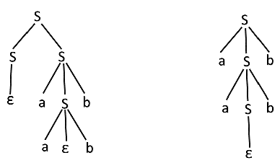
Ambiguous Grammar Example
S → aSb | SS
S → ε
Is this grammar ambiguous or not?
Solution:
For the string "aabb" the above grammar can generate two parse trees
Since there are two parse trees for a single string "aabb", the grammar G is ambiguous.

Slide 43
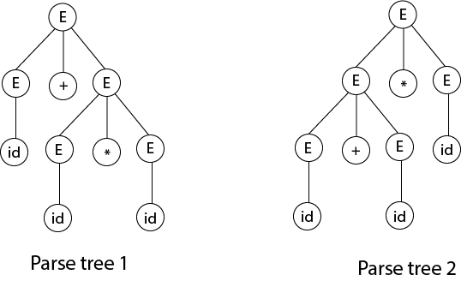
Ambiguous to Unambiguous Grammar Example
Ques. Show that the given grammar is ambiguous. Also, find an equivalent unambiguous grammar.
E → E + E
E → E * E
E → id
Solution:
Let us derive the string "id + id * id“
As there are two different parse tree for deriving the same string, the given grammar is ambiguous.
Unambiguous grammar will be:
E → E + T
E → T
T → T * F
T → F
F → id

Slide 44
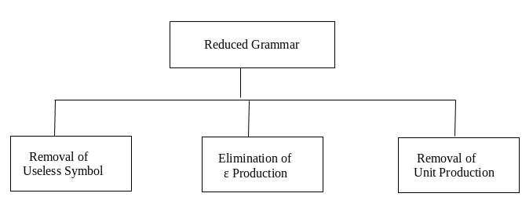
Simplification of CFG
We must eliminate useless symbols, those variables or terminals that do not appears in any derivation of a terminal string from the start symbol.
We must eliminate Null Ɛ production , those of the form X → Ɛ for some variables X.
We must eliminate unit production those of the form X → Y for variables X and Y.

Slide 45
Removal of Useless Symbols
Identified non generating symbols in given CFG and eliminate those productions which contains non generating symbols.
Identified non reachable symbols in grammar and eliminate those productions which contain non reachable symbols.
Example
S→aA|BC
A→b|bB
B→aB|ε
The final simplified grammar becomes −
S→aA
A→b|bB
B→aB|ε

Slide 46
Removal of ɛ Productions[Example]
“If A → Ɛ is a production to be eliminate then we look for all productions, whose right side contain A and replace each occurrence of A in each of these productions to obtain the non Ɛ productions.
Now these resultant non Ɛ production must be added to the grammar to keep the language generated, the same.”
Given Grammar:
S→aA
A →b|ɛ
Solution:
Substitute ɛ on production S→aA
S→a[ɛ]
S→a
Then add this production into main one:
S→aA|a
A →b

Slide 47
Removal of Unit Productions
Any production rule in the form A → B where A, B ∈ Non-terminal is called unit production.
Removal Procedure −
Step 1 − To remove A → B, add production A → x to the grammar rule whenever B → x occurs in the grammar. [x ∈ Terminal, x can be Null]
Step 2 − Delete A → B from the grammar.
Step 3 − Repeat from step 1 until all unit productions are removed.

Slide 48
Removal of Unit Productions[Example]
Problem
Remove unit production from the following −
S → XY,
X → a,
Y → Z | b,
Z → M,
M → N,
N → a
Solution −
There are 3-unit productions in the grammar −
Y → Z, Z → M, and M → N
At first, we will remove M → N.
As N → a, we add M → a, and M → N is removed.
The production set becomes
S → XY, X → a, Y → Z | b, Z → M, M → a, N → a

Slide 49
Removal of Unit Productions[Example]Continue…
Now we will remove Z → M.
As M → a, we add Z→ a, and Z → M is removed.
The production set becomes
S → XY, X → a, Y → Z | b, Z → a, M → a, N → a
Now we will remove Y → Z.
As Z → a, we add Y→ a, and Y → Z is removed.
The production set becomes
S → XY, X → a, Y → a | b, Z → a, M → a, N → a
Now Z, M, and N are unreachable, hence we can remove those.
The final CFG is unit production free −
S → XY, X → a, Y → a | b

Slide 50

Pushdown Automata
Informally a pushdown automata (PDA) is Finite Automata with control of both an input tape and a Stack to store what it has read.
Input Tape
a | b | a | b | b | b | a | a | a | b
Z₀
Finite Control
Stack

Slide 51
Pushdown Automata
A pushdown automaton (PDA) is a finite automaton equipped with a stack-based memory.
Each transition
is based on the current input symbol and the top of the stack,
optionally pops the top of the stack, and
optionally pushes new symbols onto the stack.
Initially, the stack holds a special symbol Z₀ that indicates the bottom of the stack.

Slide 52
Formal Definition of PDA
PDA is a machine with 7-tuples M= (Q, Σ, Γ, δ, q₀, Z₀, F), where
Q is a non empty finite set of states,
Σ is an non empty finite set of input symbols,
Γ is the stack alphabet of symbols that can be pushed on to the stack,
δ : Q ×{ Σ ∪ Ɛ} × Γ *→ (Q × Γ*) is the transition function,
q₀ ∈ Q is the start state,
Z₀ ∈ Γ is the stack start symbol, and
F ⊆ Q is the set of accepting states.

Slide 53
Instantaneous Description of a PDA
The Instantaneous description is called as an informal notation, and explains how a Push down automata (PDA) computes the given input string and makes a decision that the given string is accepted or rejected.
The PDA involves both state and content of the stack.
Stack is often one of the important parts of PDA at any time.
So, we make a convenient notation for describing the successive configurations of PDA for string processing.
The factors of PDA notation by triple (q, w, γ) were
q is the current state.
w is the remaining input alphabet.
γ is the current contents of the PDA stack.
Generally, the leftmost symbol indicates the top of the stack γ and the bottom at the right end. This type of triple notation is called an instantaneous description or ID of the pushdown automata.

Slide 54
Instantaneous Description of a PDA
Write down the IDs or moves for input string w = “aabb” of PDA as M = ({q₀, q₁, q₂}, {a, b}, {a, b, Z₀}, δ, q0, Z₀, {q₂}), where δ is defined by following rules:
δ(q₀, a, Z₀) = {(q₁, aZ₀)} Rule (1) δ(q₁, a, a) = {(q₁, aa)} Rule (2) δ(q₁, b, a) = {(q₂, λ)} Rule (3) δ(q₂, b, a) = {(q₂, λ)} Rule (4) δ(q₂, λ, Z₀) = {(q₂, λ)} Rule (5)
Also check string w is accepted by PDA or not?

Slide 55
Instantaneous Description of a PDA
Solution: Instantaneous Description for string w = “aabb”
(q₀, aabb, Z₀) |- (q₁, abb, aZ₀) as per Rule (1) |- (q₁, bb, aaZ₀) as per Rule (2) |- (q₂, b, aZ₀) as per Rule (3) |- (q₂, λ, Z₀) as per Rule (3)
Finally, PDA reached a configuration of (q₂, λ, Z₀) i.e. the input tape is empty or input string w is completed, PDA stack is empty and PDA has reached a final state. So the string ‘w’ is accepted.

Slide 56
The Language of a PDA
Objective: To understand the language accepted by PDA.
A language of a PDA can be accepted by two ways:
Through final State
Through empty stack
It is also possible to convert between the two states:
From Final State to empty stack
From empty stack to final state

Slide 57
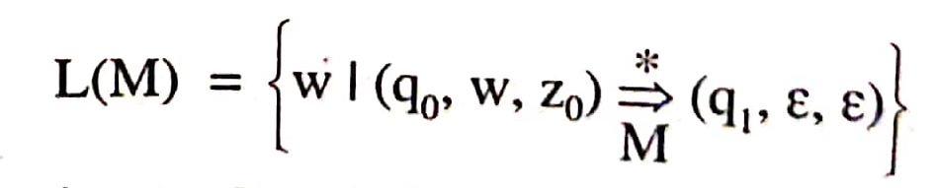
Acceptance by Empty Stack
Let the PDA , M = (Q, Σ, Γ, δ, q0, z0, Φ) then the language accepted by an empty stack is given by:
Where q1 is any state belonging to Q and the stack becomes empty on application of input string w.

Slide 58
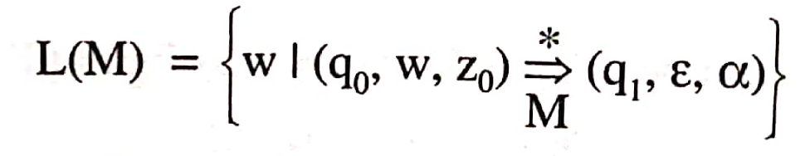
Acceptance by Final State
Let the PDA , M = (Q, Σ, Γ, δ, q0, z0, F) then the language accepted by M through a final state is given by:
Where state q1 ϵ F, α, the final contents of the stack are irrelevant as a string is accepted through a final state.

Slide 59
PDA(Example)
PDA for L= {a^{n}b^{n} | n > 0}.
Acceptance by Final state
δ( q₀, a, Z₀) = (q₁, aZ₀)
δ( q₁, a, a) = (q₁, aa)
δ( q₁, b, a) = (q₂, Ɛ)
δ( q₂, b, a) = (q₂, Ɛ)
δ( q₂, Ɛ, Z₀) = (q_{f}, Z₀)
M= {{q₀, q₁, q_{f}}, {a, b}, {a, Z₀}, δ, q_{0,} Z_{0,} q_{f}}

Slide 60
PDA(Example)
PDA for L= {a^{n}b^{n} | n > 0}.
Acceptance by Empty stack
δ( q₀, a, Z₀) = (q₁, aZ₀)
δ( q₁, a, a) = (q₁, aa)
δ( q₁, b, a) = (q₂, Ɛ)
δ( q₂, b, a) = (q₂, Ɛ)
δ( q₂, Ɛ, Z₀) = (q₂, Ɛ)
M= {{q₀, q₁}, {a, b}, {a, Z₀}, δ, q_{0,} Z_{0,} φ}

Slide 61
PDA(Example)
PDA for L= {a^{n} c^{m} b^{n} | m, n > 0}.
δ( q₀, a, Z₀) = (q₁, aZ₀)
δ( q₁, a, a) = (q₁, aa)
δ( q₁, c, a) = (q₂, a)
δ( q₂, c, a) = (q₂, a)
δ( q₂, b, a) = (q₃, Ɛ)
δ( q₃, b, a) = (q₃, Ɛ)
δ( q₃, Ɛ, Z₀) = (q_{f}, Z₀)
M= {{q₀, q₁, q₂,q_{f} }, {a, b, c}, {a, Z₀}, δ, q_{0,} Z_{0,} q_{f}}

Slide 62
PDA(Example)
PDA for L= {a^{n} c b^{2n} | n > 0}.
δ( q₀, a, Z₀) = (q₁, aZ₀)
δ( q₁, a, a) = (q₁, aa)
δ( q₁, c, a) = (q₂, a)
δ( q₂, b, a) = (q₃, a)
δ( q₃, b, a) = (q₄, Ɛ)
δ( q₄, b, a) = (q₃, a)
δ( q₄, Ɛ, Z₀) = (q_{f}, Z₀)
M= {{q₀, q₁, q₂,q_{f} }, {a, b, c}, {a, Z₀}, δ, q_{0,} Z_{0,} q_{f}}

Slide 63
Non-deterministic PDA
Construct a PDA for L = {ww^{R} | w ∈ (0, 1) }.
Why It is
Non-deterministic ??
Why not
deterministic ??

Slide 64
Deterministic PDA
Construct a PDA for L = {wcw^{R} | w ∈ (0, 1) }.

Slide 65
Difference between DPDA and NPDA
DPDA | NPDA
In NPDA, there may exits exactly one transition for each input symbol. | In PDA, there may exits more than one transition for each input symbol
Table contains single entities | Table may contain multiple defined entities.
Less powerful than NPDA. | More powerful than DPDA.
Ex: PDA for L= {wcw^{R} |w∈(0, 1)*} | Ex: PDA for L= {ww^{R} |w∈(0, 1)*}

Slide 66
Video Links
Youtube/other Video Links
https://www.youtube.com/watch?v=6b40kKe2SFg
https://www.youtube.com/watch?v=-aIRqNnUvEg&list=PL85CF9F4A047C7BF7
https://www.youtube.com/watch?v=Xk-MTgB68rQ

Slide 67
Daily Quiz
Write the formal definition of a Context Free Grammar (CFG) using its components.
State the meaning of language generated by a grammar and represent it symbolically.
Distinguish between leftmost derivation and rightmost derivation in CFG.
For the grammar: S→aSb∣ab, show a valid derivation for the string aabb.
Illustrate a parse tree for a given string derived from a CFG.
State the condition under which a context free grammar becomes ambiguous.
Give one example of an ambiguous grammar along with a string that proves ambiguity.
List any two steps involved in simplification of a CFG.
Write the formal definition of Push Down Automata (PDA) with its tuple representation.
State the relationship between Push Down Automata and Context Free Languages.

Slide 68
Weekly Assignment
Let G be the grammar S → aB | bA, A →a | aS | bAA, B → b | bS | aBB. For the string “aaabbabbba”, find | CO3 | K3
Parse tree
b.Leftmost derivation
c. Rightmost derivation
d. Is the grammar unambiguous?
2. Write CFG for regular expression r = (a+b)*aa(a+b)*. | CO3 | K3
3. Let G = ({ S,C},{a,b},P,S) where P consistes of S→aCa, C→aCa|b. Find L(G). | CO3 | K3
4. Simplified the following Context Free Grammar(CFG):S → ABA, A → 0A | ε, B → 1B | ε. | CO3 | K3
5. Construct a PDA for the language L={a^{n}b^{n} | n>=1}. | CO3 | K5

Slide 69
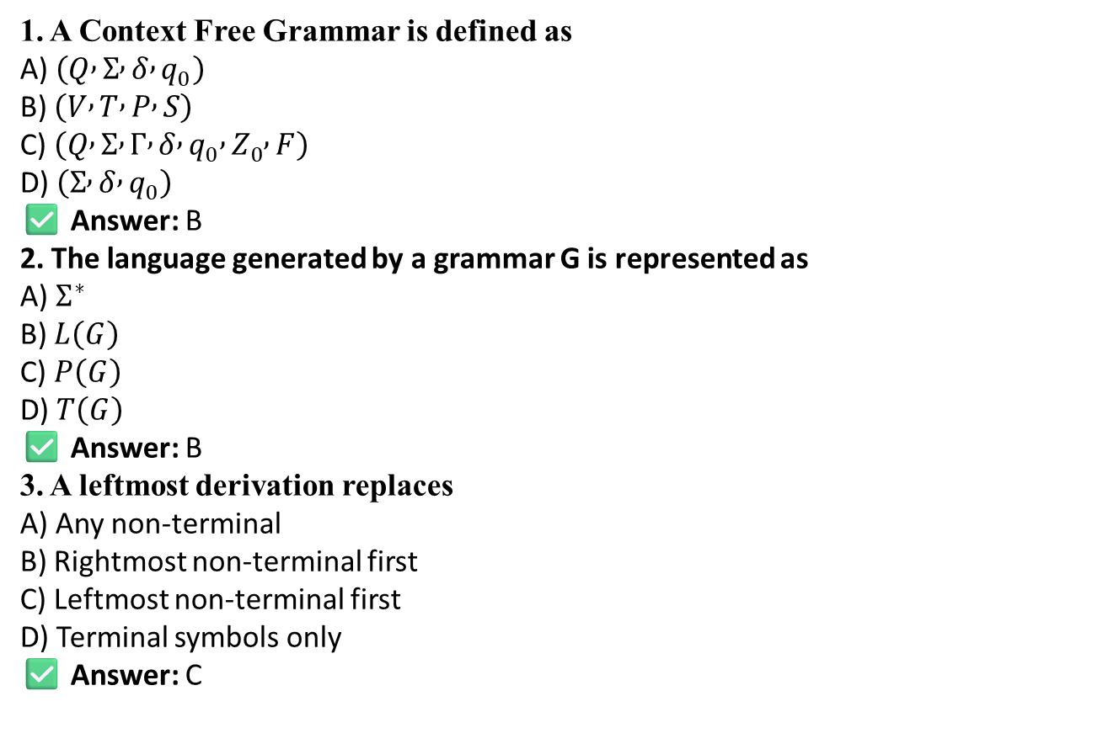
MCQs
1. A Context Free Grammar is defined as A) $\left(Q , Σ , δ , q_{0}\right)$ B) $\left(V , T , P , S\right)$ C) $\left(Q , Σ , Γ , δ , q_{0} , Z_{0} , F\right)$ D) $\left(Σ , δ , q_{0}\right)$
✅ Answer: B
2. The language generated by a grammar G is represented as A) $Σ^{∗}$ B) $L\left(G\right)$ C) $P\left(G\right)$ D) $T\left(G\right)$
✅ Answer: B
3. A leftmost derivation replaces A) Any non-terminal B) Rightmost non-terminal first C) Leftmost non-terminal first D) Terminal symbols only
✅ Answer: C

Slide 70
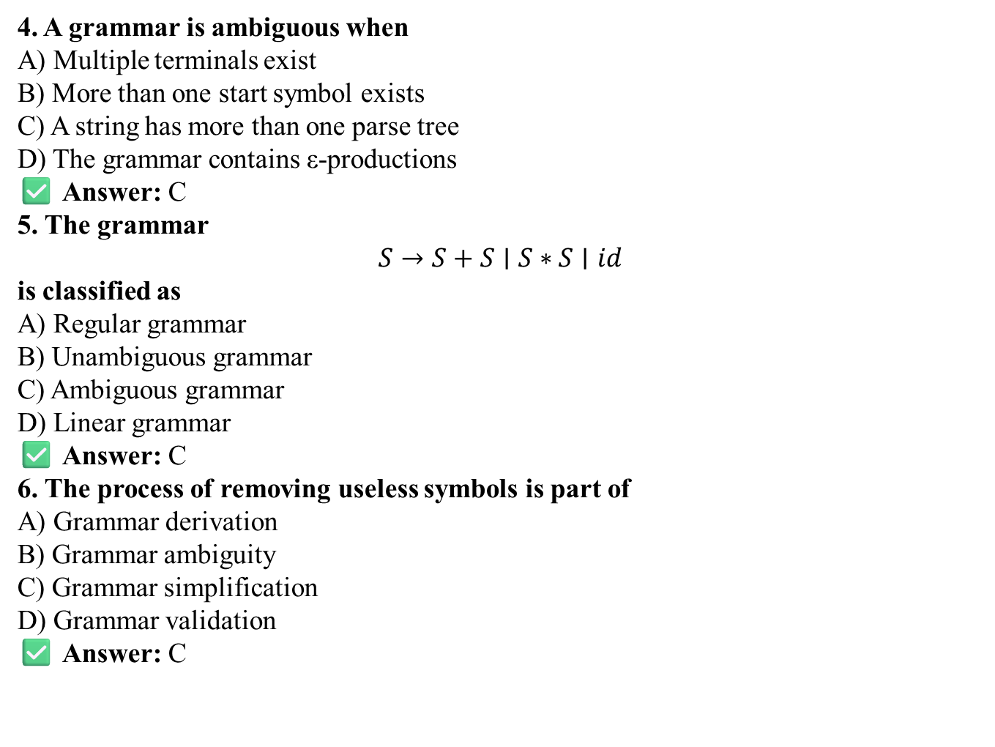
MCQs
4. A grammar is ambiguous when A) Multiple terminals exist B) More than one start symbol exists C) A string has more than one parse tree D) The grammar contains ε-productions
✅ Answer: C
5. The grammar $$S→S+S∣S∗S∣id$$ is classified as A) Regular grammar B) Unambiguous grammar C) Ambiguous grammar D) Linear grammar
✅ Answer: C
6. The process of removing useless symbols is part of A) Grammar derivation B) Grammar ambiguity C) Grammar simplification D) Grammar validation
✅ Answer: C

Slide 71
MCQs
7. A Push Down Automaton is formally defined as A) 4-tuple B) 5-tuple C) 6-tuple D) 7-tuple
✅ Answer: D
8. Push Down Automata recognize A) Regular languages B) Context free languages C) Recursive languages D) Context sensitive languages
✅ Answer: B
9. The stack in PDA is mainly used for A) Input storage B) Output generation C) Handling nested structures D) State transition storage
✅ Answer: C

Slide 72
MCQ s( Continued)
10. Acceptance of language by PDA can be done by A) Final state only B) Empty stack only C) Both final state and empty stack D) Start state only
✅ Answer: C

Slide 73
Expected Questions for University Exam
1. Let G = ({ S,C},{a,b},P,S) where P consistes of S→aCa, C→aCa|b. Find L(G). | CO3 | K3
2. Find L(G), where G = ({ S},{0,1},{S→0S1, S→ɛ},S) | CO3 | K3
3. Find out the context free language | CO3 | K3
S→aSb|aAb
A→bAa
A→ba
4.Give the CFG of the following language:0(0+1)*01(0+1)*1 | CO3 | K3
5. Give CFG for matching parenthesis. | CO3 | K3
6. Construct a PDA from the following CFG, G = ({S, X}, {a, b}, P, S) where the productions are : S → XS | ε , A → aXb | Ab | ab | CO3 | K5
7. Construct a PDA that accepts L = { ww^{R} | w = (a+b)*} | CO3 | K5
8. Construct a PDA that accepts L = { wcw^{R} | w = (a+b)*} | CO3 | K5
9.Construct a PDA for the language L={a^{n}b^{n}c^{m} | n,m>=1} | CO3 | K5
10. Construct a PDA for the language L={a^{n}b^{n} | n>=1} | CO3 | K5

Slide 74
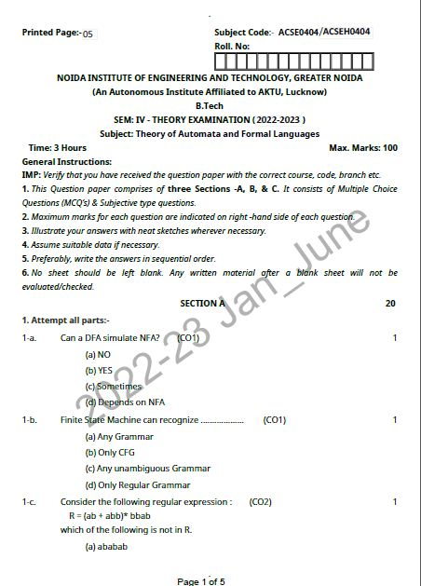
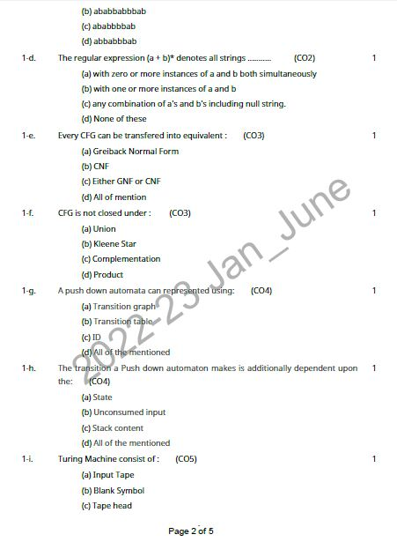
Old Question Papers

Slide 75
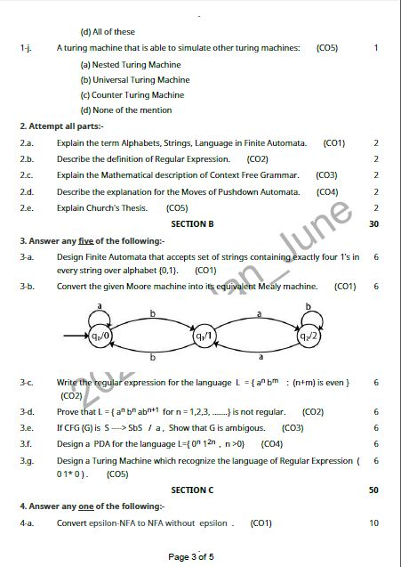
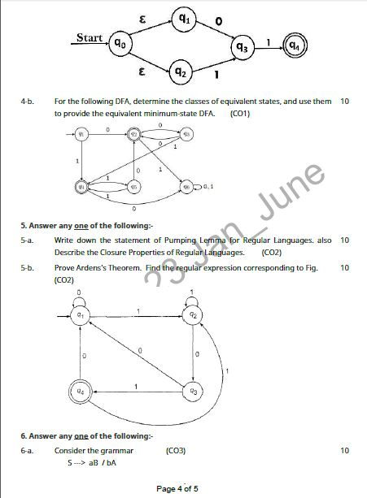
Old Question Papers

Slide 76
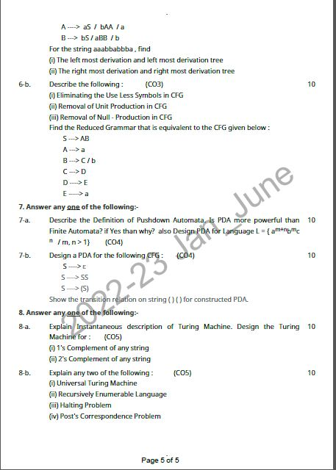
Old Question Papers

Slide 77
Summary
Introduces Context Free Grammar (CFG) and its role in defining context-free languages.
Explains derivations in CFG, including leftmost and rightmost derivations.
Describes parse trees as a graphical representation of grammar derivations.
Discusses ambiguity in grammars and how a string can have multiple parse trees.
Covers methods for simplification of CFG by removing null productions, unit productions, and useless symbols.
Introduces Pushdown Automata (PDA) as a language recognition model with stack memory.
Explains the structure and operation of PDA.
Establishes the relationship between PDA and context-free languages, showing that PDAs accept exactly the languages generated by CFGs.

Slide 78
References
K.L.P. Mishra, and N. Chandrasekharan , Theory of Computer Science-Automata, Languages and Computation
Alfred V. Aho, Jeffrey D Ullman , Compilers: Principles, Techniques and Tools
J Martin , Introduction to languages and the theory of computation
Allen I. Holub , Compiler Design in C

Slide 79
Noida Institute of Engineering and Technology, Greater Noida
Thank You

