Slide 1



Noida Institute of Engineering and Technology, Greater Noida
Theory of Computation
(BCSE0404X(TOC))
Module: 4
Parser and Intermediate Representation
Vivek Kumar Sharma
Assistant Professor
CSE
Course Details (B.Tech CSE 4th Sem)

Slide 2
Brief Introduction of Faculty
Vivek Kumar Sharma
Designation: Assistant Professor CSE Department
NIET Grater Noida
Qualifications:
B.Tech (CSE) in 2010
M.Tech (CSE) in 2013
Teaching Experinces: 10 year +
Research Publications:
Particulars | Journals (UGC) | Conference(IEEE)
International | 04 | 02
National | 01 | 00

Slide 3
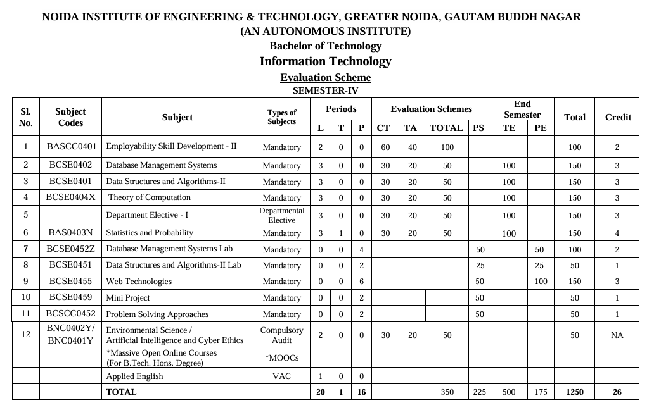
Evaluation Scheme

Slide 4
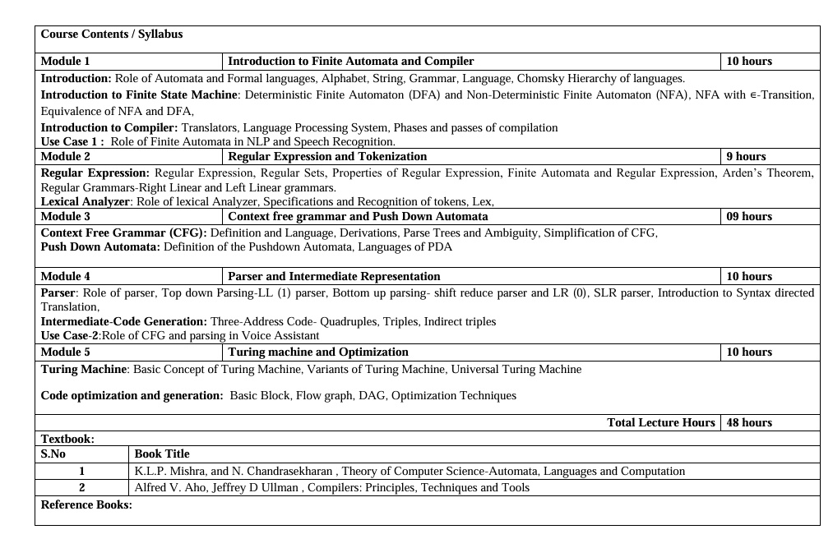
Syllabus

Slide 5
Branch Wise Applications
It can compute man-made problems as well as natural phenomena.
Automata theory has a lot of applications in real life as well, such that: Lambda calculus, Combinatory logic, Markov algorithm, and Register, Natural Language Processing ,Compiler Design and Lexical analysis and Semantic analysis. Also, the concept of Formal languages and automata theory can overlap with other subjects as well.

Slide 6

Course Objectives
The primary objective of this course is to provide a foundational understanding of Automata Theory and its role in the language processing systems, also explores their application in fields like Natural Language Processing (NLP), speech recognition.

Slide 7
Course Outcome
Theory of Computation (BCSE0404X)
Course Outcome (CO) |  | Bloom’s Knowledge Level (KL)
After completion of the course, the student will be able to:
CO 1 | Identify the fundamental concepts of automata theory, formal languages and compiler components. |  | K2
CO 2 | Understand the role of finite automata, regular expressions, and grammar rules in language processing. |  | K2
CO 3 | Demonstrate context-free grammars, pushdown automata, and syntax-directed translation to construct intermediate code for language processors. |  | K3
CO 4 | Analyze various parsing strategies, code translation methods, and intermediate representations in compiler phases. |  | K4
CO 5 | Analyze the functioning of Turing machine models and optimization techniques in code generation for performance improvement. |  | K4

Slide 8
Program Outcomes (POs)
PO1: Engineering Knowledge: Apply knowledge of mathematics, natural science, computing, engineering fundamentals and an engineering specialization as specified in WK1 to WK4 respectively to develop to the solution of complex engineering problems.
PO2: Problem Analysis: Identify, formulate, review research literature and analyze complex engineering problems reaching substantiated conclusions with consideration for sustainable development. (WK1 to WK4)
PO3: Design/Development of Solutions: Design creative solutions for complex engineering problems and design/develop systems/components/processes to meet identified needs with consideration for the public health and safety, whole-life cost, net zero carbon, culture, society and environment as required. (WK5)
PO4: Conduct Investigations of Complex Problems: Conduct investigations of complex engineering problems using research-based knowledge including design of experiments, modelling, analysis & interpretation of data to provide valid conclusions. (WK8).
PO5: Engineering Tool Usage: Create, select and apply appropriate techniques, resources and modern engineering & IT tools, including prediction and modelling recognizing their limitations to solve complex engineering problems. (WK2 and WK6)

Slide 9
Program Outcomes (POs)
PO6: The Engineer and The World: Analyze and evaluate societal and environmental aspects while solving complex engineering problems for its impact on sustainability with reference to economy, health, safety, legal framework, culture and environment. (WK1, WK5, and WK7).
PO7: Ethics: Apply ethical principles and commit to professional ethics, human values, diversity and inclusion; adhere to national & international laws. (WK9)
PO8: Individual and Collaborative Team work: Function effectively as an individual, and as a member or leader in diverse/multi-disciplinary teams.
PO9: Communication: Communicate effectively and inclusively within the engineering community and society at large, such as being able to comprehend and write effective reports and design documentation, make effective presentations considering cultural, language, and learning differences
PO10: Project Management and Finance: Apply knowledge and understanding of engineering management principles and economic decision-making and apply these to one’s own work, as a member and leader in a team, and to manage projects and in multidisciplinary environments.

Slide 10
Program Outcomes (POs)
PO11: Life-Long Learning: Recognize the need for, and have the preparation and ability for i) independent and life-long learning ii) adaptability to new and emerging technologies and iii) critical thinking in the broadest context of technological change. (WK8)

Slide 11
CO-PO Correlation Matrix
CO-PO Mapping | PO1 | PO2 | PO3 | PO4 | PO5 | PO6 | PO7 | PO8 | PO9 | PO10 | PO11
CO1 | 3 | 2 | 2 | 2 | - | - | - | - | - | - | 2
CO2 | 3 | 3 | 3 | 2 | 1 | - | - | - | - | - | 2
CO3 | 3 | 3 | 3 | 3 | 1 | - | - | - | - | - | 2
CO4 | 3 | 3 | 3 | 3 | 1 | - | - | - | - | - | 2
CO5 | 3 | 3 | 3 | 3 | 1 | - | - | - | - | - | 2
Average | 3 | 2.8 | 2.8 | 2.6 | 1 | - | - | - | - | - | 2

Slide 12

Program Specific Outcomes
On successful completion of graduation degree, the Information Technology graduates will be able to:
PSO1 | Work as a software engineer in different dimensions of information technology to provide solutions to real-world and industrial problems in an eco-friendly manner
PSO2 | Apply knowledge of core subjects with multi-disciplinary and modern computing techniques to solve complex IT problems.
PSO3 | Establish a successful and innovative career by practicing lifelong learning and communicating in a team or as an individual to manage projects with ethical concerns.

Slide 13
CO-PSO Correlation Matrix
CO-PSO Mapping | PSO1 | PSO2 | PSO3
CO1 | 2 | 3 | 1
CO2 | 2 | 3 | 1
CO3 | 3 | 3 | 2
CO4 | 3 | 3 | 2
CO5 | 3 | 2 | 2
Average | 2.6 | 2.8 | 1.6

Slide 14
End Semester Question Paper Template
Printed Page: | Subject Code:
 | Roll. No:
NOIDA INSTITUTE OF ENGINEERING AND TECHNOLOGY, GREATER NOIDA
(An Autonomous Institute Affiliated to AKTU, Lucknow)
B.Tech
SEM: - THEORY EXAMINATION (2025 - 2026) Subject:
Time: 3 Hours | Max. Marks: 100
General Instructions: IMP: Verify that you have received the question paper with the correct course, code, branch etc. This Question paper comprises of three Sections -A, B, & C. It consists of Multiple-Choice Questions (MCQ’s) & Subjective type questions. Maximum marks for each question are indicated on right -hand side of each question. Illustrate your answers with neat sketches wherever necessary. Assume suitable data if necessary. Preferably, write the answers in sequential order. No sheet should be left blank. Any written material after a blank sheet will not be evaluated/checked.

Slide 15
End Semester Question Paper Templates
SECTION-A |  | 20
1. Attempt all parts:-
1-a. |  | 1
1-b. |  | 1
1-c. |  | 1
1-d. |  | 1
1-e. |  | 1
1-f. |  | 1
1-g. |  | 1
1-h. |  | 1
1-i. |  | 1
1-j. |  | 1
1-f. |  | 1
2 Attempt all parts:-
2.a. |  | 2
2.b. |  | 2
2.c. |  | 2
2.d. |  | 2
2.e. |  | 2
Ankur Kumar Varshney BCSE0404X(TOC) Unit III

Slide 16
End Semester Question Paper Templates
SECTION-B |  | 30
3. Attempt all parts: -
3.a. Answer any one of the following: -
3.a.(i) |  | 6
3.a.(ii) |  | 6
3.b. Answer any one of the following: -
3.b.(i) |  | 6
3.b.(ii) |  | 6
3.c. Answer any one of the following: -
3.c.(i) |  | 6
3.c.(ii) |  | 6
3.d. Answer any one of the following: -
3.d.(i) |  | 6
3.d.(ii) |  | 6
3.e. Answer any one of the following: -
3.e.(i) |  | 6
3.e.(ii) |  | 6
Ankur Kumar Varshney BCSE0404X(TOC) Unit III

Slide 17
End Semester Question Paper Templates
SECTION-C |  | 50
4. Answer any one of the following: -
4-a. |  | 10
4-b. |  | 10
5. Answer any one of the following: -
5-a. |  | 10
5-b. |  | 10
6. Answer any one of the following: -
6-a. |  | 10
6-b. |  | 10
7. Answer any one of the following: -
7-a. |  | 10
7-b. |  | 10
8. Answer any one of the following: -
8-a. |  | 10
8-b. |  | 10
Ankur Kumar Varshney BCSE0404X(TOC) Unit III

Slide 18
Program Educational Objectives
PEO’S of the B. Tech. in Information Technology are:
The graduates will be:
PEO1: To apply sound knowledge combining technical expertise, and problem-solving skills to fulfill the needs of the IT industry and stay updated with the latest emerging trends.
PEO2: To provide sustainable solutions for real-life problems by designing innovative and interdisciplinary systems using the latest digital technologies for serving academia, industry, and society.
PEO3: To reflect professional attitude, social ethics, communication, teamwork, and leadership skills in research and product development to face global challenges.
PEO4: To pursue higher studies and develop their career successfully in the software industry and R&D sectors with a lifelong learning frame of mind.
.

Slide 19
Unit Objective
To understand the definition of Context Free Grammar (CFG) and the types of languages generated by CFG.
To explain the concept of derivations in CFG and analyze how strings are generated step by step.
To study parse trees and identify ambiguity in grammars through multiple derivations.
To learn the techniques for simplification of CFG by removing useless symbols, null productions, and unit productions.
To understand the definition and structure of Pushdown Automata (PDA) as a computational model.
To analyze the relationship between Pushdown Automata and Context Free Languages, and identify the languages accepted by PDA.

Slide 20
Topic Objective
Topic | Objectives
Context Free Grammar (CFG): Definition and Language | To understand the formal definition of Context Free Grammar and identify the class of languages generated by CFG.
Derivations in CFG | To learn leftmost and rightmost derivations and analyze the step-by-step generation of strings in CFG.
Parse Trees and Ambiguity | To construct parse trees and recognize ambiguous grammars through multiple parse trees or derivations.
Simplification of CFG | To understand and apply methods for simplifying CFG by eliminating useless symbols, null productions, and unit productions.
Pushdown Automata (PDA): Definition | To understand the structure, components, and working of Pushdown Automata as an abstract machine.
Languages of Pushdown Automata | To analyze the types of languages accepted by PDA and establish the equivalence between PDA and Context Free Languages.

Slide 21
Prerequisite
Prerequisite:
Basic knowledge of formal languages and automata concepts such as alphabets, strings, and languages.
Understanding of regular languages, regular expressions, and finite automata (DFA/NFA).
Familiarity with grammar basics, including terminals, non-terminals, production rules, and derivations.
Basic understanding of set theory and mathematical notation used in language definitions.
Awareness of language recognition models and their role in classifying languages.

Slide 22
Prerequisite
.
Automata Theory
Context Free Languages
Data Structure
Logic or Algebra
Simple Graph Algorithms
Computer Architecture

Slide 23
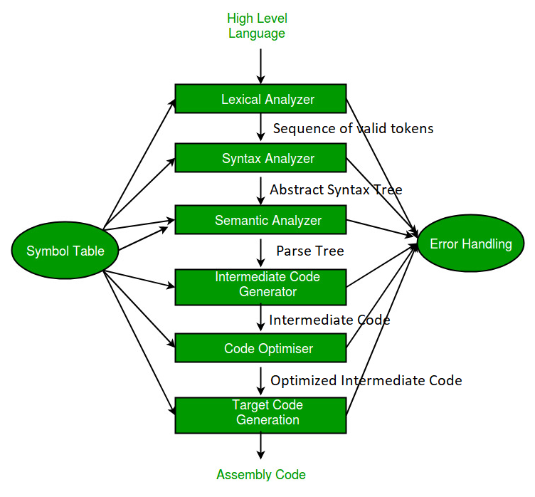
RECAP
Analysis
(Frontend)
Synthesis
(Backend)

Slide 24
Unit Content
Course Objective
Course Outcome
CO-PO and PSO Mapping
Prerequisite and Recap
Objective of Topics
Basic Parsing Techniques: Parsers
Shift reduce parsing
Top down parsing,
Predictive parsers Automatic Construction of efficient Parsers: LR parsers
The canonical Collection of LR(0) items,

Slide 25
Unit Content
Constructing SLR parsing tables
Implementation of LR parsing tables.
Faculty Video Links, Youtube & NPTEL Video Links and Online Courses Details
Daily Quiz
Weekly Assignments
MCQ
Expected Question for University Exam/old question paper
References

Slide 26
Unit Objective
Topic | Objective
Basic Parsing Techniques | To learn about different parsing techniques.
Top Down Parsing | Understand the logic behind top down parsing technique i.e. Predictive parsing technique.
Bottom Up Parsing | To know about different bottom-up parsing techniques i.e. shift-reduce parsing techniques, operator precedence parsing etc.
LR Parsing | To understand the four different types of LR parsing techniques

Slide 27
Topic Objective(CO1)
Introduce students to the concepts of Top Down and Bottom Up Parser .

Slide 28
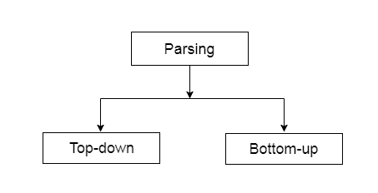
Basic Parsing Techniques(CO2)
Parsing (also known as syntax analysis) can be defined as a process of analyzing a text which contains a sequence of tokens, to determine its grammatical structure with respect to a given grammar.
Depending upon how the parse tree is built, parsing techniques are classified into two general categories

Slide 29
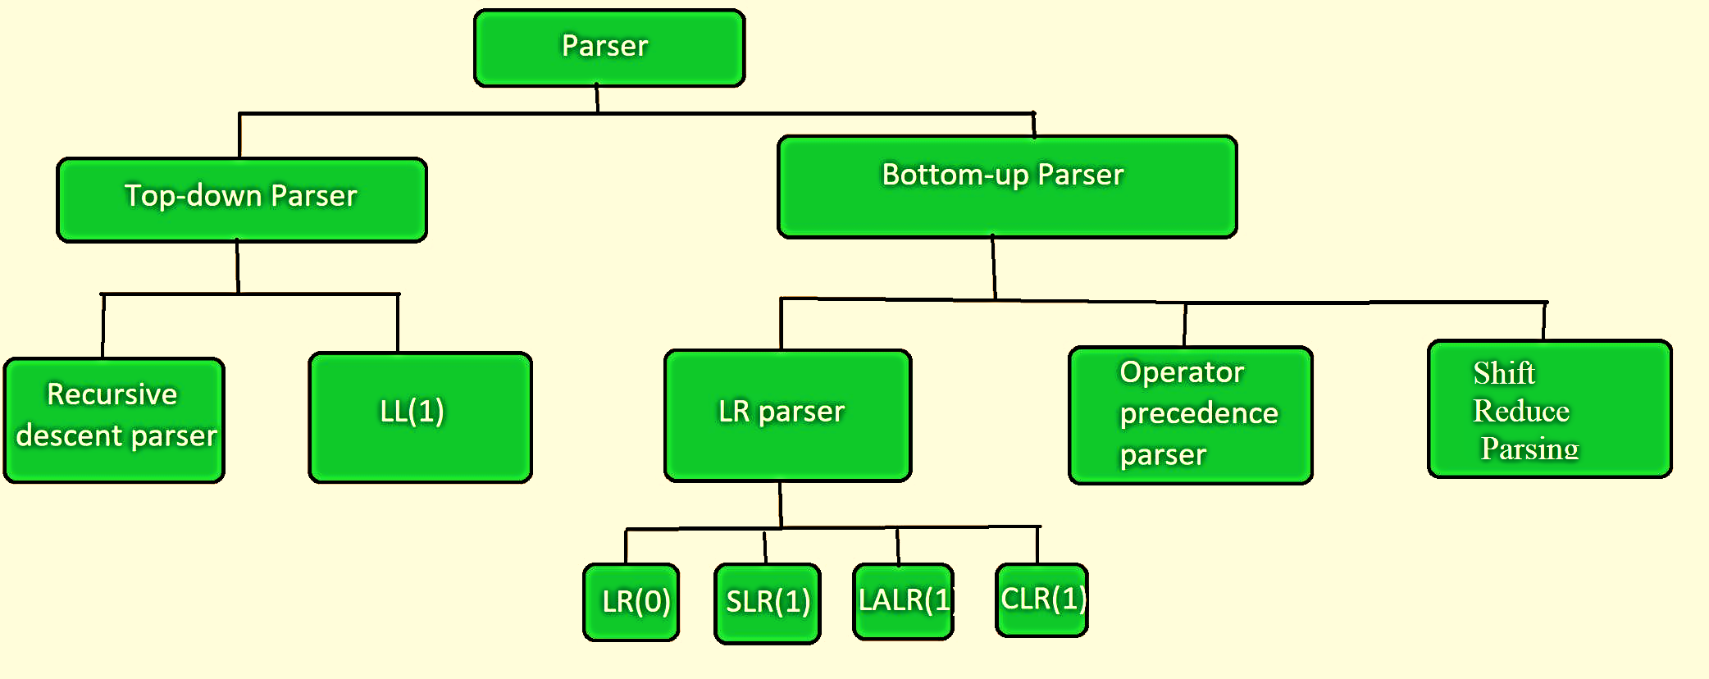
Basic Parsing Techniques(CO2)

Slide 30
Basic Parsing Techniques
Since a parse tree is the graphical representation derivation.
Top-Down parsing is equivalent to left-most derivation
Bottom-Up parsing is equivalent to reverse of right most derivation

Slide 31
Top-Down Parse(CO2)
It is the parser which generate parser for the given input string with the help of grammar production by expanding the non-terminals i.e. it starts from the start symbol and ends on the terminals.
Top Down parser uses left most derivation.
Top down parser can be constructed for the grammar if it is free from ambiguity and left recursion.

Slide 32
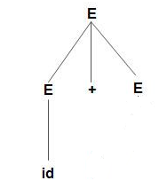
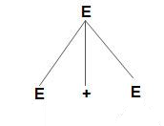
Top-Down Parse Example
Construct parse tree for
E –> E + E | E * E | id
using Top Down Parsing Technique

Slide 33
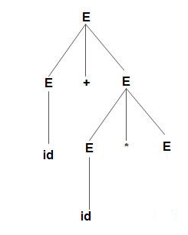
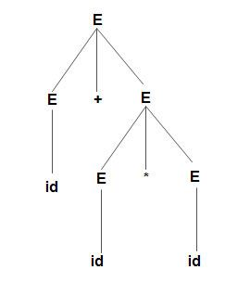
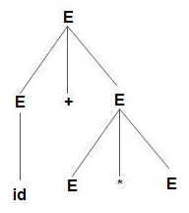
Top-Down Parse Example
Parse tree for word
id+id*id

Slide 34
Bottom-Up Parse(CO2)
Bottom-up parsing starts from the leaf nodes of a tree and works in upward direction till it reaches the root node.
Here, we start from a sentence and then apply production rules in reverse manner in order to reach the start symbol.
Bottom up parser can be constructed for the grammar if it is free from ambiguity.

Slide 35

Bottom-Up Parse Example
Example: Input string is id+id*id and production rules are as given below:
S → E
E → E + T
E → E * T
E → T
T → id
Perform bottom-up parsing technique.
Solution: Starting with input string id+id*id
id + id * id
T + id * id
E + id * id
E + T * id
E * id
E * T
E
S

Slide 36
Bottom-Up Parse Example
Bottom-up parse of n + n * n using the following grammar
E | → | T
E | → | E + T
T | → | F
T | → | T * F
F | → | n
F | → | ( E )

Slide 37
Bottom-Up Parse Example
E
|
T
|
F
|
n
E
|
T
|
F
|
n +
E
|
T T
| |
F F
| |
n + n
T
|
F
|
n
F
|
n
n

Slide 38
Bottom-Up Parse Example
E
/ | \
/ + \
/ \
E T
| / | \
T T * F
| | |
F F n
| |
n n
E
|
T T
| |
F F F
| | |
n + n * n
E T | / | \ T T * F | | | F F n | | n + n

Slide 39
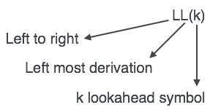
LL (1) Parsing(CO2)
An LL Parser accepts LL grammar.
LL grammar can be implemented by means of both algorithms namely, recursive-descent or table-driven

Slide 40
Predictive parsing(CO2)
It is a type of parser which has the capability to predict which production is to be used to replace the input string.
To fulfil this tasks, the predictive parser uses a lookahead pointer, which points to the next symbols.
To make the parser back-tracking free, the predictive parser puts some constraints on the grammar and accepts only a class of grammar known as LL(K) grammar.

Slide 41
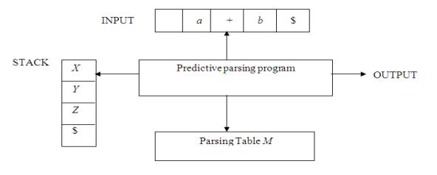
LL(1) Parser / Predictive parsing
It uses a stack and a parsing table to parse the input and generates a parse tree. Both the stack and the input contains an end symbol $ to denote that the stack is empty and the input is consumed.
The parser refers to the parsing table to take any decision on the input and stack element combination.

Slide 42
Predictive parsing
The input buffer contains the string to be parsed, followed by $, a symbol used as a right end marker to indicate the end of the input string.
The stack contains a sequence of grammar symbols with $ on the bottom, indicating the bottom of the stack. Initially, the stack contains the start symbol of the grammar on top of $.
The parsing table is a two dimensional array M[A,a] where A is a nonterminal, and a is a terminal or the symbol $.

Slide 43
Predictive parsing
A(X)\a | + | * | id | num | $
E
T
T’
F
F’
General Structure of paring Table

Slide 44
Predictive parsing table construction
The predictive parser is aided by two functions
FIRST
FOLLOW

Slide 45
Predictive parsing
First (X):-
It is used for finding the set of all terminals that begins the strings derive from the given grammar symbol.
Follow (X):-
Set of Terminals that appear immediately to the right of X

Slide 46
First Function
To complete first(x) for all grammar symbols X apply the following rules until no more terminal or ε be added to any first set.
Rules for first(X ):
1. If X is terminal, then
2. If X → ε is a production, then
3. If X is non-terminal and X → aα is a production then
4. If X is non-terminal and X → Y1 Y2…Yk is a production, then
If ε is in FIRST(Y1) then
FIRST(X) = {X}.
FIRST(X) = {ε}.
FIRST(X) = {a}.
FIRST(X) = {FIRST(Y1)}.
FIRST(X) = {FIRST(Y2)}.

Slide 47
Example on First Function
Example:- Calculate the first function of production rules:
S->ABCD
A->a | ε
B->CD | b
C->c | ε
D->Aa | d | ε
Solution:-
Symbols | First()
S | {a,b,c,d, ε}
A | {a, ε}
B | {c,a,d,b,ε}
C | {c, ε}
D | {a,d, ε}

Slide 48
Example on First Function
Example:- Calculate the first function of production rules:
S → aBDh
B → cC
C → bC / ∈
D → EF
E → g / ∈
F → f /∈
Solution:-
Symbols | First()
S | {a}
B | {c}
C | {b, ε}
D | {g,f ε}
E | {g, ε}
F | {f, ε}

Slide 49
Follow Function
To compute follows of A for all non-terminal A apply the following rules:-
1. If S is a start symbol,
2. If there is a production A → αBβ,
3. If there is a production A → αB, or a production A → αBβ where FIRST(β) contains ε, then everything in FOLLOW(A) is in FOLLOW(B).
FOLLOW(S)={$}
FOLLOW(B)=FIRST(β) except ε
FOLLOW(B)=FOLLOW(A)

Slide 50
Example on Follow Function
Example:- Calculate the follow function of production rules:
S->ABCD
A->a | ε
B->CD | b
C->c | ε
D->Aa | d | ε
Solution:-
Symbols | First()
S
A
B
C
D
Symbols | Follow()
S
A
B
C
D
{a,b,c,d, ε}
{$}
{a, ε}
{a,b,c,d,$}
{c,a,d,b,ε}
{c,a,d,$}
{c, ε}
{a,d,c,$}
{a,d, ε}
{c,a,d,$}

Slide 51
Example on Follow Function
Example:- Calculate the follow function of production rules:
S → aBDh
B → cC
C → bC / ∈
D → EF
E → g / ∈
F → f /∈
Solution:-
Symbols | First()
S
B
C
D
E
F
Symbols | Follow()
S
B
C
D
E
F
{a}
{$}
{c}
{g, f, h}
{b, ε}
{g, f, h}
{g, f, ε}
{h}
{g, ε}
{f, h}
{f, ε}
{h}

Slide 52
Recursion
Left Recursion:-
A production of grammar is said to have left recursion if the leftmost variable of its RHS is same as variable of its LHS.
Right Recursion-
A production of grammar is said to have right recursion if the rightmost variable of its RHS is same as variable of its LHS
Example: A->Aα|β
Example: A->αA|β

Slide 53
Left Recursion
Left recursion is eliminated by converting the grammar into a right recursive grammar.
If we have the left-recursive pair of productions:-
where β does not begin with an A.
Then, we can eliminate left recursion by replacing the pair of productions with-
This right recursive grammar functions same as left recursive grammar.
A → Aα / β
A → βA’
A’ → αA’ / ∈

Slide 54
Example: Left Recursion
Example1:- Consider the following grammar and eliminate left recursion-
A → ABd / Aa / a
B → Be / b
Solution:-
Firstly break the production according to the format-
A → ABd / a
A → Aa / a
B → Be / b
Than apply the rule
A → Aα / β => A → βA’
A’ → αA’ / ∈

Slide 55
Example: Left Recursion
The grammar after eliminating left recursion is-
A → aA’
A’ → BdA’ / aA’ / ∈
B → bB’
B’ → eB’ / ∈
A → ABd / a
A → Aa / a
B → Be / b

Slide 56
Left Recursion
Example 2:- Consider the following grammar and eliminate left recursion-
E → E + T / T
T → T x F / F
F → id
Solution:-The grammar after eliminating left recursion is
E → TE’
E’ → +TE’ / ∈
T → FT’
T’ → xFT’ / ∈
F → id

Slide 57
Example of first and follow function with left recursion
Example:- Calculate the first and follow function of production rules:
S → A
A → aB / Ad
B → b
C → g
Solution:-
Given grammar is left recursive.
So, first remove left recursion from the given grammar.

Slide 58
Example of first and follow function with left recursion
After eliminating left recursion, we get the following grammar
S → A
A → aBA’
A’ → dA’ / ∈
B → b
C → g
First Function
Symbols | First()
S | {a}
A | {a}
A’ | {d, ε}
B | {b}
C | {g}

Slide 59
Example of first and follow function with left recursion
Follow Function:-
Symbols | Follow()
S | {$}
A | {$}
A’ | {$}
B | {d,$}
C | {NA}

Slide 60
Left Factoring
Left factoring is a process by which the grammar with common prefixes is transformed.
To make it useful for Top down parsers.
Example- A → αβ₁ / αβ₂ / αβ₃
Top down parsers can not decide which production must be chosen to parse the string in hand.
To remove this confusion, we use left factoring.

Slide 61
Left Factoring
In left factoring,
We make one production for each common prefixes.
The common prefix may be a terminal or a non-terminal or a combination of both.
Rest of the derivation is added by new productions.
A → αβ₁ / αβ₂ / αβ₃
A → αA’
A’ → β₁ / β₂ / β₃

Slide 62
Example of Left Factoring
Example: Do left factoring in the following grammar-
S → iEtS / iEtSeS / a
E → b
Solution-
The left factored grammar is-
S → iEtSS’ / a
S’ → eS / ∈
E → b

Slide 63
Example of Left Factoring
Example: Do left factoring in the following grammar-
A → aAB / aBc / aAc
Solution-
Step-01:
A → aA’
A’ → AB / Bc / Ac
Again, this is a grammar with common prefixes.
Step-02:
A → aA’
A’ → AD / Bc
D → B / c
This is a left factored grammar.

Slide 64
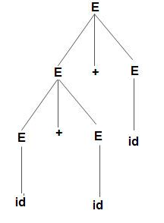
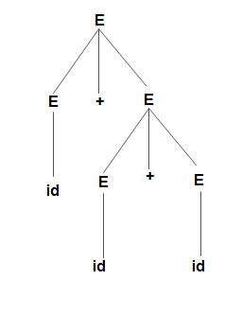
Ambiguity
Example: Production rule-
E –> E + E
E –> E * E
E –> id
Input string:-id+id+id
Correct
Incorrect
Bcoz the rule of associativity is failed

Slide 65
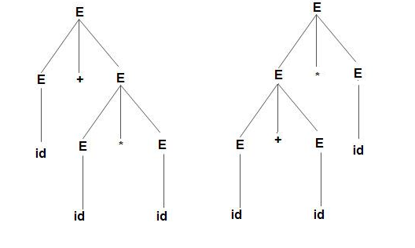
Ambiguity
Example: Production rule-
E –> E + E
E –> E * E
E –> id
Input string:-id+id*id
Incorrect
Because precedence is not taken care of
Correct

Slide 66
Ambiguity
Left Recursion, Common Prefixes makes the grammar Ambiguous
An ambiguous grammar may be converted into an unambiguous grammar by implementing
Precedence Constraints:-
Associativity Constraints

Slide 67
Ambiguity
Associativity Rule:
If the operator is left associative, induce left recursion in its production.
If the operator is right associative, induce right recursion in its production.

Slide 68
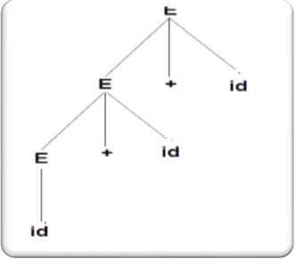
Ambiguity
According to the associativity rule:- Left associativity is obtain by converting the grammar into left recursion.
Production rule: E –> E + E
E –> E + E
E –> id
E –> E + id
E –> id

Slide 69
Ambiguity
Precedence Rule:
The level at which the production is present defines the priority of the operator contained in it.
The higher the level of the production, the lower the priority of operator.
The lower the level of the production, the higher the priority of operator.

Slide 70
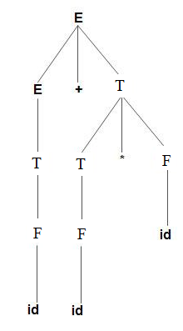
Ambiguity
According to the Precedence rule:- Highest precedence operator should be at the least level.
Production rule: E –> E + E
E –> E * E
E –> id
E –> E +T|T
T –> T * F|F
F->id

Slide 71
Example
Example: Consider the following grammar :
E→E+E
E→E*E
E→(E)|id
Check whether this input string id+id*id is accepted using LL(1) parsing technique
Solution:
Step 1: Check whether a given grammar is ambiguous or not.
If ambiguous remove ambiguity:
E→E+T |T
T→T*F |F
F→(E) |id

Slide 72
Example
Step 2:
Check and Remove Left –Recursion
After eliminating left-recursion the grammar is
E →TE’
E’ → +TE’ | ε
T →FT’
T’ → *FT’ | ε
F → (E)|id
A → Aα / β => A → βA’
A’ → αA’ / ∈

Slide 73
Example
Step 3:
Check and Remove Left –Factoring
There is no left factoring.
A → αβ₁ / αβ₂ / αβ₃
A → αA’
A’ → β₁ / β₂ / β₃

Slide 74
Example
Step 4:Construct predictive parse table.
Calculate first and follow function
First function
FIRST(E) = { ( , id}
FIRST(E’) ={+ , ε }
FIRST(T) = { ( , id}
FIRST(T’) = {*, ε }
FIRST(F) = { ( , id }

Slide 75
Example
Follow function
FOLLOW(E) = { $, ) }
FOLLOW(E’) = { $, ) }
FOLLOW(T) = { +, $, ) }
FOLLOW(T’) = { +, $, ) }
FOLLOW(F) = {+, * , $ , ) }

Slide 76
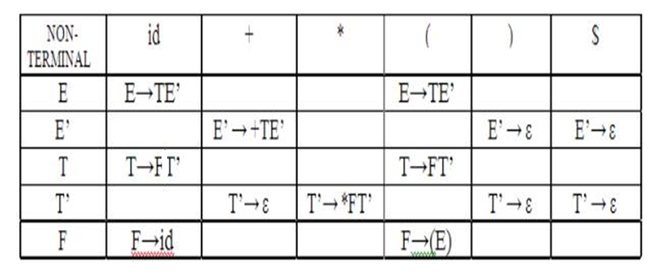
Example
Predictive Parse Table

Slide 77
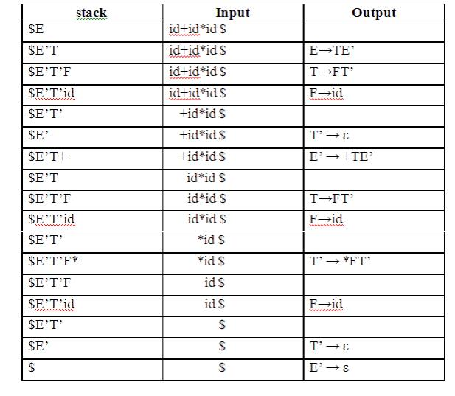
Example
Stack Implementation:

Slide 78
Example
Implementation of predictive parser:
1. Elimination of left recursion, left factoring and ambiguous grammar.
2. Construct FIRST() and FOLLOW() for all non-terminals.
3. Construct predictive parsing table.
4. Parse the given input string using stack and parsing table

Slide 79
Bottom-up Parsing(CO2)
Bottom-up parsing starts from the leaf nodes of a tree and works in upward direction till it reaches the root node.
Here, we start from a sentence and then apply production rules in reverse manner in order to reach the start symbol
E
/ | \
/ + \
/ \
E T
| / | \
T T * F
| | |
F F n
| |
n n

Slide 80
Shift-Reduce Parsing(CO2)
Shift-Reduce Parsing uses two unique steps for bottom-up parsing. These steps are known as shift-step and reduce-step.
Shift step:
The shift step refers to the advancement of the input pointer to the next input symbol, which is called the shifted symbol.
This symbol is pushed onto the stack.
The shifted symbol is treated as a single node of the parse tree.
Reduce step :
When the parser finds a complete grammar rule (RHS) and replaces it to (LHS), it is known as reduce-step.
This occurs when the top of the stack contains a handle.
To reduce, a POP function is performed on the stack which pops off the handle and replaces it with LHS non-terminal symbol.

Slide 81

Shift-Reduce Parsing
Shift Action, the current symbol in the input string pushed into a stack.
At each reduction, the symbol will replaced by the non-terminals.

Slide 82
Example of Shift-Reduce Parsing
Example:
Grammar: S → S+S
S → S-S
S → (S)
S → a
Input String: a1-(a2+a3)
Perform Shift –Reduce Parsing on above grammar.

Slide 83
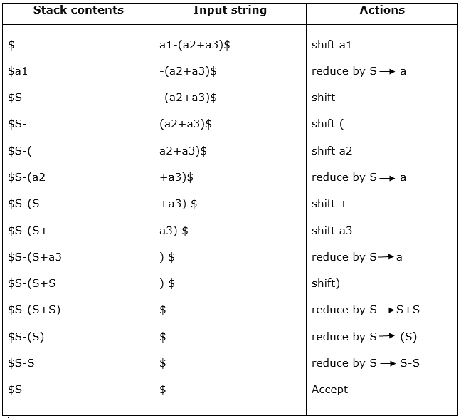
Example of Shift-Reduce Parsing

Slide 84
Example of Shift-Reduce Parsing
Example:
Grammar: E –> 2E2 E –> 3E3 E –> 4
Input String: 32423
Perform Shift –Reduce Parsing on above grammar.

Slide 85
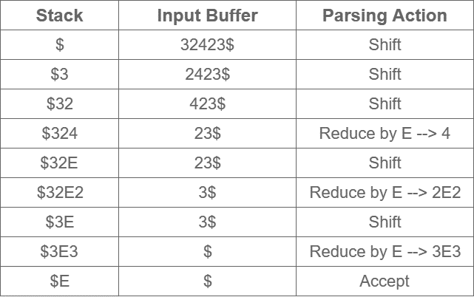
Example of Shift-Reduce Parsing

Slide 86
LR Parsing(CO2)
The LR(k) parsing technique
L is for Left-to-right scanning of input
R corresponds to a Rightmost derivation done in reverse
k is the number of lookahead symbols used to make parsing decisions

Slide 87
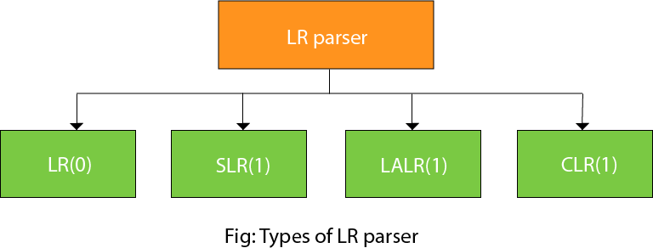
Types of LR Parser(CO2)
Four LR parsing techniques will be considered

Slide 88
Types of LR Parser
LR(0)-LR parsing with no lookahead token to make parsing decisions
SLR(1)-Simple LR, with one token of lookahead
CLR(1)- Canonical LR, with one token of lookahead
LALR(1) : Lookahead LR, with one token of lookahead
LALR(1) is the preferable technique used by parser generators

Slide 89
Structure of LR Parser
Scanner
next token
LR Parser
Driver
Output
sm
Parsing Table
Parsing Stack
s
action
goto
1
s₀

Slide 90
Structure of LR Parser
An LR parser consists of …
Driver program
Same driver is used for all LR parsers
Parsing stack
Contains state information, where s_{i} is state i
States are obtained from grammar analysis
Parsing table, which has two parts
Action section: specifies the parser actions
Goto section: specifies the successor states

Slide 91
Various steps involved in the LR (0) Parsing
For the given input string write a context free grammar
Check the ambiguity of the grammar
Add Augment production in the given grammar
Create Canonical collection of LR (0) items
Draw a data flow diagram (DFD)
Construct a LR (0) parsing table

Slide 92
Example:
Question:
S → AA
A → aA | b
Solution:
The Augment grammar G` is represented by
S`→ S
S → AA
A → aA | b

Slide 93
Canonical Collection of LR(0) items
An LR (0) item is a production G with dot at some position on the right side of the production.
LR(0) items is useful to indicate that how much of the input has been scanned up to a given point in the process of parsing.
In the LR (0), we place the reduce node in the entire row.

Slide 94
EXAMPLE
Example:-
S → AA & A → aA | b
Solution:
Add Augment Production and insert '•' symbol at the first position for S` → •S production.
S` → •S
S → •AA
A → •aA
A → •b

Slide 95
Create Canonical Collection of LR(0) items
I0 State:
Add Augment production to the I0 State and Compute the Closure
I0 = Closure (S` → •S)
Add all productions starting with S in to I0 State because "•" is followed by the non-terminal. So, the I0 State becomes
I0 = S` → •S S → •AA
Add all productions starting with "A" in modified I0 State because "•" is followed by the non-terminal. So, the I0 State becomes.

Slide 96
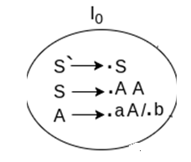
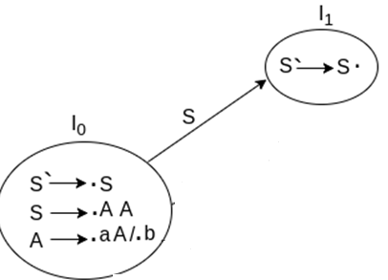
Create Canonical Collection of LR(0) items
I0= S` → •S S → •AA A → •aA A → •b
I1= Go to (I0, S) = closure (S` → S•) = S` → S•
Here, the Production is reduced so close the State.
I1= S` → S•

Slide 97
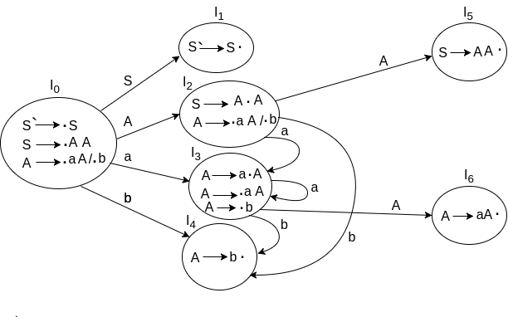
DRAWING DFD

Slide 98
Canonical Collection of LR(0) items
For I2, consider 2nd production in I0 S → •AA
Go to (I0, A) = closure (S → A•A)
Add all productions starting with A in to I2 State because "•" is followed by the non-terminal. So, the I2 State becomes
I2 =S→A•A A → •aA A → •b
Go to (I2,a) = Closure (A → a•A) = (same as I3)
Go to (I2, b) = Closure (A → b•) = (same as I4)

Slide 99
Canonical Collection of LR(0) items
I3= Go to (I0,a) = Closure (A → a•A)
Add productions starting with A in I3.
A → a•A A → •aA A → •b
Go to (I3, a) = Closure (A → a•A) = (same as I3) Go to (I3, b) = Closure (A → b•) = (same as I4)

Slide 100
Canonical Collection of LR(0) items
I4= Go to (I0, b) = closure (A → b•) = A → b•
I5= Go to (I2, A) = Closure (S → AA•) = SA → A•
I6= Go to (I3, A) = Closure (A → aA•) = A → aA•

Slide 101
LR(0) Table
If a state is going to some other state on a terminal then it correspond to a shift move.
If a state is going to some other state on a variable then it correspond to go to move.
If a state contain the final item in the particular row then write the reduce node completely

Slide 102
Drawing DFD
Reduce Completed
Reduce Completed
goto
goto
goto
Shift
Shift
Reduce Completed
Shift
goto
Shift
Shift
Shift
Reduce Completed

Slide 103
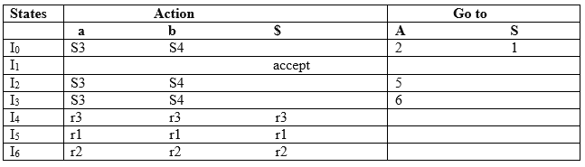
LR(0) Table

Slide 104
LR(0) Table
Productions are numbered as follows:
S → AA ... (1)
A → aA ... (2)
A → b ... (3)

Slide 105
LR(0) Table- Explanation
I1 contains the final item which drives(S` → S•), so action {I1, $} = Accept.
I4 contains the final item which drives A → b• and that production corresponds to the production number 3 so write it as r3 in the entire row.
I5 contains the final item which drives S → AA• and that production corresponds to the production number 1 so write it as r1 in the entire row.
I6 contains the final item which drives A → aA• and that production corresponds to the production number 2 so write it as r2 in the entire row.

Slide 106
LR(0) Table-Explanation:
I0 on S is going to I1 so write it as 1.
I0 on A is going to I2 so write it as 2.
I2 on A is going to I5 so write it as 5.
I3 on A is going to I6 so write it as 6.
I0, I2and I3on a are going to I3 so write it as S3 which means that shift 3.
I0, I2 and I3 on b are going to I4 so write it as S4 which means that shift 4.
I4, I5 and I6 all states contains the final item because they contain • in the right most end. So rate the production as production number.

Slide 107
SLR Parser(CO2)
SLR (1) refers to simple LR Parsing.
It is same as LR(0) parsing.
The only difference is in the parsing table.
To construct SLR (1) parsing table, we use canonical collection of LR (0) item.
In the SLR (1) parsing, we place the reduce move only in the follow of left hand side

Slide 108
Various steps involved in the SLR (1) Parsing
For the given input string write a context free grammar
Check the ambiguity of the grammar
Add Augment production in the given grammar
Create Canonical collection of LR (0) items
Draw a data flow diagram (DFD)
Construct a SLR (1) parsing table

Slide 109
SLR (1) Table Construction
The steps which use to construct SLR (1) Table is given below:
If a state (I_{i}) is going to some other state (I_{j}) on a terminal then it corresponds to a shift move in the action part
If a state (I_{i}) is going to some other state (I_{j}) on a variable then it correspond to go to move in the Go to part.
If a state (I_{i}) contains the final item, which has no transitions to the next state then the production is known as reduce production. For all terminals X in FOLLOW (A), write the reduce entry along with their production numbers

Slide 110
Example-SLR(1)
Example 1:-
S → E E → E + T | T T → T * F | F F → id
Solution:-
Step 1:- Add Augment Production and insert '•' symbol at the first position of Augment Production
S → E S` → •E

Slide 111
Example-SLR(1)
Step 2: Compute Canonical Collection
I0 State:
I0 = Closure (S` → •E)
S` → •E
S` → •E E → •E + T E → •T T → •T * F T → •F F → •id
S` → •E E → •E + T E → •T

Slide 112
Example-SLR(1)
I1= Go to (I0, E)
I2= Go to (I0, T)
I3= Go to (I0, F)
I4= Go to (I0, id)
S` → E•
E → E• + T
E → T•
T→T• * F
T → F•
F → id•

Slide 113
Example-SLR(1)
I5= Go to (I1, +)
Go to (I5, F) = Closure (T → F•) = (same as I3)
Go to (I5, id) = Closure (F → id•) = (same as I4)
I6= Go to (I2, *) = Closure ()
E → E +•T T → •T * F T → •F
E → E +•T T → •T * F T → •F
F → •id
E → E +•T
T → F•
F → id•
T → T * •F F → •id
T → T * •F

Slide 114
Example-SLR(1)
I6 = Go to (I6, id) = Closure (F → id•) = (same as I4)
I7= Go to (I5, T)
I8= Go to (I6, F)
F → id•
E → E + T•
E → E + T•
T → T• * F
T → T * F•

Slide 115
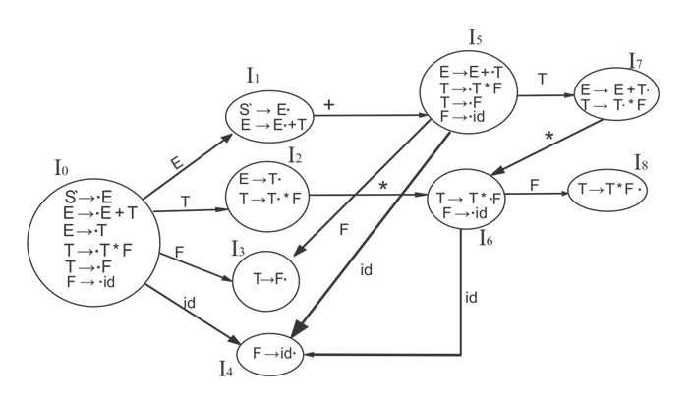
Example-SLR(1)
Step-3 Drawing DFD:
1
ACCEPTED STATE
2
3
4
5

Slide 116
Example-SLR(1)
Productions are numbered as follows:
E->E+T. ………………(1)
E->T. …………………(2)
T->T*F. ………………(3)
T->F. ………………….(4)
F->id. ………………….(5)

Slide 117
Example-SLR(1)
First and Follow Function
First (E) = First (E ) ∪ First (T) First (T) = First (T ) ∪ First (F) First (F) = {id} First (T) = {id} First (E) = {id}
Follow (E) = First (+T) ∪ {$} = {+, $} Follow (T) = First (*F) ∪ First (F)U Follow (E) = {*, +, $} Follow (F) = {*, +, $}

Slide 118
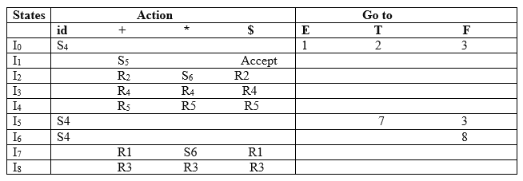
Example-SLR(1)
Step-4 SLR (1) Table

Slide 119
Example-SLR(1)
I1 contains the final item which drives S → E• and follow (S) = {$}, so action {I1, $} = Accept
I2 contains the final item which drives E → T• and follow (E) = {+, $}, so action {I2, +} = R2, action {I2, $} = R2
I3 contains the final item which drives T → F• and follow (T) = {+, *, $}, so action {I3, +} = R4, action {I3, *} = R4, action {I3, $} = R4
I4 contains the final item which drives F → id• and follow (F) = {+, *, $}, so action {I4, +} = R5, action {I4, *} = R5, action {I4, $} = R5
I7 contains the final item which drives E → E + T• and follow (E) = {+, $}, so action {I7, +} = R1, action {I7, $} = R1
I8 contains the final item which drives T → T * F• and follow (T) = {+, *, $}, so action {I8, +} = R3, action {I8, *} = R3, action {I8, $} = R3.

Slide 120
Example
Question:
A →(A)/a
Solution:
Step 1:- Augmented Grammar
A’ →.A
A’ →A A →.(A)
A →.a
Step 2:- Create Canonical Collection of LR(0) items
Find out the canonical collection of each production.

Slide 121
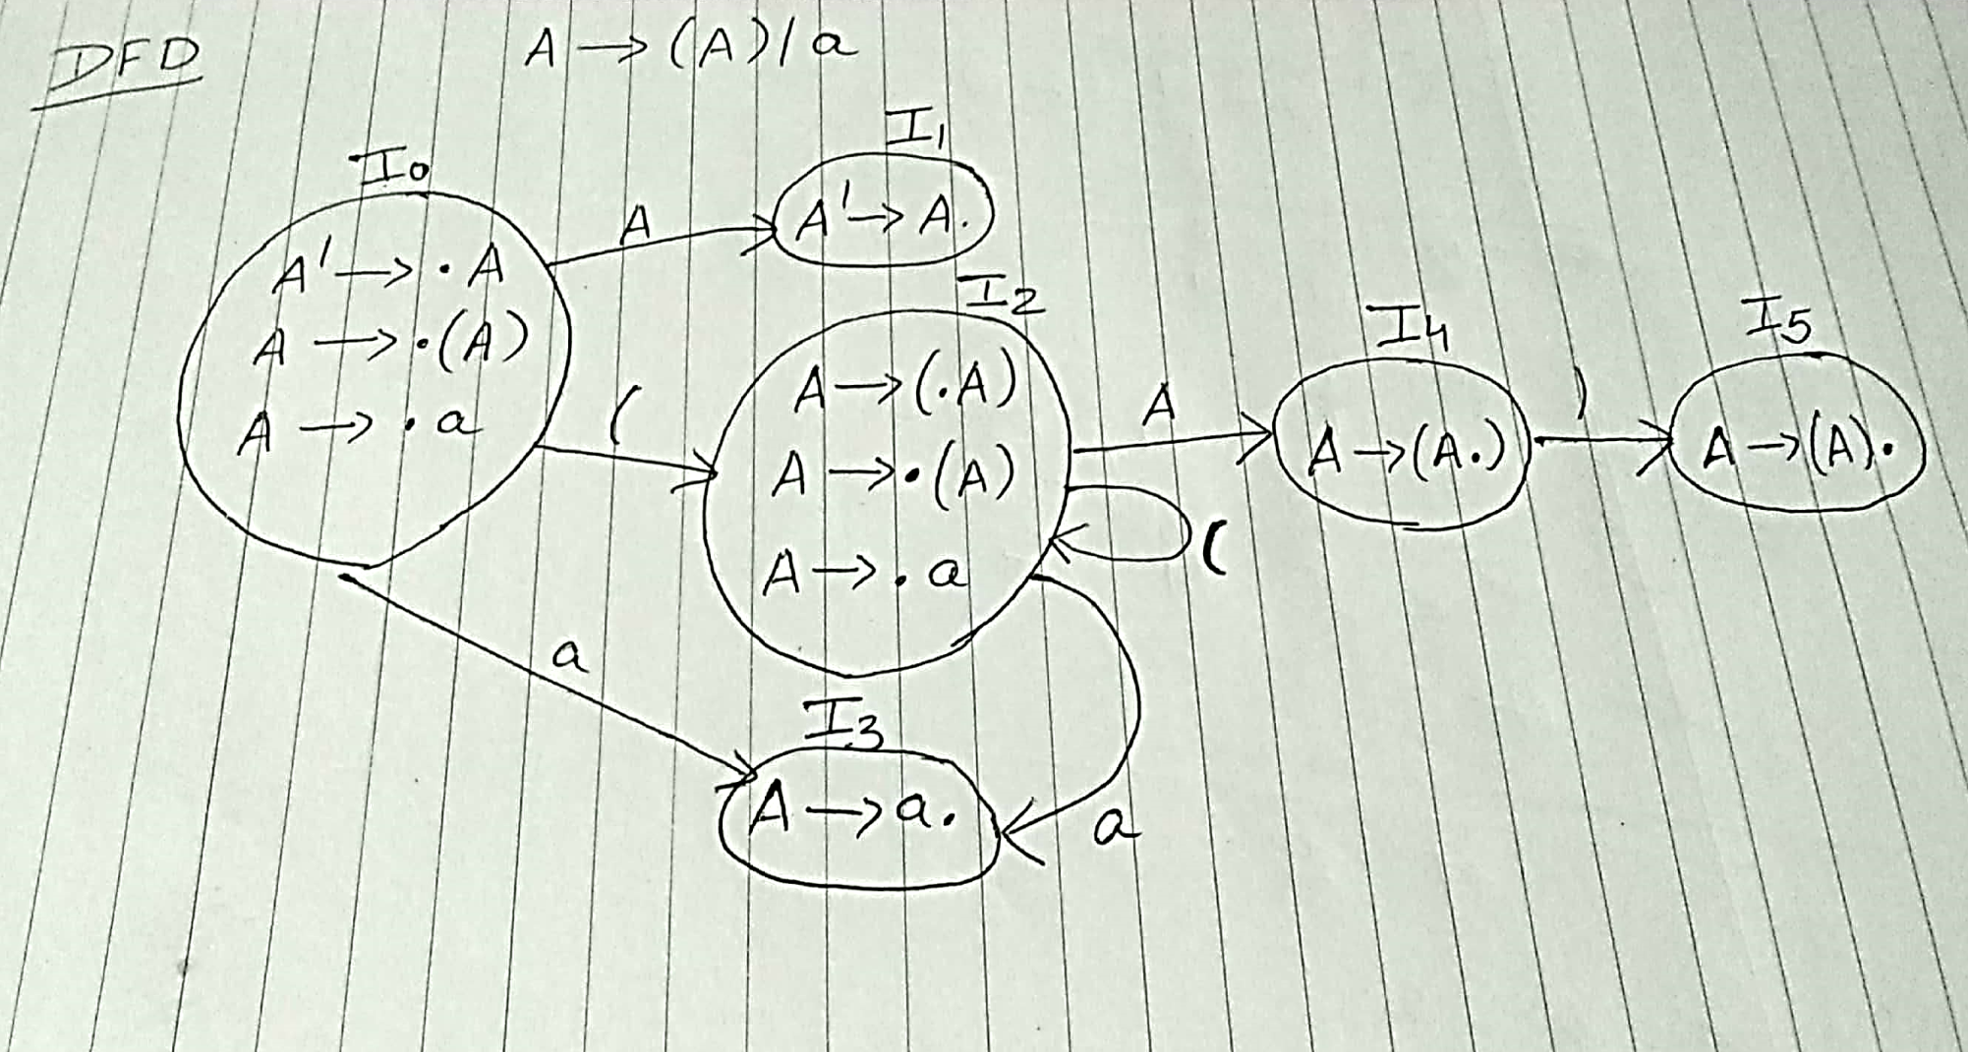
Drawing DFD:
Step:-3 Drawing DFD:

Slide 122
Example-SLR (1)
Productions are numbered as follows:
A → (A). ....(1)
A → a. ….(2)
Calculate the follow function:
Follow of A will be { ), $ }
So, just place production number on the follow of A.

Slide 123
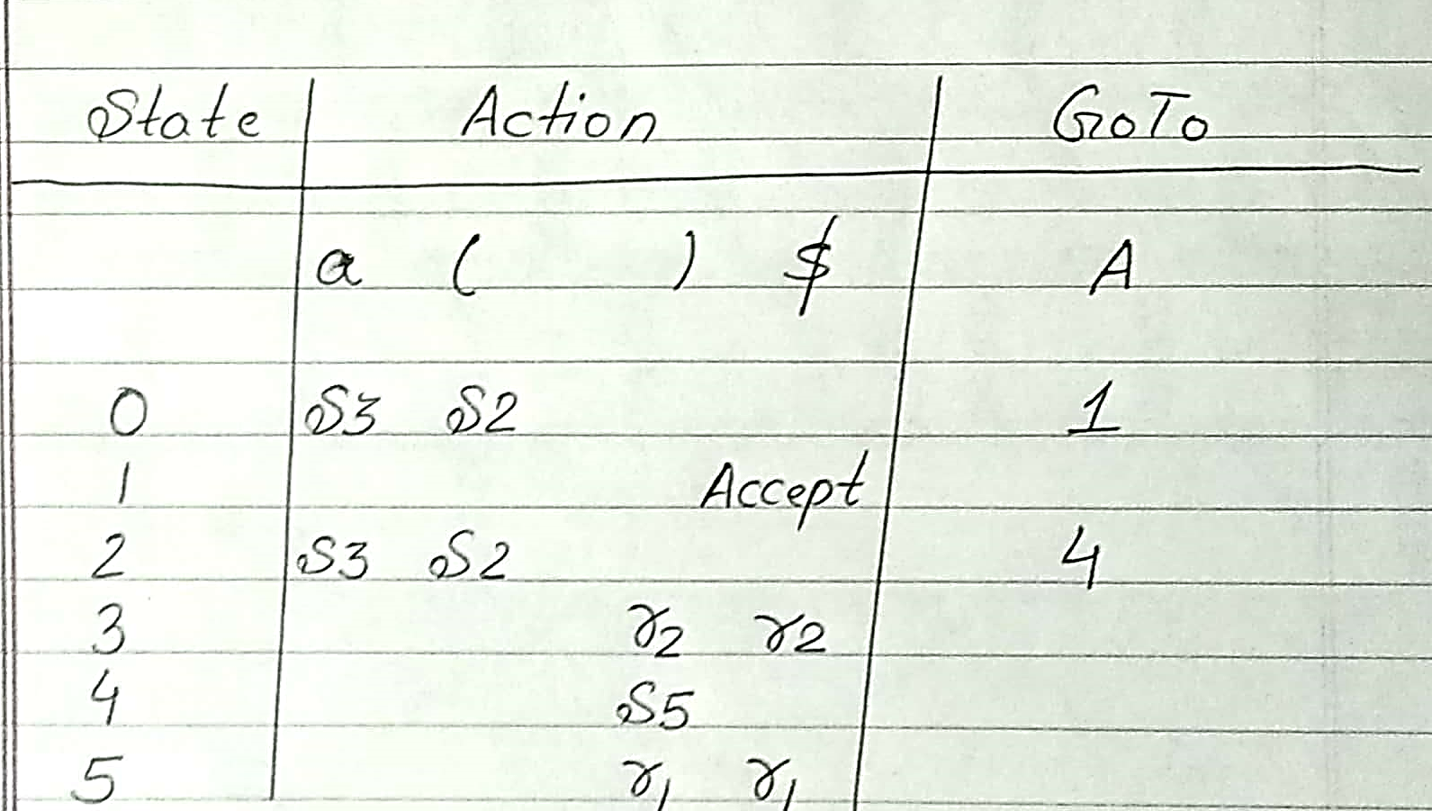
SLR (1) Table

Slide 124
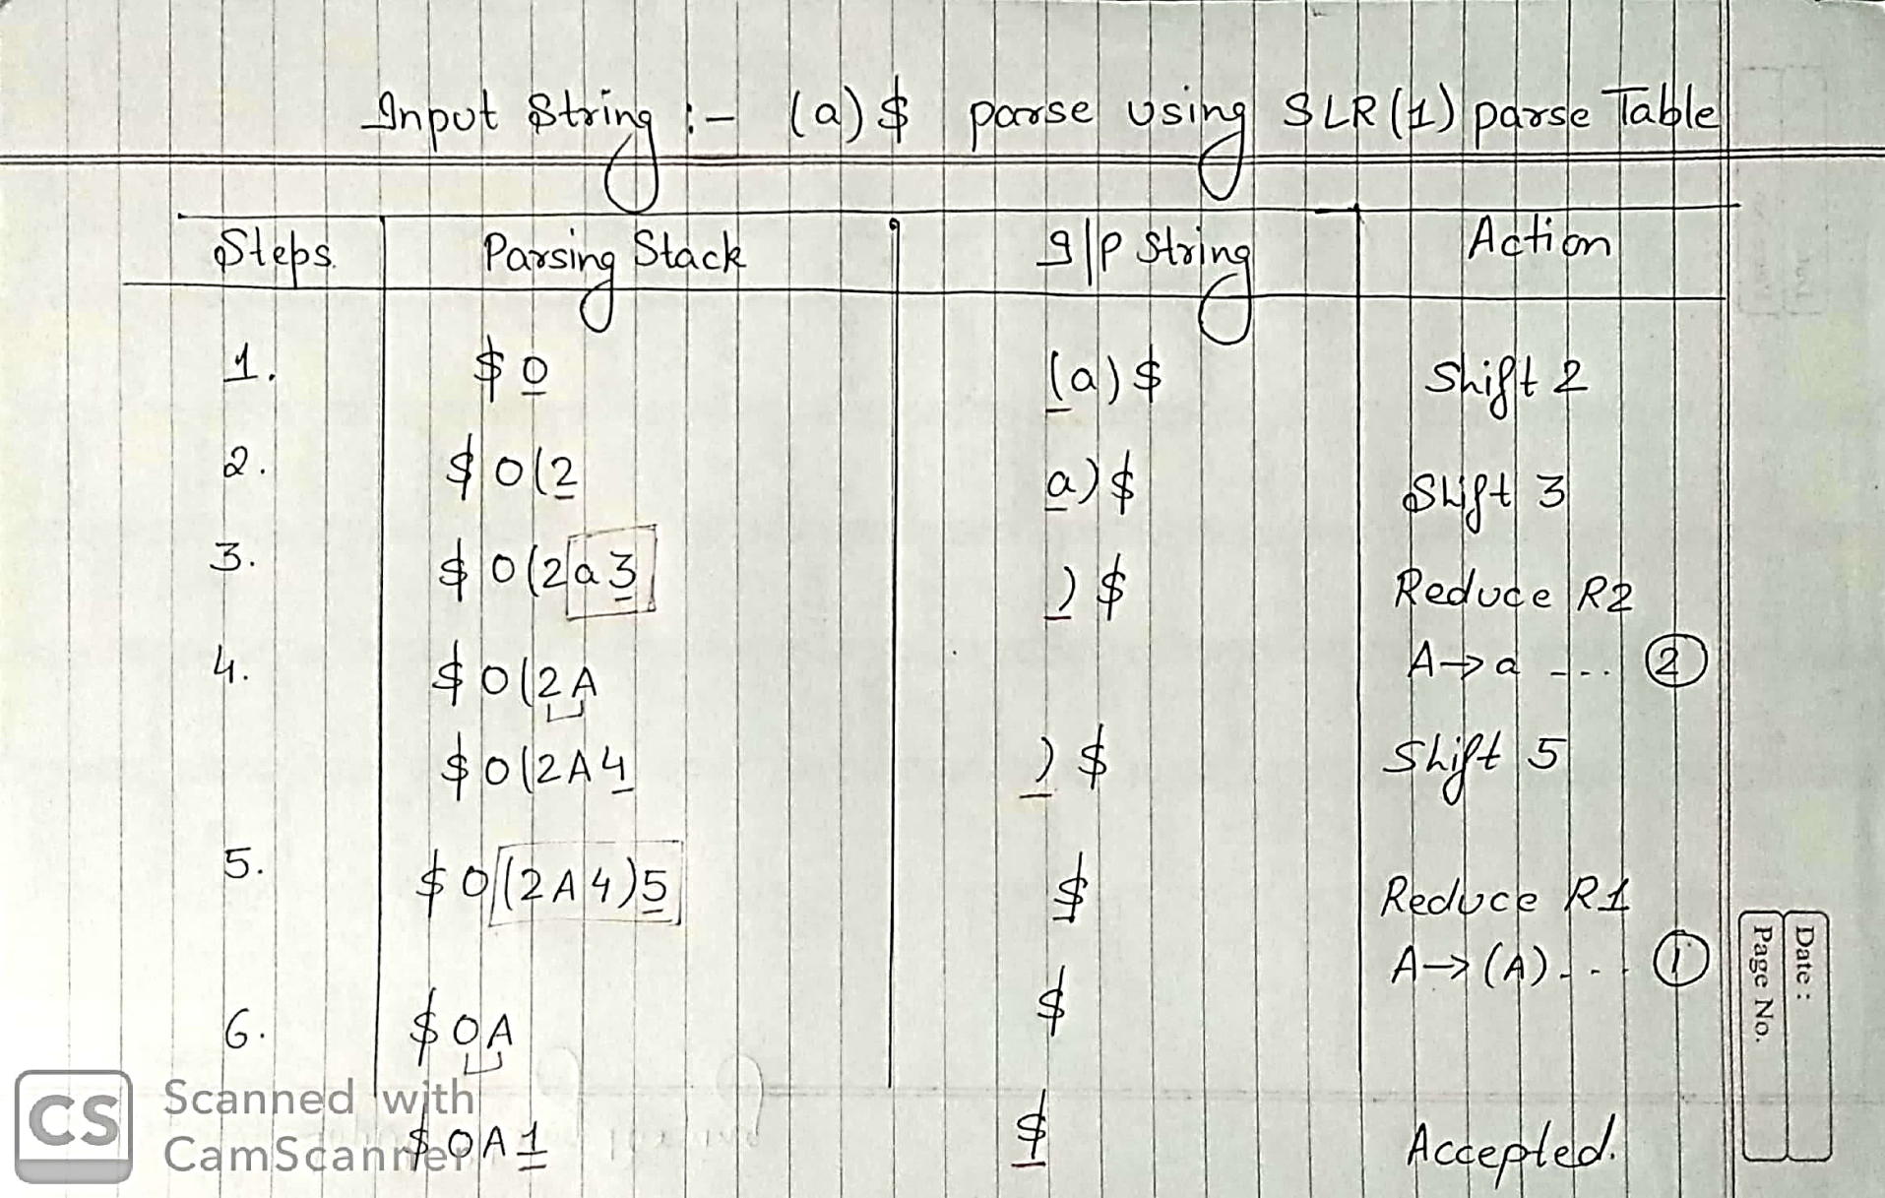
Parsing Input String

Slide 125
Syntax-Directed Translation
Grammar symbols are associated with attributes to associate information with the programming language constructs that they represent.
Values of these attributes are evaluated by the semantic rules associated with the production rules.
Evaluation of these semantic rules:
may generate intermediate codes
may put information into the symbol table
may perform type checking

Slide 126
Syntax-Directed Translation
When we associate semantic rules with productions, we use two notations:
Syntax-Directed Definitions
Translation Schemes
Syntax-Directed Definitions:
give high-level specifications for translations
hide many implementation details such as order of evaluation of semantic actions.
We associate a production rule with a set of semantic actions, and we do not say when they will be evaluated.

Slide 127
Syntax-Directed Translation
Translation Schemes:
indicate the order of evaluation of semantic actions associated with a production rule.
In other words, translation schemes give a little bit information about implementation details.

Slide 128
Attributes
Attribute grammar is a special form of context-free grammar where some additional information (attributes) are appended to one or more of its non-terminals in order to provide context-sensitive information.
Each attribute has well-defined domain of values, such as integer, float, character, string, and expressions.
E → E + T { E.value = E.value + T.value }
Semantic attributes may be assigned to their values from their domain at the time of parsing and evaluated at the time of assignment or conditions.
Based on the way the attributes get their values, they can be broadly divided into two categories : synthesized attributes and inherited attributes.

Slide 129
Synthesized attributes
These attributes get values from the attribute values of their child nodes.
Each of the non-terminals has a single synthesized attribute, called val.
An SDD that involves only synthesized attributes is called S-attributed
Each rule computes an attribute for the non-terminal at the head of a production from attributes taken from the body of the production.

Slide 130
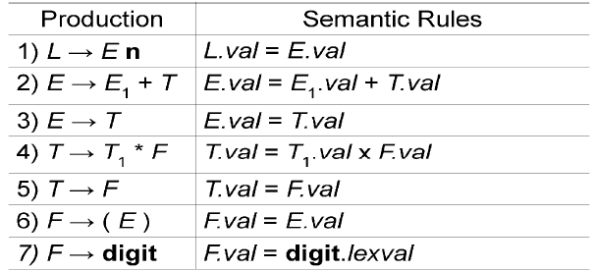
Synthesized attributes
A parse tree, showing the value(s) of its attribute(s) is called an annotated parse tree.
With synthesized attributes, evaluate attributes in bottom-up order.

Slide 131
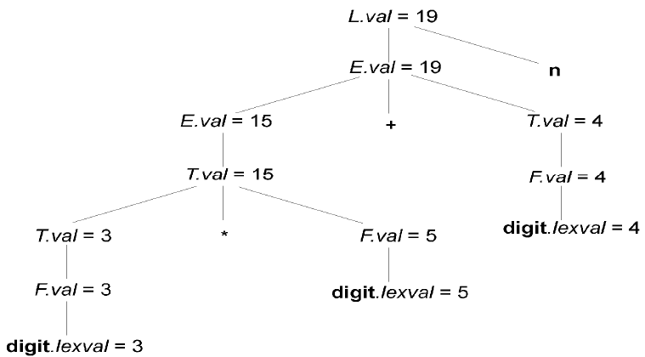
Synthesized attributes
Annotated Parse Tree of 3*5+4n

Slide 132
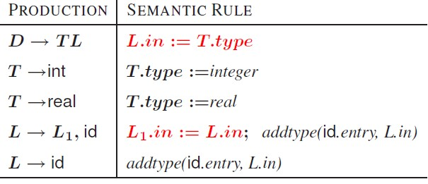
Inherited attributes

Slide 133
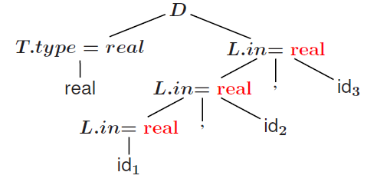
Inherited attributes
Annotated parse tree of real id, id, id

Slide 134
Daily Quiz
1. The combination of grammar and semantic rules are called as:
Syntax directed translation
semantic directed translation
Syntax translator
None of these
2. In syntax directed translation, along with the grammar we associate some informal notation are called as:
Semantic Rules
Syntax Rules
parsing Rules
None of these

Slide 135
Daily Quiz
Which mapping is described by the implementation of the syntax-directed translator?
Parse table
Input
Output
Input-Output

Slide 136
Recap
An SDD that involves only synthesized attributes is called S-attributed
An SDD that involves only inherit attributes is called L-attributed
A parse tree, showing the value(s) of its attribute(s) is called an annotated parse tree

Slide 137
Topic Objective
Introduce students to the concepts of syntax directed translation
Example of evaluating the SDT with the help of attributes

Slide 138
Implementation of desk calculator
Production Semantic Actions
S →E$ {print val[Top]}
E→E+E {val[Top]}= val[Top-1]+ val[Top]}
E→E*E {val[Top]}= val[Top-1]* val[Top]}
E→I { }
I→I.digit {val[Top]}= val[Top-1]*10+lex.val}
I→digit {val[Top]}= val[Top]=lex.val}

Slide 139
Implementation of desk calculator
Design and implement a desk calculator that can perform basic arithmetic operations (+, -, *, /) and handle parentheses for precedence.
Solution Approach:
Understanding Requirements:
The calculator should handle basic arithmetic operations: addition (+), subtraction (-), multiplication (*), and division (/).
It should respect operator precedence, where multiplication and division take precedence over addition and subtraction.
Parentheses should be used to enforce precedence.
Example Calculation: Consider the expression: 2+3∗(4−1)2 + 3 * (4 - 1)2+3∗(4−1).
Step-by-Step Evaluation:
Evaluate inside the parentheses first: 4−1=34 - 1 = 34−1=3.
Substitute back into the expression: 2+3∗32 + 3 * 32+3∗3.
Perform multiplication first: 3∗3=93 * 3 = 93∗3=9.
Add the result to 2: 2+9=112 + 9 = 112+9=11.
Execution Strategy:
Start from left to right, respecting parentheses and operator precedence.
Use a separate line or space for each step of calculation to maintain clarity.
Handling Errors:
Ensure division by zero is not attempted.
Recognize and correct input errors like missing operators or parentheses.

Slide 140
Implementation of desk calculator
Example Calculation:
Given the expression 2+3∗(4−1), follow these steps:
Compute 4−1
4−1=3
Substitute into the original expression:
2+3∗3
Perform multiplication:
3∗3=9
Add to the initial number:
2+9=11

Slide 141
Recap
Implementation of desk Calculator

Slide 142
Topic Objective
Introduce students to the concepts of intermediate code generation
Very useful in the concept of how high level program is stored in address form

Slide 143
Intermediate Code representation
Front end of a compiler is efficient and can be automated
Back end is generally hard to automate and finding the optimum solution requires exponential time
Intermediate code generation can affect the performance of the back end
Goal: Generate a Machine Independent Intermediate Form that is Suitable for Optimization and Portability
Facilitates retargeting: enables attaching a back end for the new machine to an existing front end
Enables machine-independent code optimization

Slide 144
Intermediate Code representation
Graphical representations
e.g. Abstract Syntax Tree
Postfix notation: operations on values stored on operand stack
Three-address code: (e.g. triples and quads)
x := y op z
Two-address code:
x := op y

Slide 145
Parse Tree
A parse tree, also known as a concrete syntax tree, represents the syntactic structure of a string according to the rules of a formal grammar. It's constructed during the parsing process of a compiler or interpreter. Parse trees are hierarchical structures where nodes represent terminals (tokens) and non-terminals (grammar rules). Here's an example to illustrate:
Example of a Parse Tree
Consider the grammar and input expression:
Grammar:
E -> E + E
E -> E * E
E -> (E)
E -> num
Input Expression: 2+3∗(4−1)
+
/ \
2 *
/ \
3 -
/ \
4 1

Slide 146
Syntax Tree (Abstract Syntax Tree, AST)
A syntax tree, or abstract syntax tree (AST), represents the syntactic structure of a program or expression after the parsing phase. Unlike parse trees, syntax trees abstract away from specific syntactic details and focus on the program's logical structure. They are used for semantic analysis, optimization, and code generation phases in compilers and interpreters. Here's how it differs from a parse tree:
Example of a Parse Tree
Consider the grammar and input expression:
Grammar:
E -> E + E
E -> E * E
E -> (E)
E -> num
Input Expression: 2+3∗(4−1)
+
/ \
2 *
/ \
3 -
/ \
4 1

Slide 147
Three address code(CO3)
In a three address code there is at most one operator at the right side of an instruction
Example:
+
t1 = b – c
t2 = a * t1
t3 = a + t2
t4 = t1 * d
t5 = t3 + t4
+
*
*
d
a
b
c

Slide 148
Data structures for three address codes(CO3)
Quadruples
Has four fields: op, arg1, arg2 and result
Triples
Temporaries are not used and instead references to instructions are made
Indirect triples
In addition to triples we use a list of pointers to triples

Slide 149
Three address codes Example(CO3)
Three address code
Example
b * minus c + b * minus c
t1 = minus c
t2 = b * t1
t3 = minus c
t4 = b * t3
t5 = t2 + t4
a = t5
Quadruples
Triples
Indirect Triples
op | arg1 | arg1 | result
minus | c |  | t1
* | b | t1 | t2
minus | c |  | t3
* | b | t3 | t4
+ | t2 | t4 | t5
= | t5 |  | a
 | op | arg1 | arg1
0 | minus | c
1 | * | b | 0
2 | minus | c
3 | * | b | 2
4 | + | 1 | 3
5 | = | a | 4
 | op
0 | 0
1 | 1
2 | 2
3 | 3
4 | 4
5 | 5
 | op | arg1 | arg1
0 | minus | c
1 | * | b | 0
2 | minus | c
3 | * | b | 2
4 | + | 1 | 3
5 | = | a | 4

Slide 150
Quadruples Example(CO3)
a := b * -c + b * -c
 | op | arg1 | arg2 | result
(0) | uminus | c |  | t1
(1) | * | b | t1 | t2
(2) | uminus | c |  | t3
(3) | * | b | t3 | t4
(4) | + | t2 | t4 | t5
(5) | := | t5 |  | a

Slide 151
Triples Example(CO3)
a := b * -c + b * -c
 | op | arg1 | arg2
(0) | uminus | c
(1) | * | b | (0)
(2) | uminus | c
(3) | * | b | (2)
(4) | + | (1) | (3)
(5) | := | a | (4)
Result is implicit in triples

Slide 152
Indirect triples(CO3)
a := b * -c + b * -c
 | op |  | op | arg1 | arg2
(0) | (14) | (14) | uminus | c
(1) | (15) | (15) | * | b | (14)
(2) | (16) | (16) | uminus | c
(3) | (17) | (17) | * | b | (16)
(4) | (18) | (18) | + | (15) | (17)
(5) | (19) | (19) | assign | a | (18)

Slide 153
Daily Quiz
Three address code statement are………………..
Assignment Statement
Copy Statement
procedure call
All of the above
Postfix notation of a + b * c is __ .
abc*+
abc+*
ba+c*
None of the above
A parse tree showing the value of attributes at each node is called----------
Syntax tree
Annotated parse tree
parse tree
All of the above.

Slide 154
Role of CFG in Voice Assistant
CFG is used to formally define the structure of valid sentences in a language.
: In a Voice Assistant:
CFG provides rules that describe how words can be combined.
It helps the system understand syntax (sentence structure).
Ensures that user input follows recognizable patterns.
Example:
A simple CFG rule:
S → VP
VP → Verb Object
Verb → "play" | "open"
Object → "music" | "YouTube“
If a user says: "play music" → It matches the CFG rules → valid command.
If user says: "music play quickly" → May not match → needs correction or advanced parsing.

Slide 155
Role of Parsing in Voice Assistant
Role of Parsing
Parsing is the process of analyzing the sentence using CFG rules.
In a Voice Assistant:
Converts spoken input → structured representation (parse tree)
Identifies:
Intent (what user wants)
Entities (objects involved)
Example:
User input: "Play music"
Parsing result:
Verb → play
Object → music
👉 System interprets:
Intent = Play
Entity = Music

Slide 156
Role of CFG (Context-Free Grammar)
Defines sentence structure
CFG specifies how words can be arranged to form valid commands.
Limits possible inputs
Helps the system focus only on expected patterns (e.g., “play music”, “open app”).
Provides grammatical rules
Uses production rules (like S → Verb + Object) to represent language.
Improves understanding accuracy
Reduces incorrect interpretations by filtering invalid sentences.
Useful for command-based systems
Works well where user input follows fixed formats.

Slide 157
Role of Parsing
Analyzes user input
Checks whether the spoken sentence follows CFG rules.
Builds structure (Parse Tree)
Breaks the sentence into components like verb, object, etc.
Extracts meaning (Intent & Entities)
Identifies what action is needed and on what object.
Detects errors or ambiguity
Helps identify if the sentence is incomplete or unclear.
Converts text into machine-understandable form
Prepares structured data for further processing.

Slide 158
Combined Role (CFG + Parsing)
CFG provides rules, parsing applies those rules
Together, they help the system understand commands correctly
Enable accurate execution of user requests
Form the basic language processing layer in voice assistants

Slide 159
Role of CFG and Parsing in Voice Assistant
A voice assistant converts spoken language into meaningful actions. Context-Free Grammar (CFG) and Parsing play an important role in understanding the structure and meaning of user commands.

Slide 160
Faculty Video Links, Youtube & NPTEL Video Links and Online Courses Details
Youtube/other Video Links
https://www.youtube.com/watch?v=GOlsYofJjyQ
https://www.youtube.com/watch?v=sMxqUQc_jHQ&t=360s
https://nptel.ac.in/courses/106/105/106105190/
https://nptel.ac.in/courses/106/105/106105190/

Slide 161
Daily Quiz
Calculate the first and follow function of production rules:
S → ACB / CbB / Ba
A → da / BC
B → g / ∈
C → h / ∈
Consider the following grammar and eliminate left recursion-
E → E + E / E x E / a
Do left factoring in the following grammar-
S → bSSaaS / bSSaSb / bSb / a
Consider this following grammar:
S→iEtS | iEtSeS| a
E→b
Check whether it is LL(1) grammar or not.

Slide 162
Daily Quiz
Consider the following grammar-
S → ( L ) | a
L → L , S | S
Parse the input string ( a , ( a , a ) ) using a shift-reduce parser.
Consider the grammar
E -> T+E | T
T ->id
Perform SLR(1) and LR (0) parsing on above grammar.

Slide 163
Daily Quiz
Consider the grammar and find the grammar is -
E → A | B
A → a | c
B → b | c
LR(0)
LR(0) & LR(1)
LR(1), SLR(1)
none
Consider the grammar E → E + n | E × n | n. For a sentence "n + n × n," the handles in the right sentential form of reduction are
n, E + n and E + n × n
n, E + n and E + E × n
n, n + n and n + n × n
n, E + n and E × n

Slide 164
Daily Quiz
Give the Follow set for the non-terminal E in the grammar.
E’ → E
E → num
E → (+A)
A → AA
A → E
{num, (,)}
{(,) , num, $}
{(, num, $}
{), num, $}

Slide 165
Daily Quiz
Eliminate left recursion from the following grammar:
A → Bd | Aff | CB
B → Bd | Bf | df
C → h | g
a. A → Bd AI | CB AI
A1 → ff AI | ε
B → df BI
B1 → d BI | fBI | ε
C → h | g
b. A → Bd AI | CB AI
A → ff AI | ε
B → df BI
BI → d BI | fBI | ε
C → h | g
c. A → Bd AI | CB AI
AI → ff AI
B → df BI
BI → d BI | fBI
C → h | g
d. A → Bd AI | CB
AI → ff AI | ε
B → df BI
BI → d BI | fB I | ε
C → h | g

Slide 166
Daily Quiz
Consider the grammar shown below
S → iEtSS’ | a
S’ → eS | ε
E → b
In LL(1) table M of this grammar, the entries M[S’,e] and M[S’, $] are
S’ → eS , S’ → ε
S’ → eS , {}
S’ → ε , S’ → ε
{S’ → eS & S’ → ε} , S’ → ε
Give the Follow of B in the following grammar:
A → B C D
B → w | B x
C → y C z | m
D → D B | a
{x, y, m, $}
{x, y, w, $}
{x, w, m, $}
{x, y, m, w, $}

Slide 167
Daily Quiz
Using LR(0) items we can construct.
SLR parsing table
LALR parsing table
CALR parsing table
None
Which of the following is true?
every SLR(1) is LR(0)
every LL(1) is LR(1)
every LL(1) is SLR(1)
every LL(1) is LR(0)
If a grammar is SLR(1) then [ ]
it may have S/R conflict
It will not have any conflict
It may have R/R conflict
it will not have S/R but may have R/R conflict

Slide 168
Daily Quiz
Consider the grammar S → ( S ) | a. If SLR(1) has n1 states, LR(1) has n2 states, LALR(1) has n3 states, which of the following is true?
n1<n2<n3
n1=n3<n2
n1=n2=n3
n1>n3>n2

Slide 169
Weekly Assignments-1
Consider the following grammar
S → AS | b
A → SA | a
Show that the grammar is ambiguous.
Find LR(0) Canonical collections.
Construct the SLR parsing table.

Slide 170
Weekly Assignments-2
From a given grammar remove left RECURSION E → E+T│T, T → T*F │F, F → (E) │id
2. Pasre the strings “ab” , “acdb”and “adb” using stack.
S → aABb A → c│ Ԑ
B → d│ Ԑ
3. Parse the string “ (id*id) ” and “ id+id+id ” using stack.
E → E+T│T
T → T*F │F
F → (E) │id

Slide 171
MCQ
Handle pruning forms the basis of ____________ .
(a) Bottom-up parsing
(b) Top-down parsing
(c) Both (a) and (b)
(d) None of these
Non-recursive predictive parser contains ___________ .
(a) An input buffer
(b) A parsing table
(c) An output stream
(d) All of these

Slide 172
MCQ
If A → αβ is a production and a is terminal symbol or right end marker $, then LR(1) items will be defined by the production ________.
(a) [A → α.β, a]
(b) [A → .αβ, a]
(c) [A → α.βa]
(d) [A → a.β, α]
Consider the grammar shown below
S → FR , R → *S | ε , F → id
In LL (1) table M of this grammar, the entries M[S, id] and M[R, $] are
S → FR, R → ε
S → FR & {}
S → FR & R → *S
F → id, R → ε

Slide 173
MCQ
Top-down parsing is a technique to find _________ .
(a) Leftmost derivation
(b) Rightmost derivation
(c) Leftmost derivation in reverse
(d) Rightmost derivation in reverse
Predictive parsing is possible only for __________ .
(a) LR(k) grammar
(b) LALR(1) grammar
(c) LL(k) grammar
(d) CLR(1) grammar

Slide 174
MCQ
Which two functions are required to construct a parsing table in predictive parsing technique?
(a) CLOSURE() and GOTO ()
(b) FIRST() and FOLLOW()
(c) ACTI0N() and GOTO()
(d) None of these
Which of these parsing techniques is a kind of bottom-up parsing?
(a) Shift-reduce parsing
(b) Reduce-reduce parsing
(c) Predictive parsing
(d) Recursive-decent parsing

Slide 175
MCQ
Which of the following methods is used by the bottom-up parser to generate a parse tree?
(a) Leftmost derivation
(b) Rightmost derivation
(c) Leftmost derivation in reverse
(d) Rightmost derivation in reverse
Handle pruning forms the basis of ____________ .
(a) Bottom-up parsing
(b) Top-down parsing
(c) Both (a) and (b)
(d) None of these

Slide 176
Glossary Questions
Explain the parsing techniques with a hierarchical diagram.
2. What are the problems associated with Top Down Parsing?
3. Write the production rules to eliminate the left recursion and left factoring problems.
4. Consider the following Grammar:
A-> ABd|Aa|a B-> Be|b
Remove left recursion.
5. Do left factoring in the following grammar: A-> aAB|aA|a B-> bB|b
6. Write a short note on:
Ambiguity (with example)
b. Recursive Descent Parser
c. Predictive LL(1) parser (working)
d. Handle pruning
e. Operator Precedence Parser
7. Write Rules to construct FIRST Function and FOLLOW Function.

Slide 177
Daily Quiz
Listing pointers to triples, rather than listing triples themselves is implementation of
a. Quadruple
b. Triple
c. Indirect Triple
d. Three address code
Quadruple is a record structure with four fields.
a. Op, arg1, arg2 and result
b. op1, op2, agr2 and result
c. agr1, arg2 , result and op
d. All of d above

Slide 178
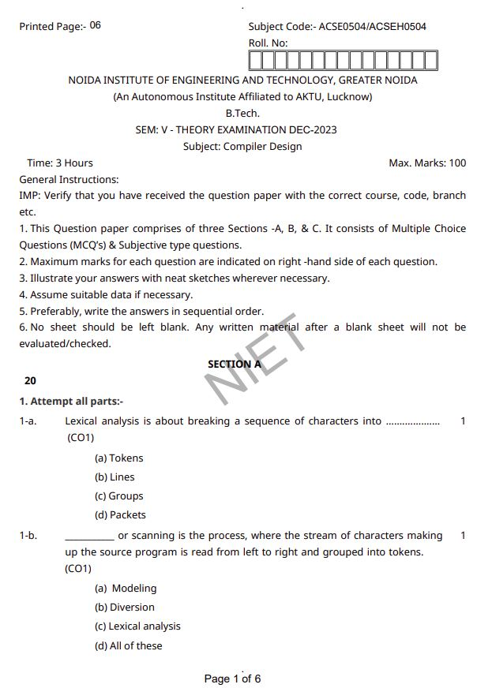
Old Question Paper

Slide 179
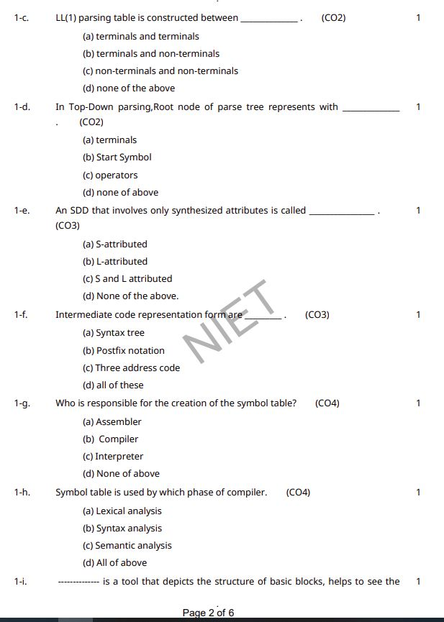
Old Question Paper

Slide 180
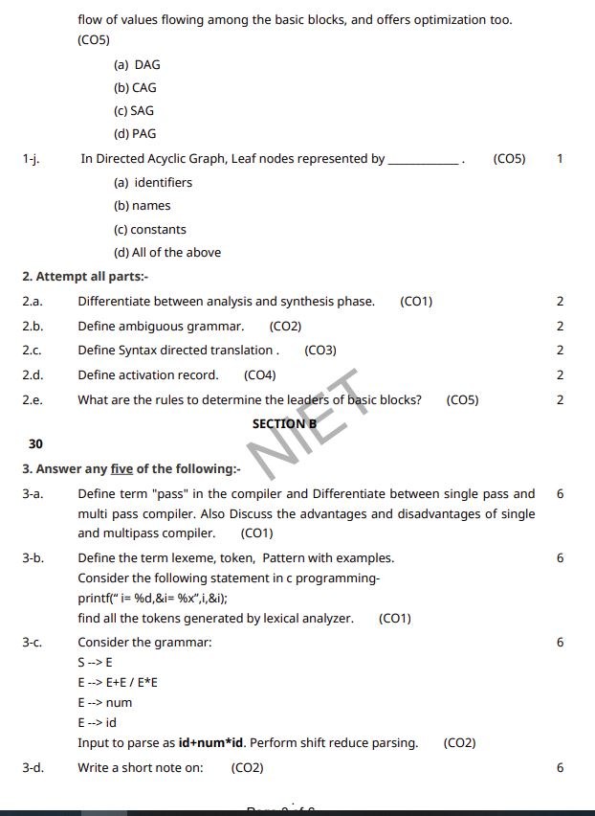
Old Question Paper

Slide 181
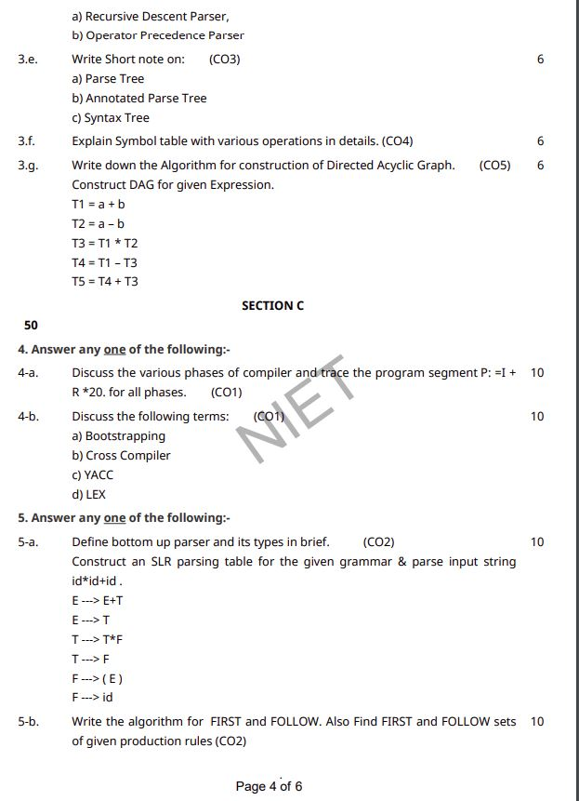
Old Question Paper

Slide 182
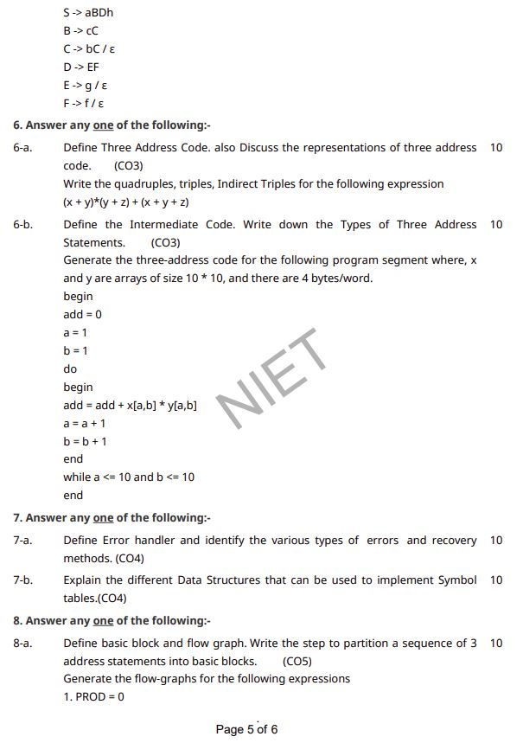
Old Question Paper

Slide 183
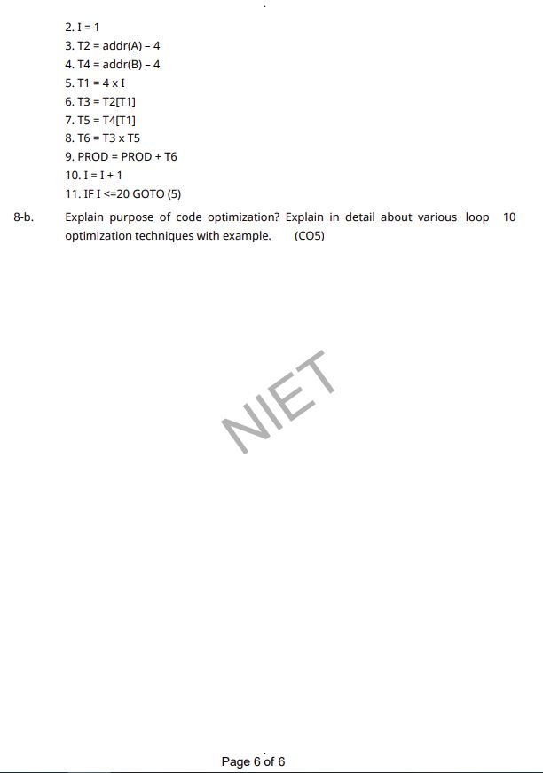
Old Question Paper

Slide 184
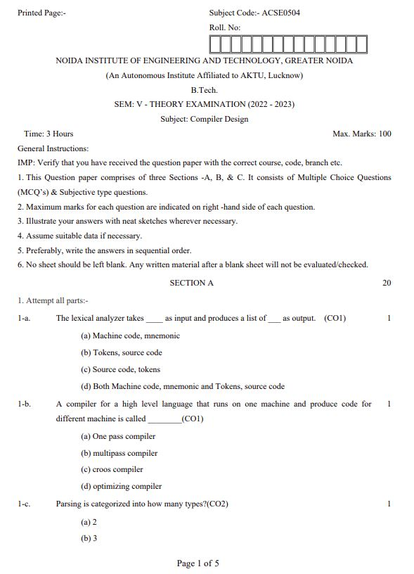
Old Question Paper

Slide 185
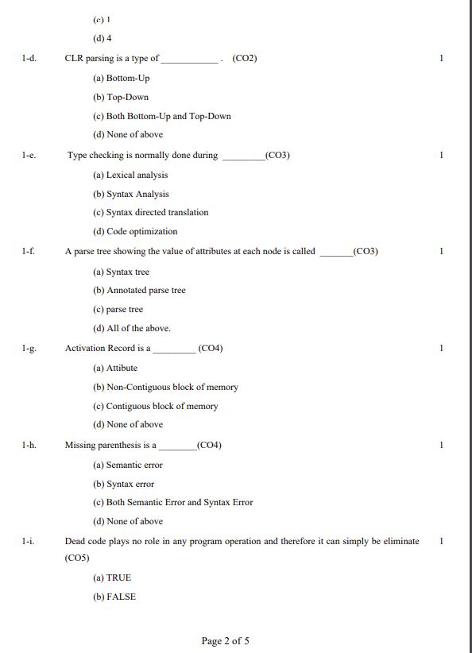
Old Question Paper

Slide 186
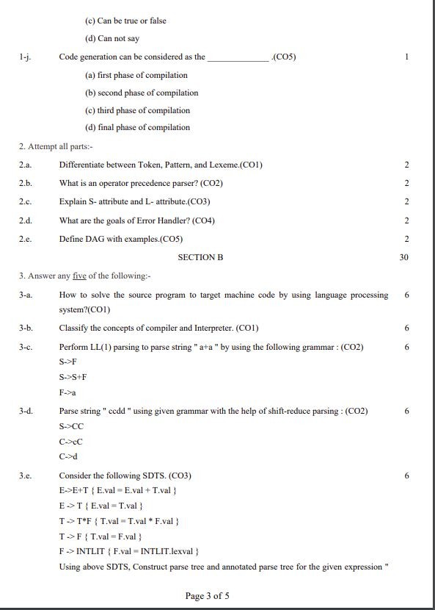
Old Question Paper

Slide 187
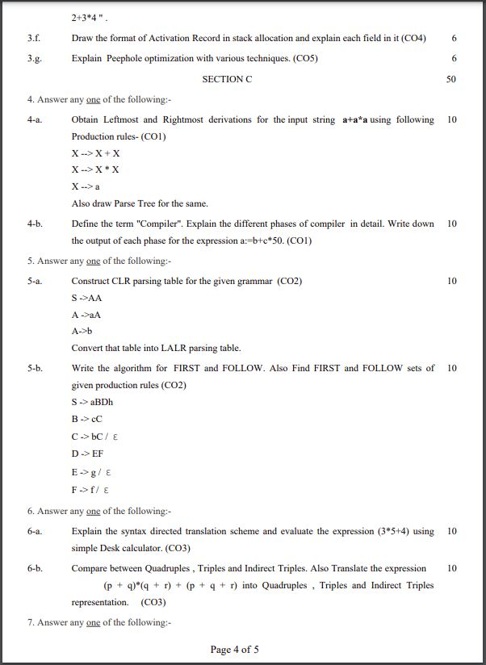
Old Question Paper

Slide 188
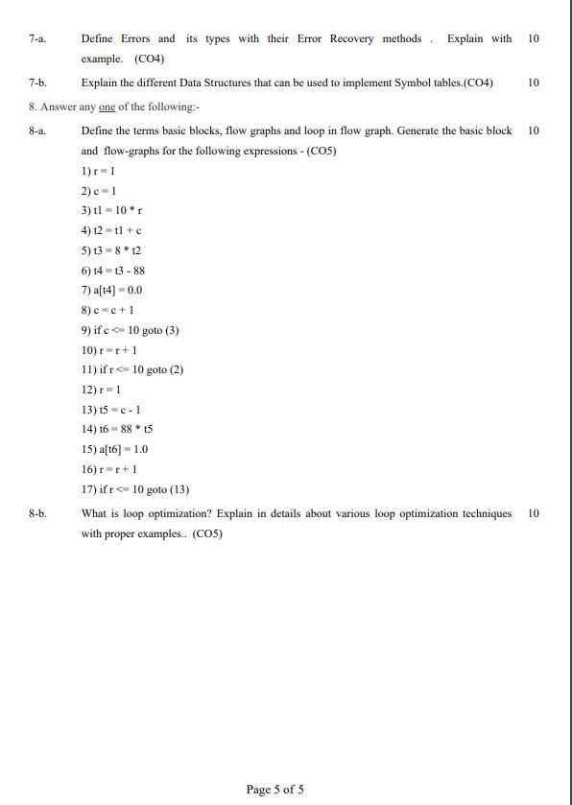
Old Question Paper

Slide 189
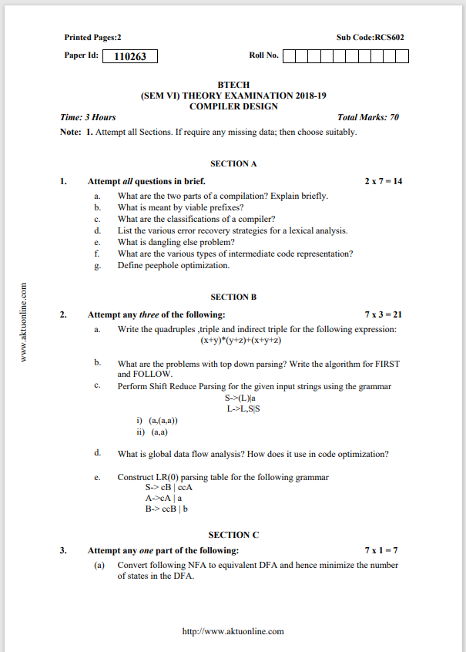
Old Question Paper

Slide 190
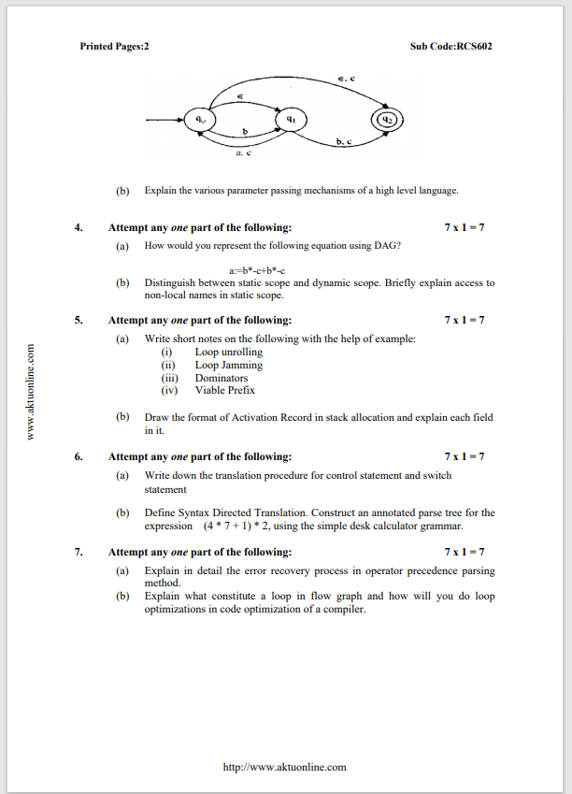
Old Question Paper

Slide 191
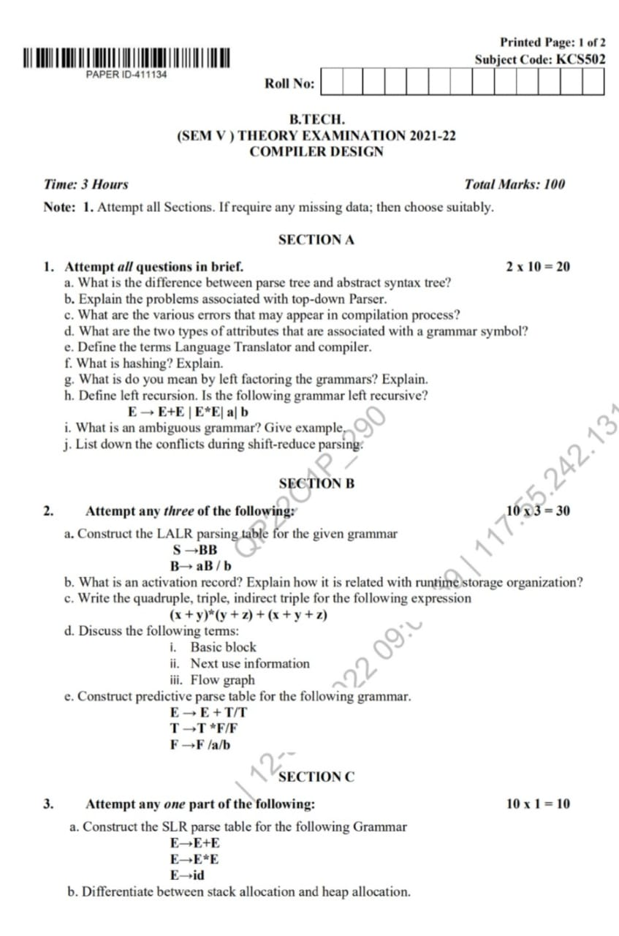
Old Question Paper

Slide 192
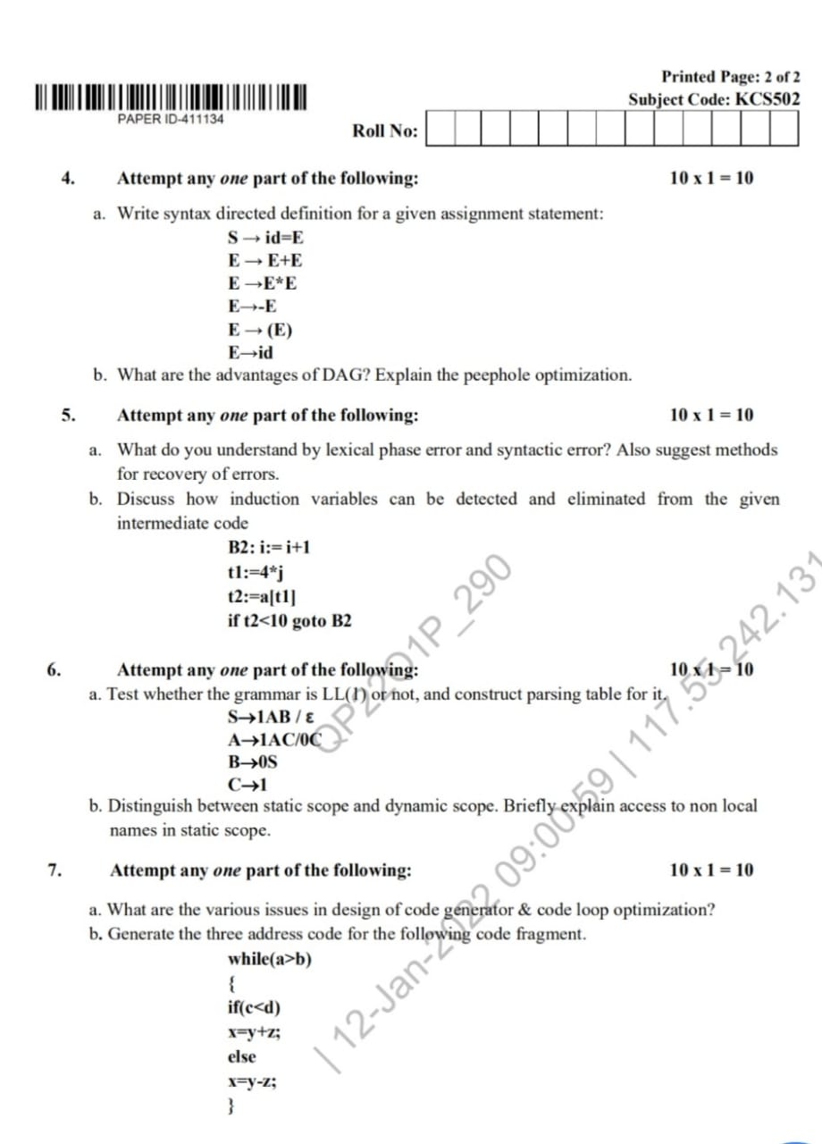
Old Question Paper

Slide 193
Expected Question for University Exam
Consider the following grammar S-AS|b A-SA|a. Construct the SLR parse table for the grammar. Show the actions of the parser for the input string “abab”.
What is a syntax tree? Draw the syntax tree for the following statement: c b c b a − ∗ + − ∗ =
Perform Shift Reduce Parsing for the given input strings using the grammar
S->(L)|a
L->L,S|S
i) (a,(a,a))
ii)(a,a)

Slide 194
Recap of Unit
Syntax Analyzer
creates the syntactic structure of the given source program.
This syntactic structure is mostly a parse tree
.Syntax Analyzer is also known as parser
LR parsers can be constructed to recognize virtually all programming-language constructs for which context-free grammars can be written.
Bottom-up parsers for a large class of context-free grammars can be easily developed using operator grammars.Operator grammars have the property that no production right side is empty or has two adjacent nonterminals.
A shift-reduce parser uses a parse stack which (conceptually) contains grammar symbols. During the operation of the parser, symbols from the input are shifted onto the stack. If a prefix of the symbols on top of the stack matches the RHS of a grammar rule which is the correct rule to use within the current context, then the parser reduces the RHS of the rule to its LHS,replacing the RHS symbols on top of the stack with the nonterminal occurring on the LHS of the rule.
This shift-reduce process continues until the parser terminates, reporting either success or failure. It terminates with success when the input is legal and is accepted by theparser.

Slide 195
References
K. Muneeswaran,Compiler Design,First Edition,Oxford University Press.
J.P. Bennet, “Introduction to Compiler Techniques”, Second Edition, Tata McGraw-Hill,2003.
Henk Alblas and Albert Nymeyer, “Practice and Principles of Compiler Building with C”, PHI, 2001.
Aho, Sethi & Ullman, "Compilers: Principles, Techniques and Tools”, Pearson Education
V Raghvan, “ Principles of Compiler Design”, TMH
Kenneth Louden,” Compiler Construction”, Cengage Learning.
Charles Fischer and Ricard LeBlanc,” Crafting a Compiler with C”, Pearson Education

Slide 196
Thank You

