Slide 1
Project
Advanced Topics in Human Computer Interaction
Master of Computer Science (MCS)
Algoma University
Group5
Topic: Accessible User Interface Design and Testing for People with Hearing Loss

Slide 2

Project Overview
Objective: Develop an accessible user interface for individuals with hearing loss by following the principles of user-centered design, ISO standards, and guidelines provided by the Prof. MD Nashid Anjum.
Key Features:
Text to ASL Conversion
Speech to Text Conversion
Speech to ASL Conversion (Combining Steps 1 & 2)
3D Modeling of ASL Numbers
Integration with Unity for ASL translation
Speech to 3D ASL Translator

Slide 3
Part I: Speech to ASL Conversion
Part I: Conversion Techniques
Text to ASL Conversion
Python-based implementation that maps English alpha-numerics to ASL symbols.
Utilized signconverter.com and ASL font references for symbol creation.
Speech to Text Conversion
Recognizes speech using speech_recognition.
Outputs the recognized text for further conversion.
Speech to ASL Conversion
Combines steps 1 and 2 for seamless speech-to-ASL functionality.

Slide 4
Part II: Sign Language 3D Modeling
3D ASL Modeling
Tools: Blender or open-source alternatives.
Create 3D hand representations for numbers 0 through 9.
Ensure detailed and accessible.
Unity Integration
Designed software to be able to display 3D ASL numbers from an input given by the user.
Inputs supported: keyboard, mouse, touchscreen, or game controller.
Speech to 3D ASL
Voice input via embedded speech recognition within Unity software
Instant conversion of spoken numbers into 3D ASL symbols.

Slide 5
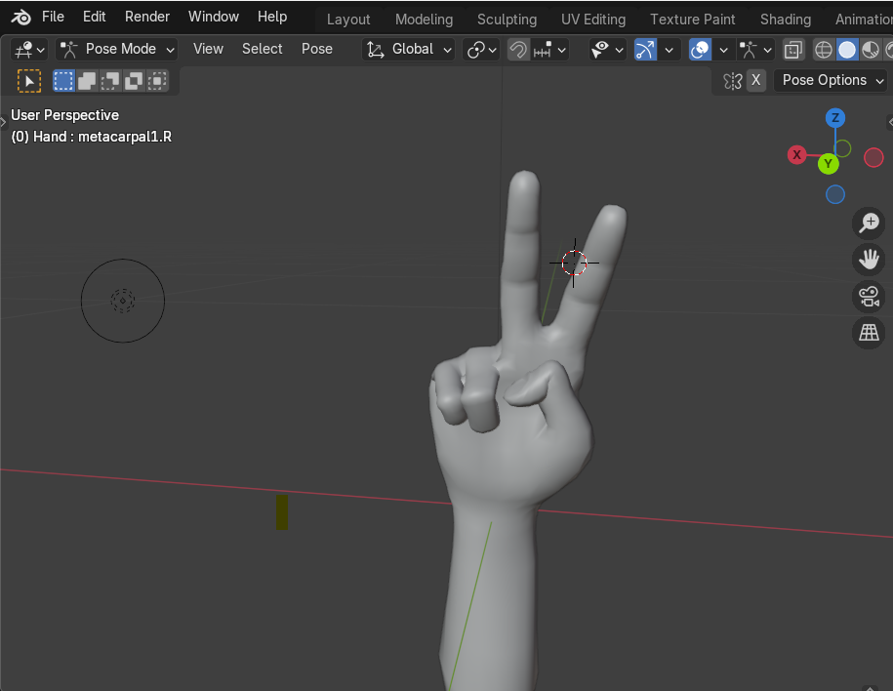
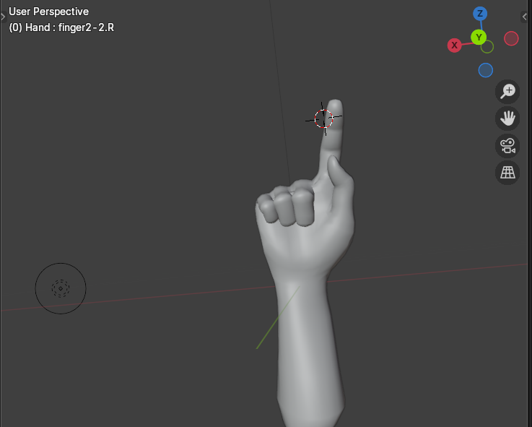
Part II : Hand 1 and 2

Slide 6
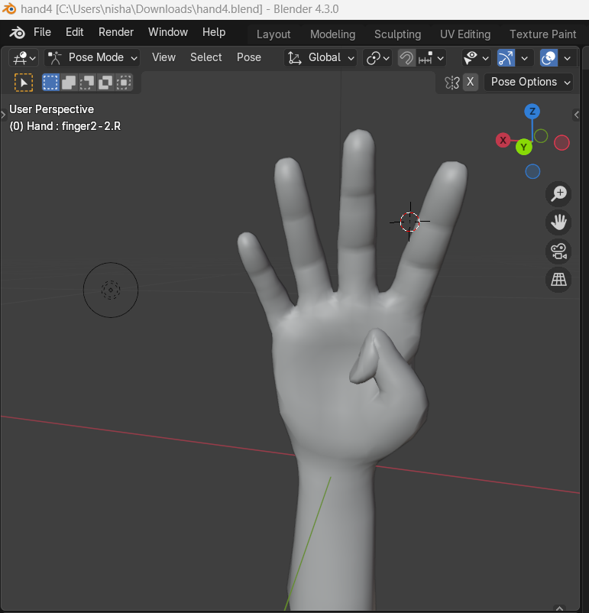
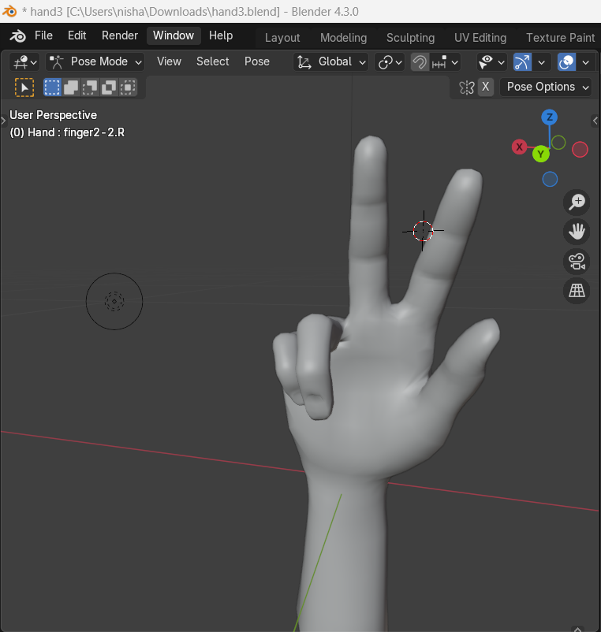
Hand 3 and 4

Slide 7
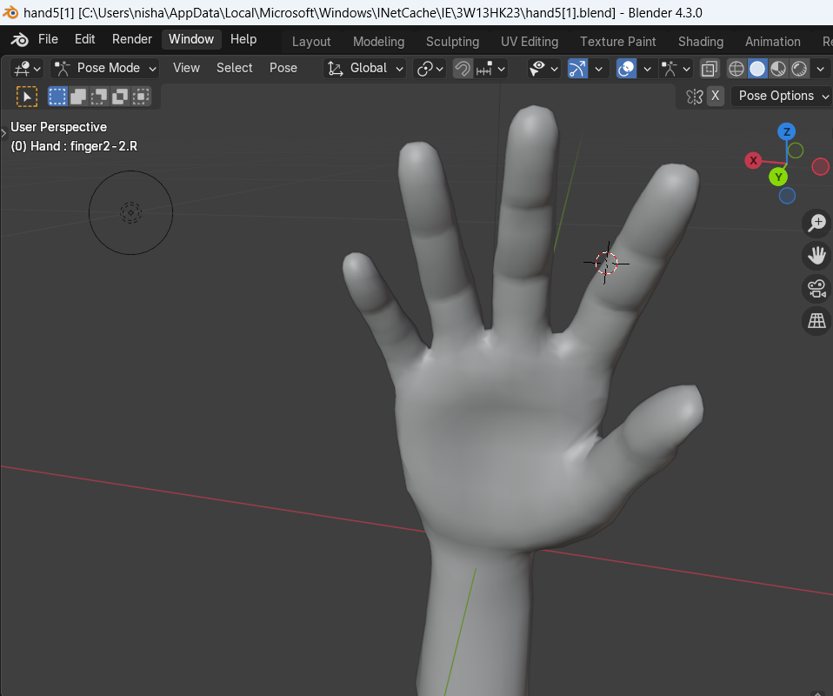
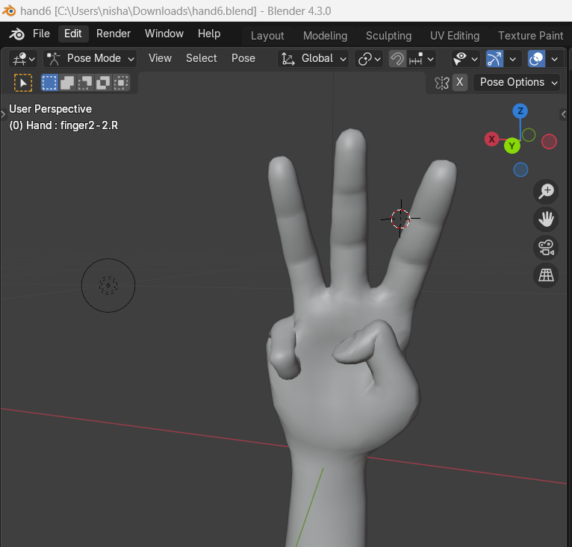
Hand 5 and Hand 6

Slide 8
Challenges and Solutions:
Mapping accurate ASL symbols: Researched reliable sources such as sign charts and font references for accurate representation.
Speech Recognition Accuracy: Implemented error handling to manage unknown or unclear inputs.
3D modeling complexities: Managed Blender tutorials and simplified designs to maximum effect.
Unity integration: Utilized Unity documentation and API to accomplish smooth input and 3D model rendering.

Slide 9
Progress
Text to ASL Conversion - Completed
Speech to Text Conversion - Completed
Speech to ASL Conversion (Combining Steps 1 & 2) - completed
3D Modeling of ASL Numbers - in Progress
Integration with Unity for ASL translation - pending
Speech to 3D ASL Translator - pending

Slide 10
Conclusion
This project successfully developed an accessible user interface tailored to the needs of people with hearing loss by combining user-centered design principles and ISO/NNG standards. Some of the major achievements are: text-to-ASL conversion, speech-to-text functionality, 3D modeling of ASL numbers, and speech-to-3D ASL translator integrated with Unity. Such innovations bridge the gaps in communication and provide inclusivity.
This work utilizes Python, Blender, Unity, and speech recognition, among other technologies, for the implementation of this solution, in order to provide accessibility, while future updates will add more vocabulary to the current dataset and implement complex machine learning. The contribution underlines the importance of inclusivity in software design while opening up further options for improving assistive technologies.

Slide 11
References
Citations:
ACM/APA format references for sources used in the project.
Sign Language Website:
Blender Software: https://www.blender.org/download/
Unity Software: https://unity.com/
https://docs.blender.org/

Slide 12


