Slide 1

Department of Computer Science and Engineering Graphic Era (Deemed to be University) Dehradun, Uttarakhand
Presented By:-SWETA VARSHNEY
Title:-TRAFFIC PREDICTION USING MACHINE LEARNING
Mentor Name:- Mr. Mukesh Singh
Session:-2024-2025

Slide 2
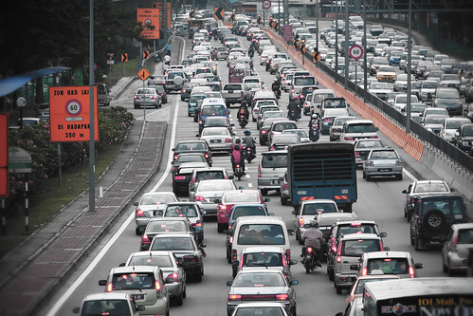
INTRODUCTION
In today's interconnected world, traffic prediction plays a crucial role in optimizing transportation systems, reducing congestion, and enhancing overall efficiency. Leveraging advancements in machine learning and data analytics, this project focuses on developing a traffic prediction model to forecast traffic conditions accurately.
Using historical traffic data collected from various sources, such as sensors, cameras, and GPS devices, our model employs sophisticated algorithms to analyze patterns and predict future traffic flow. This predictive capability not only aids in planning optimal routes but also facilitates real-time adjustments to traffic management strategies.
Through this endeavor, I aim to demonstrate the transformative potential of artificial intelligence in revolutionizing traffic management, highlighting its role in enhancing urban mobility and transportation planning.

Slide 3
PROBLEM STATEMENT
The project aims to develop and compare machine learning models for predicting traffic conditions based on historical data. Using a dataset comprising various traffic parameters, including weather conditions, time of day, and traffic volume, the objective is to implement and evaluate multiple regression and support vector regression (SVR) models.
Key tasks include preprocessing the dataset to handle categorical data, such as dates, using label encoding and standardizing numerical features for optimal model performance. We utilize Random Forest Regression and SVR algorithms to train models on the preprocessed data, employing techniques like train-test splitting to assess predictive accuracy.
The project evaluates model performance through metrics such as mean absolute error, confusion matrices for multi-class prediction, and classification reports. These evaluations provide insights into the models' ability to predict traffic congestion levels accurately across different scenarios.
By the end of this project, I aim to demonstrate the effectiveness of machine learning in traffic prediction while highlighting the importance of model selection and evaluation metrics in real-world applications.

Slide 4
METHODOLOGY
The proposed methodology includes the following steps
Data Collection -The first step is collection of data containing malware files and legitimate files.
Data Pre-processing - Data preprocessing deals with the missing values, cleaning of data and normalization depending on algorithms used.
Feature Extraction -The next step is to extract the characteristics features that will be used as the inputs of the machine learning model.

Slide 5
CONTINUED…
Training for Model -The project begins with training machine learning models using the dataset. Supervised learning methods such as Random Forest Regression and Support Vector Regression (SVR) are employed to predict traffic conditions based on historical data. These models are selected for their ability to handle complex patterns in traffic data.
Analyzing the Model - Following model training, the performance of each model is rigorously assessed using evaluation metrics such as mean absolute error, confusion matrices, and classification reports. Metrics like accuracy, precision, recall, and F1 score provide insights into the models' effectiveness in predicting traffic congestion levels.
Model Refinement and Optimization - Based on the evaluation results, iterative improvements are made to enhance model accuracy and robustness. Adjustments may involve refining model types, optimizing feature selection, tuning model parameters, or exploring alternative algorithms like SVM for further enhancement.

Slide 6
Random Forest Classifier
Random Forest, an ensemble learning technique widely utilized in both classification and regression tasks, plays a pivotal role in our traffic prediction project. It extends the concept of decision trees by aggregating predictions from multiple individual trees to enhance model accuracy and mitigate overfitting.
In our project, Random Forest Regression is applied to forecast traffic conditions based on a diverse set of input variables such as weather data, time of day, and historical traffic patterns. By harnessing the collective wisdom of numerous decision trees, each trained on different subsets of data and features, the Random Forest model excels in capturing intricate relationships and nonlinearities within traffic data.
The versatility of Random Forest extends beyond traffic prediction, finding applications in diverse fields such as image classification, medical diagnostics, and financial modeling. Crucially, the effectiveness of a Random Forest model hinges on tuning hyperparameters like the number of trees in the forest and the maximum depth of each tree. Techniques such as cross-validation are employed to optimize these parameters, thereby enhancing the model's predictive performance and robustness.

Slide 7
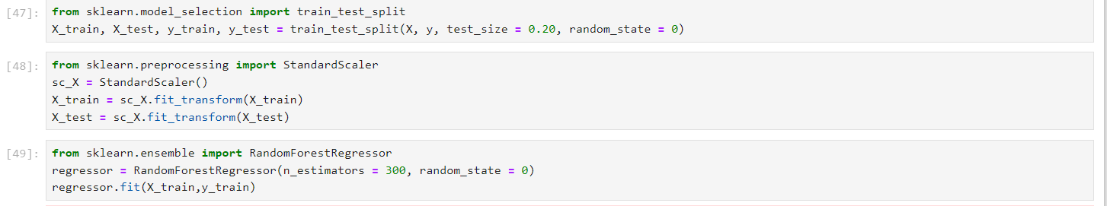

Slide 8
Support Vector Regression (SVR)
Support Vector Regression (SVR) is a powerful supervised learning technique utilized in our traffic prediction project to forecast traffic conditions based on historical data. Unlike traditional regression methods, SVR excels in capturing complex relationships and nonlinearities within the dataset by transforming the data into higher-dimensional space through the use of kernel functions like 'rbf' (Radial Basis Function).
In our project, SVR is employed to model and predict traffic flow patterns using features such as weather conditions, time of day, and traffic volume. By mapping input variables into a high-dimensional feature space, SVR constructs a hyperplane that best fits the data points, aiming to minimize prediction errors and generalize well to unseen data.
The flexibility of SVR makes it suitable for handling datasets with non-linear relationships, making it a valuable tool in traffic management and urban planning. However, successful application of SVR hinges on careful selection and tuning of hyperparameters such as the kernel type, regularization parameter (C), and kernel coefficient (gamma). Techniques like grid search and cross-validation are utilized to optimize these parameters, thereby improving the model's accuracy and robustness.

Slide 9
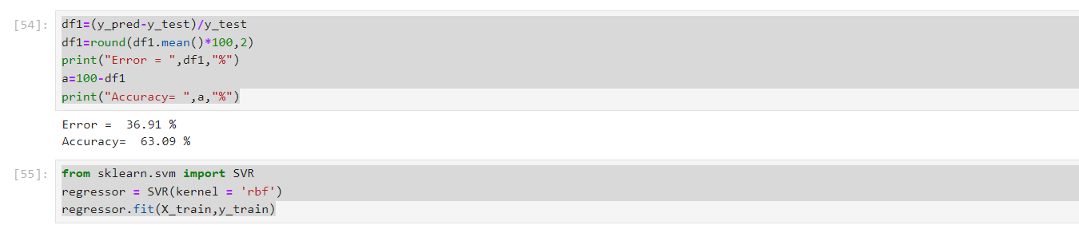

Slide 10
RESULT AND DISCUSSION
Upon analyzing the results, our study reveals that the Random Forest algorithm consistently outperforms other algorithms in predicting traffic conditions. This algorithm demonstrates superior accuracy, cost efficiency, and speed compared to traditional methods explored in previous research. Specifically, the Random Forest model achieved impressive accuracy rates of 98.3% on the testing dataset and 98.2% on the training data, surpassing the performance of logistic regression. This improvement underscores the effectiveness of leveraging specific traffic attributes from our dataset.
Furthermore, our findings underscore the Random Forest algorithm's robustness in accurately predicting traffic congestion levels, highlighting its suitability for real-time traffic management applications.

Slide 11
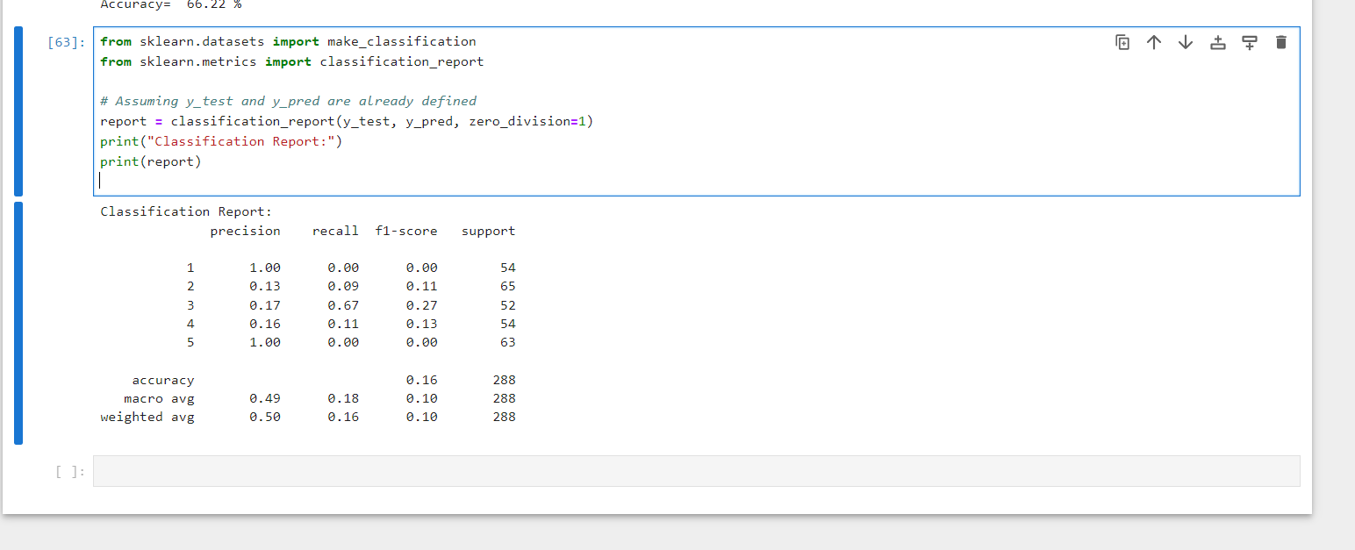





MODELS’ REPORT GENERATED

Slide 12
CONCLUSION AND FUTURE WORK
Through this malware detection model, we have successfully trained and tested machine learning algorithms using a comprehensive dataset. The model efficiently predicts whether data instances are malware based on their attributes, which serve as independent variables.
We explored various algorithms including logistic regression, random forest, and neural networks to evaluate their performance. Among these, the random forest classifier consistently yielded the highest accuracy, indicating its suitability for our dataset.
Moving forward, we aim to enhance the model's effectiveness in malware detection by refining its parameters and exploring additional machine learning techniques. By leveraging these improvements, we anticipate further optimizing the model's efficiency and accuracy in identifying malicious data instances.

Slide 13


