Slide 1

Swetcha Reddy Vangala
Pavan Jakkepalli
Todd
Sangeetha Muppidi
Chanikya Merugu

Slide 2
Why DynamoDB???
Dynamo is a highly available key-value storage system that Amazon use to provide always-on experience.
Reliability and scalability are the most important requirements.
There is a need for storage technologies that are always available.
For example, customers should be able to view and add items to their shopping cart even if disks fail, network routes flap, or data centres get destroyed.
Control over tradeoffs between availability, consistency, cost-effectiveness and performance.

Slide 3
Provides a primary-key interface.
Data is partitioned and replicated using consistent hashing, and consistency is facilitated by object versioning.
No manual partitioning or redistribution.
Scale to extreme peak loads.
For example, Shopping cart served tens of millions requests in a single day.

Slide 4
System Assumptions and Requirements
Query Model
ACID Properties
Efficiency

Slide 5
Service Level Agreements
Contract where a client and a service agree on several system-related characteristics like request rate distribution.
Example, SLA providing a response within 300ms for 99.9% of requests for client load of 500 requests per second.
Common approach- Describe SLA using average , median and expected variance.
At Amazon, SLAs are expressed and measured at the 99.9th percentile of the distribution.

Slide 6
Service-oriented architecture of Amazon’s platform:
Abstract view where page rendering components
generate dynamic web content.
To manage its state a service can use different
data stores which are only accessible within its
service boundaries.
Some services act as aggregators to produce
a composite response.

Slide 7
Data versioning:
Dynamo provides eventual consistency, which allows for updates to be propagated to all replicas asynchronously.
Put() call.
Get() call.
Applications in Amazon’s platform to tolerate inconsistencies:
Add to cart, delete item from cart.
Treats each result as a new and immutable version of data.
Collapse operation: To perform reconciliation.
Vector clock- list of (node,counter) pairs to capture causality.

Slide 8
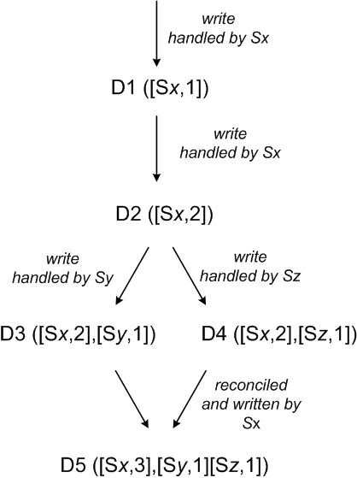
Version is specified by passing context it obtained from earlier read operation.
Upon processing request, dynamo has to access to multiple branches.
Illustration of vector clocks:

Slide 9
Execution of get() and put() operations:
Get and put- Invoked using Amazon’s infrastructure-specific request processing framework over HTTP.
Two strategies to select a node: 1) Route request 2) use a partition-aware client library.
Coordinator: Node handling a read or write operation.
To maintain consistency, Dynamo uses a consistency protocol.
Two key configurable values: R and W.
Receiving a put() request, coordinator generates the vector clock and writes the new version.

Slide 10
Handling Failures: Hinted Handoff:
To remedy reduced durability, Dynamo uses “sloppy quorum”- all read and write operations performed on first N healthy nodes.
Example:
If node A is temporarily down or unreachable during a
write operation??
Hinted handoff: ensures that read and write
Operations are not failed due to temporary node.
Dynamo is configured such that each object is replicated
Across multiple data centers
Key K
A
G
B
Nodes B, C
and D store
keys in
F
C
range (A,B)
including
K.
E
D

Slide 11
Handling permanent failures: Replica synchronization
To handle the scenarios under which hinted replicas become unavailable, Dynamo implements anti-entropy protocol.
Merkle tree- to detect the inconsistencies:
Hash tree where: leaves-hashes of values of individual keys.
Parent nodes- hashes of their respective children.
Advantage: Each branch can be checked independently.
Dynamo uses Merkle trees for anti-entropy as follows: each node maintains separate Merkle tree, allows node to compare whether the keys are up-to-date.
Two nodes exchange the root of the Merkle tree corresponding to the key ranges that they host in common.

Slide 12
Membership and failure detection:
Ring membership.
External discovery.
Failure detection.
Decentralized failure detection protocols use a simple gossip style protocol that enable each node to learn about the arrival of others.
Early designs of Dynamo used a decentralized failure detection.

Slide 13
Adding/Removing Storage Nodes:
When new node added to the system, it gets assigned a number of tokens that are randomly scattered on the ring.
For every key range, there may be a number of nodes that are handling keys.
Consider simple bootstrapping scenario:
When X is added.. It is in charge of storing keys in the ranges (F,G],(G,A] and (A,X].
Operational experience- load distribution of key is uniform, which is important to meet latency requirements.

Slide 14
IMPLEMENTATION:
Storage node has three components:
Local persistence engine
Request co-ordination
Membership and failure detection

Slide 15
EXPERIENCES AND LESSONS LEARNED:
Business logic specific reconciliation
Timestamp based reconciliation
High performance read engine

Slide 16
N, R and W values can be tuned to achieve desired performance, availability and durability.
Typical value of N is 3.
W and R impact availability, durability and consistency.
For example, If W=1, never rejects a write request.
Low values of W and R increase the risk of inconsistency.
Common (N, R, W) configuration mostly used is (3, 2, 2).
Network latencies between datacenters affect the response time.

Slide 17
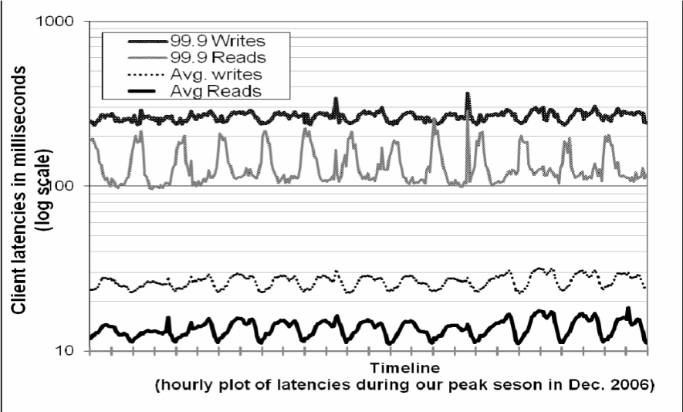
Balancing performance and Durability:
Dynamo’s principle design goal is to build a highly available data store.
Amazon’s services set their performance targets at high percentiles.
Since Dynamo have far less I/O throughput hardware components, providing high performance is a non-trivial task.

Slide 18
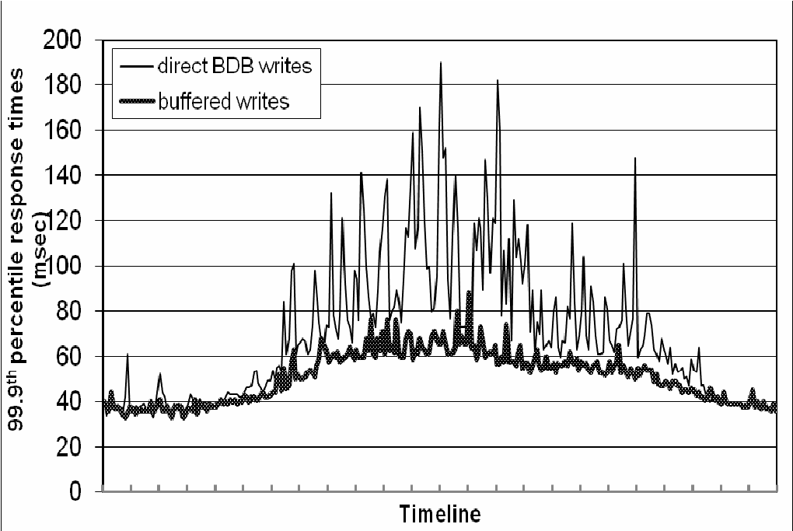
Provides ability to trade-off durability guarantees for performance.
Each storage node maintains an object buffer.
Each write operation is stored in it and gets periodically written into storage by writer thread.
Read operations checks for the presence of requested key in the buffer. If so, read from buffer instead of storage engine.
Resulted in lowering the 99.9th percentile latency by factor 5.

Slide 19
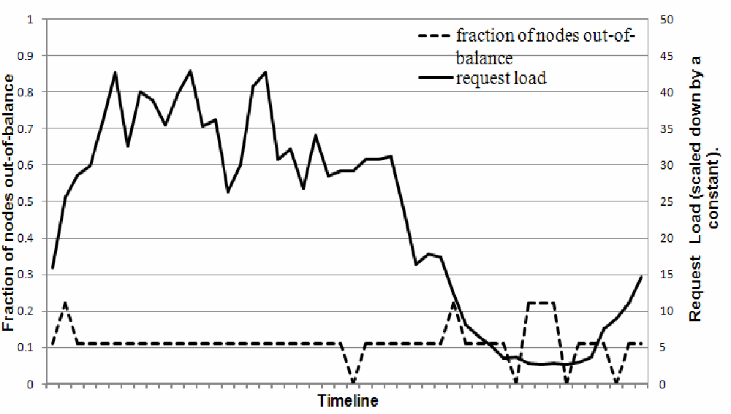
Ensuring uniform load distribution:
Uses consistent hashing to partition key space.
A uniform key distribution help achieve uniform load distribution.
To study load imbalance and its correlation with request load:
Total number of requests- period of 24 hours-broken into interval of 30 minutes.
In a time window: node “in-balance”, node “out-of-balance”.

Slide 20
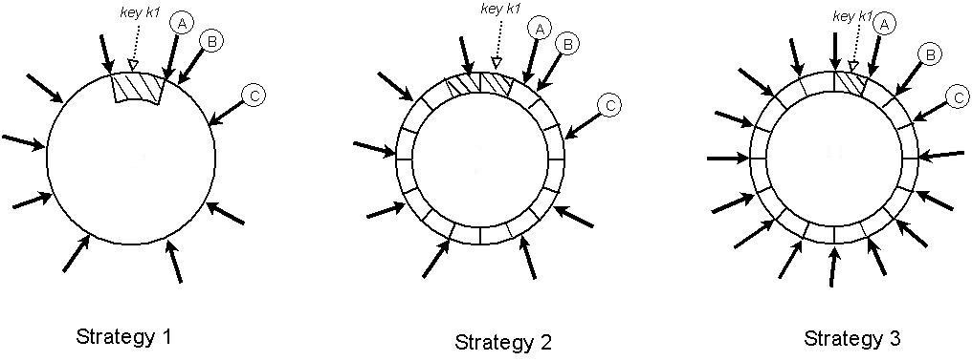
Partitioning and placement of keys:
Strategy1: T random tokens per node and partition by token value.
Strategy2: T random tokens per node and equal sized partitions.
Strategy3:Q/S tokens per node, equal-sized partitions.

Slide 21
Efficiency of three strategies evaluated for a system with S=30 and N=3.
Load distribution property of strategy 1 – number of tokens, strategy 3-number of partitions.
Load balancing efficiency – ratio of average number of requests served by each node to the maximum number of requests served by the hottest node.

Slide 22
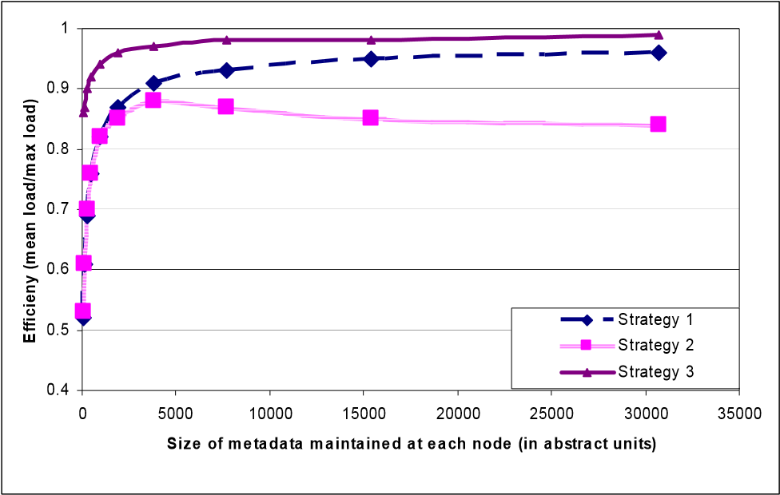
Strategy 3 is advantageous for these reasons:
(i) Faster bootstrapping/recover.
(ii) Ease of archival.

Slide 23


Slide 24


