Slide 1

MOVIE TWEETS ANALYSIS
BY:
Swetcha Reddy Vangala
Pavan Jakkepalli
Chanikya Merugu
Sangeetha Muppidi

Slide 2
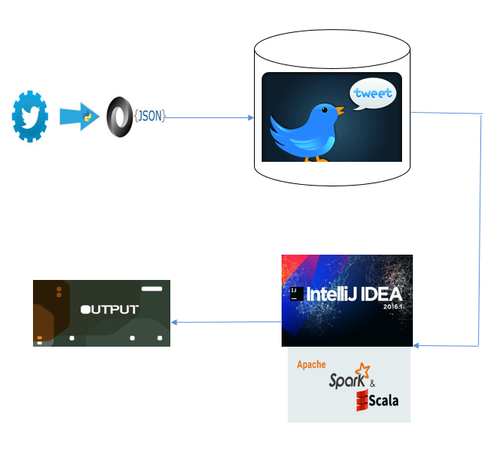
Tools Used AND FLOW:

Slide 3
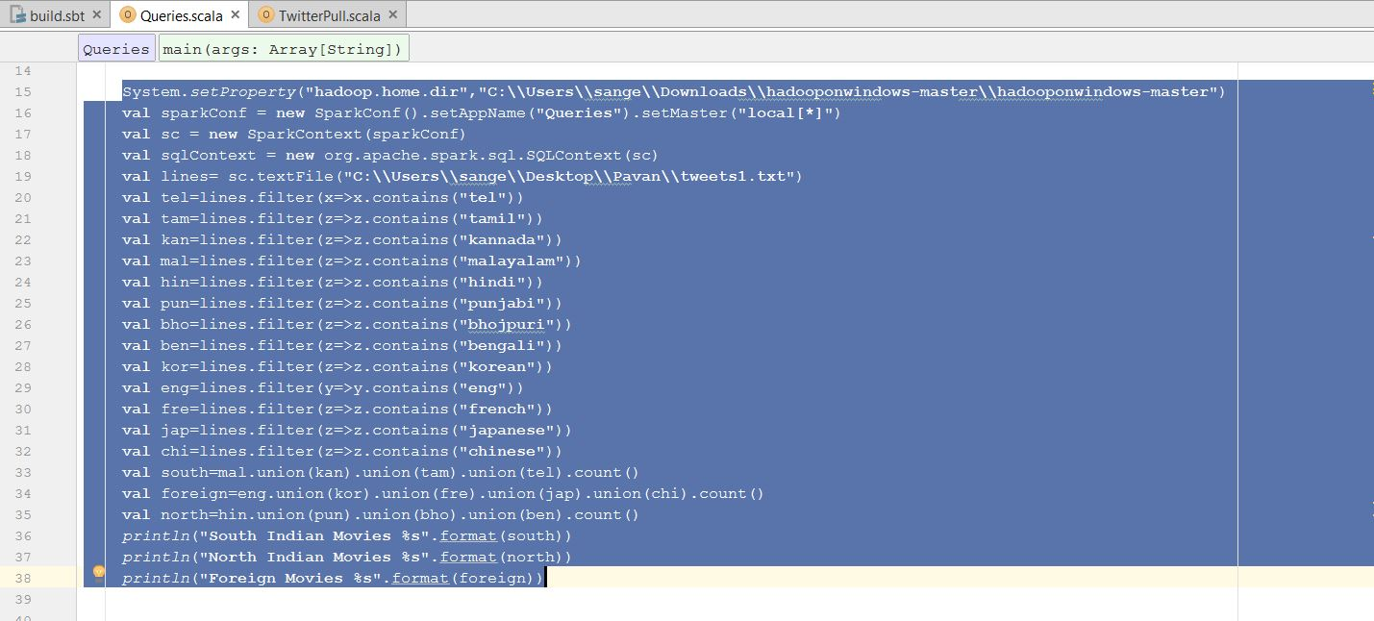
QUERIES:
Query1: Count of the tweets on Foreign movies, South Indian Movies and North Indian Movies

Slide 4
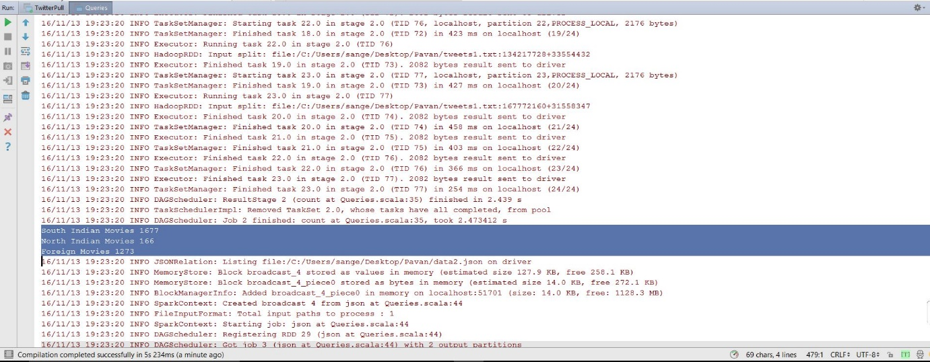
Output:

Slide 5
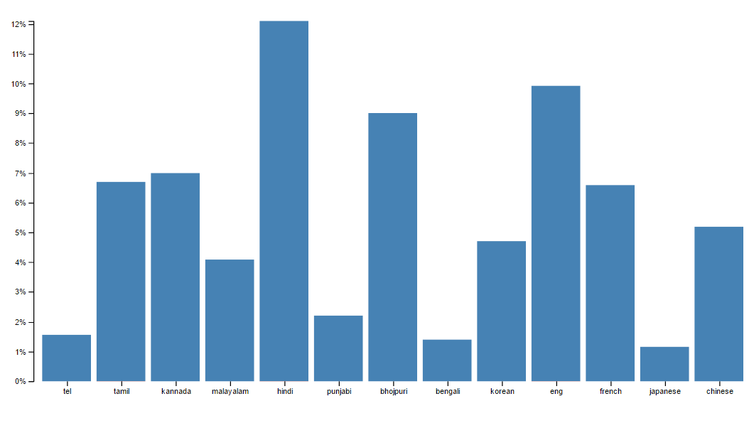
Visualization: Bar Chart

Slide 6
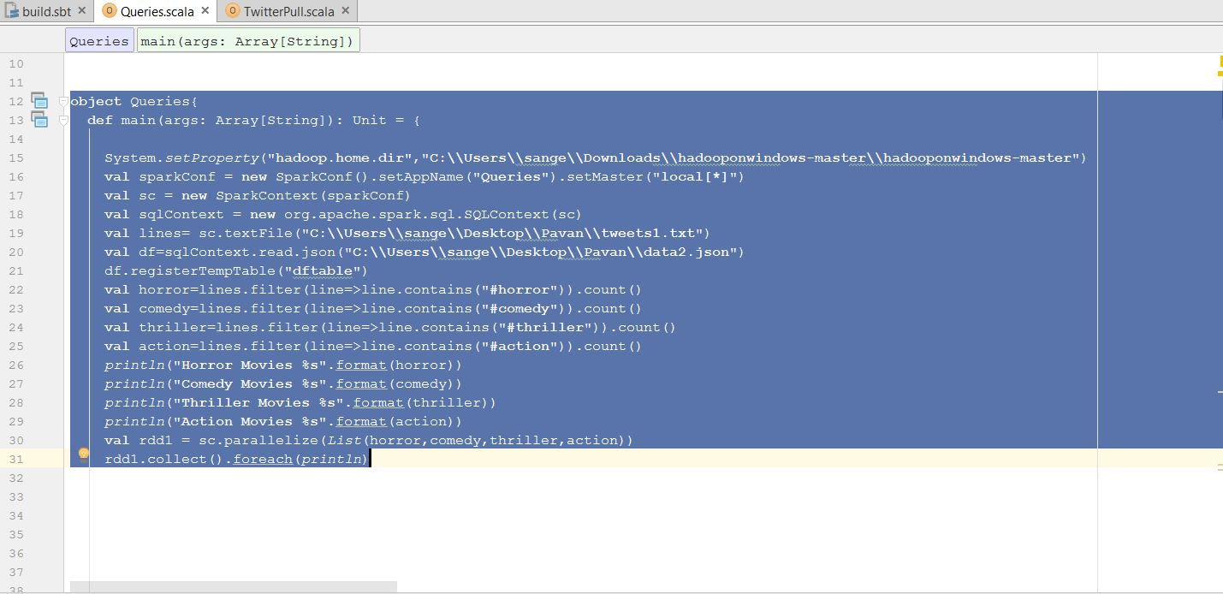
Query2: Number of users searching different types of movies like animated , thriller, comedy and horror.

Slide 7
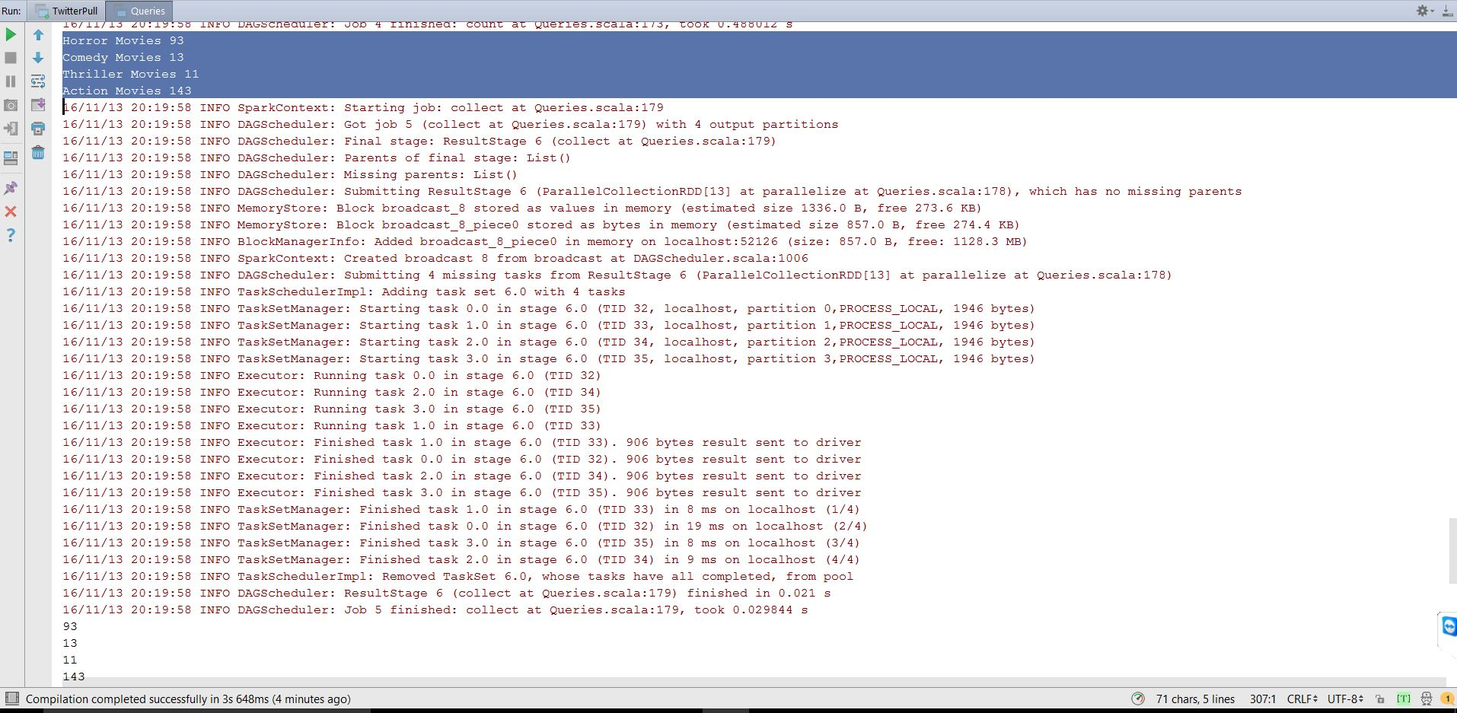
Output:

Slide 8
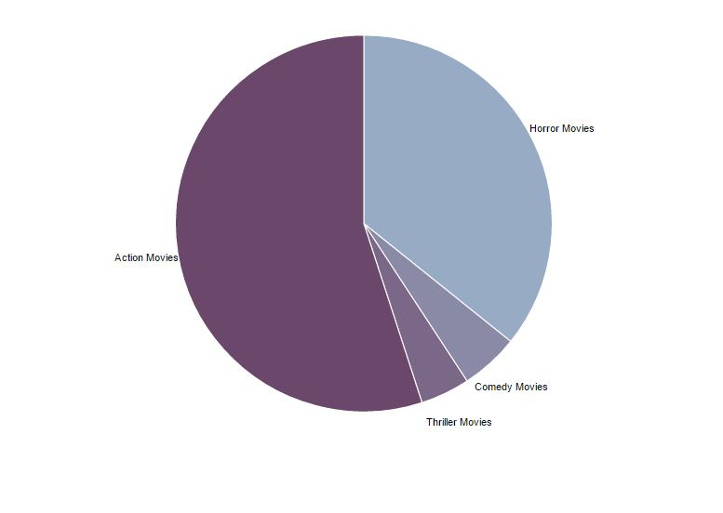
Visualization: Pie Chart

Slide 9
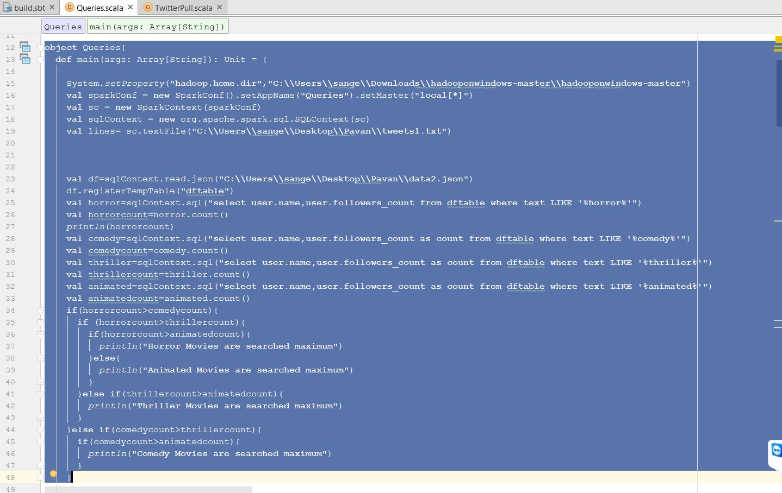
Query3: Type of movie (horror, comedy, animated, thriller) having the highest number of tweets.

Slide 10
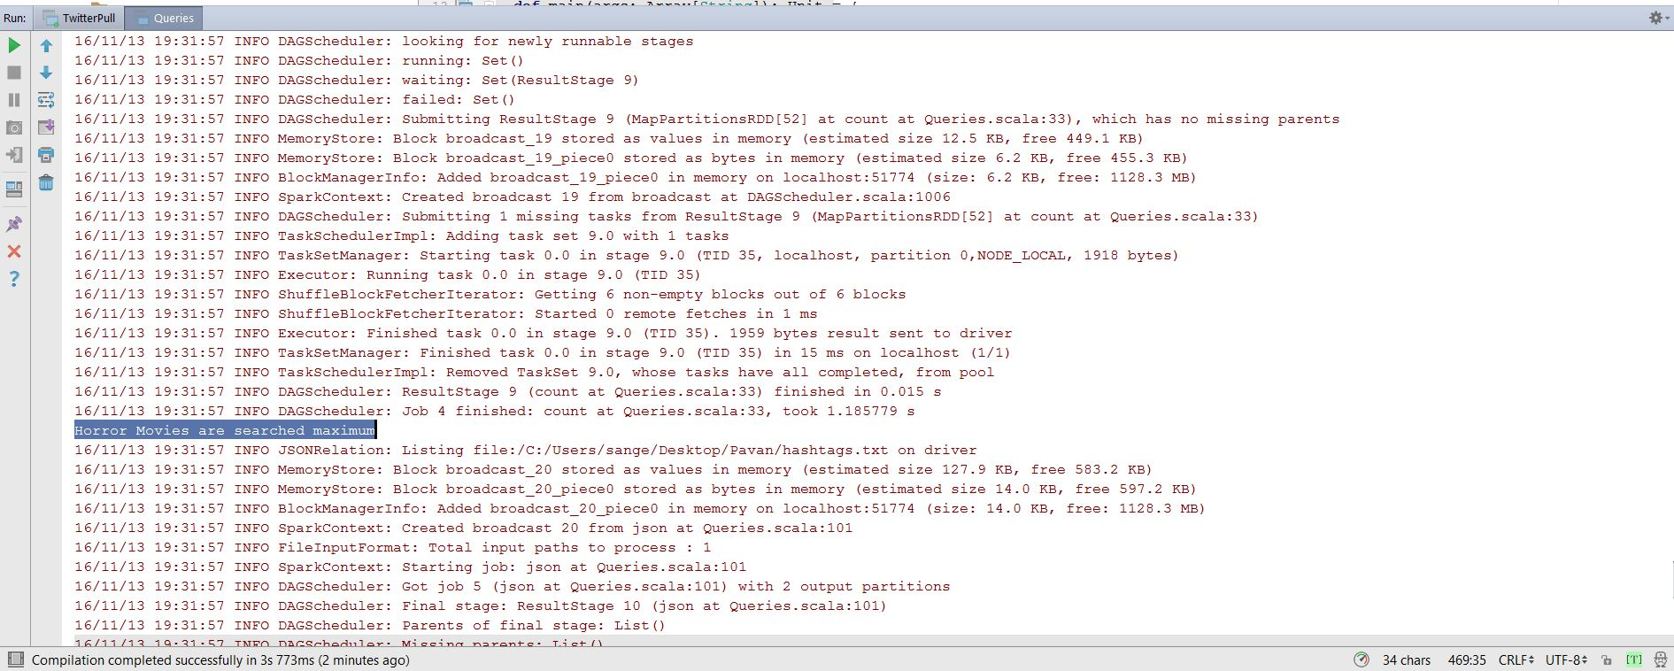
Output:

Slide 11
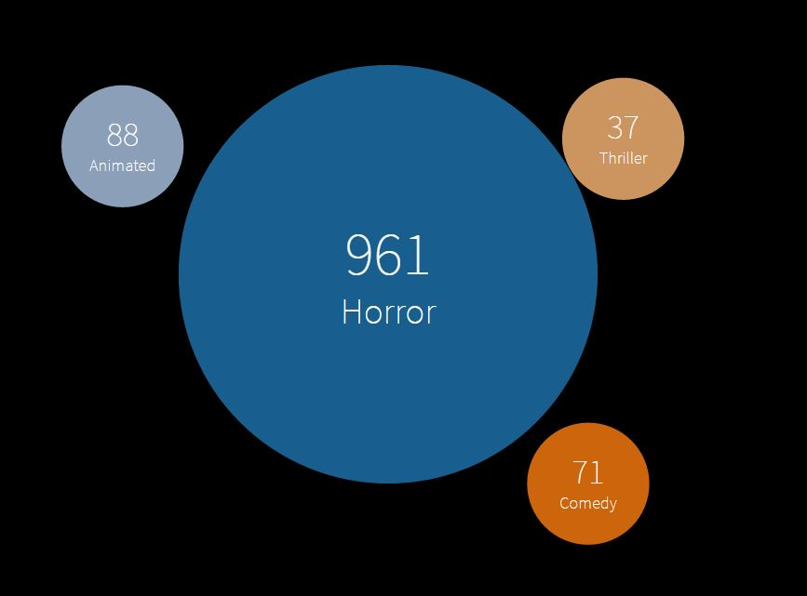
Visualization: Bubble Chart

Slide 12
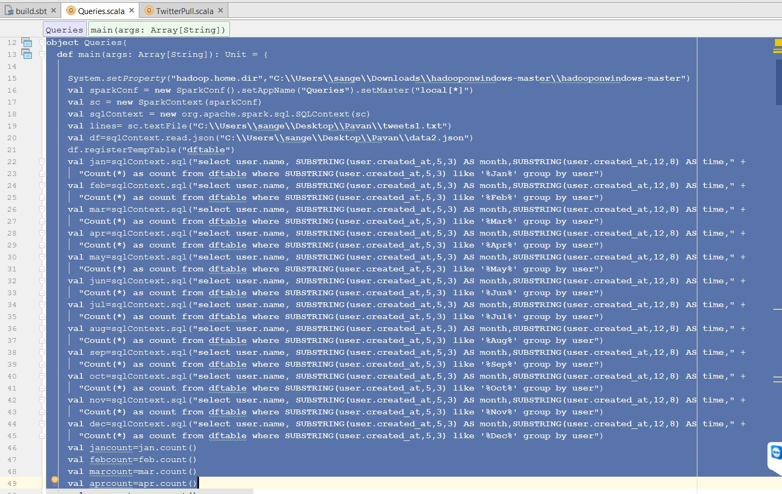
Data Frame Query 4: Number of users who created their twitter accounts in different months.

Slide 13
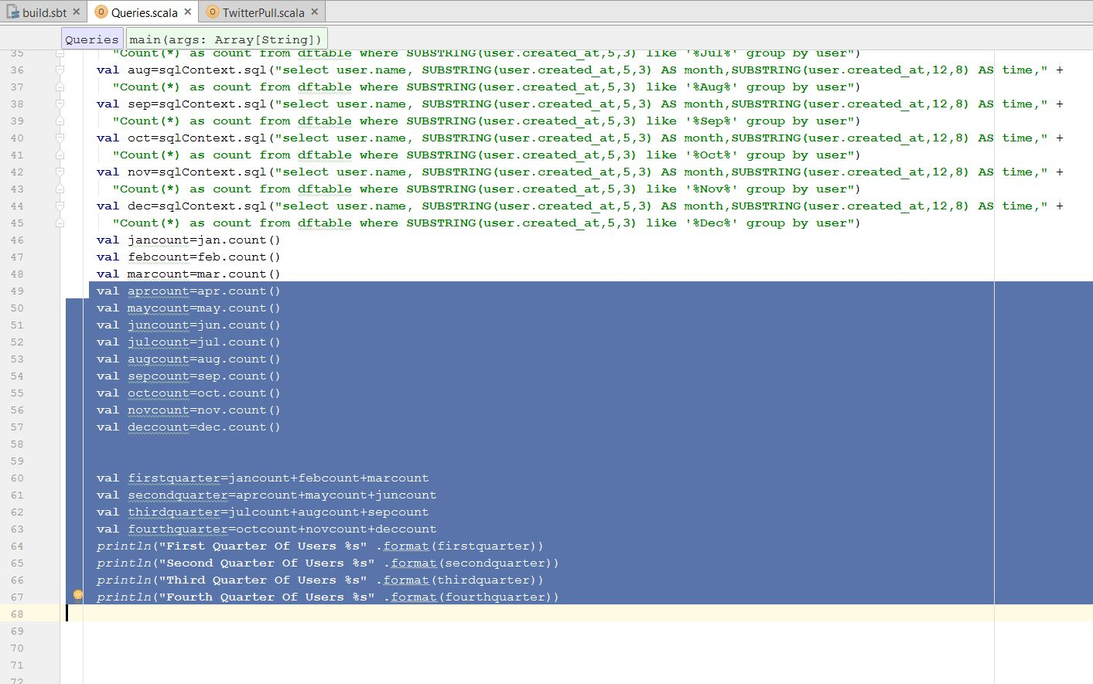

Slide 14
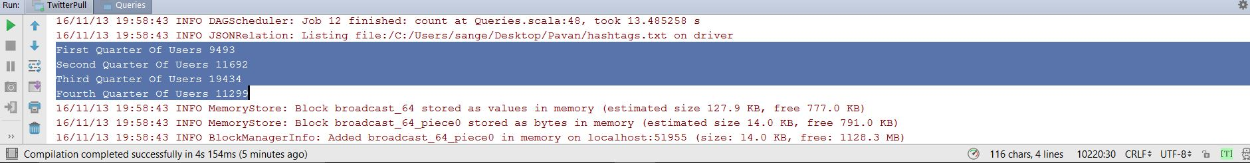
Output:

Slide 15
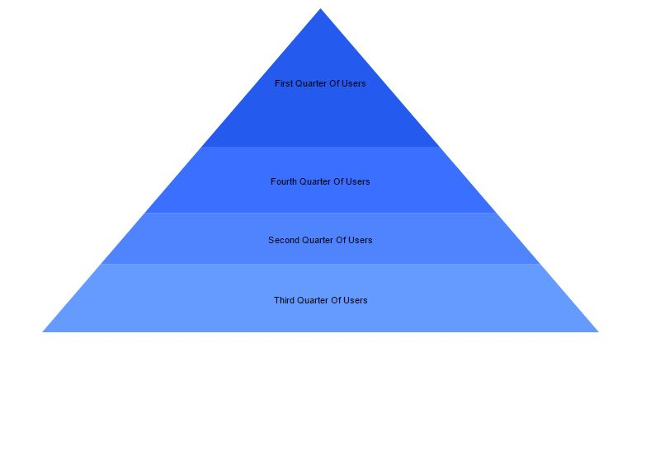
Visualization: Pyramid

Slide 16
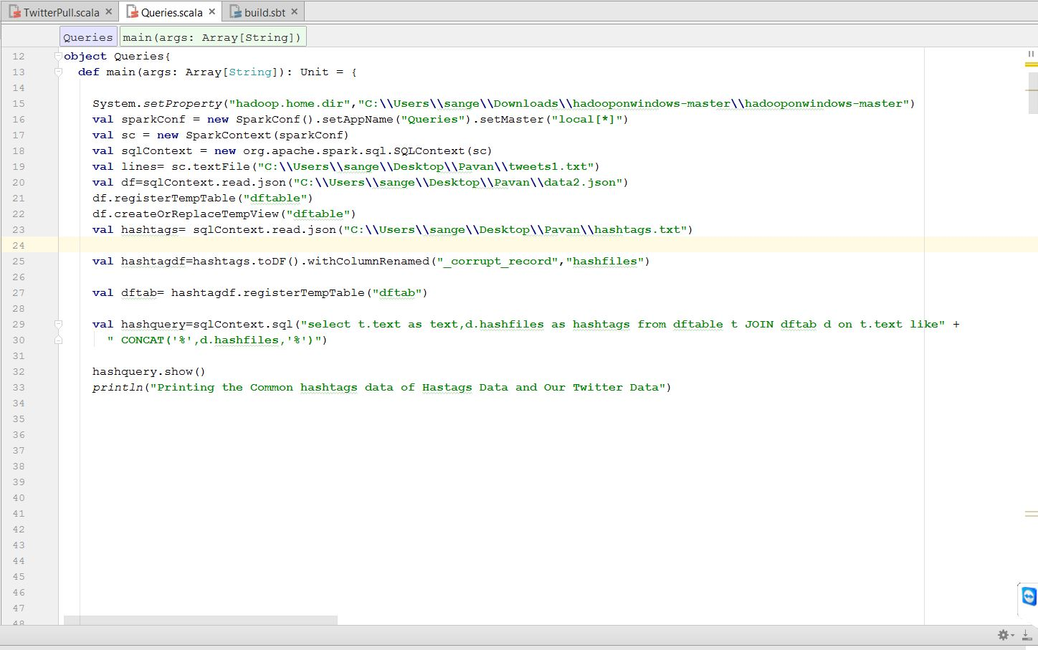
Hashtags Query 5:
Considers the both hashtag file and text file, prints the hashtags that are in common.

Slide 17
Output:

Slide 18
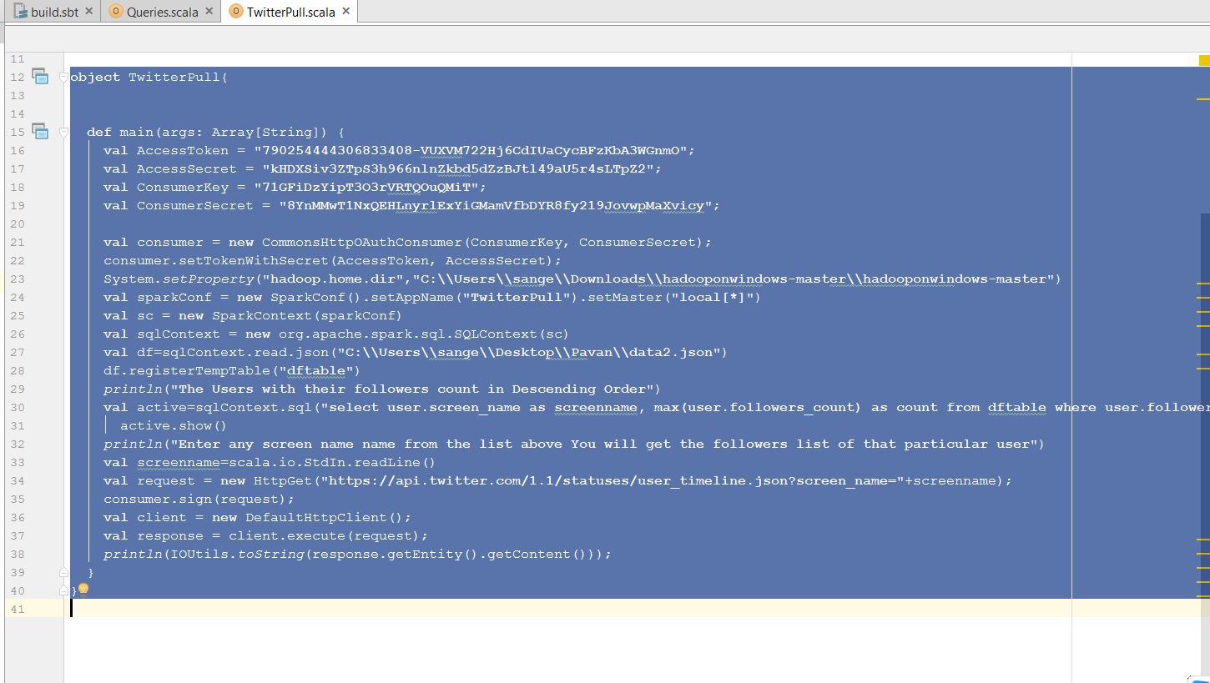
Twitter API Query 6: Count of tweets done in different countries.

Slide 19
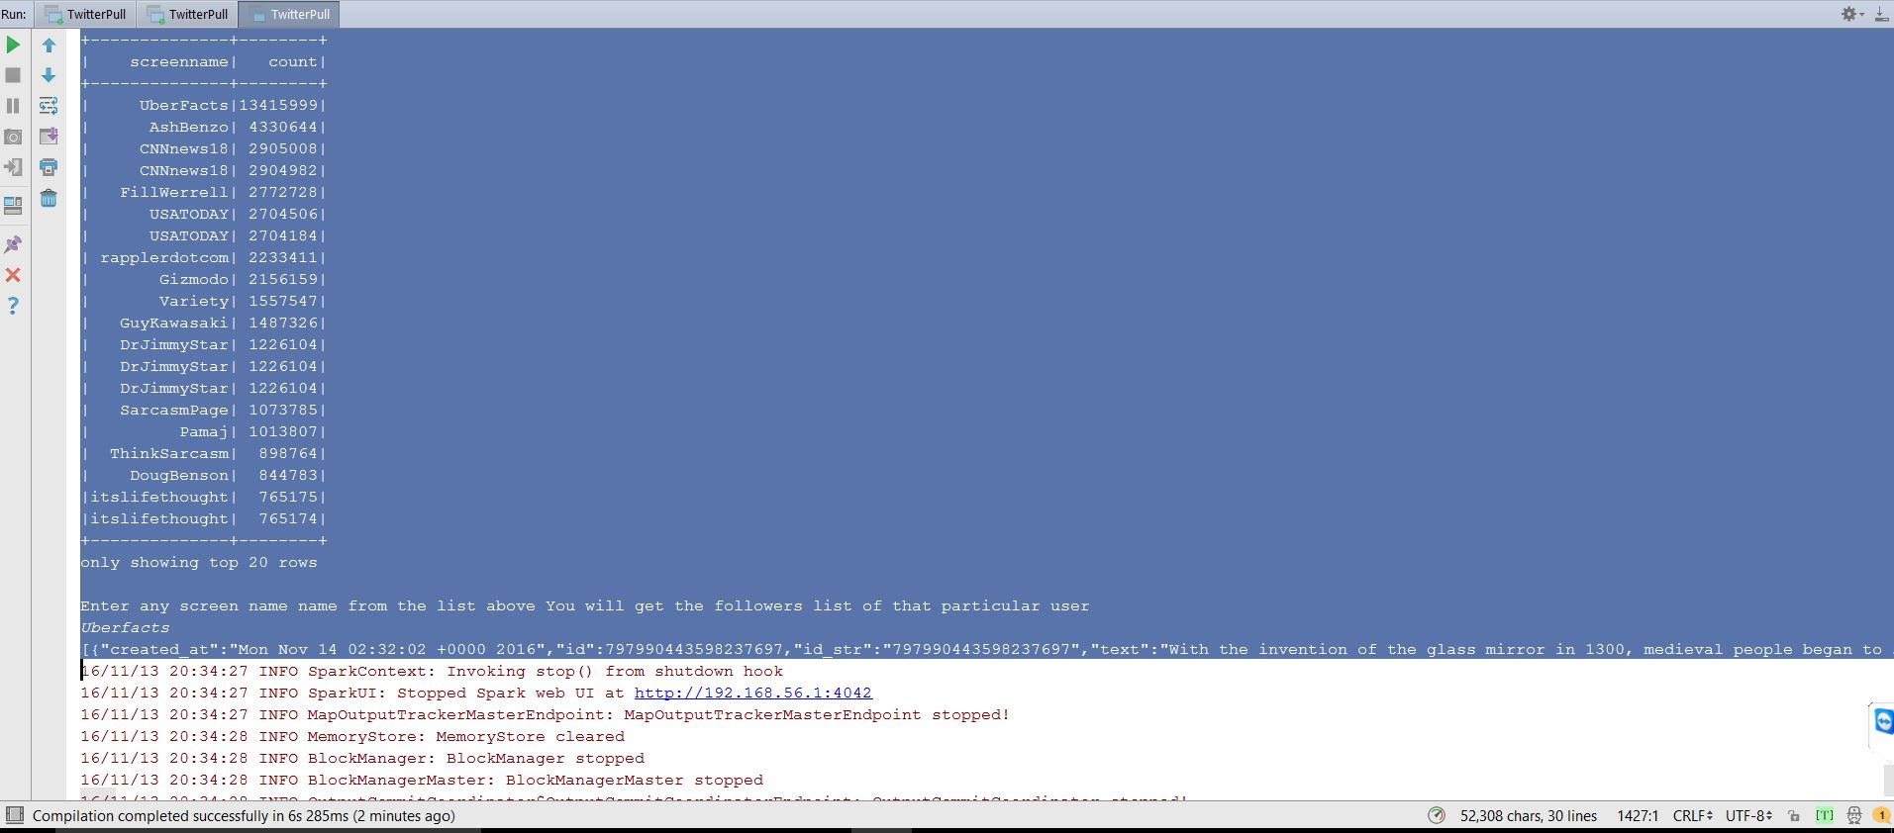
Output:

Slide 20
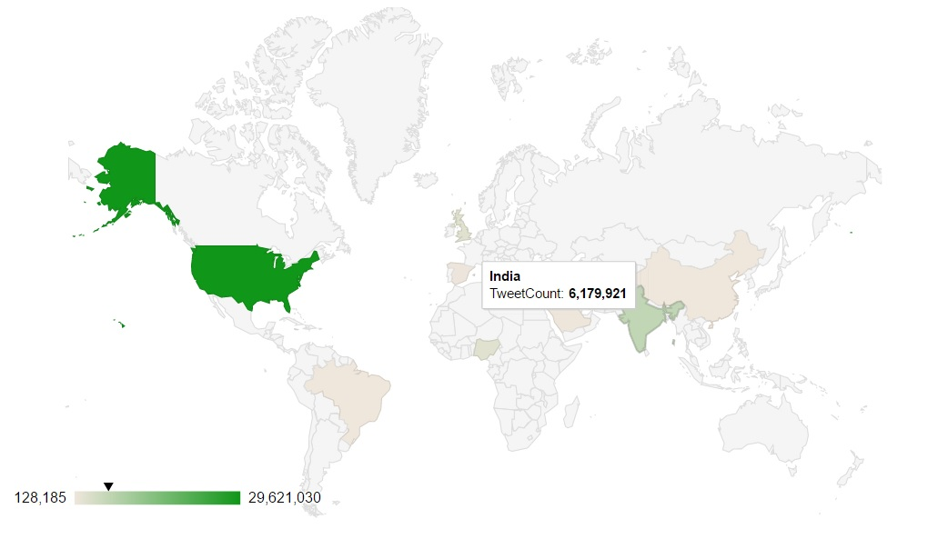
Visualization: World Map

Slide 21
REFERENCES:
https://www.supergloo.com/fieldnotes/apache-spark-examples-of-transformations/
http://public-repo-1.hortonworks.com/hdp-win-alpha/winutils.exe
https://trongkhoanguyenblog.wordpress.com/2014/11/27/understand-rdd-operations-transformations-and-actions/
http://stackoverflow.com/questions/34047332/unresolved-dependency-issue-when-compiling-spark-project-with-sbt
https://mvnrepository.com/artifact/org.apache.spark/spark-core_2.10
https://github.com/apache/spark/blob/master/sql/core/src/main/scala/org/apache/spark/sql/SQLContext.scala
https://www.infoq.com/articles/apache-spark-sql
https://github.com/apache/spark/blob/master/sql/core/src/main/scala/org/apache/spark/sql/functions.scala
https://github.com/apache/spark/tree/master/sql/core/src/test/scala/org/apache/spark/sql
http://spark.apache.org/docs/latest/sql-programming-guide.html
http://www.agildata.com/apache-spark-rdd-vs-dataframe-vs-dataset/
https://mvnrepository.com/artifact/org.apache.spark
https://dzone.com/articles/access-twitter-rest-api-v11

Slide 22

THANKYOU….
ANY QUERIES??

