Slide 1
Problem set 6
Team 12
Avinash banala-5
Sai smaran chinthala-11
Rahul nagavalli-28
Swetcha reddy vangala-41

Slide 2
OBSERVER DESIGN PATTERN- STORY
As a developer, I want to implement distributed event handling systems, I want to notify the observers of objects automatically of any changes, as a result I do this by calling methods.

Slide 3
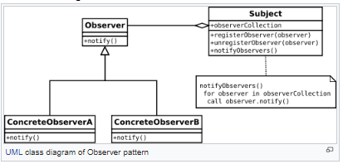
UML DESIGN

Slide 4
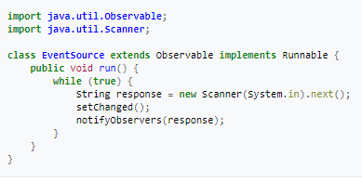
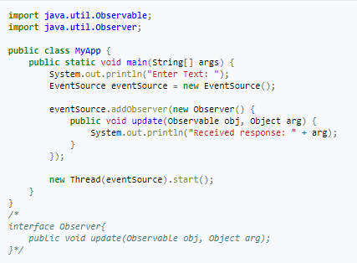
CODE

Slide 5
quiz
Define one to many dependency between objects so that when one object change state, all its dependent are notified and updated automatically.
A. Chain of responsibility
B. Event Notification
C. Mediator
D. Observer
D) Observer
Which design pattern defines one-to-many dependency among objects? A. Singleton pattern B. Facade Pattern C. Observer pattern D. Factory method pattern
C)Observer pattern

Slide 6
QUIZ
Observer pattern defines:
A. one-to-many dependency between objects
B. many-to-many dependency
C. many-to-one dependency
A. one-to-many dependency between objects

Slide 7
REFERENCES
https://www.proprofs.com/quiz-school/story.php?title=NTc3NTAy
https://en.wikipedia.org/wiki/Observer_pattern
https://www.sporcle.com/games/.../gang-of-four-design-patterns-by-description
www.sanfoundry.com

Slide 8
PROXY DESIGN PATTERN
Proxy pattern is used when we want to provide controlled access of any functionality.
This pattern comes under the Structural Design Pattern.
It can add a wrapper for the pattern against the complexity.

Slide 9
User Story
As a developer, I created an interface for the ATM machine which accepts and receives the cash from the users. For the security purpose, I have designed a proxy object called ATMproxy which allows to limit the access in the ATM machine with the fields assigned in it.
It is protected by implementing the same interface between the proxy object and the protected object.

Slide 10
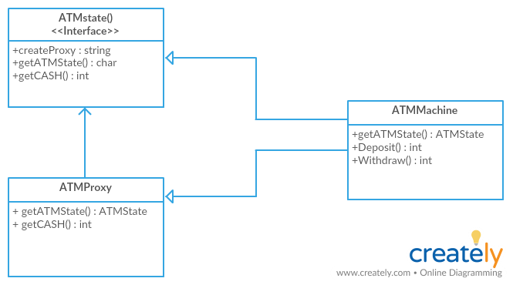
UML Design

Slide 11
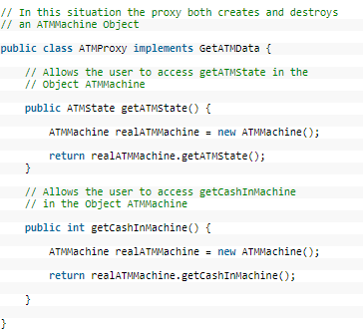
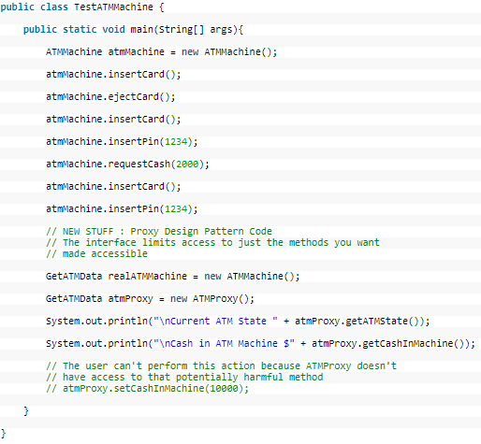
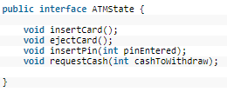
Code
Ref: http://www.newthinktank.com/2012/10/proxy-design-pattern-tutorial/

Slide 12
Quiz
1) A pattern known as Surrogate is :
Adaptor
Proxy
Façade
Method Factory
Ans: b) (Proxy)
2) A Proxy Pattern is best used to :
control access to a remote object
assemble complex objects
fetch a resource-intensive object when requested by a client
store common redundant data between large number of objects
extract out from the calling client the access or connection logic needed to call an object
Ans: a, c, e

Slide 13
Quiz
3) A Proxy design pattern comes under structural design pattern. State whether
true or false
TRUE
FALSE
Ans: a) (TRUE)

Slide 14
State Design Pattern
State design pattern comes under Behavioral Design Pattern
State design pattern is used when object changes it behavior depending on the internal state
State design pattern describes how to solve recurring design problems to design flexible object oriented software

Slide 15
Story
Here the story is about people financial status. People can be either rich or poor. So, here we have two states: Rich and Poor. People travel in cars when they are rich and people travel in buses when they are poor. The behavior of the people depends on the state in which they are living. The states can be converted to each other from time to time.

Slide 16
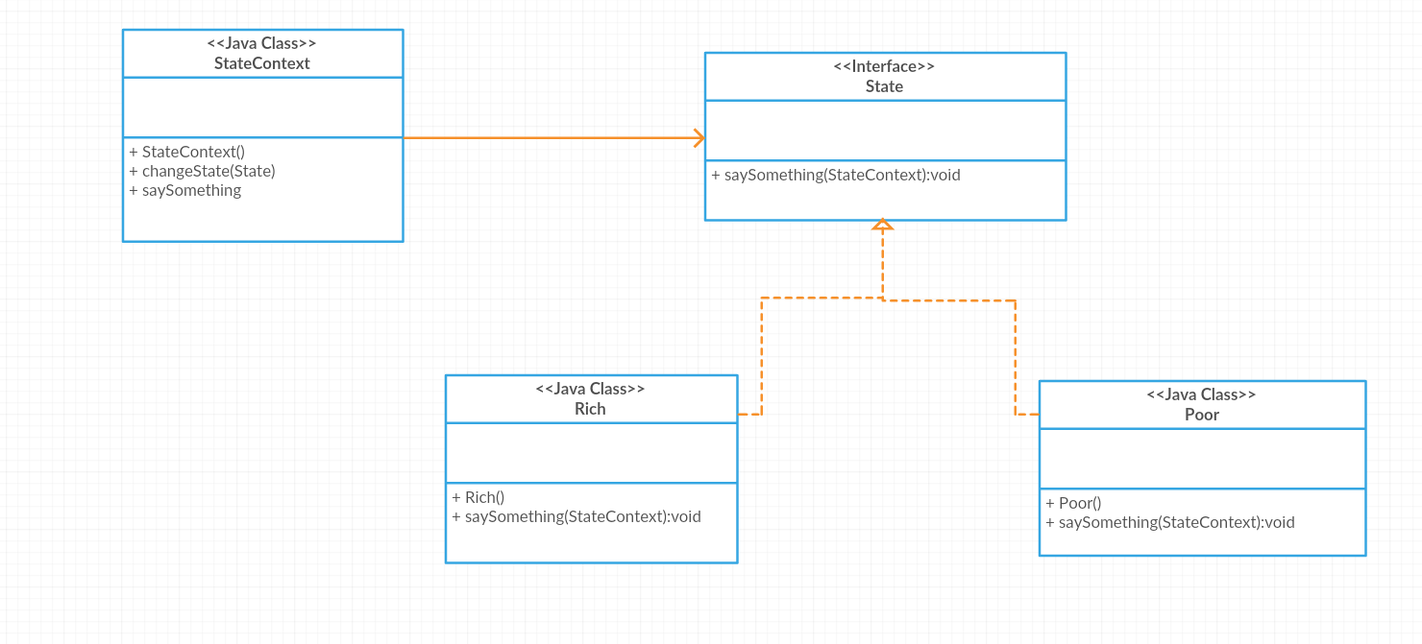
UML Diagram

Slide 17
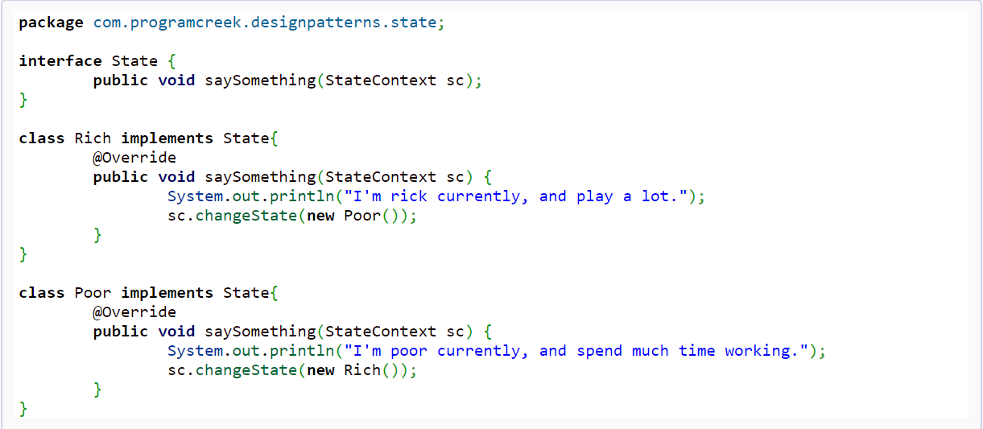
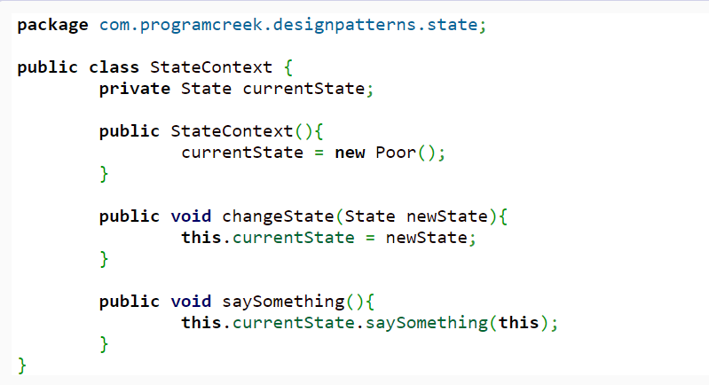
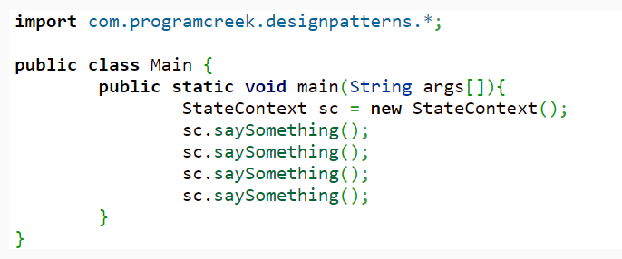
Reference: https://www.programcreek.com/2011/07/java-design-pattern-state

Slide 18
Quiz
State design pattern is used when an Object changes its behavior based on its internal state. State whether the above statement is true or false
A) True
B) False
Answer: A) TRUE
“State-specific behavior should be defined independently”. What does the above statement mean ?
Answer: New states should be added and behavior of the existing states should be changed independently

Slide 19
Quiz
State Design Pattern Comes under:
a) Creational Design Pattern
b) Structural Design Pattern
c) Behavioral Design Pattern
Answer: c) Behavioral Design Pattern

Slide 20
Flyweight design pattern
The flyweight design pattern is used to dramatically increase the speed of your code when you are using many similar objects.
This pattern comes under structural design patterns.
To reduce memory usage, the flyweight design pattern shares objects that are the same rather than creating new ones.

Slide 21
User story
Here, the Shape interface and the concrete class Circle have been created. The key is the color of the Circle object.
If a request arrives to get a circle of particular color, then it checks circle object in its Hashmap, and when the object is found, it is returned, if not a new object will be created and stored for any of the future use.

Slide 22
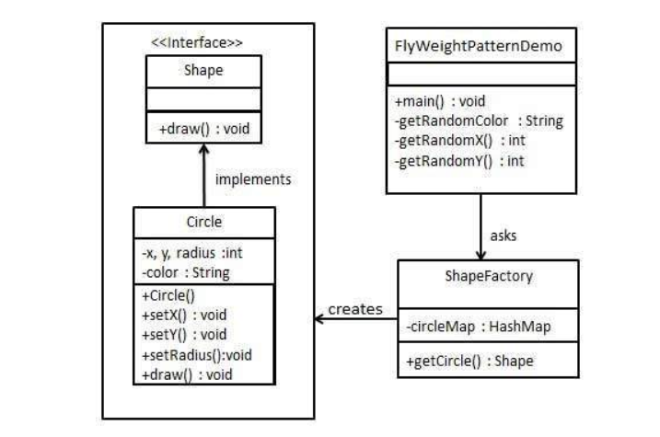
UML Design

Slide 23
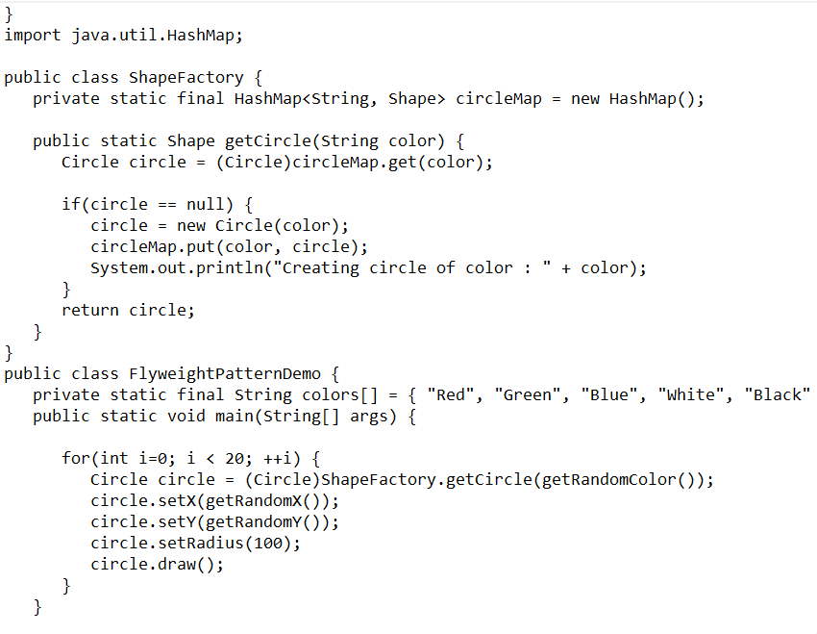
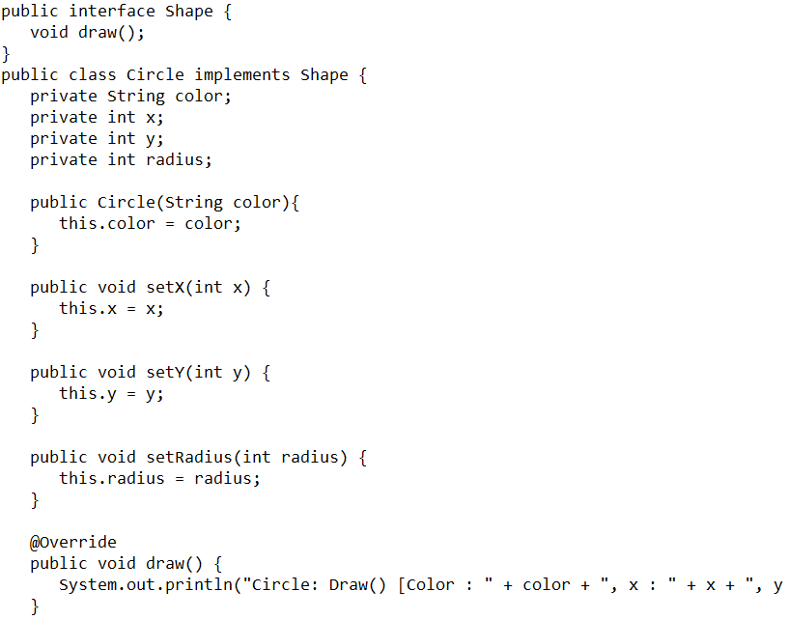
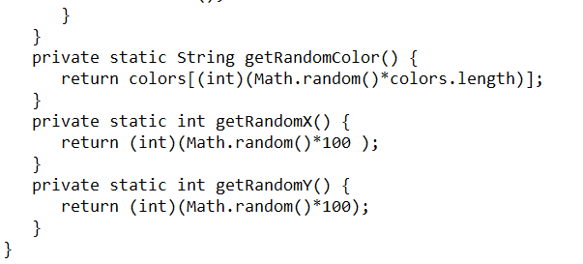
Code
Source: https://www.tutorialspoint.com/design_pattern/flyweight_pattern.htm

Slide 24
QUIZ
1. Which type of design pattern you use when you want to reduce the number of objects?
a) Proxy
b) Strategy
c) State
d) Flyweight
Ans: d)
2. The flyweight design pattern comes under the structural design pattern.
A) true b) False
Ans : A)

Slide 25
3. The flyweight design pattern reduces the object structure of the application.
A) True
B) False
Ans: B)

