Slide 1
Yoospots in Image Advertising with Interactive Hotspots
Prepared by
Shalin
Khushbu
Shwechcha

Slide 2










Architecture
User
Server
(Node.js)
Database
Admin
(AngularJs)

Slide 3


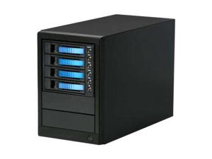


Dataflow
Request to recognize
Ambassador(s) and Logo(s)
Models
Concepts
Create Modals
Create Inputs
Identify Concepts
Inputs
User
Cloud
Server
Admin
Add Model
Add Inputs
Get Ambassadors, Logos and Ads

Slide 4
Advantages
Easy to use over any application
Admin can configure suggestion and Advertise according parameters like Time, Frequency, Domain
Quick response
All kinds of Ads supported (Video, Audio, Image, Text, Weblink)
Precision can raise to more than 95% with proper model training
Analyze data for current and future Ads priority
Easily scalable
For newly register companies
For newly assigned Ambassadors

Slide 5
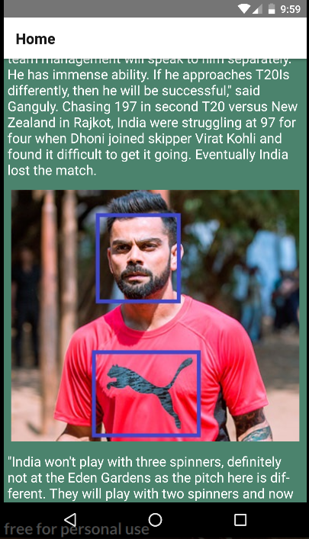
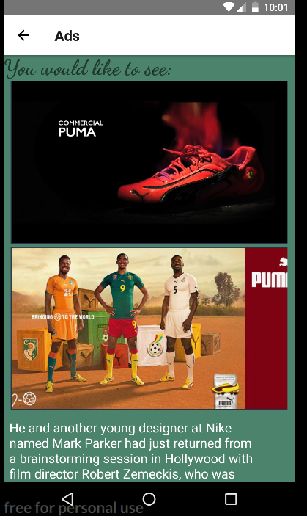
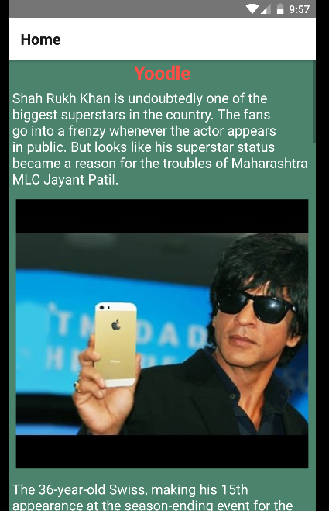

Slide 6
