Slide 1
ANALYSIS AND PREDICTION OF HEART DISEASE
By Swetha Mandala

Slide 2
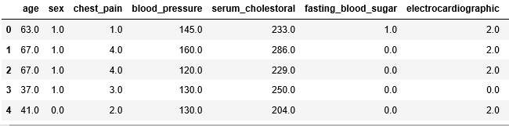
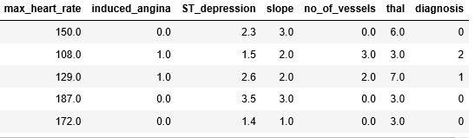
INPUT DATA

Slide 3
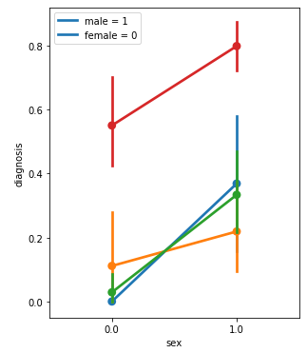
ANALYSIS
Men have more chances of getting heart disease than women.
The higher number of vessels detected through fluoroscopy, the higher risk of disease.
 | diagnosis
no_of_vessels
0.0 | 0.261364
1.0 | 0.676923
2.0 | 0.815789
3.0 | 0.850000

Slide 4
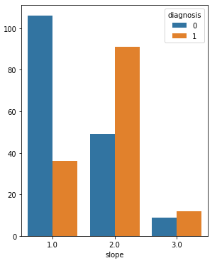
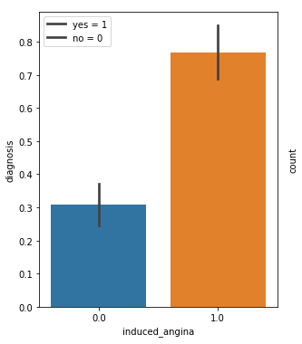
The flat slope (value=2) and downslope (value=3) of the peak exercise indicates a high risk of getting disease
Risk of getting heart disease might be even 3 times higher for someone who experienced exercise-induced angina.

Slide 5
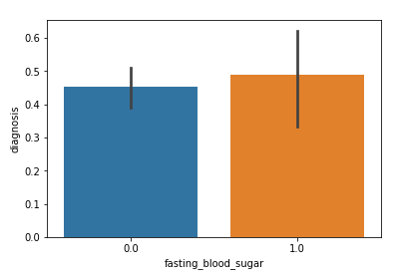
As bigger is mean blood pressure as higher is risk of heart disease.
Higher the blood sugar level or cholesterol, higher risk of heart disease.
 | blood_pressure
diagnosis
0 | 129.250000
1 | 134.568345

Slide 6
PREDICTION
I predicted if patients have heart disease or not and compared them with actual values using six different algorithms:
K Nearest Neighbours
Train accuracy: 88.21%, Test accuracy: 86.81% at k=5
Logistic Regression
Train accuracy: 85.85%, Test accuracy: 85.71%
Decision Trees
Train accuracy: 97.17%, Test accuracy: 79.12% at depth=6
Notes:
303
212
91

Slide 7
Gaussian Naïve Bayes
Train accuracy: 85.38%, Test accuracy: 86.81%
Support Vector Machines
Train accuracy: 84.91%, Test accuracy: 87.91%
Random Forests
Train accuracy: 100.00% Test accuracy: 89.01%

Slide 8
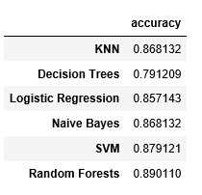
ACCURACY RESULTS

