Slide 1
CS 561 FINANCIAL INFORMATICS PROJECT TITLE: BACKTEST AND IMPLEMENT TRADING STRATEGIES ON UNIVERSE OF STOCK DATA
-By Swetha Mandala

Slide 2
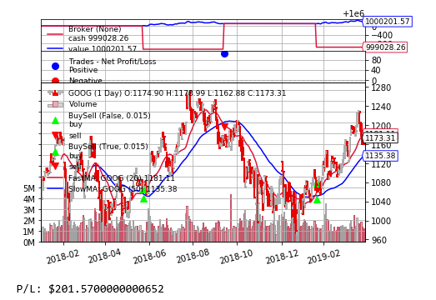
Simple Moving Average Crossover strategy
Number of stocks: 10 stocks each time
Finance: Loss (P/L: $-2168.500000000233)
Health care: Loss (P/L: $-786.0999999992782)
Information technology: Profit (P/L: $10343.300000000163)
Energy: Loss (P/L: $-1234.800000000163)
Real estate: Profit (P/L: $937.8000000003958)
So we can observe that this strategy made good profits in Information technology and real estate sector.

Slide 3
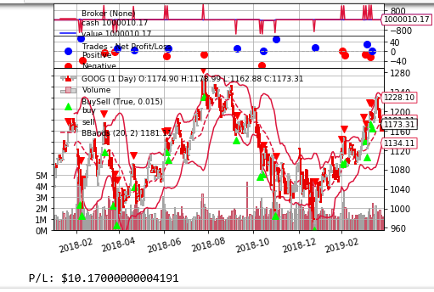
Bollinger Band Strategy
Number of stocks: 10 each time
Finance: Loss (P/L: $-404.09999999497086)
Health: Loss (P/L: $-8182.299999999697)
Information Technology: Profit (P/L: $4112.199999993201)
Energy: Profit (P/L: $219.0999999990454)
Real Estate: Loss (P/L: $-3505.7999999960884)
So we can observe that this strategy made good profits in Information Technology and energy sector.

Slide 4
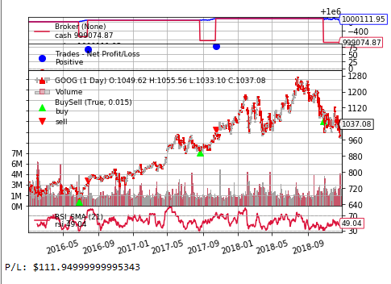
Relative Strength Index Trading Strategy
Number of stocks: 10 each time
Finance: Loss (P/L: $-391.49999999965075)
Health care: Profit (P/L: $11596.90000000014)
Information Technology: Profit (P/L: $4939.099999999395)
Energy: Profit (P/L: $-721.6999999997206)
Real Estate: Profit (P/L: $1539.3999999995576)
So we can observe that this strategy made good profits in health care, Information technology and real estate sectors.

Slide 5
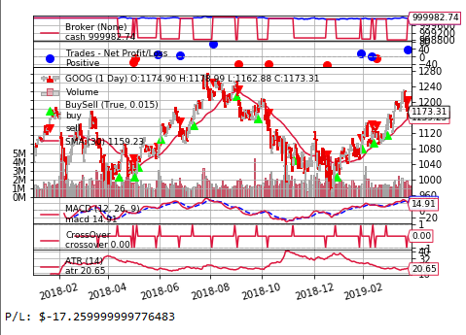
Moving Average Convergence Divergence Strategy
Number of stocks: 10 each time
Finance: Profit (P/L: $4347.299999999115)
Health care: Loss (P/L: $-8906.499999997672)
Information Technology: Profit (P/L: $8257.399999999558)
Energy: Profit (P/L: $759.600000000326)
Real estate: Profit (P/L: $4821.7999999983)
So we can observe that this strategy made good profits in Finance, Information technology, energy and real estate sectors.

Slide 6
QUESTIONS

