Slide 1
TERM PROJECT TITLE: PERSONAL COMMAND LINE ASSISTANT SAI SWETHA MANDALA

Slide 2
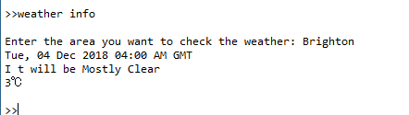
Functions
Opens Google maps
Opens applications on the system
Opens URL
Weather Information

Slide 3
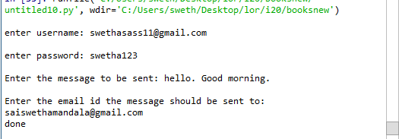
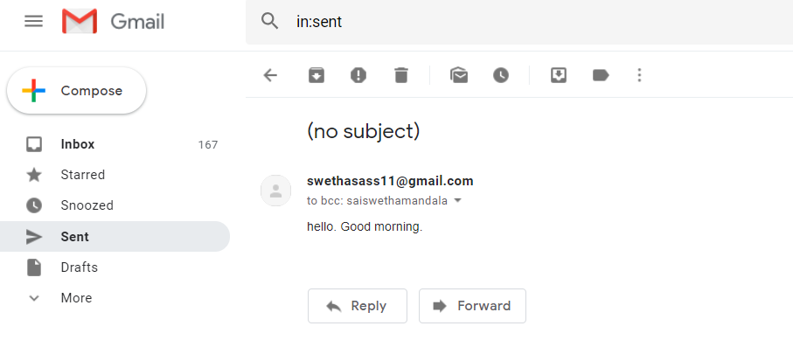
Sends emails

Slide 4
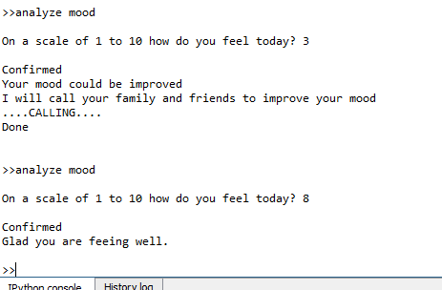
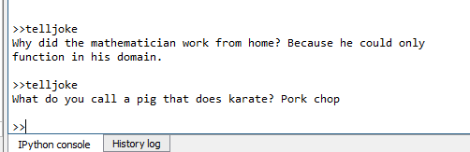
Analyses mood
Tells jokes

Slide 5
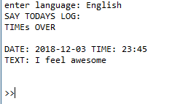
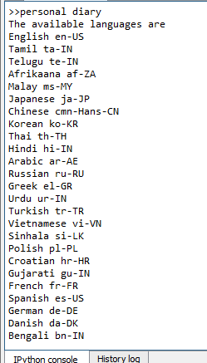
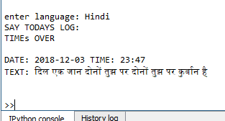
Maintains Personal Diary

Slide 6
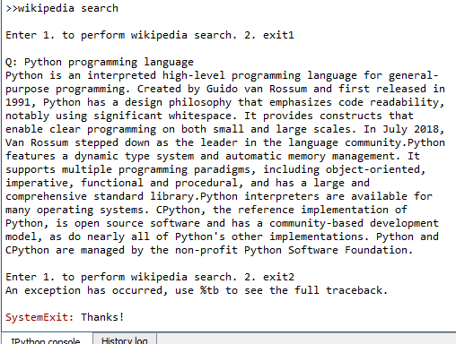
Wikipedia search

Slide 7
THANK YOU

