Slide 1



TEAM NAME: 6DX
PROBLEM STATEMENT: Urban Policy Decision Engine for Pollution Mitigation

Slide 2



PROBLEM STATEMENT
URBAN AIR POLLUTION SCENARIO
Rapid urbanization and increased vehicular traffic have led to severe air pollution in cities
Harmful pollutants such as PM2.5, PM10, and NO₂
frequently exceed safe limits
Weather conditions (low wind speed, high humidity) worsen pollution accumulation
Pollution levels show strong temporal and spatial variation across city zones
Prolonged exposure results in health risks, environmental degradation, and reduced quality of life
Urban authorities are under pressure to take timely and effective mitigation actions
LIMITATIONS OF CURRENT SYSTEMS:
Existing systems mainly provide AQI monitoring and reports
Pollution, traffic, and weather data are fragmented
Decisions are often reactive and manually driven
No predictive or proactive support for policymakers
DECISION MAKING - GAP :
Absence of an integrated, real-time decision-support system
No tools to predict short-term pollution levels
Lack of mechanisms to evaluate mitigation policies before implementation
Policy actions are taken without impact simulation

Slide 3






PROPOSED SOLUTION
HIGH-LEVEL SYSTEM APPROACH:
IoT sensors continuously capture real-time air quality and weather data
External data sources provide traffic and contextual information
Intelligent analytics process incoming data streams in real time
Short-term pollution levels are predicted using data-driven models
System logic evaluates conditions to identify critical pollution scenarios
DECISION INTELLIGENCE & OUTCOMES:
Recommends context-aware pollution mitigation actions
Supports policy comparison and impact estimation before execution
Enables proactive decision-making instead of reactive response
Provides authorities with clear, explainable decision insights
Helps optimize resource usage through informed policy selection
SOLUTION OVERVIEW
An AI-driven Urban Pollution Decision Engine designed to assist city authorities
Combines IoT-based real-time air quality sensing with traffic and weather data
Built as a hardware + software integrated system for smart-city environments
Continuously monitors urban conditions using low-cost IoT sensor nodes
Applies data analytics and intelligence to understand pollution dynamics
Converts raw sensor data into actionable, city-level insights
Enables timely, informed, and evidence-based pollution mitigation decisions
Designed to be scalable and adaptable across different urban zones and cities

Slide 4








KEY FEATURES
Real-Time IoT-Based Environmental Sensing
ESP32 with air quality & weather sensors
AI-Based AQI Estimation and Forecasting
Machine learning–based AQI estimation
Decision Support with Policy Simulation
Multi-Source Data Fusion
Urban policy recommendations
Live pollution and weather monitoring
Sensor data + traffic data + weather data
Short-term AQI prediction
What-if impact simulation
Hardware & software integrated system
Data fusion and preprocessing
Early warning of pollution spikes
Decision support for authorities
Context-aware pollution analysis

Slide 5
ARCHITECTURE

Slide 6




IMPACTS AND BENIFITS
IMPACTS
Enhanced Public Health Safety
Protects against dangerous pollutants with early warning and detection capabilities.
Proactive Pollution Management
Enables data-driven decision-making for environmental policies and strategies.
Geographic Pollution Analysis
Smart City Development
Enhances urban infrastructure with IoT and smart analytics.
BENEFITS
Real-Time Air Quality Index Tracking
Monitors AQI in real-time using IoT sensors.
Hardware and Software Integration
Cost-Competitive and Scalable
End-to-end solution that integrates hardware, software, and analytics.
Utilizes low-cost hardware and scalable architecture.
Easy-to-Use Data Visualization

Slide 7
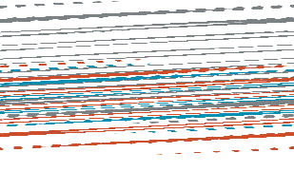



FUTURE SCOPE
Intelligent Prediction & Automation
Improve the system by incorporating more advanced AI algorithms for pollution hotspot prediction and automated action.
City-Wide Smart Infrastructure Integration
Expand the IoT sensor network to cities and integrate with smart city infrastructure, traffic management, and city governance systems.
Expanded Environmental & Health Monitoring
Scalable, Sustainable & Citizen-Centric Deployment
Use energy-efficient sensor nodes with cloud and mobile connectivity for real-time alerts and transparency.

Slide 8





MONETIZATION
Monetization & Feasibility :
Cost Structure (Per City / Pilot)
IoT Hardware (per unit): ₹2.5K – ₹3.5K
Cloud & Software (monthly): ~₹2.5K
Annual Operational Cost: ~₹30K
1
Profit Snapshot (Per City / Year)
Revenue: ~ ₹2L
Cost: ~₹30K – ₹40K Net Profit: ~ ₹1.6L Margin: ~ 75–80%
2
3
Feasibility & Scalability :
Low-cost IoT hardware
Software-driven → low marginal cost Mandatory pollution monitoring → high demand
10 cities: ~₹16L / year
100 cities: ~₹1.6Cr / year
4
Revenue Model :
City / Govt Subscription: ₹1.5L – ₹3L per year One-time Deployment & Integration: ₹1L+ Analytics / API Access (optional): ₹10K – 25K per yr

Slide 9
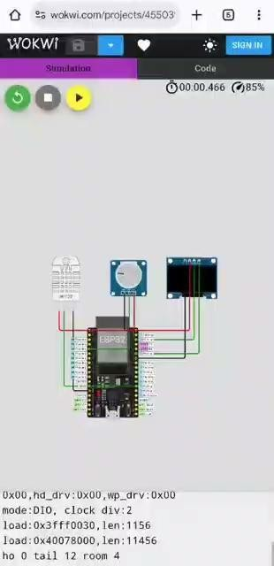
. This is a basic simulation for checking the quality of air with the help of potentiometer(instead of MQ135 gas sensor)
. For live simulation : https://wokwi.com/projects/455039976760765441

Slide 10

TEAM DESCRIPTION
Team Name: 6DX
College Name: St. Joseph’s College of Engineering
Team Leader: Saaivishrudh S (saaivishrudh.9626@gmail.com, +91 7550054748)
Team Members:
Sujitvinu RR (sujitvinurr@gmail.com)
Pooja MM (poojamm0613@gmail.com)
Swetha S (swetha070222@gmail.com)
Rupika Sri S (rupikarupika86@gmail.com)
Vedhaswaruban S (senthilruban06@gmail.com)

