Slide 1

By Swetha Chintamaneni
Code Refactoring and Bug Fixing

Slide 2
Gaining In-Depth Domain Insights via Thorough Requirements Gathering and Use Case Modeling :
Objectives:
Conduct a code review and refactor the existing codebase of the note-taking application to guarantee its intended functionality and enhance performance.
Document any detected defects identified during the debugging process. The goal is to optimize the current code rather than undertake a complete reconstruction of the application.
Problem-Solving Strategies :
Revise the current codebase to enhance performance, extensibility, and maintainability, ensuring the intended functionality remains intact, as verified through thorough testing.
Create comprehensive documentation for identified issues, including root cause analysis, steps for replication, a comparison of intended versus actual behavior, exploration of mitigation strategies, rationale for the chosen solution, and verification of resolution across relevant use cases.

Slide 3
Identification of Deficiencies Preceding Structural Code Enhancement via Refactoring: HTML-Flask Integration Gap: The current implementation lacks seamless integration between the HTML front-end user interface and the Flask backend application logic, hindering the effective transmission of data changes among modular components. The absence of clearly defined interfaces and data flow pathways between the presentation layer and the core application tier obstructs dynamic updates across architecture boundaries, impeding flexible cross-module communication. Key Focus Areas in this Evaluation: Utilizing precise technical terminology to articulate deficiencies. Elaborating on high-level issues to reveal underlying technical shortcomings. Discussing the impact of inadequate decoupling and interfacing. Inconsistent HTTP Method Specification: Misalignment exists between the declared HTTP POST method in the HTML form definition for transmitting input data and the usage of the request.args.get() function on the server side, relying on GET parameters. This creates discordance in expected communication protocols for extracting submitted information. The inconsistent encoding of client request mode and server retrieval mechanism may prevent backend handlers from accessing and validating user-supplied data accepted through front-end UI flows. This architectural deviation from web development best practices can lead to failures during form submission and application state change procedures.

Slide 4
Focus Areas in this Assessment: Using precise web development terminology. Expanding on the core technical discrepancies. Highlighting downstream impacts of the inconsistency.
Challenges in Data Retrieval:
The application faces issues in retrieving data as the implementation relies on the request.args.get() method to fetch form-posted data. This approach deviates from the front-end's HTML definition, which utilizes the POST protocol for transmission. This misalignment may lead to server-side handlers being unable to fully acquire the details submitted in a notebook entry. Consequently, this hampers back-end processing and impedes the persistence of data across architecture tiers.

Slide 5
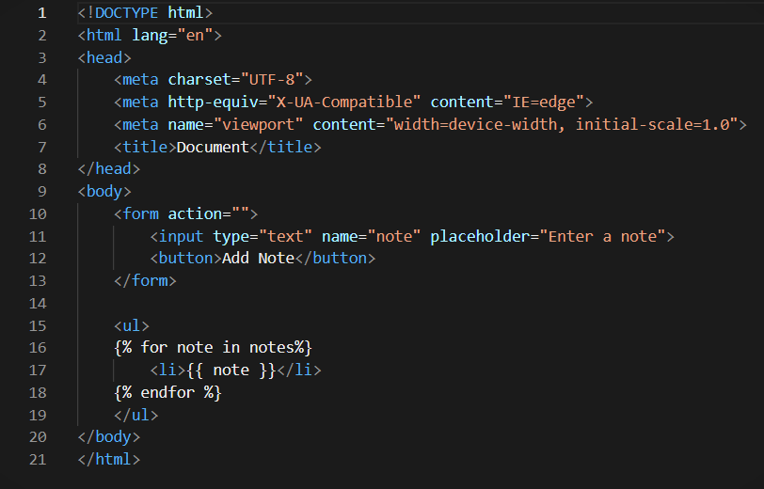
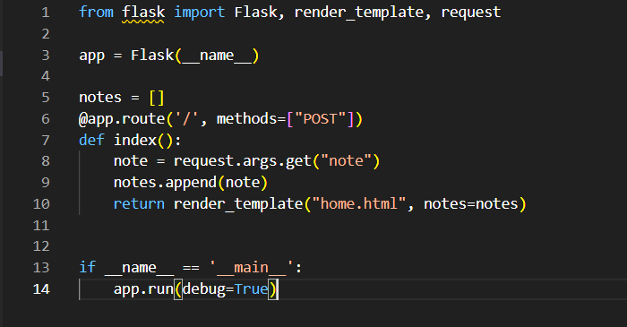
Files in HTML and Python Format Prior to Troubleshooting:
Recognized software flaws in both Figure 1 and Figure 2 are detrimentally affecting system functionality. To ensure seamless progress and the integration of additional capabilities, focused remediation efforts aligning with standard practices are imperative.

Slide 6
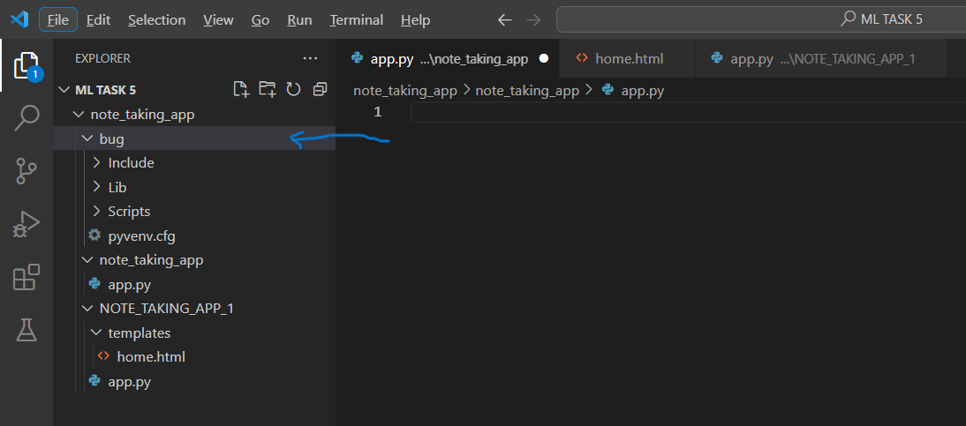
Refinement of Code and Rectification of Bugs/Defects:
Creation of a Custom Ecosystem :

Slide 7
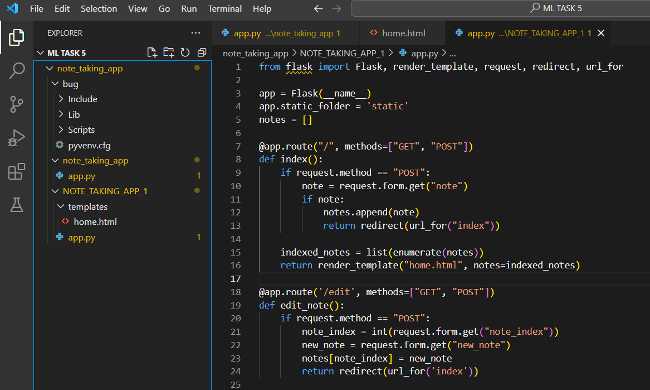
Essential Technical Components:
Employing debugging features in Python
Conducting tests across the architecture tiers illustrated in the image
Isolating and categorizing defects through trace analysis
Systematically identifying root causes
Iteratively formulating and testing fixes
Verifying resolutions across the entire architecture
Safeguarding the integrity of the original architectural paradigms

Slide 8
Resolution of Issues in the Home.html File:
Well-Structured HTML:
The HTML document defines the structure of a user-friendly web application for note-taking.
It includes a header with a stylish pen emoji and a tagline promoting seamless note-taking.
Flask-Enabled Form Management:
In the 'top' section, a form efficiently captures user input using the POST method, seamlessly interacting with the Flask server's root route ('/').
The 'action' hidden input field discerns intent, while the 'Add Note' button initiates form submission.
Dynamic Note Presentation:
The 'todo' section dynamically displays existing notes retrieved from the Flask server via Jinja templating.
Each note triggers the creation of a 'note' div with an 'Edit' button, allowing users to modify, save, or discard their edits.
Integrated JavaScript Interaction:
Embedded JavaScript functions enhance user engagement, creating a more intuitive experience.
'Edit' buttons smoothly toggle the visibility of corresponding edit forms, enabling real-time note editing.
'Cancel' buttons within edit forms discreetly hide the form, providing users the freedom to undo their edits.
Aesthetics and Brand Consistency:
Adding to the design ethos is a 'container' div that ensures layout consistency, along with CSS stylings for edit form concealment and button aesthetics.

Slide 9
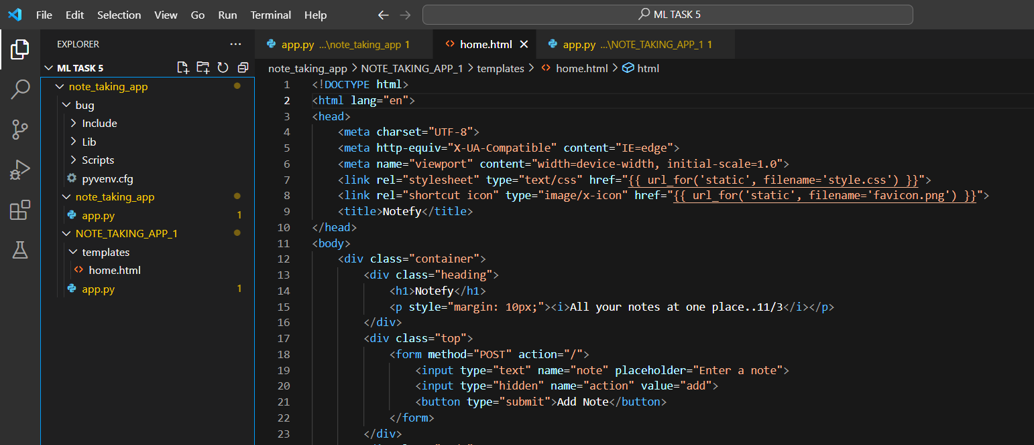
Revitalizing HTML Code: Expert Bug Identification and Correction:

Slide 10
Creating Flask Application Structure:
Setting up Flask Web Application:
- Implementation of Flask(name) for a streamlined setup.
Configuration of Static Folder:
- Configuring the static folder to 'statics' using app.static_folder = 'statics,' emphasizing the recommended use of the default 'static' folder.
Global Variable and Routes:
- Introduction of a global list, 'notes,' for storing user-added notes.
- Definition of three key routes:
'/' (Root Route): Handling both GET and POST requests, with post-request actions and redirection.
'/edit': Managing GET and POST requests for note editing, ensuring seamless updates and redirection.
'/delete': Handling GET and POST requests for note deletion, with efficient removal and redirection.
Executing the Application:
- Implementation of the if name == 'main': block for controlled execution.
- Utilization of app.run(debug=True) for real-time debugging and server reloading.
Template Rendering:
- Leveraging the render_template function for rendering the 'home.html' template, ensuring the seamless display of notes on the webpage.
CSS Styling:
- Enhancing visual appeal and user experience through the integration of CSS.

Slide 11

THANK YOU

