Slide 1
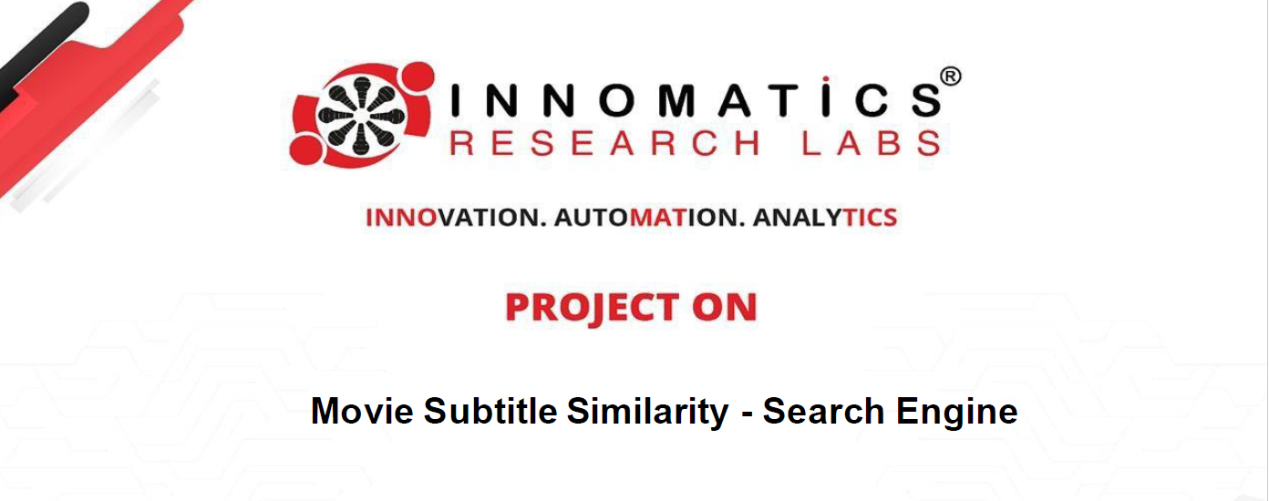
By , Swetha Ch (Data Science Intern)
Teammate: Raja Raghu Vamsi Krishna

Slide 2
Objective:
Create a sophisticated search engine algorithm with a focus on subtitle material that effectively pulls subtitles in response to user queries. The main objective is to improve the relevancy and accuracy of search results by utilizing machine learning and natural language processing techniques. This study presents a semantic search engine project that creates embeddings from subtitle documents using 'SentenceTransformers' based on BERT. In order to provide effective and precise semantic search and give users relevant results based on their search queries, the engine ingests material, preprocesses it, and applies embeddings.

Slide 3
Features of Search Engine for Subtitles:
This manual aims to give developers guidance on creating a semantic search engine for movie subtitles. By using natural language search queries, the search engine will make it possible for users to locate pertinent subtitles for movies. In order to guarantee correct results, the difficult aspect of developing such a search engine is having to comprehend both the user's search query and the movie's content.
This tutorial will go over the essential procedures and strategies used in the search engine development process.
Core Logic: The three main steps in the core logic are to compare a user query with a video subtitle document.
actions:
Preprocessing of the data: You can choose to randomly select thirty percent of the data if your computing power is constrained.
Clean: Removing time stamps is one potential cleaning procedure. (Note: Before vectorization, the text data must be cleaned.)
Vectorize the supplied Documents with Subtitles
After obtaining the user query, vectorize it.
Computing Cosine Similarity:
Determine the cosine similarity between the user query vector and the document vector.
The relevance of the documents to the user's query is determined by this similarity score.
Provide back the papers that are most comparable.

Slide 4
Methodology:
Using pandas, the project starts by importing data from a CSV file. Three columns make up the dataset: file_content (which holds each document's text content), name (which holds each document's title or name), and num (which is a unique identifier). The processed data is then ready for storage when the code completes cleaning and preparation operations.

Slide 5
Importing Libraries:
Pandas
Numpy
Re
Nltk
Sqlite
Gensim
Sentence_transformer
Chromadb
Flask

Slide 6
Text data preprocessing:
Step 1: Lowercase
Change all text to lowercase for uniformity.
Step 2: Tokenization
Divide the text into manageable chunks (tokens).
Step 3: Eliminating Parenthesis
Remove all punctuation.
Phase 4: Eliminating Stopwords
Toss out words that aren't very informative.
Step 5: Lemmatization or Stemming
For normalization, reduce words to their base or root form.

Slide 7
Recognizing Text Vector:
Text vectors are machine learning models' interpretable numerical representations of text.
Text can be converted into vectors so that it can be subjected to different mathematical processes for comparison and analysis.
Text vectors can be created using a variety of methods, and the search engine's functionality and speed may be affected by the method selected.
Term Frequency-Inverse Document Frequency and Bag of Words (BOW) are two important text vector creation techniques.
The last one I employed was a bert model sentence transformer.

Slide 8
Applying Vectors Based on BERT:
As NLP has progressed, models such as BERT have demonstrated notable gains in comprehending the meaning and context of text. Through the utilization of BERT and other deep learning models, it is possible to produce text vectors that more precisely convey the semantic meaning. When understanding the subtleties and context of movie language and subtitles, this is very helpful.

Slide 9
Document chunking for large text:
Movie subtitles are frequently long documents, which makes it challenging to search through and locate relevant subtitles in such large text files. To solve this problem and improve the effectiveness of the search engine, think about using a document chunking strategy, which divides large texts into smaller parts for indexing and searching.

Slide 10
Chroma db for storage:
A structured and effective storage system is essential to the search engine's operation since it handles and analyzes massive amounts of movie subtitles and related data. The search engine can rapidly and precisely obtain and display the results to users by storing the preprocessed subtitles and their vectors in a Chroma database.
The semantic search engine for movie subtitles requires rapid reads and complicated search algorithms, which Chroma database's high-performance, column-oriented data storage solution is perfect for.

Slide 11
Constructing the Web App Flask:
The primary purpose of the program is to create an interactive Flask web application for searching for comparable subtitles in movies and television shows. In order to locate comparable subtitles, users of the program can input a query text that is subsequently evaluated against the subtitle corpus. The user is presented with the top matched subtitles on the result page, along with their ratings of similarity and excerpts of content.

Slide 12
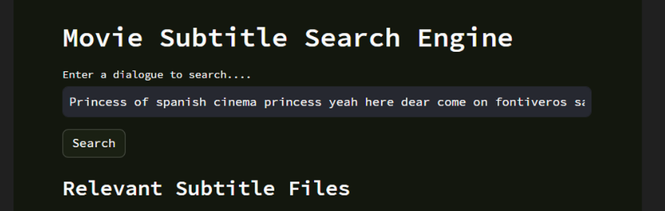
The webapp:

