Slide 1
Covid 19-Mortality Data Analysis
Swetha Kambham
Dec 14th 2024

Slide 2
Data Description
Data Loading/Cleaning
The analysis utilizes two primary datasets from the Johns Hopkins University Center for Systems Science and Engineering (JHU CSSE), publicly available on their GitHub repository.
The datasets contain time-series data on confirmed COVID-19 cases and deaths globally.
Loading: Data is loaded using the Pandas library's read_csv() function, directly from the raw URLs.
Cleaning:
A dedicated function, clean_data(), ensures data quality.
It filters out rows with zero confirmed cases to avoid undefined mortality rates.
Missing values in the 'Mortality_Rate' column are filled with 0 for consistency.
Cite the Source of the Data
Source: Johns Hopkins University Center for Systems Science and Engineering (JHU CSSE)
Data Repository: Reference

Slide 3
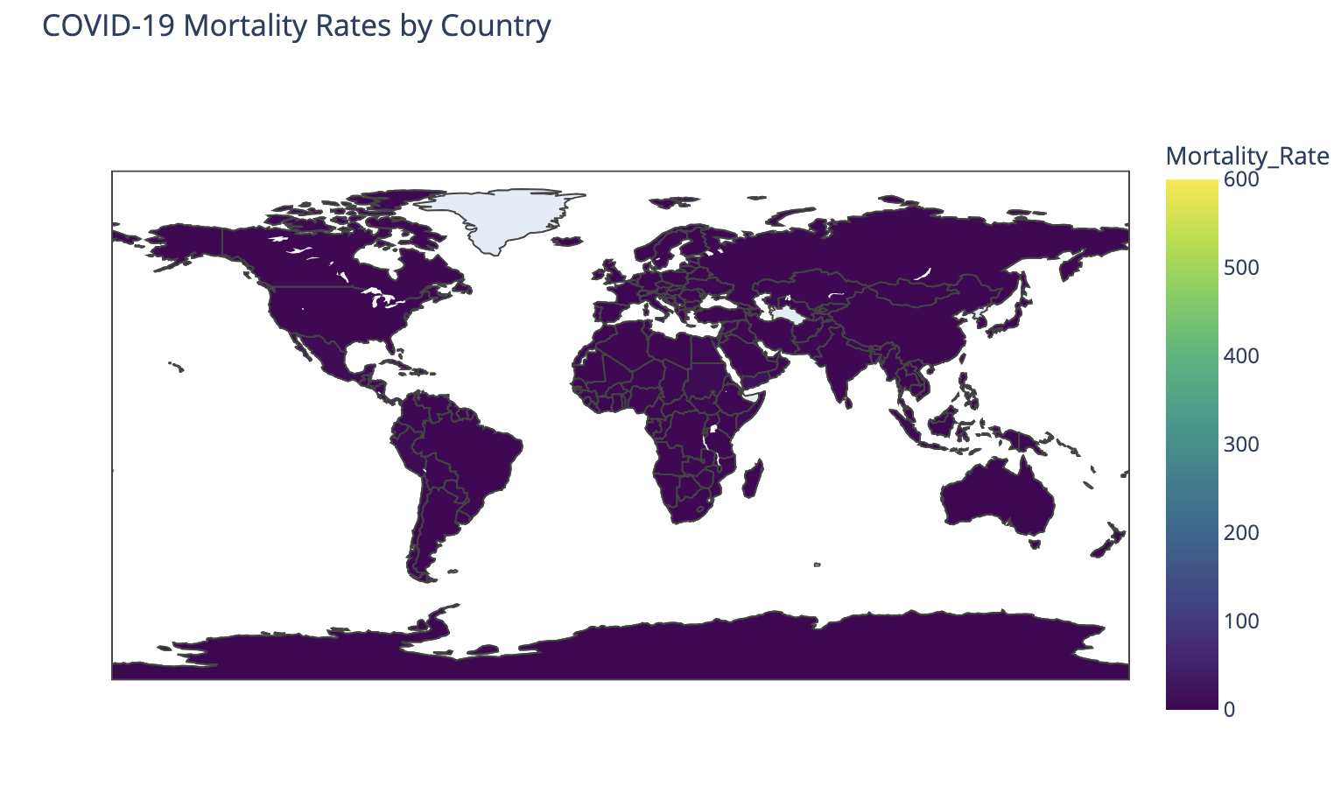
Map Visulization
Choropleth Map: Provides a global overview of mortality rates, allowing easy comparison between countries.
Uses plotly.express to create an interactive choropleth map.
Countries are colored based on their mortality rate.
Hovering over a country displays its name and mortality rate.

Slide 4
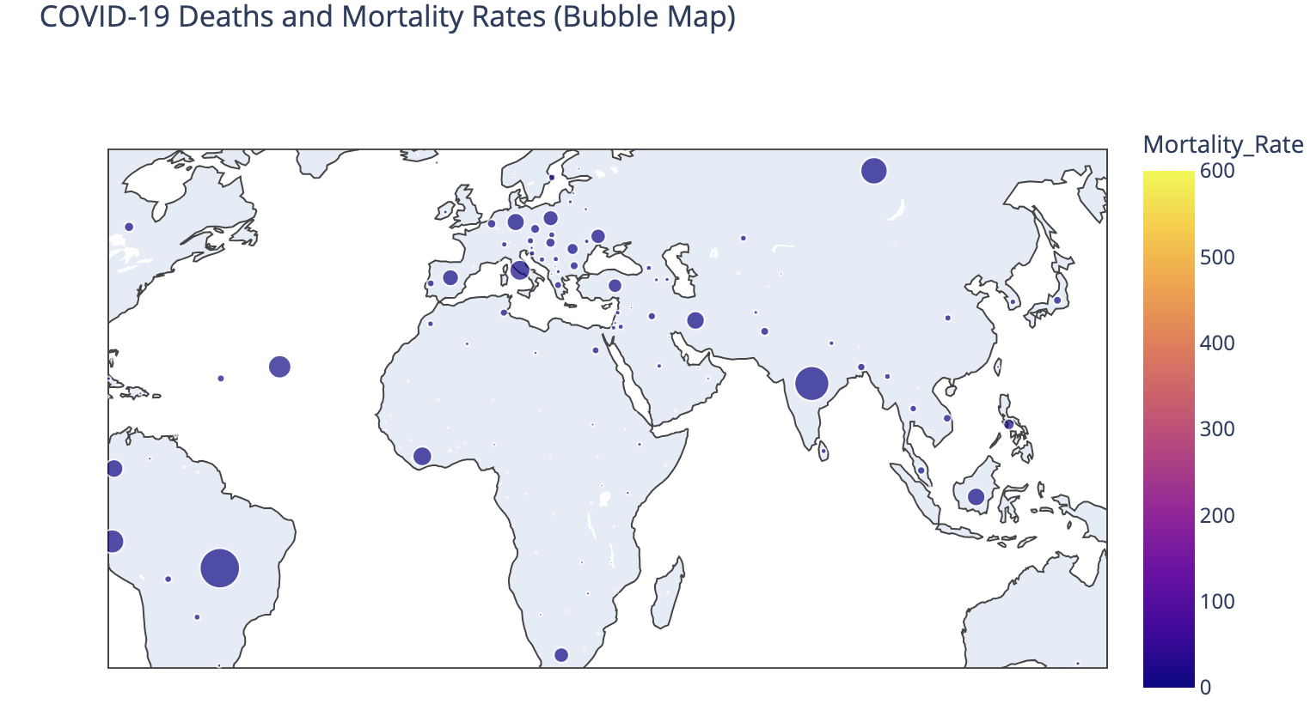
Bubble Map
Bubble Map: Adds information about the total deaths by varying bubble size, providing a more nuanced view of the impact of COVID-19. Both maps are interactive, enabling users to explore specific regions and countries in more detail.
Uses plotly.express to generate a bubble map.
Bubbles are centered on countries' geographic locations.
Bubble size represents the total number of deaths.
Bubble color indicates the mortality rate.

Slide 5
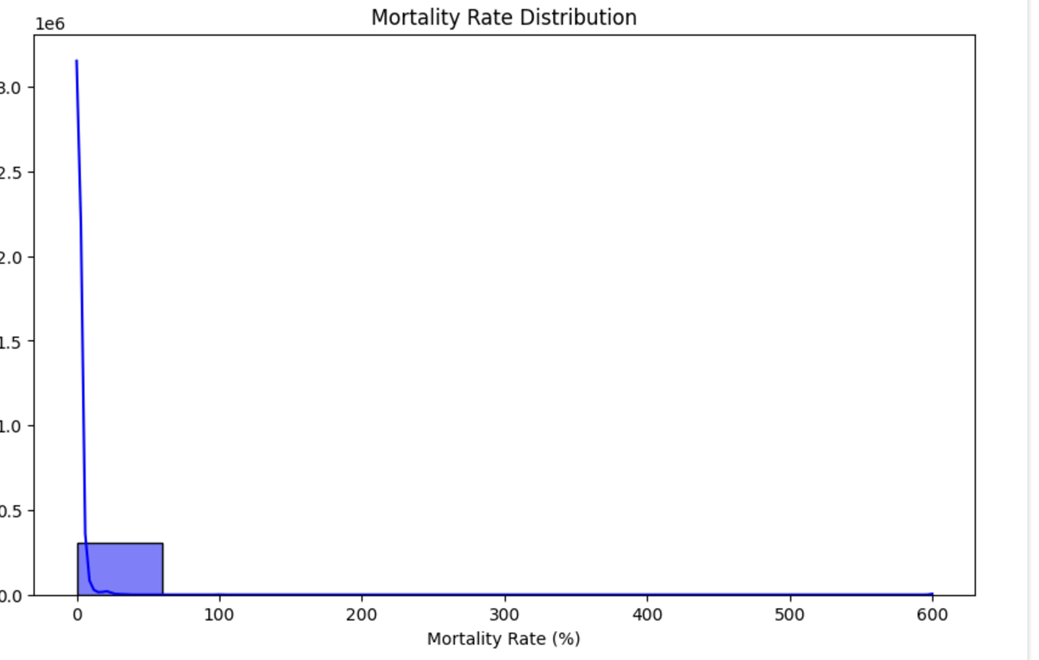
Aggregation Visualization
Histogram/Density
Observations:
Most mortality rates are concentrated near zero, indicating that a significant number of regions or countries have low mortality rates.
There is a long tail extending to higher mortality rates, which suggests that some locations experienced a notably high rate of deaths relative to confirmed cases.
The density curve helps to visualize the probability distribution, showing where most data points lie.
Insights:
While most regions have low mortality rates, the presence of outliers with higher rates could indicate systemic healthcare or reporting challenges in those areas.

Slide 6
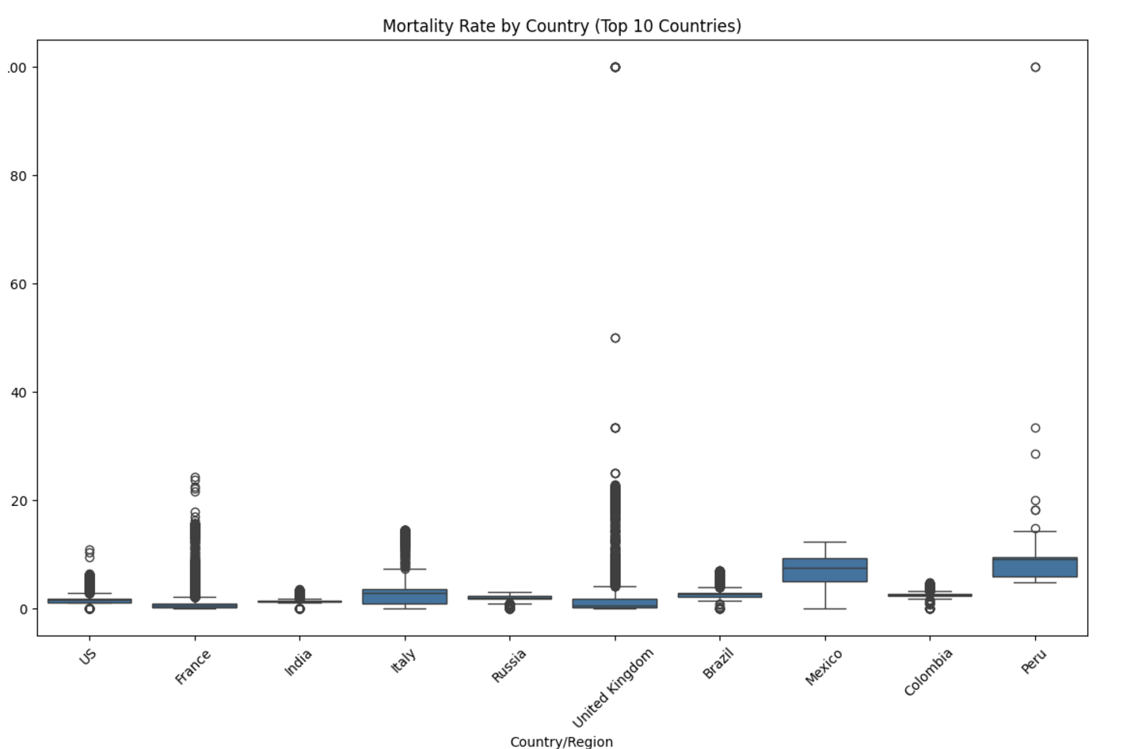
Box Plot/ Violin Plot
Observations:
The box plot complements the violin plot by summarizing the distribution of mortality rates for each country using medians, interquartile ranges, and outliers.
For countries with high outliers (dots beyond whiskers), a few regions might have faced localized severe outbreaks.
Insights:
Countries with smaller interquartile ranges (e.g., a compact box) have consistent mortality rates across regions.
Outliers indicate areas within countries that might require further investigation, such as hotspots or under-reported cases.

Slide 7
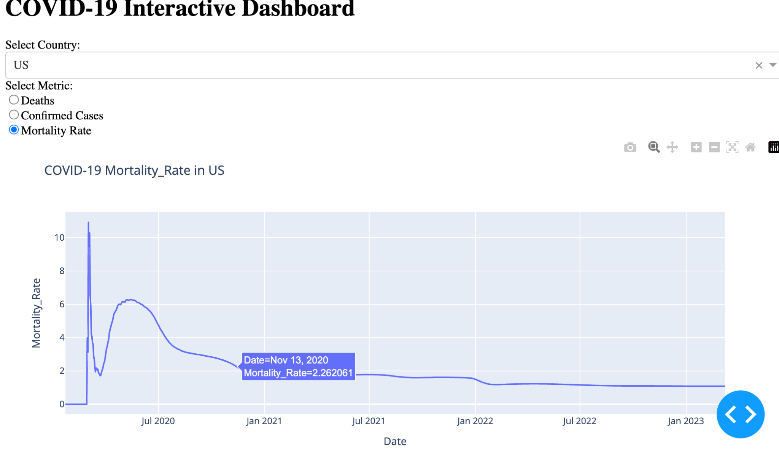
Interactive Visualizations- DashBoard
Uses Dash to create a web-based dashboard with interactive components.
Allows users to select a country and metric (deaths, confirmed cases, or mortality rate).
Displays a line chart showing the selected metric over time for the chosen country.
Interactive Dashboard: Enables users to explore the data dynamically by selecting different countries and metrics.
Line Chart: Shows the trend of the selected metric over time, providing insights into the pandemic's progression in a specific country.

Slide 8
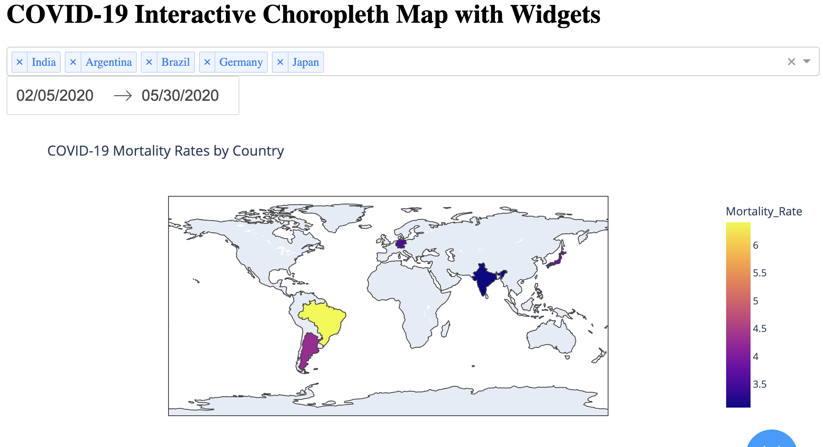
COVID-19 Interactive Choropleth Map
with Widgets
Compares COVID-19 metrics: The scatter plot visualizes the relationship between Confirmed Cases and Deaths for different countries.
User-selectable metric: Users can choose to display either Confirmed Cases or Deaths on the y-axis using radio buttons.
Adjustable scale: A checkbox allows toggling between linear and logarithmic scales for the axes, improving data visualization across different magnitudes.
Interactive data points: Each point represents a country, and hovering over it reveals detailed information about that country's data.

Slide 9
Conclusion
Key Findings:
Countries with higher mortality rates likely faced overburdened healthcare systems and inadequate resource allocation.
Regions with low mortality rates often reflect robust healthcare infrastructure or proactive pandemic responses.
Recommendations:
Prioritize resource allocation to high-mortality regions during pandemics.
Analyze and replicate policies from countries with low mortality rates to improve outcomes elsewhere.

