Slide 1
TITLE OF THE PROJECT
Student management system

Slide 2
CONTENTS
PROBLEM DEFINITION
CONCEPTS USED
CONTENT OF THE RECORD
WORKING OF THE PROGRAM
• MODULES INCLUDED
FUNCTIONS USED AND ITS PURPOSES
• DIAGRAMMATIC REPRESENTATION
UI DESIGN

Slide 3
PROBLEM DEFINITION
TO CREATE A STUDENT RECORD MANAGENENT SYSTEM THAT CAN PERFORM CERTAIN OPERATIONS USING DATA STRUCTURES.

Slide 4
CONCEPTS USED
STRUCTURE (FOR STUDENT INFORMATION)
LINKED LIST
FILES
STACK
POINTERS
LOOPS
SORTING
SEARCHING

Slide 5
CONTENTS OF THE RECORD
ROLL NUMBER
NAME
CLASS
TUTOR NAME
ADDRESS
CONTACT NUMBER
MARKS
PERCENTAGE
GRADE
BLOOD GROUP
SPECIALITY

Slide 6
CALCULATIONS
PERCENTAGE - PERCENTAGE IS CALCULATED BASED ON THE TOTAL MARKS ENTERED BY THE USER
GRADE - GRADE IS CALCULATED BASED ON THE PERCENTAGE

Slide 7
PROJECT OVERVIEW
OPERATIONS PERFORMED
1. CREATE AND INSERT A RECORD INTO LIST
2.DELETE A RECORD
3.MODIFY A RECORD
4.SEARCH AND DISPLAY A RECORD
5.DISPLAYING ALL THE RECORDS IN LIST
6.DISPLAYING THE STUDENTS DETAILS HAVING SAME BLOOD GROUP
7.DISPLAYING THE RANK LIST OF STUDENTS

Slide 8
WORKING OF PROGRAM
FILE
LIST
Start of the program
End of the program

Slide 9
CREATING AND INSERTING A RECORD INTO A LIST
The details of the students are stored in structure using create function .
Each record is inserted in a linked list as a node using insert function .
The records are inserted at the beginning of the singly linked list.

Slide 10
DELETING A RECORD
Deleting the record based on roll number given by the user
Traverse the list , if the given roll number matches the roll no in the list delete that particular record
Else print the record is not found

Slide 11
MODIFY A RECORD
Modification is done by getting roll number as input and if the roll number matches with the record in the list then get the details of the student else print the record is not found

Slide 12
SEARCH AND DISPLAY A RECORD
Get the roll number from the user
Traverse the list , if the roll number in the list matches with the roll number given by the user display the details
else print the record is not found
Here linear search technique is used

Slide 13
Display all the records in a list
Simply traverse the list and print all the records in a list if head is null then display there are no records in the list

Slide 14
Display the details of student having same blood group
In case of any emergency this operation is used
Enter the blood group which the user needs , if the blood group matches with the user’s need , it will display the details of the student having that blood group
Here linear search technique is used

Slide 15
Displaying the rank list
This operation is for selecting only 10 students in a class for a competition based on the ranks obtained
The marks and roll number of all the students in a class are inserted into a separate list and the list is sorted based on the marks scored by the students
Only the students who secured rank from 1 to 10 will be displayed
Here bubble sorting is used

Slide 16
File operations
At first the record in the file is inserted into the linked list using fread
Performing all the operations like [modify , delete ….]and finally the records present in the list are written into the file using fwrite , which is opened in write mode
File name: stud.dat
Format : combination of ACSII , binary or mix of them

Slide 17
Validations
No two roll number can be same in a list
The phone number should be 10 digits [not more than 10 or less than 10]
The total marks should be 0 to 500 [not more than 500 and less than 0]

Slide 18
FUNCTIONS USED AND PURPOSE
Red, green , yellow - functions used to change the colour of texts
Create - Gets the input from the user and store it in structure
Insert - to insert the structure into the list
Search - to search the record of the specified student and display the details
Display - traverses the list and displays all the records
Update- to update the details if wrong value is given while creating
Delete - to delete the record if that particular record is not needed
Bldgrp- displays certain details of student if the blood group matches with the blood group given by the user
Addnode- adds roll no and marks to separate list to calculate ranks
Sortlist- it sorts the list based on the marks scored by the students
Dispmarks- displays first 10 rank holders marks and roll number with rank
Delmarks, updatemarks - these two are used to delete or update the marks in rank list if it is deleted/updated in the main list
Addrank- used to add the ranks and marks which are copied to main list from file at starting of the program to rank list
read_binary, write_binary - to read the contents in file , insert into list and write the contents in the list to file

Slide 19
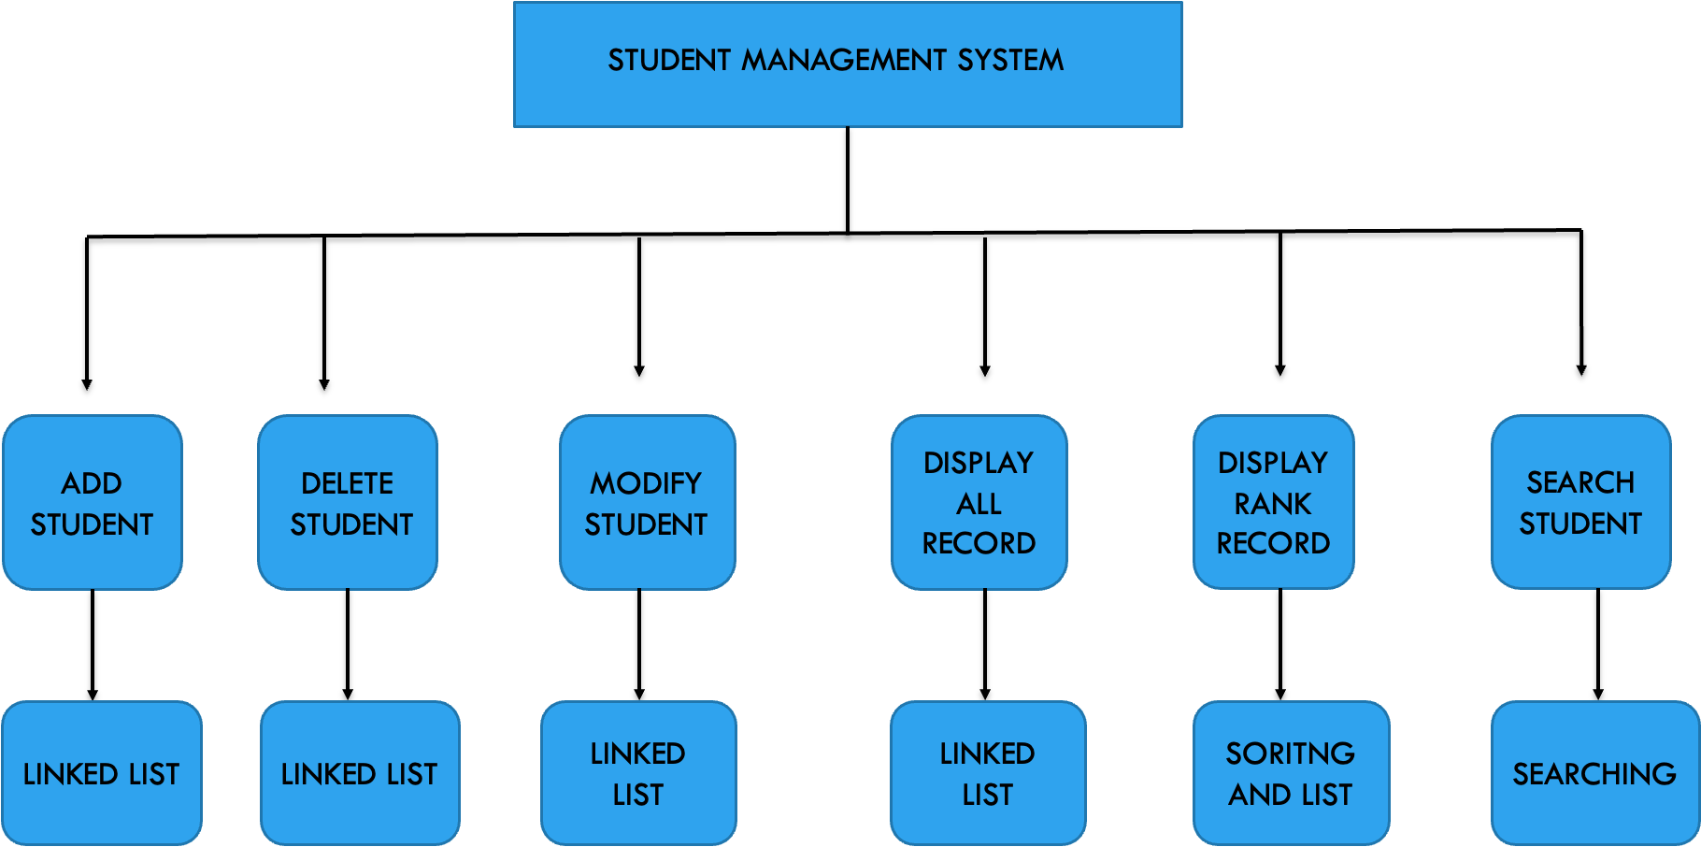
DIGRAMMATIC REPRESENTATION

Slide 20
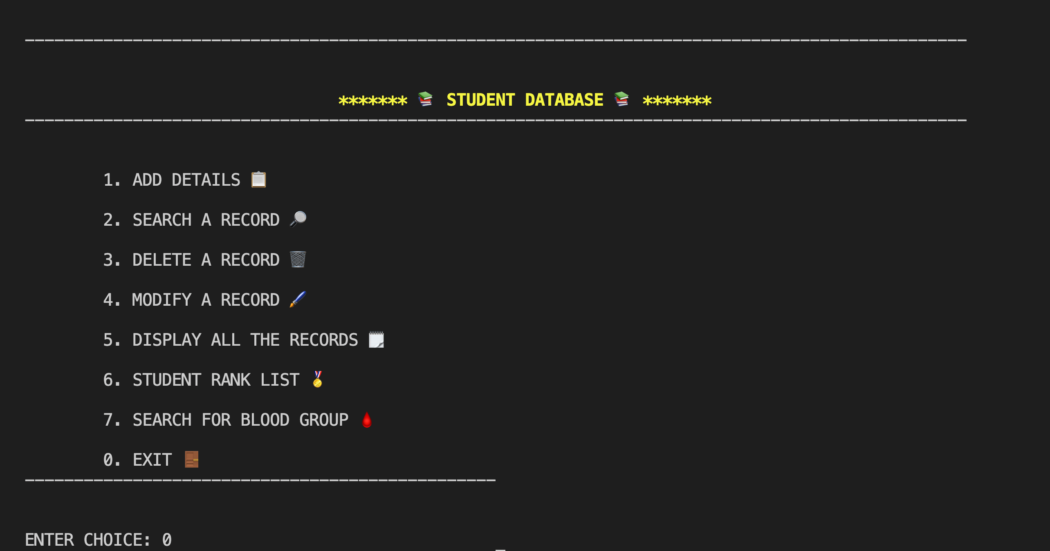
UI DESIGN

Slide 21
THANK YOU

