Slide 1
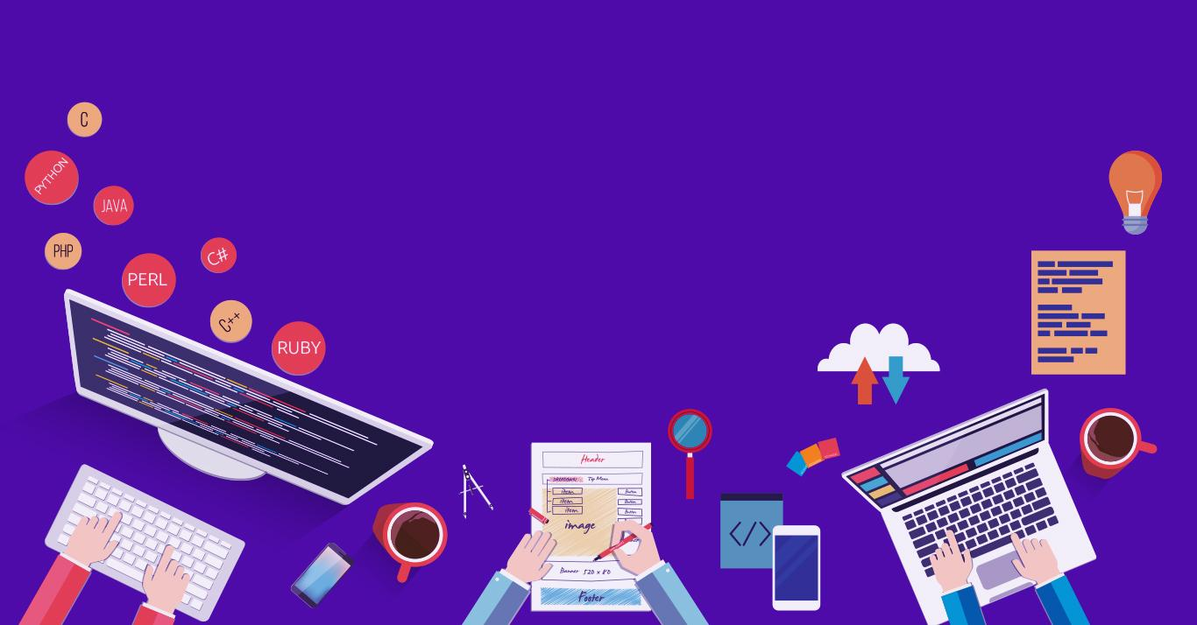

Introduction to
Robotic Process Automation
Title of the Project
220701297
Name:Swetha R
Guide Name:Ms. U. Farjana
CSE E-3rd year

Slide 2
Abstract
Core features:
Expense tracking
Budget analysis
Savings tracking
Notifications
Objective:
Simplify financial management
Reduce manual effort
Improve accuracy

Slide 3
Need for the Proposed System
Manual budgeting is time-consuming and prone to errors.
Lack of real-time alerts for overspending.
Difficulty in tracking categorized expenses efficiently.
No integrated solution for generating insights and reports.

Slide 4
Advantages of the Proposed System
Automates budgeting and expense tracking.
Provides categorized expense summaries and insights.
Alerts users for overspending and generates monthly reports.
Reduces manual effort and minimizes human errors.

Slide 5
Literature Survey
RPA automates financial tasks, improving efficiency and accuracy (Avasarala & Raja, 2020).
AI enhances budgeting and forecasting (Chakraborty & Jain, 2020).
Excel integration with automation simplifies data handling (Li et al., 2021).
Alerts and APIs improve budgeting accuracy and real-time data syncing (Singh et al., 2019, Martin & Evans, 2021).

Slide 6
Main Objective
Automate personal budgeting: Streamline income, expense tracking, and savings calculations.
Improve financial decision-making: Provide insights and alerts to help users stay within budget.
Enhance accuracy and efficiency: Use RPA to minimize human errors and reduce manual effort.
Provide user-friendly financial reports: Offer real-time visualizations and detailed financial summaries for informed decisions.

Slide 7
System Requirements
Software Requirements:
UiPath Studio
Microsoft Excel
RPA Platforms (UiPath Orchestrator)
Email Service (SMTP)
Web Browser (Google Chrome, Microsoft Edge)
Hardware Requirements:
Processor
RAM
Storage
Operating System (Windows 10 or later)
Internet (Required)

Slide 8
Functional Description
User Input
File Validation
Data Processing
Expense Calculation
Savings Calculation
Threshold Monitoring
Reporting
Financial Report Generation
Email Notifications
Output

Slide 9
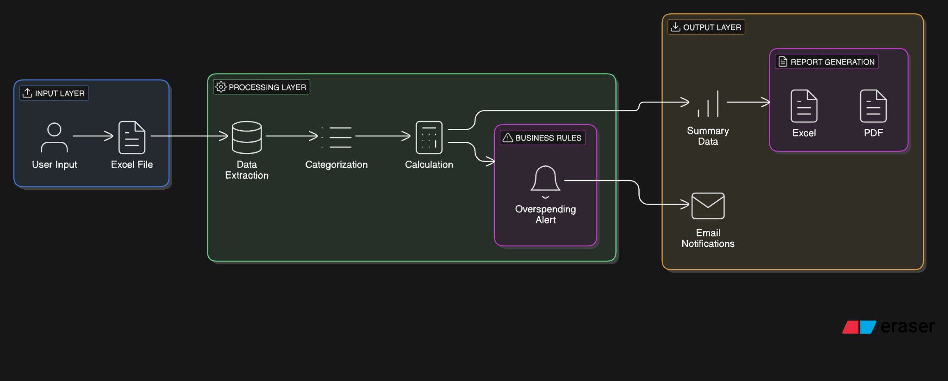
Architecture Design

Slide 10
Process Design
Main Process:
Input Data Collection
Data Validation
Expense Categorization
Budget Calculation
Report Generation
Alert Notification
Sub-Process:
Calculate Total Expenses
Determine Savings
Update Financial Data
Check for Overspending

Slide 11
Implementation
→ Start
→ Read Excel Data
→ Validate Data
→ Calculate Income, Expenses, and Budget
→ Categorize Expenses
→ Detect Overspending (if yes, send alert email)
→ Generate Report
→ Send Report via Email
→ End

Slide 12
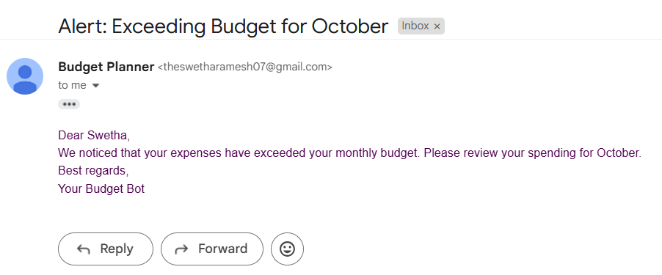
Testing

Slide 13
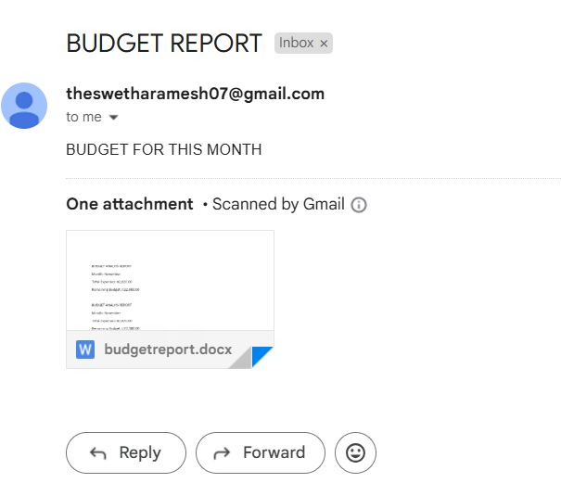
Testing

Slide 14
Conclusions
The Bot developed using UiPath Studio offers a robust and automated solution for managing personal or business finances. By automating the process of collecting income and expense data, calculating total expenses, checking for overspending, and generating detailed reports, this bot significantly streamlines financial management tasks. The use of Robotic Process Automation (RPA) ensures efficiency, accuracy, and consistency, reducing the likelihood of human error and saving time on routine financial tasks.
The Monthly Finance Tracker Bot demonstrates the power of RPA to automate and optimize everyday financial processes. It empowers users with valuable insights, ensuring they stay within budget while providing transparency and control over their finances.

Slide 15
Future Enhancement
Future enhancements for the Monthly Finance Tracker Bot include multi-month or yearly budgeting to track long-term trends and expense categorization for better analysis. Add budget threshold alerts to notify users when spending exceeds limits. Integrate financial APIs for real-time data synchronization with bank accounts or external tools like Google Sheets. Introduce data visualization with pie charts or graphs for insights. Incorporate predictive analytics using machine learning to forecast future expenses and savings, helping users make informed financial decisions.

Slide 16
References
[1]https://www.moneycontrol.com/personal-finance/tools/budget-calculator.html
[2] https://www.nerdwallet.com/article/finance/budget-worksheet
[3]https://www.moneyhelper.org.uk/en/everyday-money/budgeting/budget-planner
[4] https://www.thebalancemoney.com/budgeting-calculator-5120904
[5] https://app.gravitywrite.com/tools/budget-planner

Slide 17
Queries

Slide 18
Demonstration

Slide 19
Thank You

