Slide 1

DOORWAY GROCERY CATALOGUE

Slide 2
ABSTRACT
Grocery shopping is one of the most frequently occurring tasks in our daily life, and it is observed that most of the people prefer supermarkets in order to purchase their required items.
In the Supermarkets we usually see huge number of customers rushing around and we go clueless where our available item is present. Yes ,everyone might have experienced this.
As touch screen monitors serve many people and are becoming an integral part of human life.
Digital grocery list can be introduced at the entrance of a supermarket by creating an application which gives the complete list of all the items available in the store.
It is a digital grocery list that can be used by group of members in the store and it will be easy to operate for any individual .The application consists of several modules where the user can approach the item category wise , including the price and discounts on the item, location of the product in the store , availability etc. and many more features can be implemented further .Also we have this special feature in our application where the user/customer can provide a review on the store and he can be rewarded with the prize money which will be later transferred to his account. As it is a console based language we have included few colour effects too.
The “DOORWAY GROCERY CATALOGUE” is a challenging project and a concept which is not only based on Social lifestyle but also on the technology.

Slide 3
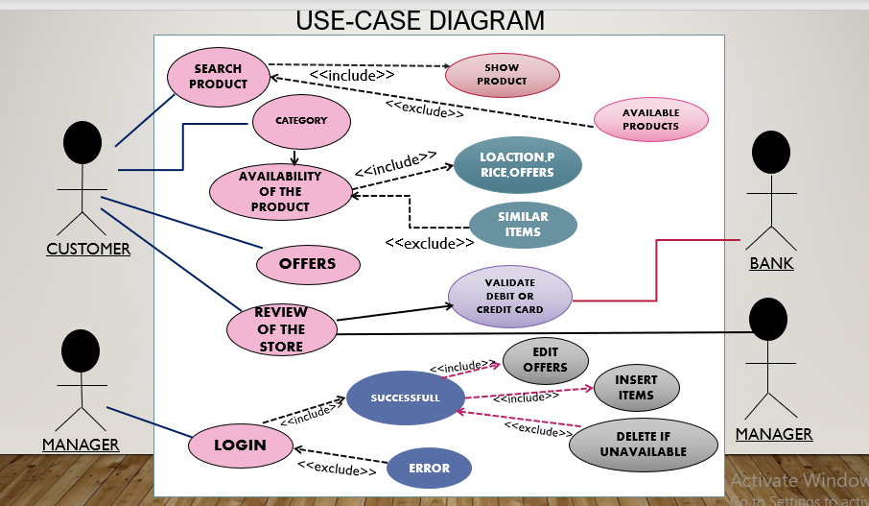

Slide 4
TECHNOLOGY USED
The software and hardware requirements for the project are:
HARDWARE REQUIRMENTS
Processor : Intel (IR) Core(TM) /Ryzen.
Processor Speed : 250 MHz to 833MHz
RAM : 512MB to 1024 MB
Hard Disk : minimum(2GB ) to 30GB
Standard Input : (QWERT)Key Board
System Type : 32-bit processing system(can be more)
SOFTWARE REQUIRMNETS
Software : gcc compiler
Language : C Programming Language
Operating System : Windows XP (or greater version)/Linux
Web Technologies : Console based project

Slide 5
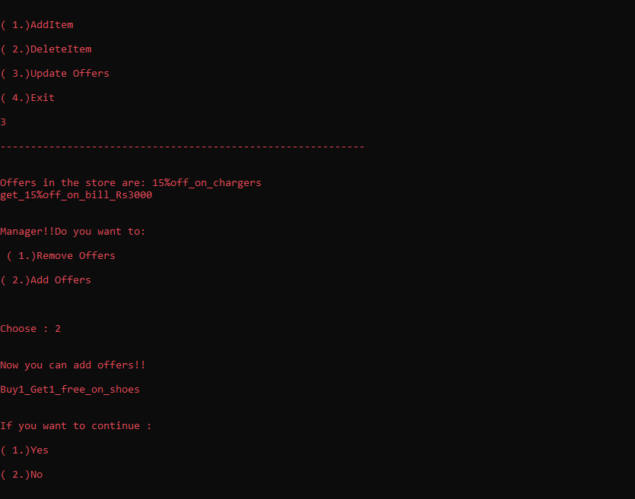
RESULTS:

Slide 6
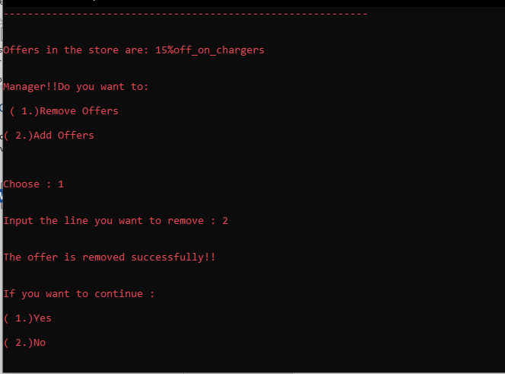

Slide 7
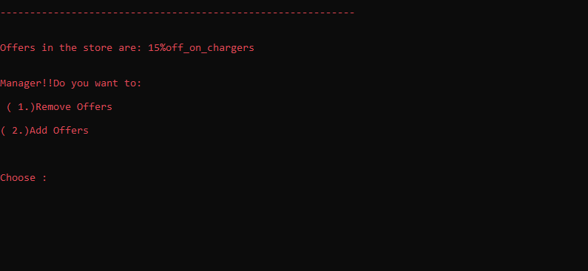

Slide 8
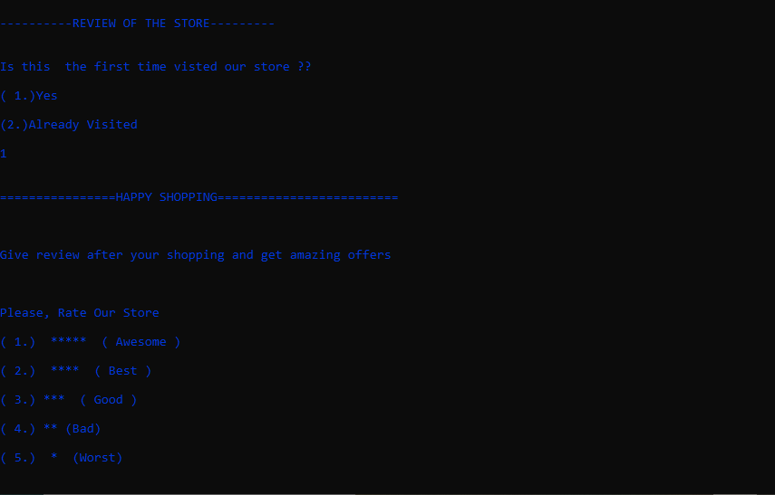

Slide 9


Slide 10
CONCLUSION AND FUTURE WORK
We conclude that this application is useful for offline shopping.
It can be operated very easily
Future work is that we want to add some features like search with price range,showing similar products.

Slide 11
THANK YOU
TEAM
V.SWETHA-118
K.RUSHITHA-090

