Slide 1
Employee Data Analysis using Excel
STUDENT NAME: Swetha J
REGISTER NO: 312216130
DEPARTMENT: B.com (Accounting and Finance)
COLLEGE: S.S.S. Jain college for Women

Slide 2
PROJECT TITLE
Employee Performance Analysis using Excel

Slide 3


AGENDA
Problem Statement
Project Overview
End Users
Our Solution and Proposition
Dataset Description
Modelling Approach
Results and Discussion
Conclusion
3/21/2024 Annual Review

Slide 4

PROBLEM STATEMENT
Performance evaluations provide a stepping-stone for the employee and supervisor to identify and discuss areas where performance can be improved. It can also be an important opportunity for employee and manager expectations to be reinforced or clarified.

Slide 5

PROJECT OVERVIEW
The main objective of Employee Performance Analysis is to create an analysis model that makes performance management at individual employee level simpler. Employee performance analysis involves evaluating various metrics such as productivity, efficiency, and output quality to assess individual and team performance. By leveraging data analytics, organizations can identify top performers, areas for improvement, and potential training needs.

Slide 6
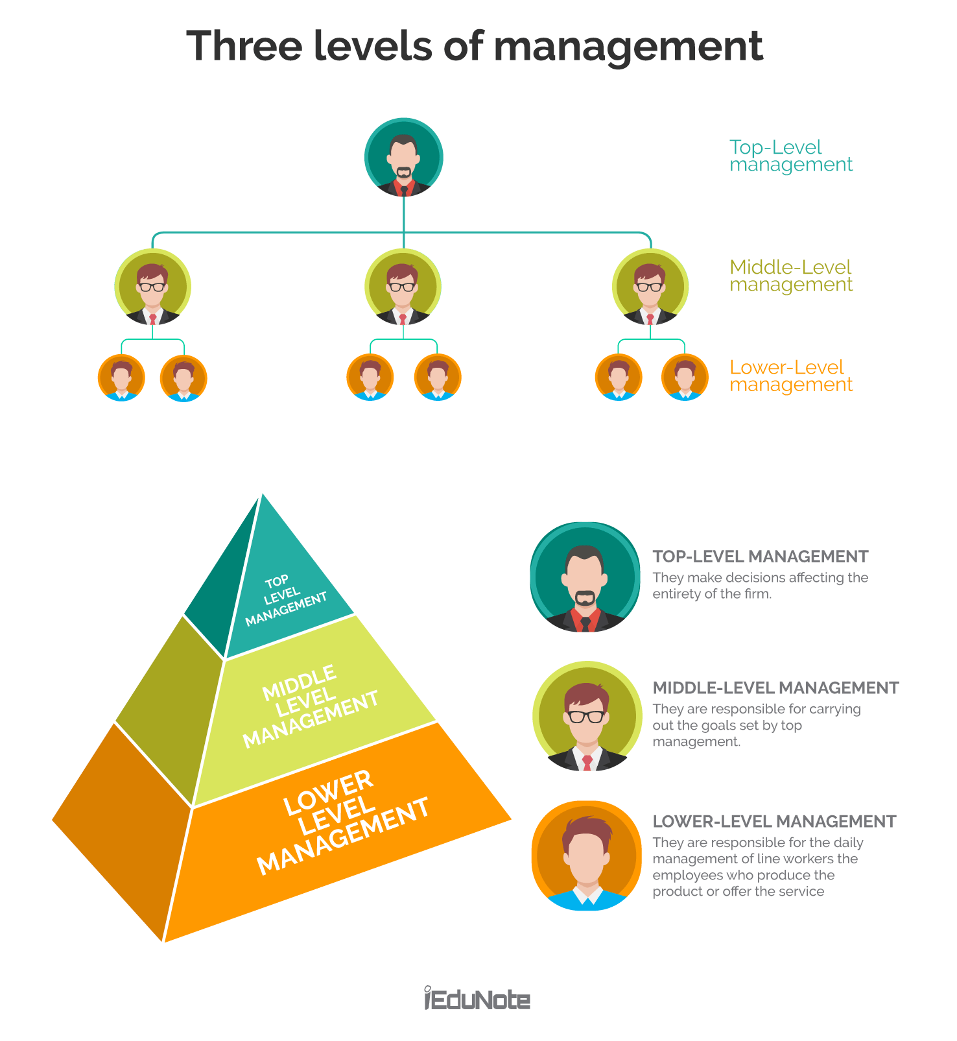

WHO ARE THE END USERS?

Slide 7

OUR SOLUTION AND ITS VALUE PROPOSITION
Conditional Formatting- Missing
Filter-Sort
Formula-Performance
Pivot-Summary
Graph- Data visualization

Slide 8
Dataset Description
Employee Data - Edunet
26- Features
9-Features
Emp Id- Num
Name- Text
Emp Type
Performance Level
Gender- Male, Female
Employee Rating- Numerical Values

Slide 9

THE "WOW" IN OUR SOLUTION
Performance Level =IFS(Z8>=5,"VERY HIGH",Z8>=4,"HIGH",Z8>=3,"MED",TRUE,"LOW")
3/21/2024 Annual Review
9

Slide 10
MODELLING
Data Collection
Data fetched from Edunet portal for set of employee
Feature Collection
Segregating features of employee data from the whole dataset
Data Cleaning
Filtering out original values required by removing the blank data in the sheet
Performance Level
Performance level is measured by using the employee rating given for every individual
10

Slide 11
MODELLING
Summarisation
Summarising the dataset by using Pivot table
Visualisation
Visualised the dataset using charts

Slide 12
RESULTS
12

Slide 13
RESULTS

Slide 14
Conclusion
Employee Performance has been implemented to cater the needs of company employees and administrative people of the company in submitting appraisals, evaluating the appraisals, calculating the average ratings of the employees and finally generating the consolidated ranks effectively with role based access. The resultant data will be used by our model to analyze and predict the performance levels of new individuals thus making the recruitment process simpler. The final result of the analyzed data is that 51% of the employees are rated as “Medium”, 25% as “Low”, 14% as “High”, 9% as “ Very High”.

