Slide 1


K.RAMAKRISHNAN COLLEGE OF TECHNOLOGY
(AUTONOMOUS), TRICHY.
DEPARTMENT OF
COMPUTER SCIENCE AND ENGINEERING
20CS5501 DESIGN PROJECT-1
Batch No. : 05
Date : 07.12.2024

Slide 2
Virtual Text Assistant
Guided by Team
Dr.C.Shyamala M.E.,Ph.D., Subhika S (811722104158)
Associate Professor, CSE Swetha M (811722104166)
Swethalasmi G (811722104167)

Slide 3
OBJECTIVE OF THE PROJECT
The objective of a virtual text assistant is to provide users with a seamless, efficient, and personalized experience for accessing information, completing tasks, and facilitating communication.
Information Retrieval: Quickly and accurately provide users with answers to queries, whether for general knowledge, technical information, or current events.
Engagement and Learning: Provide a conversational, human-like interaction to enhance user engagement and improve understanding of complex topics.
Confidentiality and Security: Ensure user data and interactions are private and secure. Maintain user data confidentiality and secure interactions.
Streamlining Communication: Facilitate clear and efficient text-based interactions for answering queries and solving problems.

Slide 4
ABSTRACT
A Virtual Text Assistant (VTA) is an AI-powered system designed to interact with users through natural language processing (NLP) to provide assistance in performing a wide range of tasks.
By leveraging machine learning and deep learning techniques, a VTA can understand, process, and respond to text-based inputs, offering users personalized support.
These systems can handle tasks such as answering queries, managing schedules, generating content, and providing recommendations. The VTA is often integrated into various platforms, enhancing user experience by delivering instant, automated, and efficient services.
The evolution of VTAs is driven by advancements in AI, enabling more accurate and human-like interactions. Their applications span from personal use to business contexts, improving productivity, customer support, and decision-making processes.

Slide 5
LITERATURE SURVEY
TITLE OF THE PAPER | AUTHOR (S) | PUBLISHER | PAPER GIST | TECHNOLOGY USED
A Survey of Virtual Assistant using Machine Learning | Simhadri Madhuri | Journal of Advanced Research in Dynamical & Control Systems | This paper provides a overview of virtual assistants, focusing on their applications, challenges, and the role of machine learning in their development. | Machine Learning, Natural Language Processing (NLP), Speech Recognition
Survey on Virtual Assistant: Google Assistant, Siri, Cortana, Alexa | Patel .R Singh .T | 4th International Symposium SIRS 2018, Bangalore, India | This paper presents a comparative analysis of popular virtual assistants like Google Assistant, Siri, Cortana, and Alexa | Natural Language Processing (NLP), Machine Learning, Speech Recognition
SURVEY ON SMART VIRTUAL TEXT ASSISTANT | Zhang .X Wang .Y | International Research Journal of Engineering and Technology (IRJET) | This paper explores the evolution of virtual voice assistants, their applications, and the challenges faced in their development | Natural Language Processing (NLP), Machine Learning, Speech Recognition
Developing multilingual text assistants | Garcia .M Lopez .J | International Journal of Research and Analytical Studies (IJRASET) | This paper focuses specifically on the role of natural language processing in virtual voice assistants. It discusses techniques like intent recognition, entity extraction, and dialogue management | Natural Language Processing (NLP)
Ethics in conversational AI systems | Johnson .L Murphy .P | International Journal of Computer Applications | This paper provides a broad overview of virtual personal assistants, covering their history, current state, and future trends. | Natural Language Processing (NLP), Machine Learning, Artificial Intelligence (AI)

Slide 6
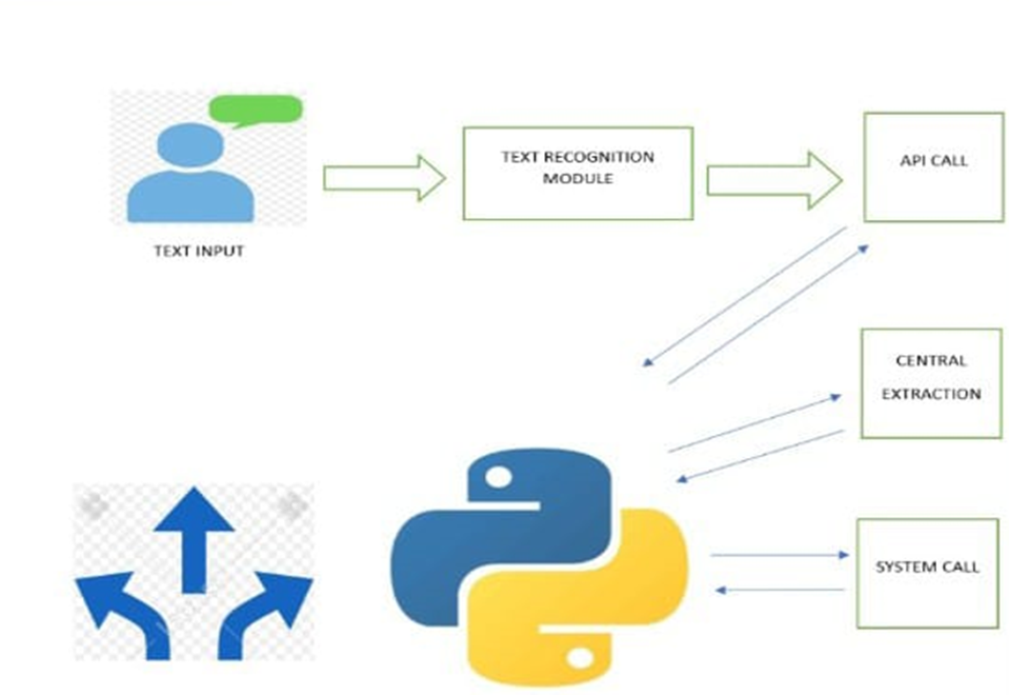
PROPOSED SYSTEM ARCHITECTURE

Slide 7
EXISTING SYSTEM ARCHITECTURE
The existing system for a virtual text assistants are implemented with multiple algorithm like Amazon Alexa found in echo devices and smart home products to have capabilities like task management.
Apple Siri has strong emphasis on privacy and localized processing and integration with Apple’s ecosystem.
Microsoft Cortana has limited customer presences but widely used in enterprise environment.
Samsung Bixby was integrated into Samsung devices with multilingual support.
IBM Watson assistant has AI conversational with multichannel platform.

Slide 8
SOFTWARE AND HARDWARE REQUIREMENTS
HARDWARE
SOFTWARE
Processor: Intel i5
RAM : 4GB(min) , 8GB(recommended)
Storage :256 GB SSD(min)
Operating system windows 11
Visual studio code
Python IDE
Python libraries
Python modules

Slide 9
MODULES
Pyttsx3
PyWhatKit
Wikipedia
Date and time
Web browser
Pyjokes

Slide 10
SUMMARY OF MODULE-1
Pywhatkit
It is a python library for sending messages at a certain time. It is an inbuilt libraries to ease our work. It can also be used for converting text into handwritten text images. The features are:
1.Send WhatsApp message
2.Play a YouTube video
3.Perform a google search
4.Get information on a particular topic
5.Sending mails with HTML code

Slide 11
SUMMARY OF MODULE-2
Wikipedia
The feature that enables user to access and retrieve content directly from Wikipedia, a free and widely used online encyclopedia. This module is commonly used to quickly access reliable general knowledge and explore diverse topics. With this module user can perform tasks such as:
1.Searching Wikipedia
2.Content Retrieval
3.Citations and Sources

Slide 12
SUMMARY OF MODULE-3
Pyttsx3
It is a python library used for text-to-speech conversion. It provides a way to convert written text into spoken words, allowing python programs to interact with users through auditory output.
Key features:
1.Cross-platform support
2.Voice customization
3.Offline functionality
4.Ease of integration

Slide 13
SUMMARY OF MODULE-4
Web browser
It allows you to control and open web pages in a browser directly from your python script. It’s a part of python’s library and provide provides interface to open URLs in the default or specific web browser.
Practical Use Cases:
1.Automating access to web-based dashboards or tools.
2.Opening web pages for educational or demonstration purposes.
3.Creating simple python scripts for personal browsing shortcuts.

Slide 14
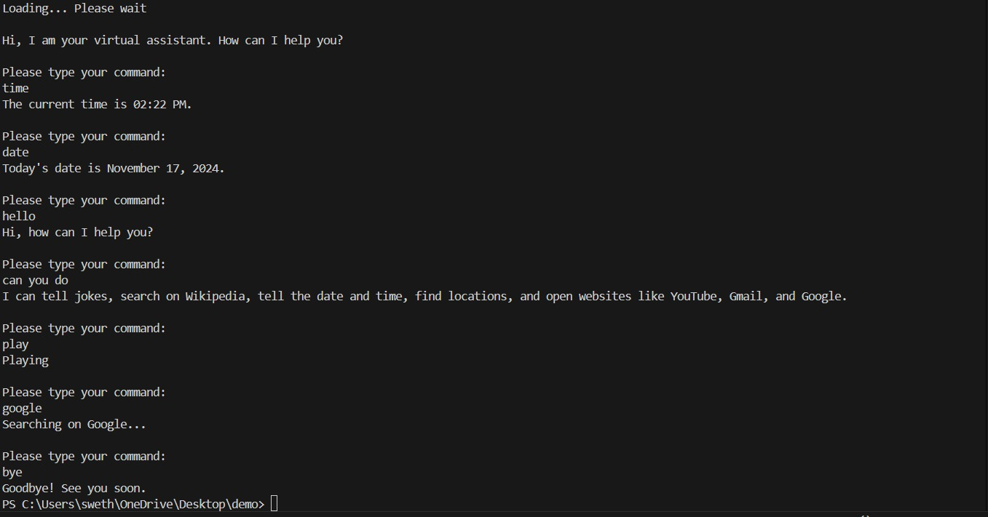
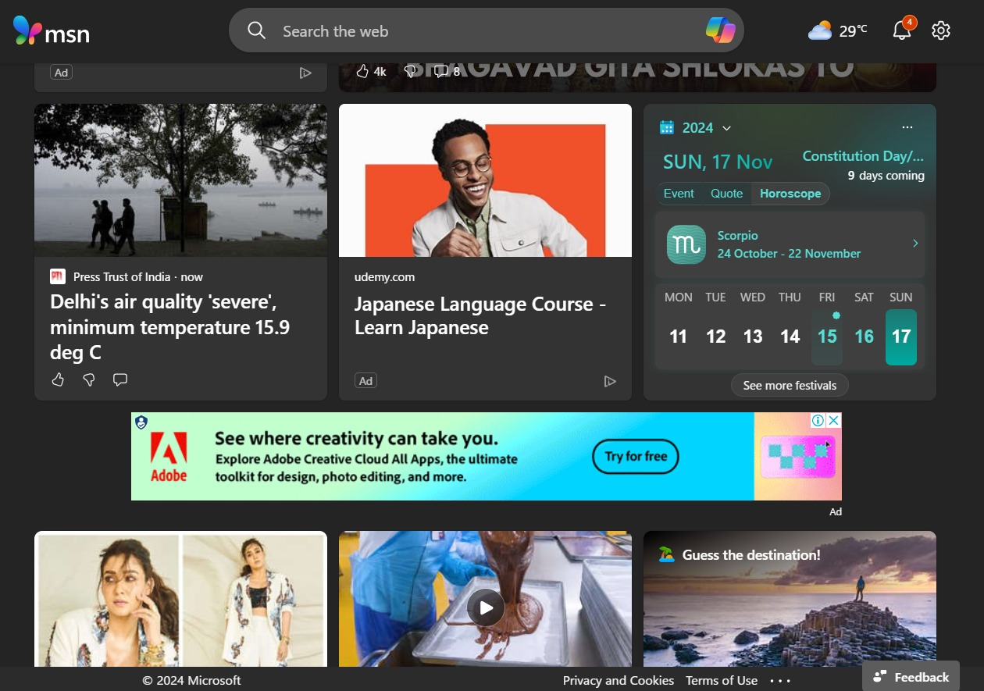
RESULTS AND DISCUSSION

Slide 15
CONCLUSION
In a conclusion, a virtual text assistant is a powerful tool that leverages artificial intelligences to provide efficient, interactive and personalized communication. It can perform a wide range of such as answering question, managing schedules, automating repetitive activities and enhancing productivity. As virtual assistants continue to evolve, they are becoming more integrated into daily life an workplaces, revolutionizing the way we interact with technology. The future holds potential for even smarter, context-aware, and human-like virtual assistants, bridging the gap between humans and machines.

Slide 16
THANK YOU

