Slide 1
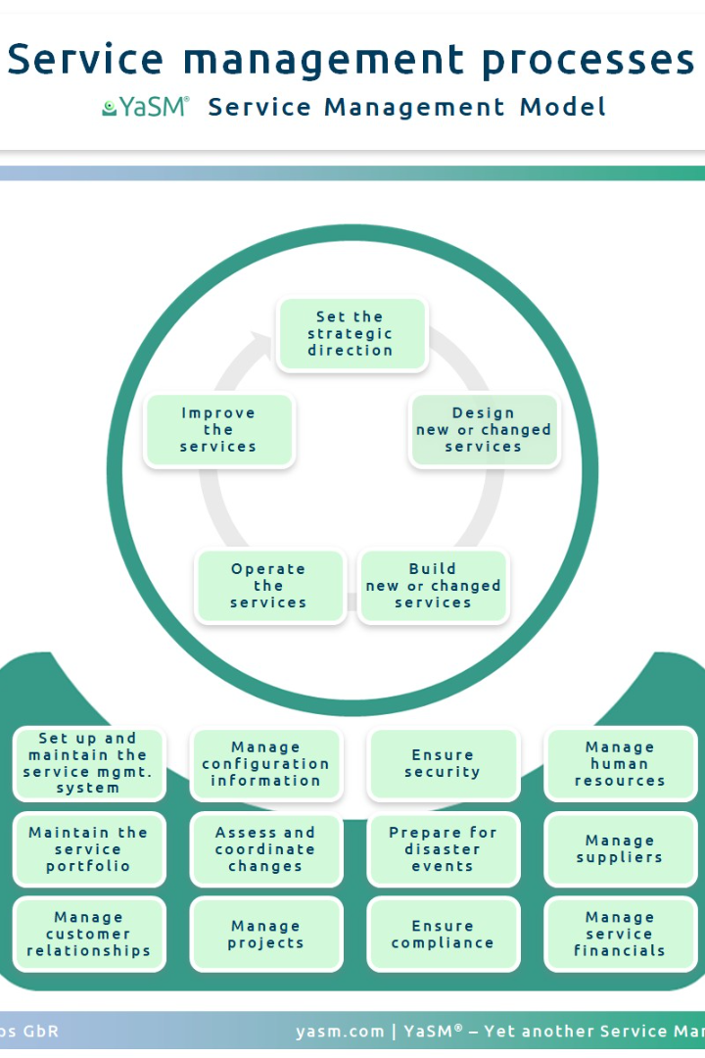


Understanding Process Handling Utilities
Process handling utilities are essential tools and commands used in operating systems to manage and control processes. These utilities enable users to monitor, manipulate, and optimize system processes effectively. In this presentation, we will explore some of the most commonly used process handling utilities and their functionalities.
by Swetha Lakkavattula

Slide 2

ps (Process Status)
The ps command is used to display information about currently running processes. It provides valuable insights into the current state of the system and helps identify resource-consuming processes.
To use ps, simply type ps [options] in the terminal.
For example, running ps aux will display a list of all running processes, their resource utilization, and other relevant details.

Slide 3

top
top is a powerful process monitoring utility that provides a dynamic and real-time view of system processes. It offers a comprehensive overview of CPU and memory usage, as well as other system statistics.
To use top, simply run it in the terminal. It will continuously update and display a list of active processes, their resource consumption, and other relevant information.

Slide 4

kill
The kill command is used to terminate or signal processes. It allows users to gracefully shut down misbehaving or unnecessary processes.
The basic syntax for kill is kill [signal] [pid].
For example, to terminate a process with a specific PID, you can use the command kill 12345. This will send a termination signal to the process and stop its execution.

Slide 5

killall
The killall command is similar to kill, but instead of targeting processes by their PID, it terminates or signals processes by their name.
The syntax for killall is killall [options] process_name.
For example, to terminate all instances of a process named "myapp", you can use the command killall myapp. This will stop all running processes with the specified name.

Slide 6

pgrep
The pgrep command is used to search for processes based on their name or other attributes and retrieve their associated PIDs (Process IDs). By specifying the relevant search pattern, you can quickly identify the processes you need.
The syntax for pgrep is pgrep [options] pattern.
For example, to find the PID of a process named "myprocess", you can use the command pgrep myprocess. This will return the PID of the matching process.

Slide 7

pkill
Similar to killall, the pkill command terminates or signals processes based on their name or other attributes. It provides a convenient way to stop multiple processes simultaneously.
The syntax for pkill is pkill [options] pattern.
For example, to terminate all processes whose name matches "myprocess", you can use the command pkill myprocess. This will effectively stop all matching processes.

Slide 8

nohup (No Hang Up)
nohup is a useful command that allows a process to run immune to hangups. It enables users to execute a command that continues running even after the terminal session is closed.
The syntax for nohup is nohup command [args].
For example, to run a long-running process in the background, you can use the command nohup ./myapp &. This will detach the process from the terminal and keep it running persistently.

Slide 9

bg (Background) and fg (Foreground)
The bg and fg commands are used to manage suspended or stopped processes. bg resumes a stopped job in the background, while fg brings a background job to the foreground.
The syntax for bg and fg is bg [job_spec] and fg [job_spec] respectively.
For example, to move a stopped job to the background, you can use the command: bg %1. To bring a background job to the foreground, you can use: fg %1.

