Slide 1



Understanding Security Permissions
Controlling access to files and directories is essential to ensure data security and privacy. This presentation covers the different security permission categories and ways to grant or revoke permissions.
by Swetha Lakkavattula

Slide 2
The Three Permission Categories
1
User (u) Permissions
User permissions apply to the owner of the file or directory. They can read, write, and execute files.
Group (g) Permissions
2
Group permissions apply to a specified group of users. Members can read, write, and execute files.
3
Others (o) Permissions
Others permissions apply to everyone else who is not the owner or in the specified group. They can read, write, and execute files.

Slide 3

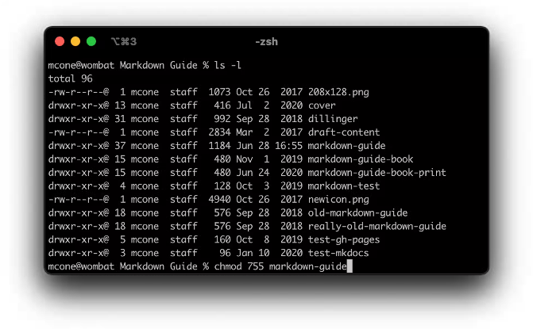
User (u) Permissions
Description
Actions
User permissions apply to the owner of the file or directory.
Users can read (r), write (w), and execute (x) files.

Slide 4
Group (g) Permissions
Description
Actions
Group permissions apply to a specified group of users.
Group members can read (r), write (w), and execute (x) files.

Slide 5
Others (o) Permissions
1
Description
Others permissions apply to everyone else who is not the owner or in the specified group.
Actions
2
They can read (r), write (w), and execute (x) files.

Slide 6
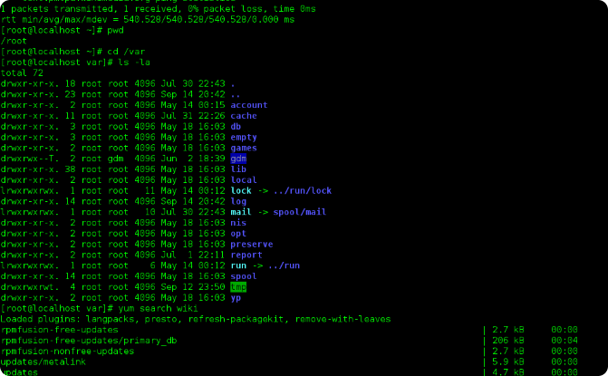
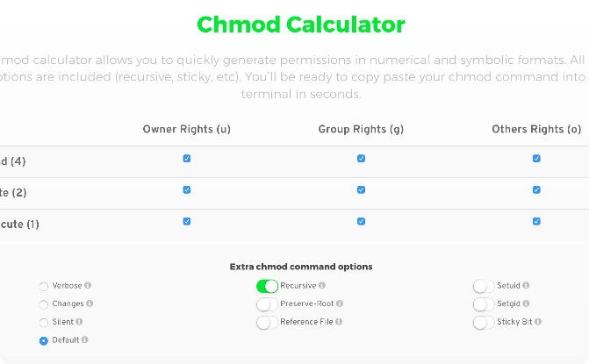
Adding Permissions
Explanation
Syntax
You can add permissions to files or directories using the chmod command.
chmod [options] permissions file(s)

Slide 7

Deleting Permissions
1
Explanation
You can delete permissions from files or directories using the chmod command.
2
Syntax
chmod -[permissions] file(s)

Slide 8
Permissions Commands
chmod
chown
chgrp
Changes file permissions.
Changes file ownership.
Changes file group ownership.
Syntax
Syntax
Syntax
chmod [options] permissions file(s)
chown [options] new_owner:group file(s)
chgrp [options] new_group file(s)
Example
Example
Example
chmod u+rwx file.txt (Grants read, write, and execute permissions to the owner of file.txt).
chown newuser:newgroup file.txt (Changes the owner to newuser and the group to newgroup for file.txt).
chgrp mygroup file.txt (Changes the group ownership to mygroup for file.txt).

Slide 9
Permissions Commands
ls
umask
getfacl
setfacl
Lists files with their permissions.
Sets default permissions for new files.
Displays Access Control Lists (ACLs).
Sets Access Control Lists (ACLs).
Syntax
Syntax
Syntax
Syntax
ls [options] [file(s)]
getfacl file(s)
setfacl [options] acl_spec file(s)
umask [options] [octal_mask]
Example
Example
Example
ls -l (Lists files in the current directory with detailed information, including permissions).
Example
getfacl file.txt (Displays the ACL information for file.txt).
setfacl -m u:username:rw file.txt (Grants read and write access to a specific user, username, on file.txt).
umask 022 (Sets the default file permissions to read and write for the owner, and read-only for others).

Slide 10
Conclusion
Summary
Key Takeaways
Understanding security permissions and efficiently managing them is essential to control file access and ensure system security.
Learn how to grant, revoke, and modify permissions for users, groups, and others using the provided commands.

