Slide 1


AI-POWERED COMPANY-SPECIFIC MOCK INTERVIEW SYSTEM
BATCH : D13
GUIDE : Mrs.Rajeshwari
TEAM MEMBERS:
Thilshi A- 211422104519
Swetha J - 211422104510
Sridevi V - 211422104474
1

Slide 2
ABSTRACT
Campus hiring requires interview preparation tailored to specific companies and job roles. Many students lack access to realistic and structured mock interview environments. Artificial Intelligence enables personalized and adaptive interview experiences. Different companies follow unique interview patterns, evaluation criteria, and skill expectations. The proposed system bridges the gap between academic learning and industry requirements. It helps students improve technical knowledge, communication skills, and interview confidence.
2

Slide 3
INTRODUCTION
The primary objective of this project is to develop an AI-based mock interview system tailored to specific companies and job roles. The system aims to simulate real-time interview scenarios using previous interview questions and job descriptions. It evaluates user responses using AI and provides structured feedback to identify strengths and areas for improvement. The platform helps students enhance technical knowledge, communication skills, and interview confidence. Ultimately, the system aims to improve student readiness and success in campus hiring processes.
3

Slide 4
PROBLEM STATEMENT
Students preparing for campus placements often lack access to realistic and company-specific interview practice. Most existing mock interview platforms provide generic questions that do not reflect actual hiring patterns of individual companies. Manual mock interviews require experienced interviewers and are difficult to scale for large numbers of students. As a result, students receive limited feedback on their technical, behavioral, and communication skills. This gap between academic preparation and real interview expectations reduces student confidence and placement success rates. Therefore, an intelligent and automated mock interview system is required to address these challenges.
4

Slide 5
EXISTING SYSTEM
Mock interviews are conducted manually or through generic online platforms.
Questions are not tailored to specific companies or job roles.
Limited availability of experienced interviewers.
Feedback is subjective, delayed, or minimal.
Not scalable for large numbers of students.
Does not provide data-driven performance analysis.
5

Slide 6
PROPOSED SYSTEM
Generates intelligent, real-time, company-specific interview questions.
Analyzes candidate responses using advanced NLP techniques.
Assesses both technical skills and behavioral attributes effectively.
Reduces manual effort in conducting and evaluating interviews.
Provides automated scoring and insightful performance analytics.
Improves hiring decision accuracy with data-driven insights.
Enhances candidate experience with AI-supported interactions..
6

Slide 7
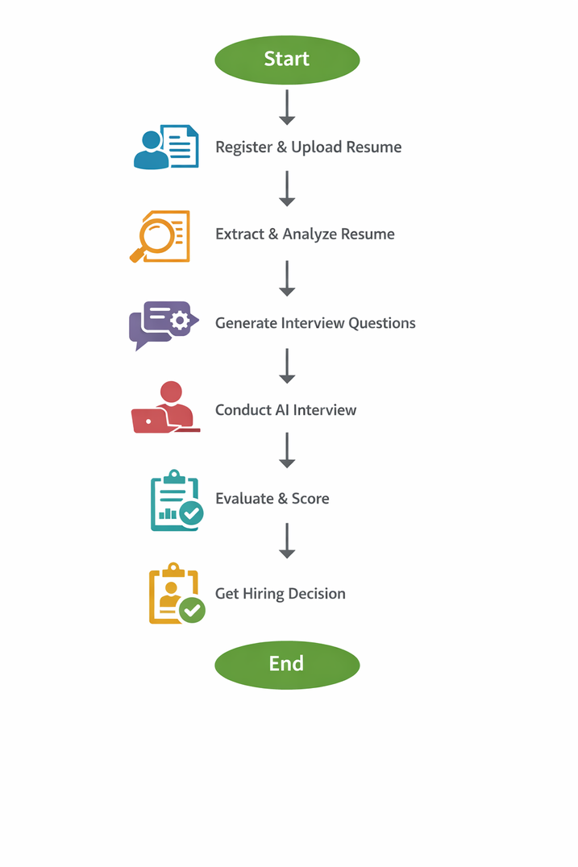
FLOW DIAGRAM
The candidate registers on the system and uploads their resume.
The system extracts and analyzes resume details using NLP techniques.
Large Language Models generate role-specific interview questions dynamically.
The candidate attends AI-driven assessment and interview rounds.
The system analyzes responses and performs automated scoring.
Performance reports and hiring recommendations are generated for HR review.
7

Slide 8
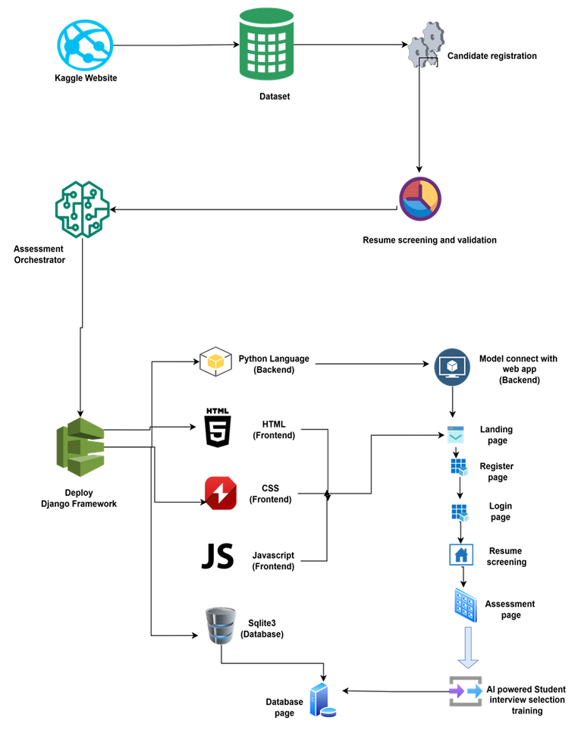
ARCHITECTURE DIAGRAM
8

Slide 9
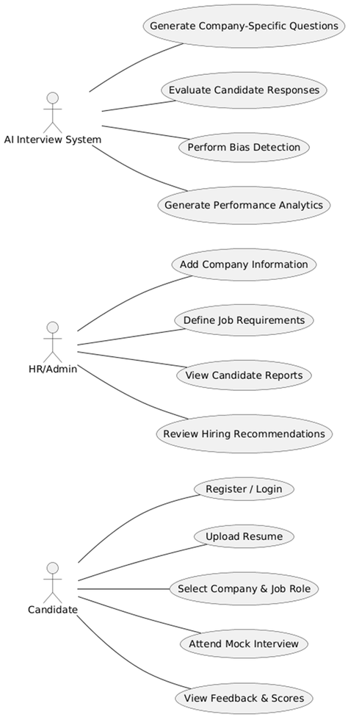
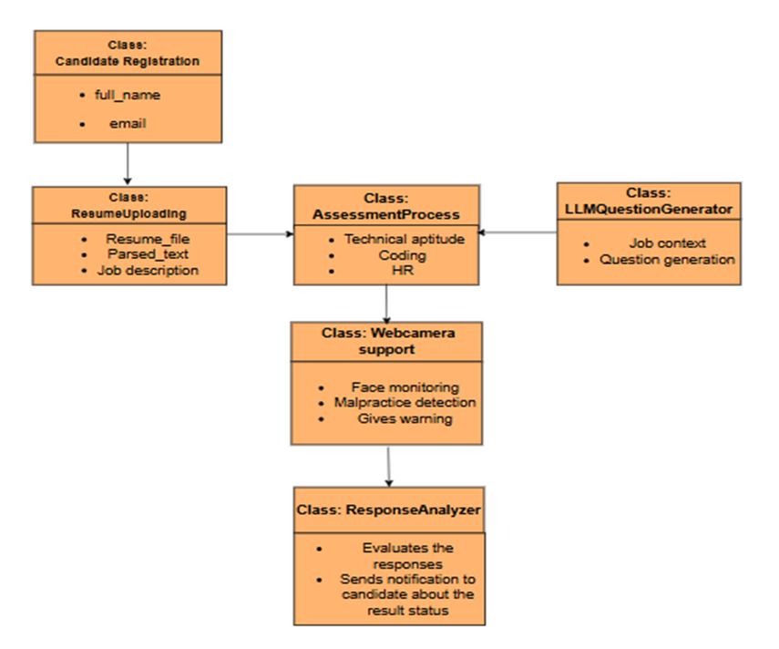
UML DIAGRAM
CLASS DIAGRAM
USECASE DIAGRAM
9

Slide 10
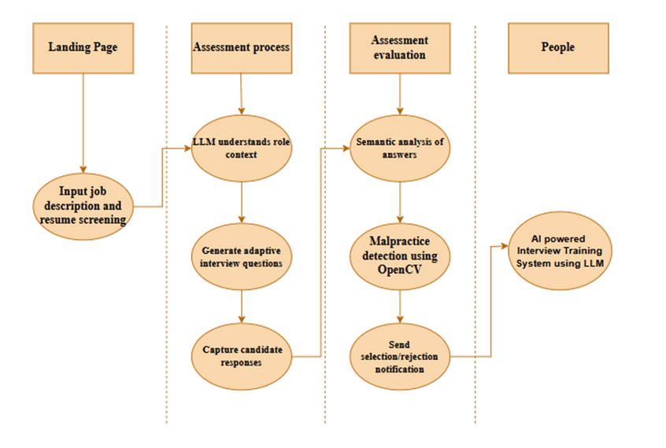
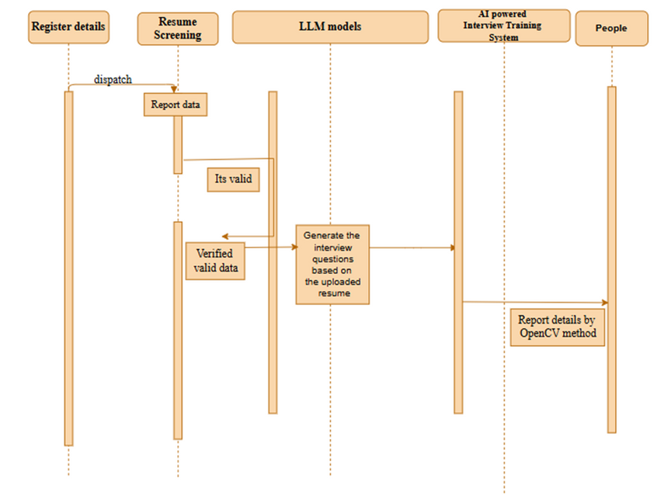
UML DIAGRAM
ACTIVITY DIAGRAM
SEQUENCE DIAGRAM
10

Slide 11
SOFTWARE REQUIREMENTS
Operating System : Windows 10 / Linux
Frontend Technologies : HTML, CSS, JavaScript
Backend Technologies : Python with Django Framework
AI & NLP Tools : Large Language Models (LLMs), Natural Language Processing (NLP), Transformer-based Models (BERT, GPT)
Machine Learning Frameworks : TensorFlow / Keras
Development Tools : Anaconda Navigator, Jupyter Notebook, Visual Studio Code
Web Browser : Google Chrome / Microsoft Edge
11

Slide 12

OUTPUT SCREENSHOTS
12

Slide 13
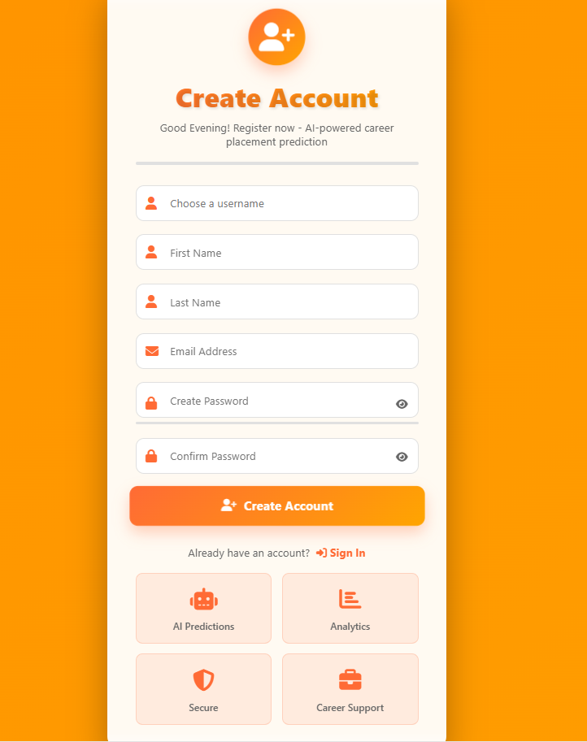
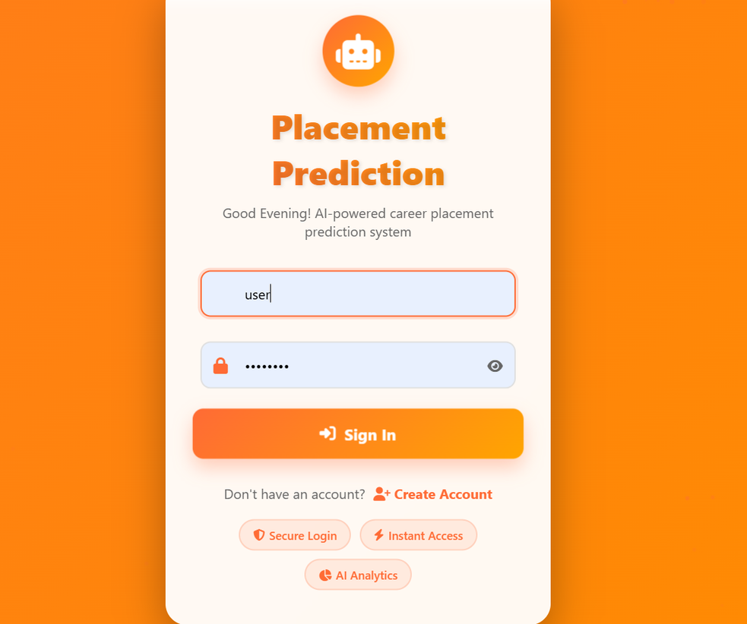
OUTPUT SCREENSHOTS
REGISTER PAGE
LOGIN PAGE
13

Slide 14
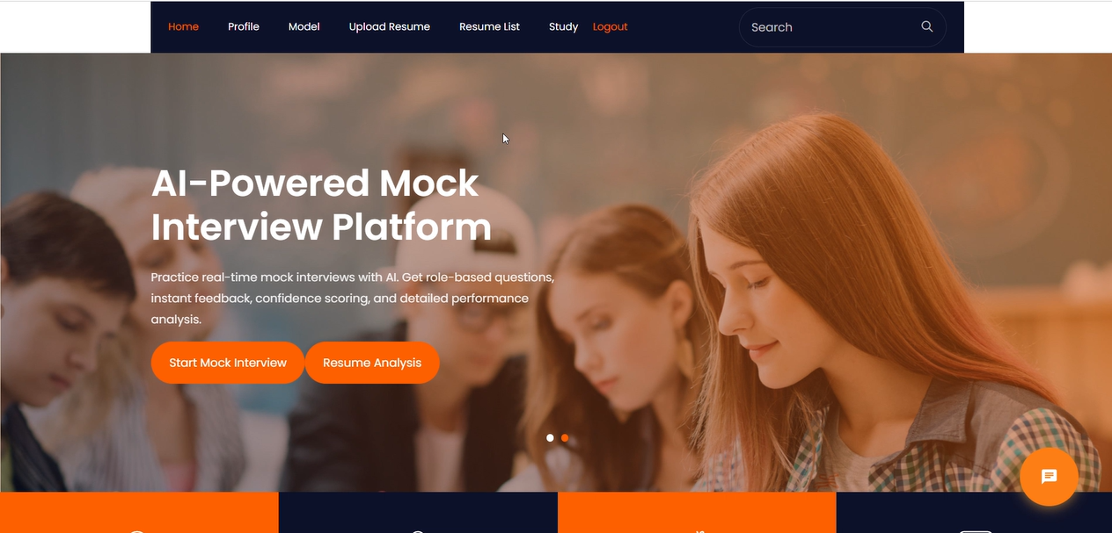
OUTPUT SCREENSHOTS
14

Slide 15
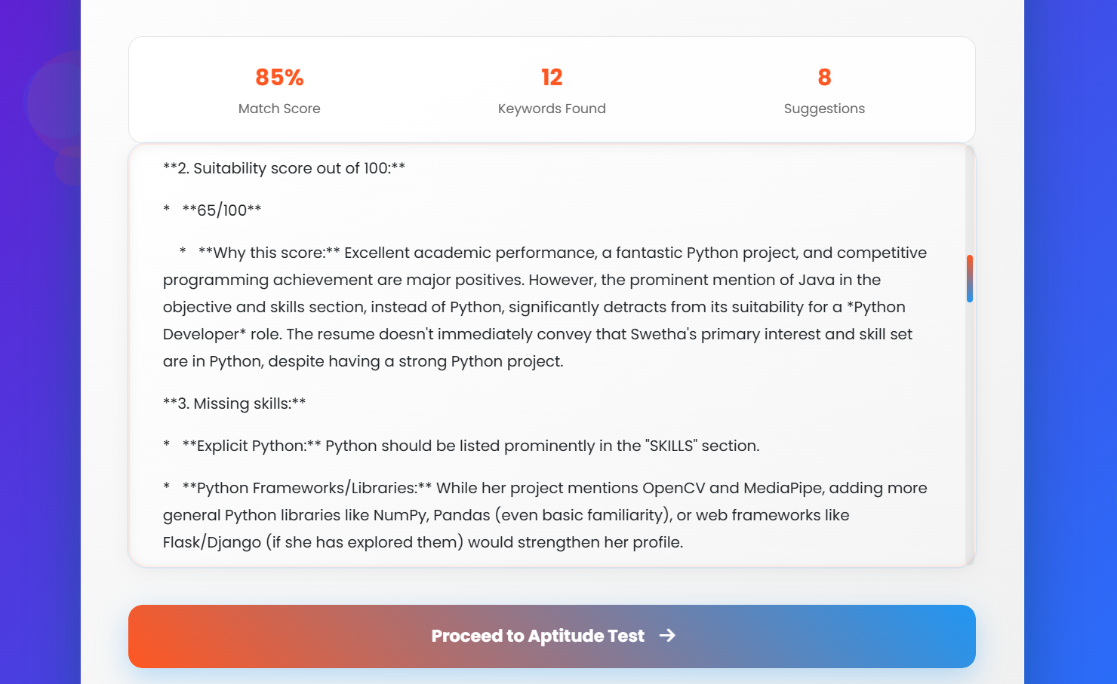
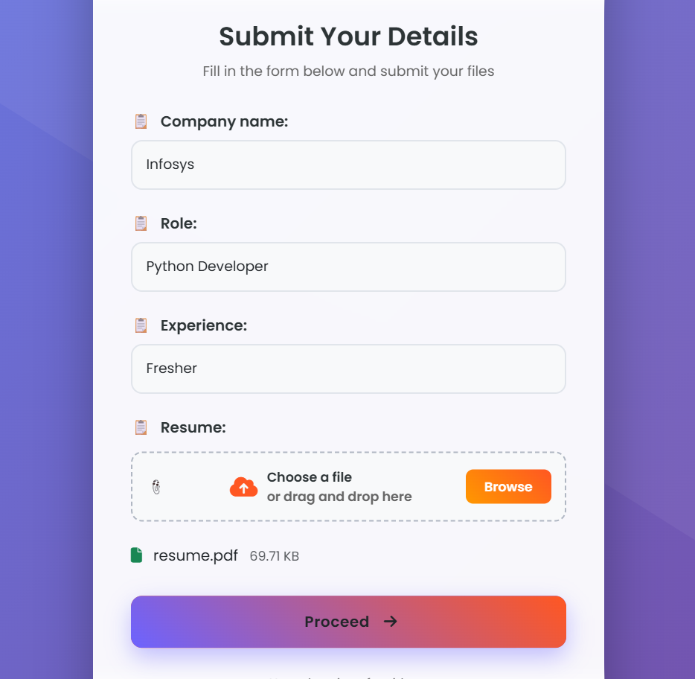
OUTPUT SCREENSHOTS
DETAILS SUBMISSION FORM
RESUME ANALYSIS
15

Slide 16
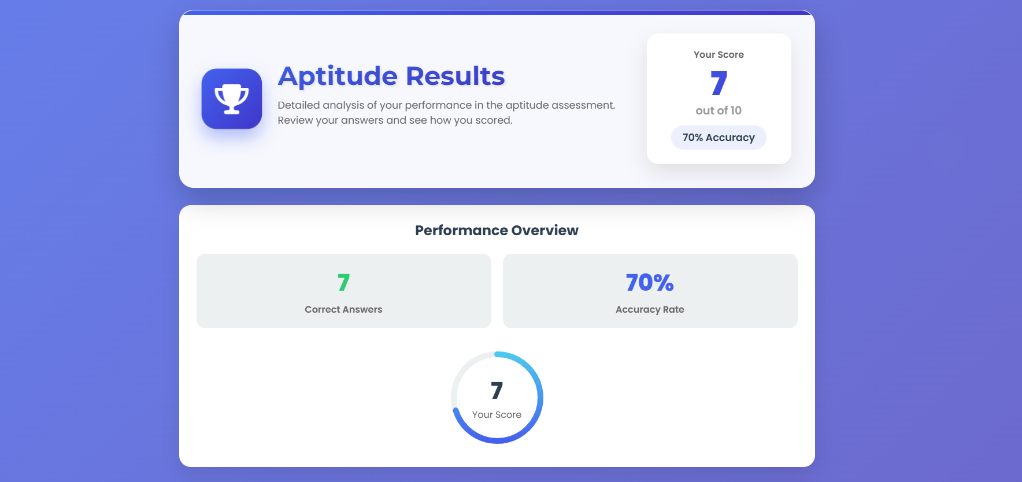
OUTPUT SCREENSHOTS
16

Slide 17
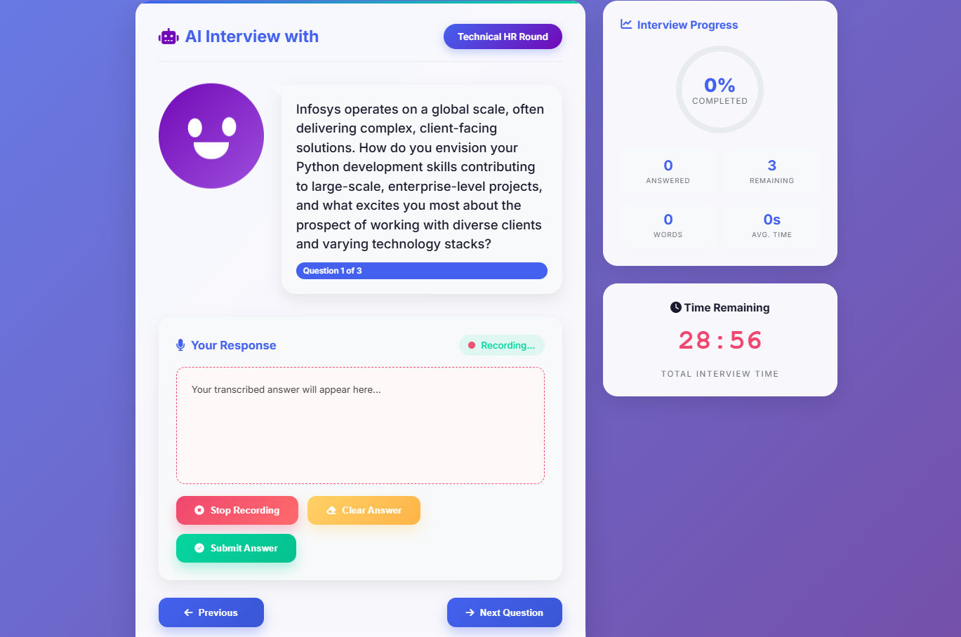
OUTPUT SCREENSHOTS
17

Slide 18
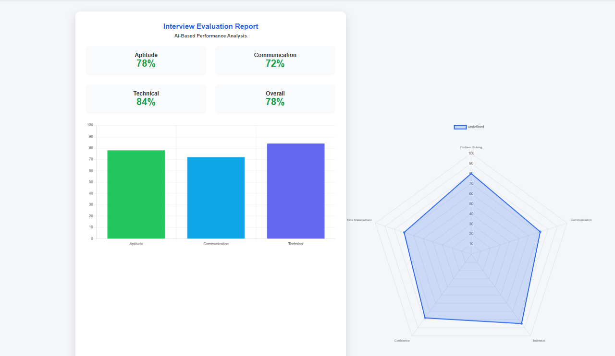
OUTPUT SCREENSHOTS
PERFORMANCE REPORT
18

Slide 19
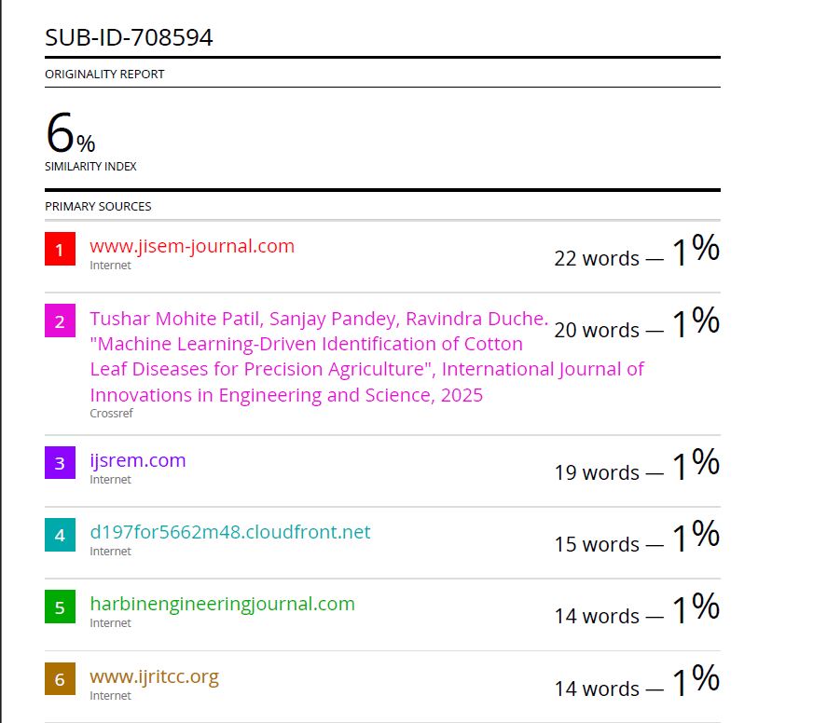
PLAGIARISM REPORT
19

Slide 20
REFERENCES
1) Bhavana Amrutha Mandalapu et al., “Enhancing Interview Evaluation: AI-Based Emotion and Confidence Analysis in Mock Interviews”, 2024
2) Chintalapati P. V. et al., “A Research Model for Automated Prediction and Analysis of Job Interview Performance”, 2024
3) M. Kaviya et al., “AI-Based Mock Interview Evaluator: An Emotion and Confidence Classifier Model”, 2024
4) Yi-Chi Chou et al., “An AI Mock-interview Platform for Interview Performance Analysis”, 2022
5) S. Sivaramakrishnan, F. Z. Minni, A. Anand, A. Sahoo, B. Hemang, “Real time mock interview evaluation using CNN”, 2024
20

Slide 21
CONCLUSION
Students often lack access to realistic, company-specific interview practice, as existing platforms offer generic questions and limited feedback. Manual mock interviews are difficult to scale and depend on experienced interviewers. To address this gap, the project proposes an AI-based mock interview system that simulates real-time, company-specific interviews, evaluates responses, and provides structured feedback to improve students’ technical skills, communication, confidence, and overall placement readiness.
21

Slide 22
THANK YOU
22

