Slide 1

“PORTFOLIO WEBSITE”
Task - 2

Slide 2
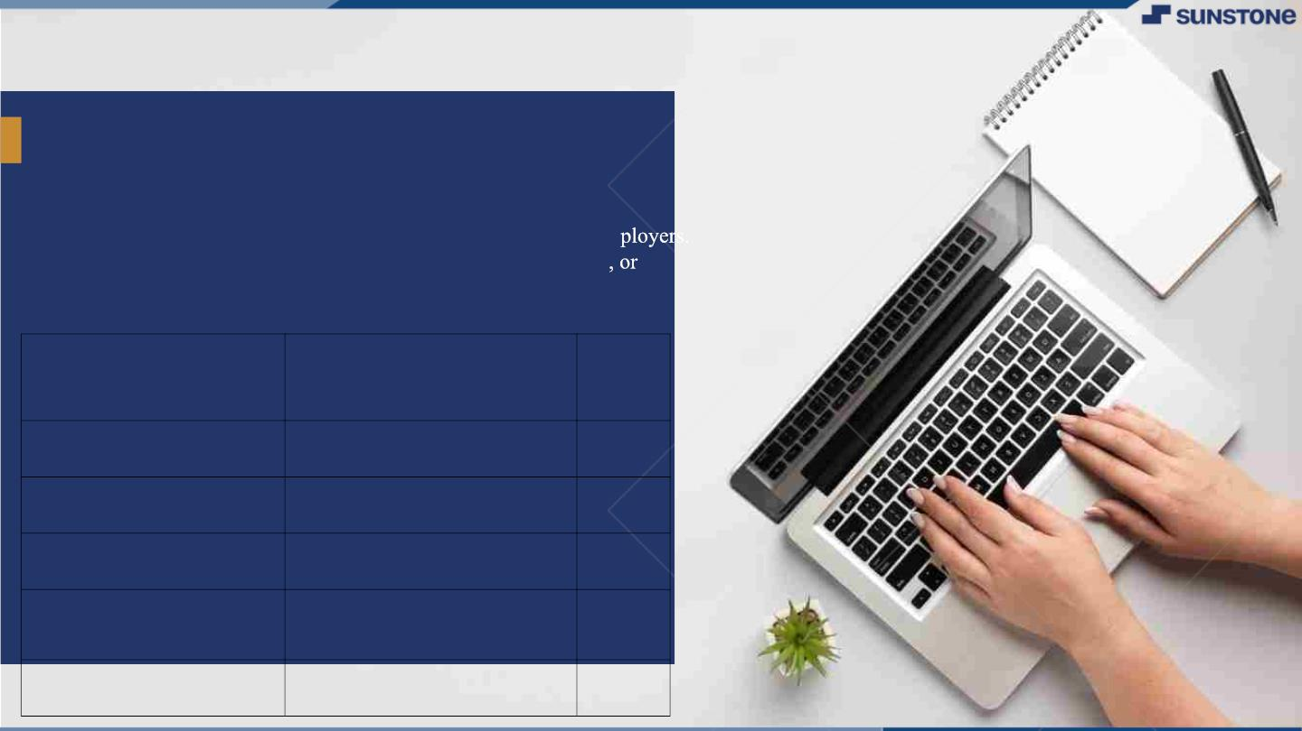
PORTFOLIO WEBSITE
INTRODUCTION: A portfolio website is a type of website that
showcases your professional work and skills to potential clients or em
It's an essential tool for any freelancer, artist, designer, photographer
creative professional who wants to market their services online.
LMS Username
Name
Batc
h
2115a1011
2115a102
2115a1019
2115a1017
NAJEETHA BANU.N
ANUROOPA.PV
SWETHA.S
A10
A10
A10
A10
SATHIYAVARSHINI.S

Slide 3

Taskꢀ-ꢀ2
CreateꢀUIꢀandꢀimplementꢀvariousꢀcomponentsꢀusingꢀreact
●
●
●
SplitꢀdesignꢀintoꢀcomponentsꢀandꢀHigherꢀorderꢀComponents
Defineꢀstructureꢀofꢀtheꢀcomponents
Setꢀtheꢀbasicꢀuiꢀcomponentsꢀwithꢀdummyꢀdata
IntegrateꢀtheꢀAPIsꢀtoꢀfrontendꢀtoꢀensureꢀtheꢀdynamicꢀfeatureꢀofꢀwebsite
●
●
●
●
●
Pointꢀbaseꢀapiꢀtoꢀtheꢀseversꢀbaseꢀurlꢀ
Designꢀapiꢀcallsꢀforꢀeachꢀelementꢀ
Handleꢀerrorsꢀinꢀtheꢀoutput
Renderꢀoutputꢀofꢀapisꢀtoꢀdifferentꢀlowꢀlevelꢀcomponents
Secureꢀcontentꢀofꢀpostꢀapisx
EvaluationꢀMetric:
● 100%ꢀCompletionꢀofꢀtheꢀaboveꢀtasks
Learning Outcome
▪
▪
▪
▪
DevelopingꢀcomplicatedꢀUIꢀusingꢀreactꢀcomponents
Usingꢀpropsꢀdrillingꢀandꢀcontextꢀtoꢀpassꢀvariables
Gettingꢀfamiliarꢀwithꢀdifferentꢀtypeꢀofꢀapiꢀcalls
Handlingꢀdifferentꢀinputꢀdata

Slide 4

Step-WiseꢀDescription
• PLAN YOUR WEBSITE: Decide on the design, layout, and structure of our website. Consider our
audience and what We want to communicate through your portfolio.
• SET UP YOUR DEVELOPMENT ENVIRONMENT: Install a code editor, such as VSCode or Sublime
Text, and a web browser to preview our work.
• CREATE THE HTML STRUCTURE: Begin by writing the HTML code for the basic structure of our
website. Start with the header, which should include the navigation menu and your logo or name. Then
add the main content, which we included sections for our portfolio items, about me, and contact
information.
• STYLE WITH CSS: Once you have the basic HTML structure, add CSS to style the website. Use CSS to
change the font, color, layout, and overall design of the website. we can also use CSS to add effects like
hover animations, background images, and transitions.
• ADD IMAGES AND MULTIMEDIA: Enhance our portfolio by adding images and multimedia, such as
videos or audio recordings. Use HTML to embed media and CSS to control the display.
Summaryꢀofꢀyourꢀtask
The summary is that creating a front-end portfolio website using HTML and CSS involves planning the
design, setting up a development environment, creating the HTML structure, styling with CSS, adding
multimedia content, testing, optimizing, and publishing the website. This involves considering the audience
and what to communicate, using a code editor, creating a header and main content, using CSS to style and
add effects, adding multimedia, testing the website and optimizing it, and publishing it using a hosting
service.

Slide 5

Submission Github
https://github.com/swethasenthilnathan63/Swetha_Senthilnathan

Slide 6


