Slide 1
Introduction to Artificial Intelligence
Introduction to Artificial Intelligence involves key concepts and fundamental ideas
It helps in understanding important aspects related to the topic
Various techniques and methods are applied in this area
This plays a significant role in real-world scenarios
Introduction to Artificial Intelligence involves key concepts and fundamental ideas

Slide 2
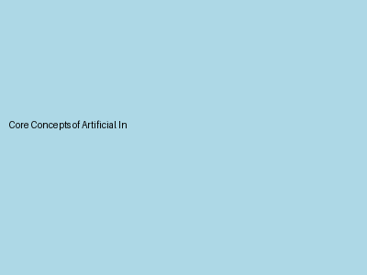
Core Concepts of Artificial Intelligence
Core Concepts of Artificial Intelligence involves key concepts and fundamental ideas
It helps in understanding important aspects related to the topic
Various techniques and methods are applied in this area
This plays a significant role in real-world scenarios
Core Concepts of Artificial Intelligence involves key concepts and fundamental ideas

Slide 3

Detailed Explanation of Artificial Intelligence
Detailed Explanation of Artificial Intelligence involves key concepts and fundamental ideas
It helps in understanding important aspects related to the topic
Various techniques and methods are applied in this area
This plays a significant role in real-world scenarios
Detailed Explanation of Artificial Intelligence involves key concepts and fundamental ideas

Slide 4

Real-world Applications of Artificial Intelligence
Real-world Applications of Artificial Intelligence involves key concepts and fundamental ideas
It helps in understanding important aspects related to the topic
Various techniques and methods are applied in this area
This plays a significant role in real-world scenarios
Real-world Applications of Artificial Intelligence involves key concepts and fundamental ideas

Slide 5
Conclusion
Conclusion involves key concepts and fundamental ideas
It helps in understanding important aspects related to the topic
Various techniques and methods are applied in this area
This plays a significant role in real-world scenarios
Conclusion involves key concepts and fundamental ideas

