Slide 1

SNIPE TEAM
2 December 2017
www.snipe.co.in
1
Notes:
1

Slide 2

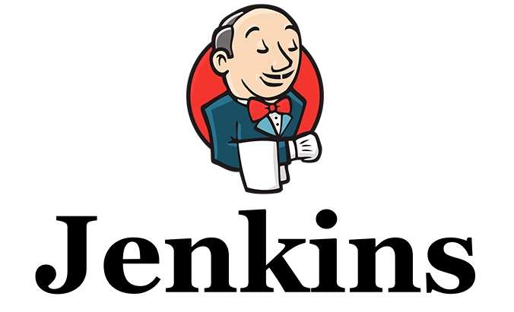
Jenkins – CI

Slide 3
Contents
What is Jenkins?
How It works?
Process Before CI
Problems Before CI
Process After CI
Alternatives of Jenkins
Jenkins Plugins
Use cases
Practical Example

Slide 4
What is Jenkins ?
It is a Continuous Integration Server.
It is an Open Source Tool.
It is written in Java.
It has over 1000+ Plug-ins which makes it widely accepted tool for CI.

Slide 5
How it Works ?
Notice a Change
Check out the Source Code
Execute the build tests
Record and Publish results
Notify Developers

Slide 6
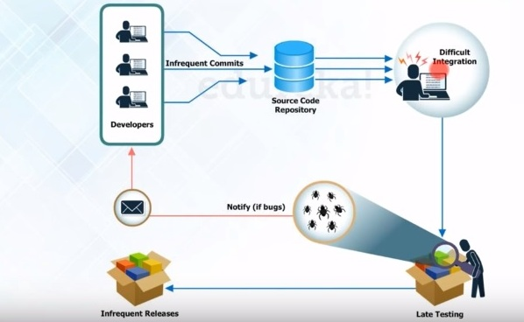
Process Before CI
Group of developers make changes to the Source code that is present in Source code repository.
( Source code repository may be Git, Subversion etc)

Slide 7
When the code is written in the repository it will be build by tools like Ant, Maven etc.
The build application is then sent for testing, if they find a bug they will notify the developer.
If there are no bugs it will be sent for production server for release.

Slide 8
Problems Before CI
Developers have to wait till the complete software is developed for the test result.
If it fails, locating and fixing bugs is very difficult.
Developer need to check the entire code of the software for bugs.

Slide 9
Software delivery process was slow.
Continuous feedback relating to coding, build failures and test status were not available.

Slide 10
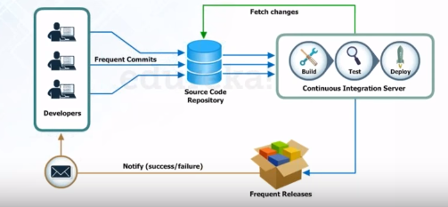
Process after CI
After every change to the source code an auto build is
triggered and is automatically deployed on the test server.

Slide 11
If the test result shows any bug in the code the developer have to check the last change made to the code.
This Increases the frequency of new software release.
The Concerned teams are notified with feedback.

Slide 12
Alternatives to Jenkins
Travis CI
Buildbot
Bamboo
JetBrains TeamCity
12

Slide 13
Jenkins Plugins
Build Tools
Test Frameworks
Ant
Maven
MSbuild
Cmake
Gradle
Junit
Nunit
MSTest
Selenium
Fitnesse

Slide 14
Use Cases
The infrastructure provided by Jenkins allows us to automate our build process.
The ability to work with numerous plugins makes it super easy to change various parts of the manual process to be fully automated.
We are mainly using Jenkins to automate many parts of out software development life cycle like:
- Build artifacts after commits. - Run integration tests. - Deploy artifacts.

Slide 15
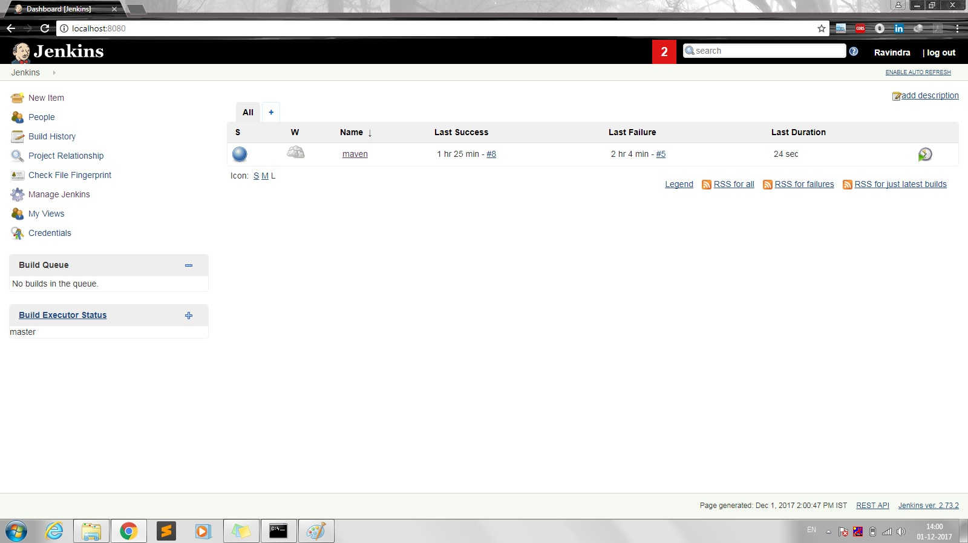
Practical Example
Jenkins DashBoard :-
All projects created are displayed here

Slide 16
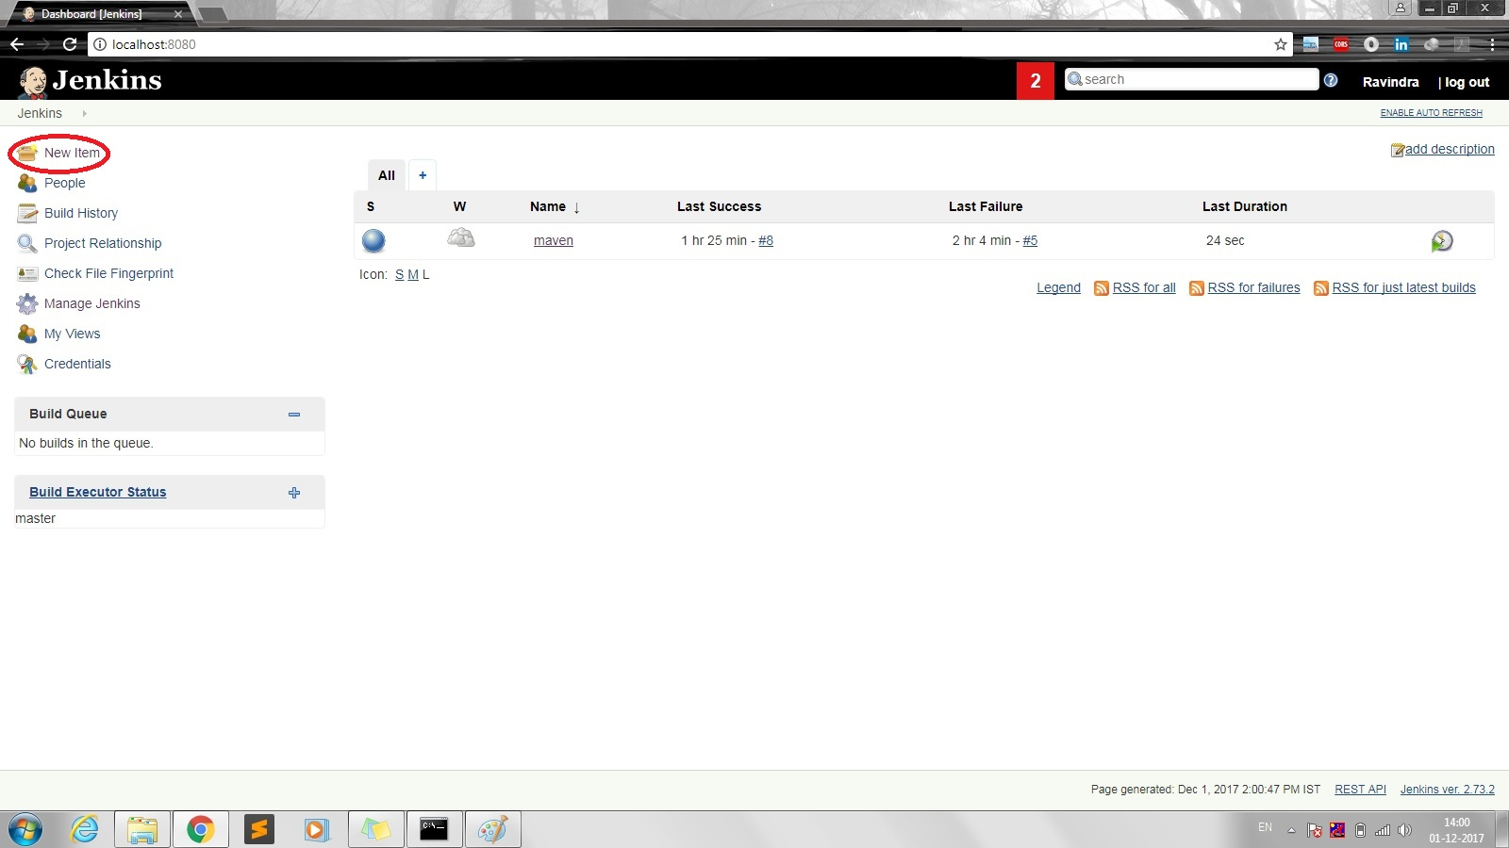
Click on New item:-
We can create new project with this.

Slide 17
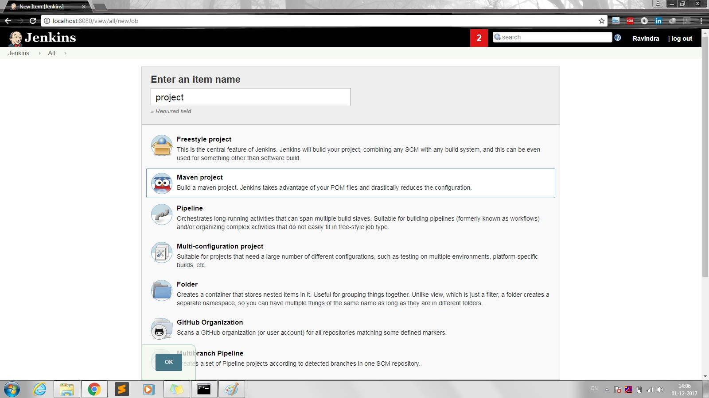
Enter item name
Select the type of project and hit OK.
Note:- Here Maven project is selected

Slide 18
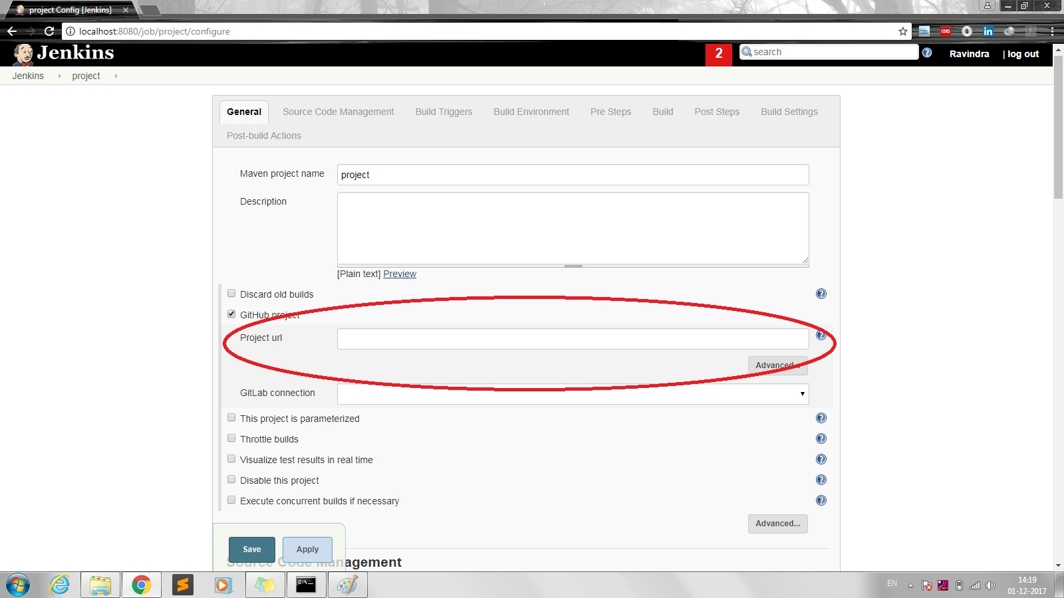
If it’s a GitHub project
Provide its GitHub project URL.

Slide 19
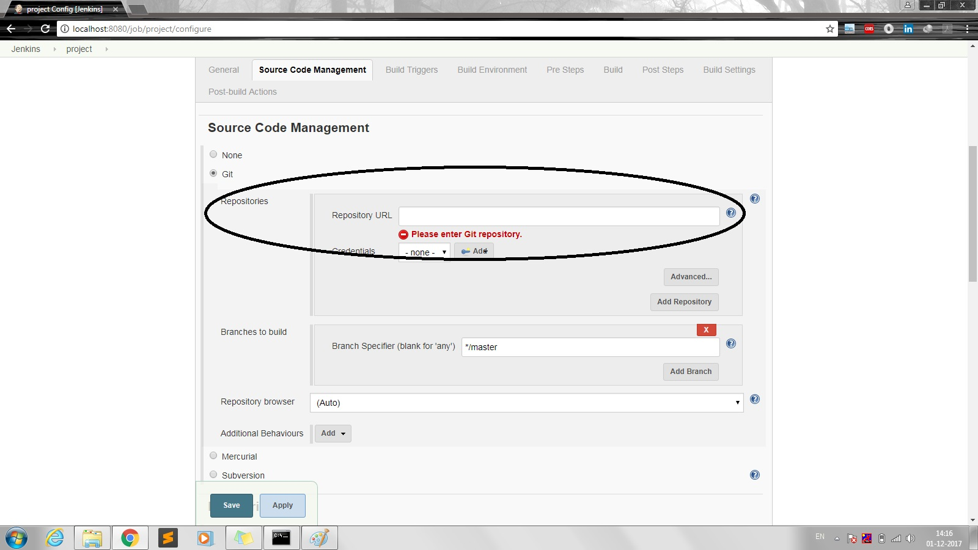
If the Source Code is in Git repository
Provide the repository URL

Slide 20
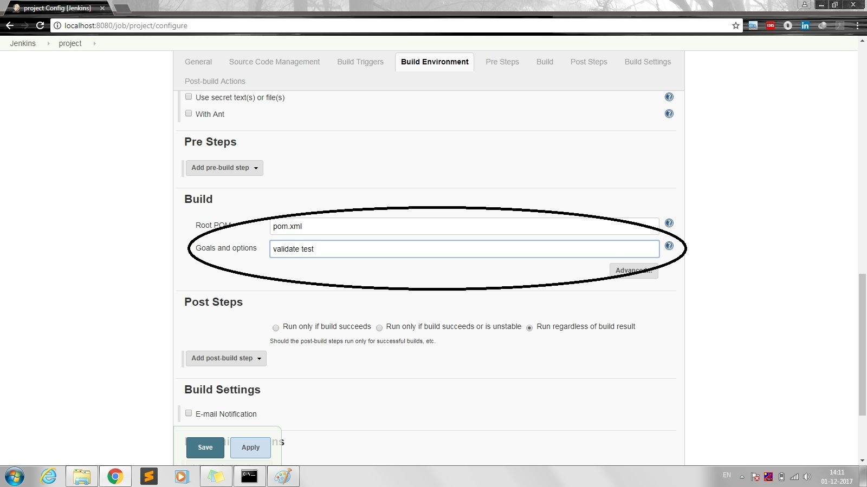
In build environment:-
Provide Root POM file as pom.xml(Default)
Provide Goals and options for project
Here I have given validate & test

Slide 21
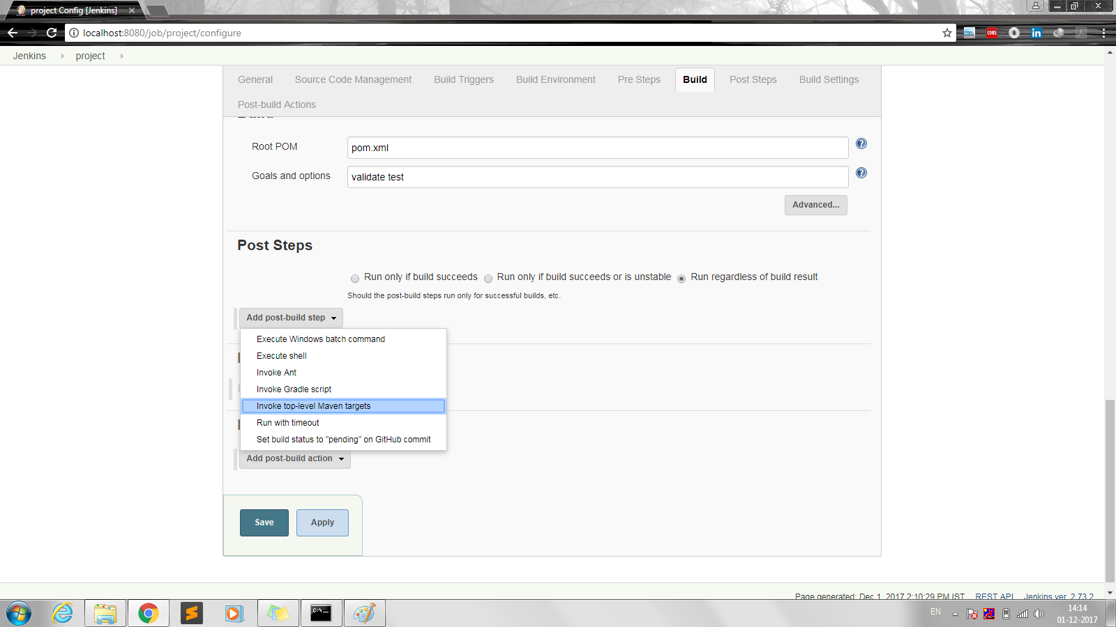
In post steps:-
Click on Add post build step
Select invoke top level maven targets from dropdown

Slide 22
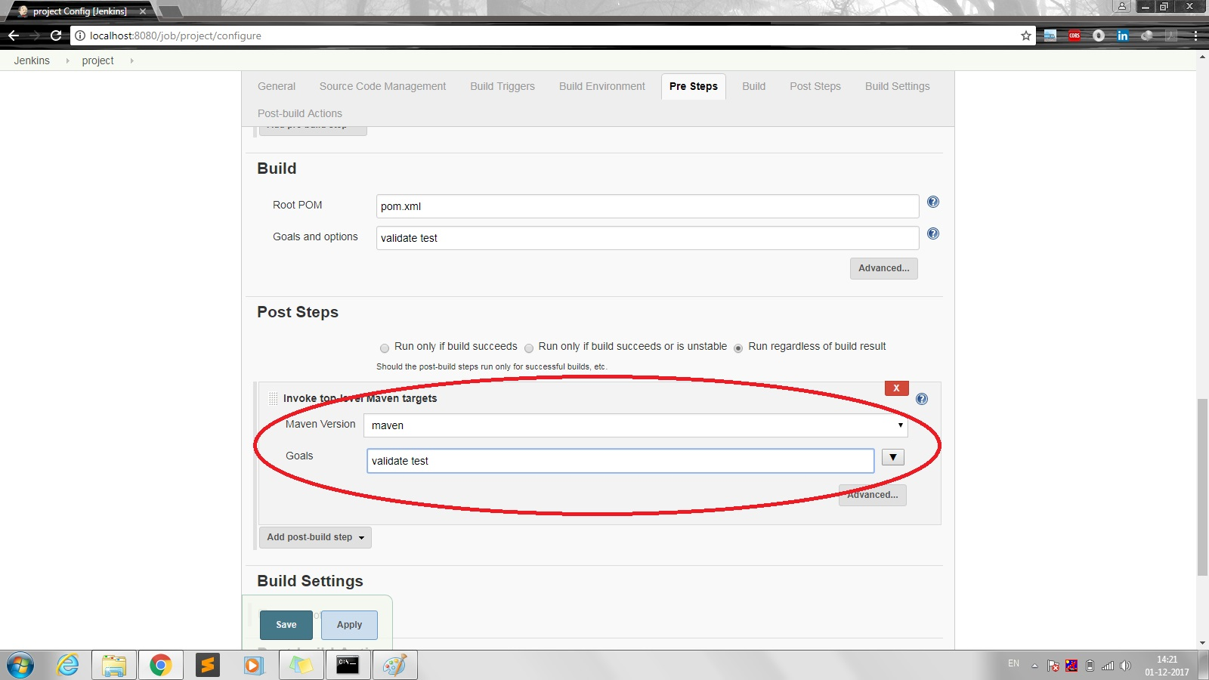
Post Steps:-
In Maven Version select maven from dropdown
Specify goals and hit Save

Slide 23
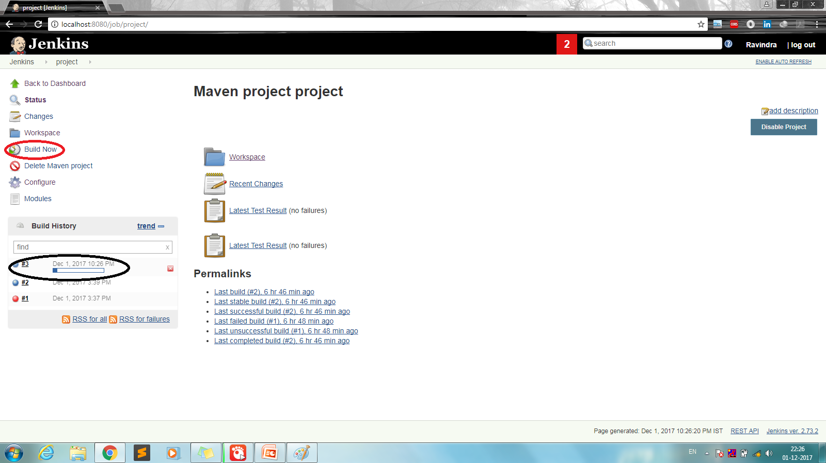
Click on build now
You can see your project build below
If there are any errors or if project fails at some
point it will be represented with red ball.
If the build is successful it will be represented with
Blue ball.

Slide 24
If the project is not present in GitHub &
If the project is present locally follow these steps below :-
After a project is created click on build now.
It will create a folder with specified project name in
C:\Program Files (x86)\Jenkins\workspace.
Add all the project files in the created folder.
Hit refresh button in browser to reflect all the files
added to the folder. You can see all the added files
in Workspace folder in Jenkins.

Slide 25
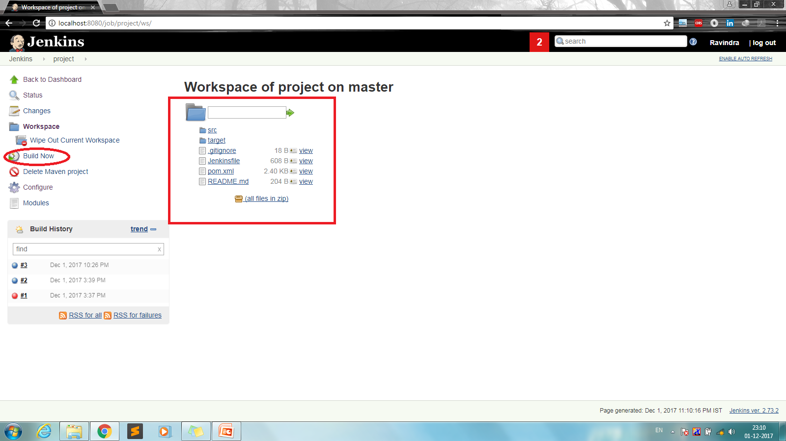
Click on build now.

Slide 26
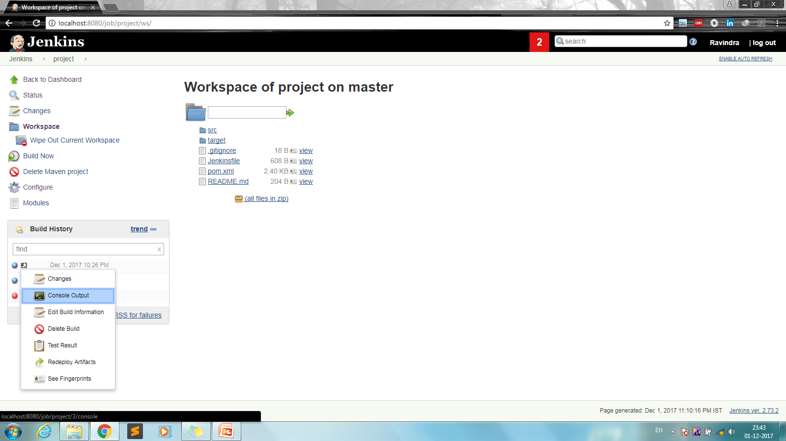
Click on the build and select console output from
Dropdown to see project under build and to check for
Errors if any.

Slide 27
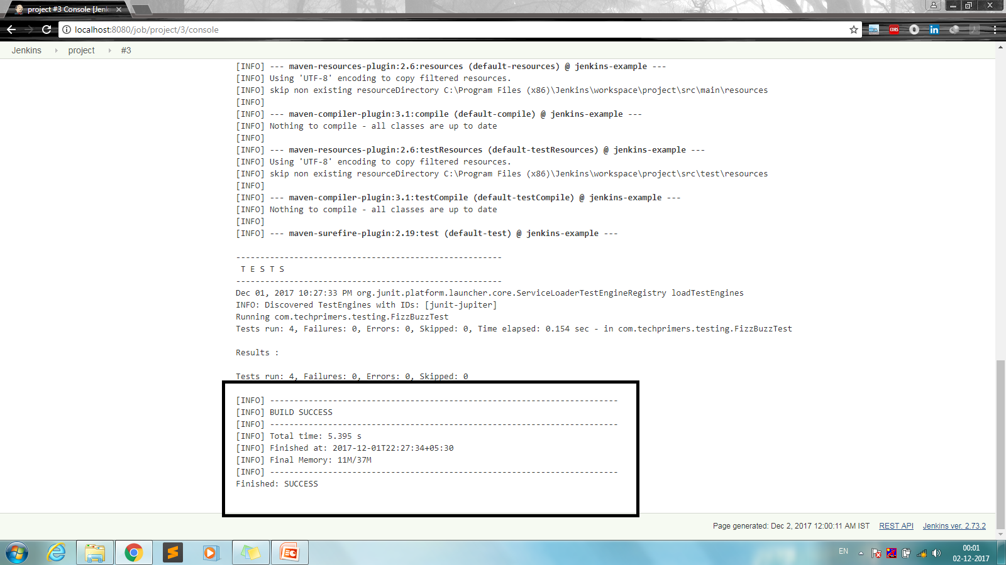
Console output:-
If there are no errors and if the project build is success
it will be displayed as shown below.

Slide 28
Thank You

