Slide 1
EDA Assignment
Swetha G

Slide 2
Analysis of Previous application data & present application data

Slide 3
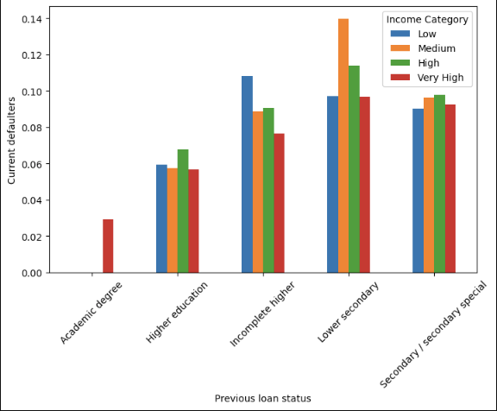

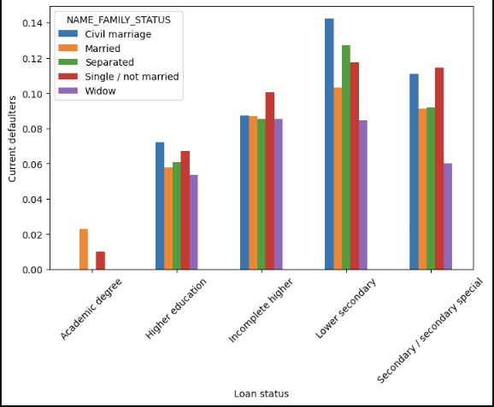
The highest default rates are observed for the "Very high" income category across all previous loan status groups. This suggests that having a very high income alone does not necessarily guarantee a lower risk of default.
For the "Low" and "Medium" income categories, the default rates are better.
The lowest default rates are observed for borrowers in the "Low" and "Medium" income categories with successful previous loans or no previous loans.
Observation: it may be advisable to exercise caution when lending to individuals with very high incomes or those with a history of defaulted or revolving loans, as they appear to have higher default rates.
Widows generally have the highest default rates compared to other family status groups across most loan types, except for the "Lower secondary" loan type not recommended to give loan for these categories
Recommended to loan for "Academic degree" and "Higher education" loan types, the default rates are relatively lower across all family status groups compared to other loan types.

Slide 4
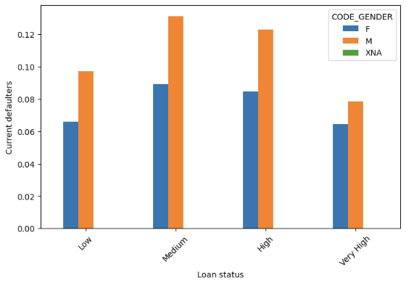
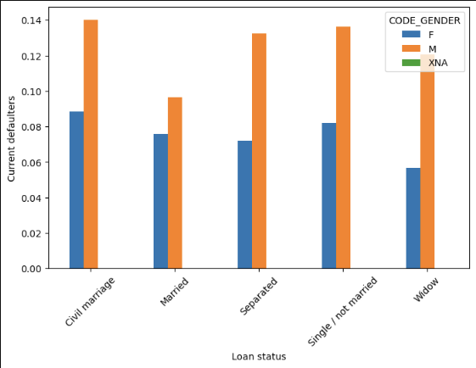
For the "Low" loan status, males tend to have a higher default rate compared to females.
For the "Medium" and "High" loan statuses, females exhibit slightly higher default rates than males.
1. For the "Children" and "Family" loan statuses, males tend to have slightly higher default rates compared to females.
2. There are no significant disparities in default rates between genders for other loan statuses like "Group or property", "Other", or "Real estate".

Slide 5
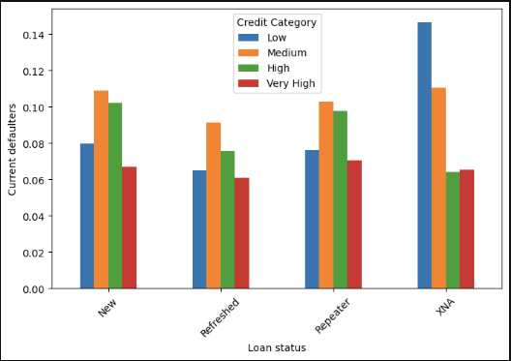
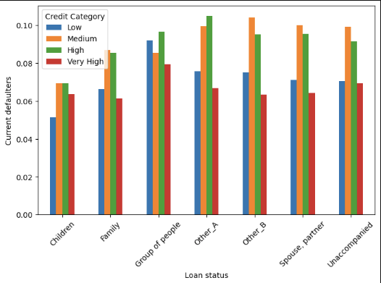
1. The "Very High" credit category has the highest overall default rate across all loan statuses.
2. Borrowers with "Low" and "Medium" credit categories tend to have relatively lower default rates.
1.For the "Low" credit category, default rates are generally low across most loan statuses, except for "Repair" loans.
2. The "Very High" credit category consistently exhibits the highest default rates across all loan statuses.
3. For the "Medium" and "High" credit categories, default rates vary depending on the loan status, with some higher-risk loan types like "Car", "Repair", and "House/Apartment"

Slide 6
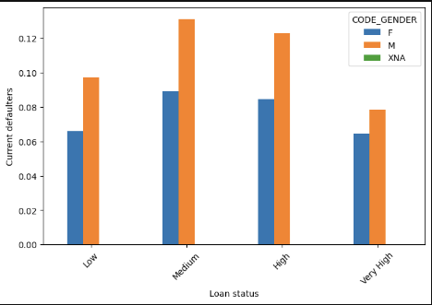
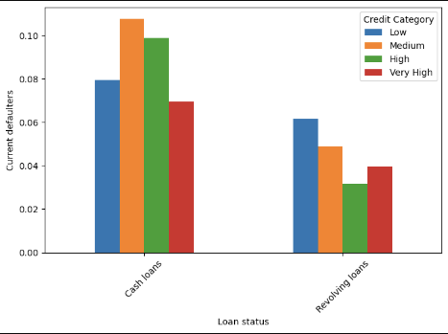
The graphs depict default rates for different income categories (low, medium, high, very high) across various loan status situations.
For the "Current" loan status in the first row, we see higher default rates for lower income categories (low and medium) compared to higher income categories (high and very high). This suggests that lower income borrowers may be more likely to default on current loans.
3. The "Renewable" loan status in the third row shows a similar trend, with lower income categories exhibiting higher default rates compared to higher income categories.

Slide 7
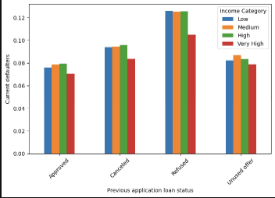
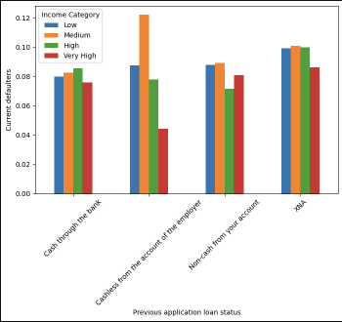
For the "Issued" loan status the default rates are generally lower across all income categories compared to "Current" loans. However, the pattern of lower income categories having higher default rates persists.
2. Cashless from the bank seems to be of more defaulter. SO it is recommended to avoid

Slide 8
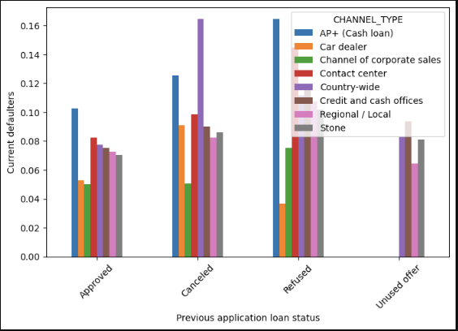
The defaulter rate is generally higher for groups with higher personal revolved utilization rates. This suggests that individuals who have higher outstanding balances relative to their credit limits are more likely to default on loans.
The group with the highest personal revolved utilization rate (above 88.5%) has the highest defaulter rate of around 0.15. This indicates that for individuals who have maxed out or nearly maxed out their credit limits, the risk of default is quite high.
The group with the lowest personal revolved utilization rate (below 50.5%) has the lowest defaulter rate of around 0.035. This suggests that individuals who maintain lower credit utilization rates are less likely to default on loans.

Slide 9
Summary
The "Very High" credit category has the highest overall default rate across all loan statuses
The highest default rates are observed for the "Very high" income category across all previous loan status groups. This suggests that having a very high income alone does not necessarily guarantee a lower risk of default.
Recommended to provide loan for Female as they are least defaulters
The defaulter rate is generally higher for groups with higher personal revolved utilization rates. This suggests that individuals who have higher outstanding balances relative to their credit limits are more likely to default on loans.
There is high for secondary education
The applicants who were previously rejected to better avoid those

Slide 10

Thank you

