Slide 1
UiPath Test Suite Automation
Test Suite Demo
Anji Reddy Tangirala
Swetha Godi
Solution Architect - RPA
RPA Developer
Miracle Software Systems, Inc.
Miracle Software Systems, Inc.

Slide 2
UiPath Test Suite Introduction
Components of UiPath Test Suite
Data Driven Testing Model
Live Demo – Purchase Requisition Creation of FB50

Slide 3
UiPath Test Suite
The act of testing covers an extensive set of activities, including test case execution, reporting, requirements management.
The UiPath Test Suite is a tightly integrated bundle of tools that consolidates the testing process through integrations with your test management and ALM tools.

Slide 4
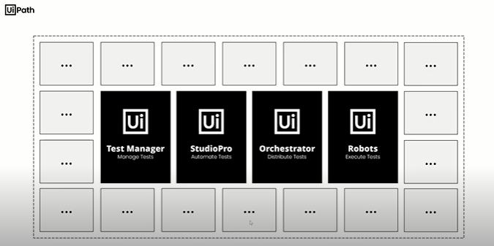
Components of UiPath Test Suite
The UiPath Test Suite contains the following product component:
Test Manager
Studio Pro
Orchestrator
Robots

Slide 5
Test Manager:
It allows you to manage your testing process.
Studio Pro:
It enables you to create the automated tests just like you would create RPA workflows.
Orchestrator:
Ability to run RPA workflows, Orchestrator is capable of executing test cases from Studio Pro on testing-robots.
Robot:
A UiPath Robot is able to execute the tests

Slide 6
Data Driven Testing:
Data Driven Testing is a software testing methodology that is used in the testing of computer software to describe testing done using a table of conditions directly as test inputs and verifiable outputs as well as the process where test environment settings and control are not hard-coded.
Data Driven Test Cases:
It imports the data from excel sheet and fetch the test data from excel row one by one, it executes the test cases.
Here all the data has been managed from excel with different scenarios and working on workflow here it validates the all test cases is correct or not
The default activities packages for this type of project are: UiPath.System.Activities, UiPath.UIAutomation.Activities, and verification activities from the UiPath.Testing.Activities.

Slide 7
Live Demo - Purchase Requisition Creation of FB50
Creating Purchase Requisition POC

Slide 8
Our teams are dedicated to innovating with IT and redefining solutions for customer excellence.

