Slide 1
P
Smart Container and Port
Operations Intelligence Platform
PORT & TERMINAL BUSINESS INTELLIGENCE PROJECT
Crane Ops · Truck Gate · Container Yard · Decision Intelligence
Presented By
Swetha M
AF05303152
Data and Business Analytics with AI
Anudip Foundation, Pallavaram, Chennai

Slide 2
PROJECT OVERVIEW
A Unified View of Port Performance
This project is a Business Intelligence solution built to analyse multi-terminal port data and translate it into meaningful insight across cranes, trucks, containers, yards, and decision-ready risk signals.
FOUR DASHBOARD PAGES
01
Executive Overview
1
MySQL for structured storage of crane, truck, container, yard and shipping-line data
Overall port performance
2
Power BI for data modelling, relationships, DAX calculations and visualization
02
Container & Yard Intelligence
Yard occupancy & container flow
3
Four interactive dashboard pages built on a single connected data model
03
Crane & Truck Operations
Equipment & gate efficiency
DASHBOARD SNAPSHOT
6K
10K
87.9%
84.6%
04
Decision Intelligence
Containers
Truck Moves
Crane Util.
Yard Util.
Forecast & risk scoring
SMART CONTAINER AND PORT OPERATIONS INTELLIGENCE PLATFORM
02

Slide 3
INDUSTRY CONTEXT
Why a Port Needs Analytics
■
No Unified Visibility
▲
Yard Congestion Risk
Crane, truck-gate, and yard systems run in silos, delaying operational response.
Uneven yard utilization (up to 96%) causes bottlenecks and delayed vessel turnaround.
●
Reactive, Not Predictive
◆
Manual Reporting Overhead
Managers lack forecasted throughput and early-warning signals to divert cargo in time.
Downtime and dwell-time figures are compiled manually, slowing peak-season decisions.
SMART CONTAINER AND PORT OPERATIONS INTELLIGENCE PLATFORM
03

Slide 4
TOOLS & TECHNOLOGIES
The Analytics Stack
SQL
ETL
PBI
DAX
GIT
MySQL
Power Query
Power BI
DAX
GitHub
Structured relational storage across 6 linked tables
Data preparation and transformation layer
Modelling, DAX calculations, KPIs & interactive visuals
Calculated measures & columns behind every KPI
Version control for PBIX, scripts & documentation
SMART CONTAINER AND PORT OPERATIONS INTELLIGENCE PLATFORM
04

Slide 5
DATASET
Dataset Introduction & Source
The dataset was not taken from an external source — it was simulated using Python to reflect realistic multi-terminal port operations, then imported into MySQL and connected to Power BI for analysis and dashboard development.
SIX CONNECTED TABLES
✓
port_crane_activity
CSV → MySQL Import → Power BI Connection
✓
port_truck_gate_log
Time span: Dec 2025 – Jun 2026 | 4 Terminals | 5 Yards | 7 Shipping Lines
✓
port_container_movements
✓
port_yard_master
✓
port_shipping_line_ref
✓
port_terminal_ref
SMART CONTAINER AND PORT OPERATIONS INTELLIGENCE PLATFORM
05

Slide 6
DATABASE DESIGN
MySQL — Database & Table Structure
▤
Cranes
▤
Trucks
▤
Containers
crane_id, terminal_id, date, downtime_hrs, status
truck_id, gate_status, movement_time, terminal_id
container_id, type, status, yard_id, shipping_line
▤
Yards
▤
Shipping Lines
▤
Terminals
yard_id, capacity_teu, occupied_teu, utilization_pct
line_id, line_name, port, container_count
terminal_id, terminal_name, port_name
SMART CONTAINER AND PORT OPERATIONS INTELLIGENCE PLATFORM
06

Slide 7
INTEGRATION
Connecting MySQL with Power BI
01
02
03
04
Get Data → MySQL Database
Select the Six Tables
Build Relationships
Validate the Model
Power BI connects directly to the port_operations_db using MySQL Connector/NET.
Cranes, trucks, containers, yards, shipping lines and terminals are selected via Navigator.
Fact tables linked to dimension tables in a star schema inside the Power BI model.
Relationships and cardinalities checked before moving to DAX and dashboard design.
SMART CONTAINER AND PORT OPERATIONS INTELLIGENCE PLATFORM
07

Slide 8
DATA PREPARATION
Loading Data (ETL) & Cleaning
Power Query served as the ETL layer between MySQL and the Power BI model — loading, cleaning, and preparing the six tables before DAX.
FIELDS CHECKED DURING CLEANING
Load
Data imported from MySQL via the Power Query / Power BI connection
✓
Date fields (order, delivery, transit)
L
✓
Numerical fields (amounts, quantities)
C
Clean
Duplicates removed, nulls handled, data types & formats standardized
✓
Categorical fields (status, reason, method)
✓
Relationship keys between tables
S
Shape
Fields trimmed & reorganised to support relationship building across the model
✓
Duplicate gate-scan records
✓
Missing / null downtime values
SMART CONTAINER AND PORT OPERATIONS INTELLIGENCE PLATFORM
08

Slide 9
CALCULATIONS
Basic DAX Measures
Crane Utilization %
Crane Downtime (Total)
Avg Movement Time
Share of scheduled hours cranes were actively operating
Sum of maintenance & inspection hours across all cranes
Average truck gate-to-yard movement time, in minutes
Yard Utilization %
Avg Dwell Time (Days)
Total Throughput
Occupied TEUs divided by total yard capacity
Average number of days a container sits in yard
Count of container movements across the selected period
SMART CONTAINER AND PORT OPERATIONS INTELLIGENCE PLATFORM
09

Slide 10
DASHBOARD DESIGN
Four Pages, One Connected Model
01
Executive Overview
02
Container & Yard Intelligence
6K orders · 84.6% yard util · 43.9 day dwell · 1 hr downtime
6K containers · 84.6% yard util · Yard A at 96% risk
03
Crane & Truck Operations
04
Decision Intelligence
87.9% crane util · 26.61 productivity · 10K truck moves
+4.4% forecast · 87.7% crane score · high-risk yard alert
SMART CONTAINER AND PORT OPERATIONS INTELLIGENCE PLATFORM
10

Slide 11
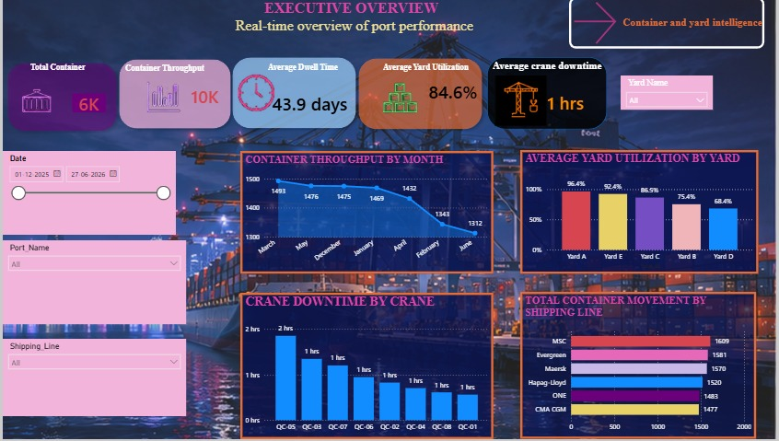
EXECUTIVE OVERVIEW
Executive Dashboard — View
6K containers · 10K throughput · 43.9 day avg dwell · 84.6% yard utilization · 1 hr avg crane downtime
SMART CONTAINER AND PORT OPERATIONS INTELLIGENCE PLATFORM
11

Slide 12
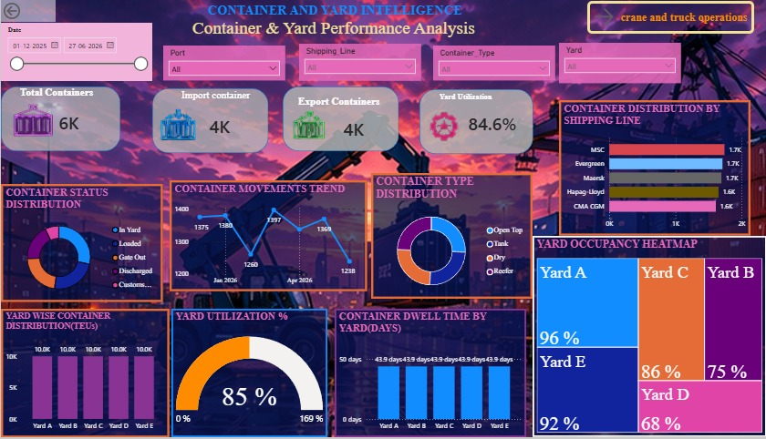
CONTAINER & YARD INTELLIGENCE
Container & Yard Intelligence — View
6K total containers · 4K import / 4K export · 84.6% yard utilization · Yard A at 96% (high risk)
SMART CONTAINER AND PORT OPERATIONS INTELLIGENCE PLATFORM
12

Slide 13
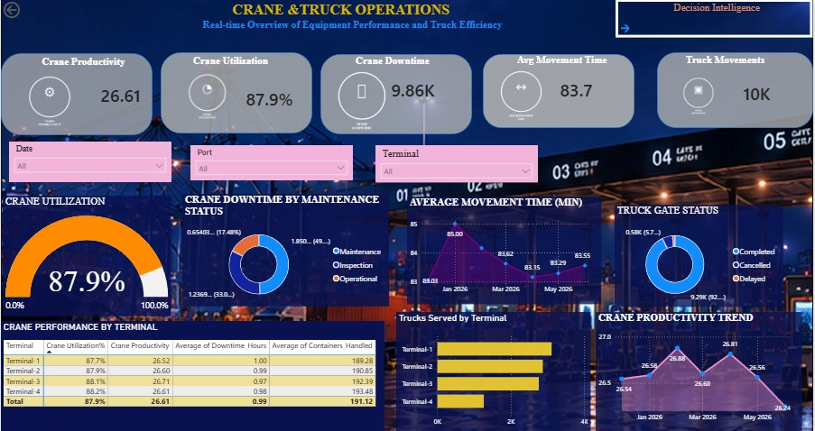
CRANE & TRUCK OPERATIONS
Crane & Truck Operations — View
26.61 crane productivity · 87.9% crane utilization · 9.86K downtime hrs · 10K truck movements
SMART CONTAINER AND PORT OPERATIONS INTELLIGENCE PLATFORM
13

Slide 14
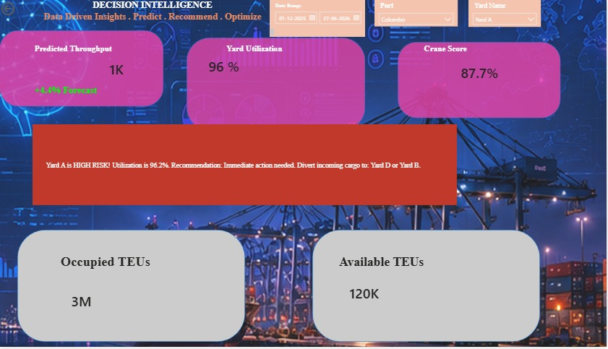
DECISION INTELLIGENCE
Decision Intelligence — View
1K predicted throughput (+4.4%) · 87.7% crane score · 3M occupied TEUs · 120K available TEUs
SMART CONTAINER AND PORT OPERATIONS INTELLIGENCE PLATFORM
14

Slide 15
INTERACTIVITY
Filters & Slicers
□
Date Range
◇
Port & Terminal
○
Yard Name
Filters the reporting period across all four pages
Filters visuals by port or specific terminal
Focuses analysis on an individual yard (A–E)
$
Shipping Line
△
Container Type
⇄
Cross-Filtering
Compares MSC, Evergreen, Maersk, Hapag-Lloyd, ONE, CMA CGM
Segments by Open Top, Tank, Dry, Reefer container types
Selecting one visual filters every other visual on the page
SMART CONTAINER AND PORT OPERATIONS INTELLIGENCE PLATFORM
15

Slide 16
FINDINGS
Key Insights from the Dashboard
●
Yard Risk
●
Crane Performance
Yard A is at 96.2% utilization — the model recommends diverting incoming cargo to Yard D or B.
87.9% average crane utilization, led by Terminal-4 at 88.2%, reflecting efficient scheduling.
●
Throughput Trend
●
Shipping-Line Mix
Container throughput fell from 1,493 (March) to 1,312 (June) — worth investigating.
MSC, Evergreen and Maersk each account for ~1.7K containers, the port's top three lines.
●
Dwell Time
●
Forecast
Average container dwell time is 43.9 days across all yards — a target for process improvement.
Decision Intelligence predicts a +4.4% throughput increase, supporting proactive yard rebalancing.
SMART CONTAINER AND PORT OPERATIONS INTELLIGENCE PLATFORM
16

Slide 17
METHODOLOGY
Project Workflow
1
2
3
4
5
6
Data
MySQL
Power BI
ETL &
DAX Measures
4-Page
Simulation
Import
Connection
Cleaning
& KPIs
Dashboard
SMART CONTAINER AND PORT OPERATIONS INTELLIGENCE PLATFORM
17

Slide 18
THANK YOU!!!

