Slide 1
Plagiarism Analyzer
Team Members
- Swetha Malladi
- Sudheer Kumar Chunduri

Slide 2
Statement of project objectives
With the advent of technology, content-stealing is widespread. At times, determining which content is plagiarised and which is not, might be difficult.
Prevention is one of the important tasks to all professional educators and in research community at large.
Our project aim is to solve plagiarism issues using string searching algorithms and cosine similarity

Slide 3
String searching Algorithms
String matching algorithms are an important class of string algorithms that try to find a place where one or several strings are found within a larger string or text.
The most basic case of string searching involves string, sometimes called the haystack, and one string , sometimes called the needle.
The goal is to find one or more occurrences of the needle within the haystack
The string-matching algorithms that we are using in this project are
Knuth-Morris-Pratt
Boyer-Moore Algorithm
Rabin-Karp Algorithm

Slide 4
Knuth-Morris-Pratt Algorithm
Knuth-Morris-Pratt string-searching Algorithm searches for occurrences of “word” W within a main text “text string” S by employing the observation that when a mismatch occurs
The word itself embodies sufficient information to determine where the next match could begin, thus bypassing re-examination of previous matched characters.
The KMP matching algorithm uses degenerating property of the pattern and improves the worst-case complexity to O(n).

Slide 5
Boyer-Moore Algorithm
Boyer-Moore is a combination of following two approaches
Bad character Heuristic
Good Suffix Heuristic
Both above heuristics can also be used independently to search a pattern in a text
It uses best of the two heuristics at every step
Boyer Moore algorithm starts matching from the last character of the pattern

Slide 6
Rabin-Karp Algorithm
The Rabin-Karp algorithm is a string-searching algorithm that uses hashing to find an exact match of a pattern string in a text.
It uses a rolling hash to quickly filter out positions of the text that cannot match the pattern , and then checks for a match at the remaining positions
Generalization for the same idea can be used to find more than one match of a single pattern, or to find matches for more than one pattern

Slide 7
Cosine similarity
In this algorithm, we will check the similarity between the text files. To compute the similarity between two text documents, the textual raw data is transformed into vectors, and then the similarity between them is computed using cosine similarity.

Slide 8
Approach
An input file is provided with which it will compare all other files.
By comparing line to line, each algorithm will generate a plagiarism percentage, indicating how much of the content is plagiarized.
Similarly, we may compare ‘n’ number of files using our plagiarism detection algorithms and can know the plagiarism percentage for each file.

Slide 9
Implementation for string searching
The string searching algorithms are implemented in Java.The entire pool of program documents are provided through GitHub link.
When you run the MClass.java file, it will take the input file and compare it to the files in the document pool for plagiarism.
The plagiarism's result is displayed on the terminal, and the results are also recorded back to the result files: lcss.txt, kmp.txt, boyreMoore.txt, naive.txt, and rk.txt, which correspond to the various algorithms employed in the comparison.
To pick the appropriate comparison findings, execute stringPlagarismOutputUI.java in the user interface.

Slide 10
Implementation for cosine similarity
cosine similarity algorithm is implemented in Python. To compute the similarity between on two text documents, the textual raw data is transformed into vectors => arrays of numbers and then from that we are going to use a basic knowledge vector to compute the similarity between them.
When we run app.py file it will compare all the text files present in the particular directory and generates a similarity score among the files.

Slide 11
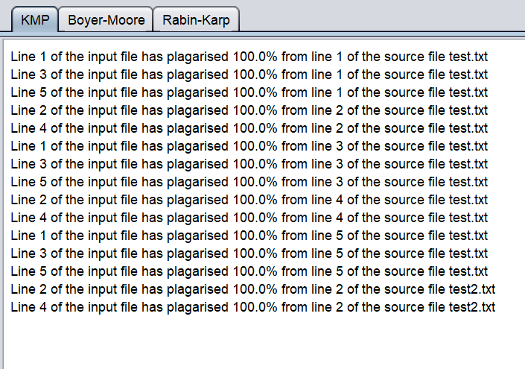
Results - Knuth-Morris-Pratt

Slide 12
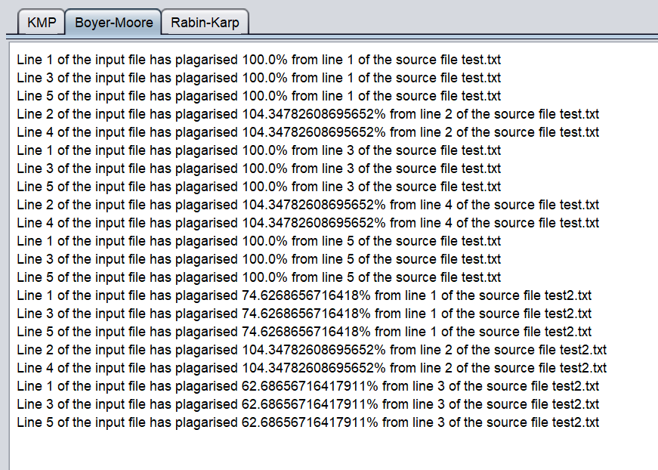
Results - Boyer-Moore

Slide 13
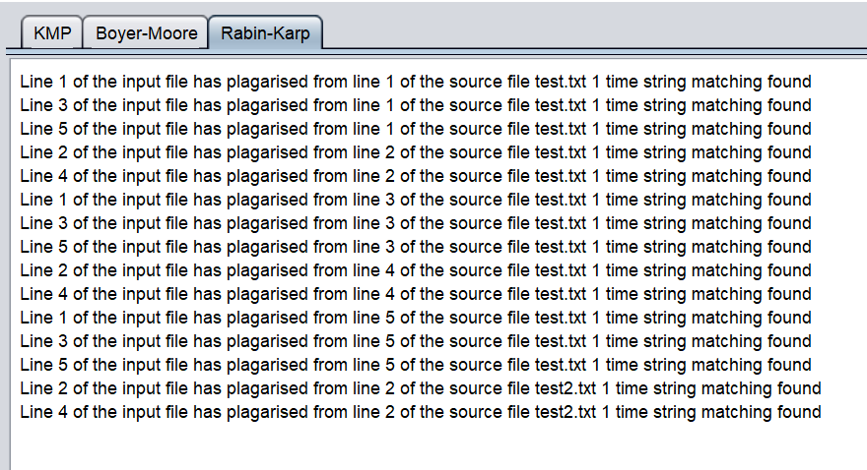
Results - Rabin-Karp

Slide 14
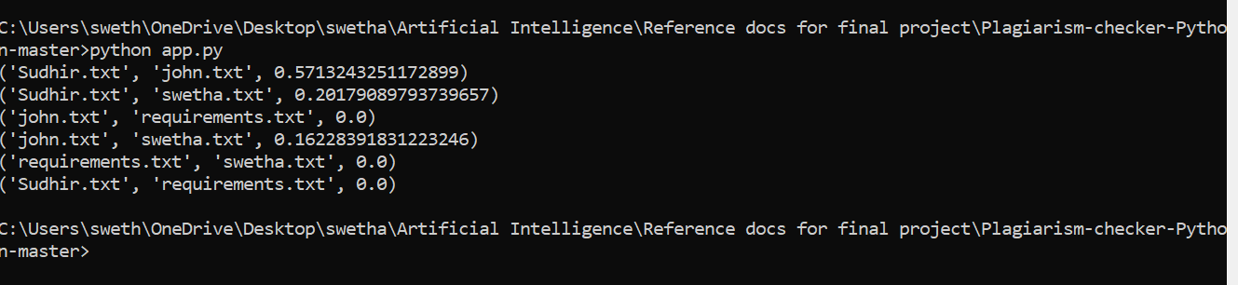
Results - Cosine similarity

Slide 15
Results
The Rabin-Karp algorithm is better when searching for a large text and Boyer-Moore is better when the pattern is relatively large with a moderately sized alphabet and with a large vocabulary. KMP Algorithm has a guaranteed worst-case linear-time performance, in both time and space complexity
But as per our results, The best results we got is for KMP because KMP guarantees 100% reliability.

Slide 16
hardware and tools used:
Operating System : Windows 64bit
Tools : PyCharm (python IDE)
Eclipse
Language : Java 18.0.1
Python 3.8 and above

Slide 17
Deliverables
Plagiarism detection algorithm developed in python(.py file) and in java(.java files)
Sample text documents for plagiarism check
Sample output image
You tube link
Git Hub repository link
Documentation Report (README.MD)
PPT Presentation slides

Slide 18
Thank you

