Slide 1

Final Project
March 29, 2018
CSC301H5S
Notes:
Introduce Each team member’s name

Slide 2

Overview
“An Android app that helps manage the logistics of remote teams working on projects in an Agile Scrum environment. SCRUMtious keeps track of user stories, tasks, sprint backlogs, the product backlog, amongst many other things.”
Notes:
Intro to our app

Slide 3
Demo
Notes:
Walkthrough the app 5 mins max

Slide 4
Process
Notes:
Team intro, what everyones contribution was/ or something about there experience

Slide 5




Communication
&&
Scheduling
Notes:
Voting at the beginning of the sprint where we needed to decide what we were going to do
Mention how we used to meet up every Thursdays for an hour to work on the sprints, but that did not work out so we met up on one weekend, and spent those 2 days just working on the sprint
Very good naming conventions, following Android style guide
Using github, creating branches, branch naming convention was very good, and assigning each person individual tasks
Github commit messages were done professionally
Running code reviews before the submission of each sprint
All of us were on time for every single meeting, we were there for every tutorial

Slide 6
Difficulties
&
Resolutions
Meeting up to work or remote work?
Sol: Meet up every weekend (Sat and Sun)
Learn on your own, or learn together?
Sol: Work together where everyone did everything
Assign single responsibilities to group members or let everyone do a bit of everything?
Sol: Everyone in group did everything (work was split up equally and on a rotating basis)
Notes:
Meeting up to work on the weekends
Realistic since teams are in the same location
Learn together
If anyone is stuck, teams stops, helps, then resume work
We tend to find more time to meet up and finalize everything
The only thing we left for individuals were debugging and testing

Slide 7
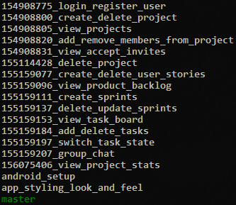
Conventions
&&
Workflow
Naming:
TextView projectRowTitleTextView = findViewById(R.id.projectRowTitleTextView);
GroupChatActivity,GroupChatViewInt, GroupChatPresenter, GroupChatPresenterInt, activity_group_chat.xml
Notes:
Throwing all our strings into a string.xml file (global file)
All variable names being consistent across all files

Slide 8
Tech Stack && Tech Challanges
Android Framework
Android Studio IDE
Git for Version Control
Firebase (FB) Backend
FB Cloud Database (NoSQL)
FB Authentication
Java for code
XML for views and layouts
Tech Challenge:
Setting up Android Studio
Sol: Get 1 member to set up for everyone
Using 3rd Party libraries NPChartAndroid (Burndown Chart), RingProgressCircle
Sol: Lot’s of API referencing (learned how to use API’s appropriately)

Slide 9
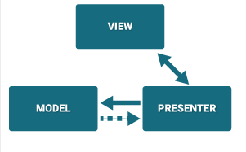
Architecture
MVP (Model, View, Presenter)
An Activity (View) is a “screen”
Model (POJOs for Firebase)
View (Activities and XML layouts)
Presenter (Database Interactors)
Notes:
Mention this:
Activity, fragments, UI, database,
Activites talk to presenter, presenters update the models
An activity is an entire screen and what it does (each activity was a feature in our app)
A fragment is like an activity, but more flexible, it can be put inside activities and can be drawn over other things
XML layouts define how a view is going to look, it defines the components that make up the view (activities control and manipulate this XML through code)

Slide 10
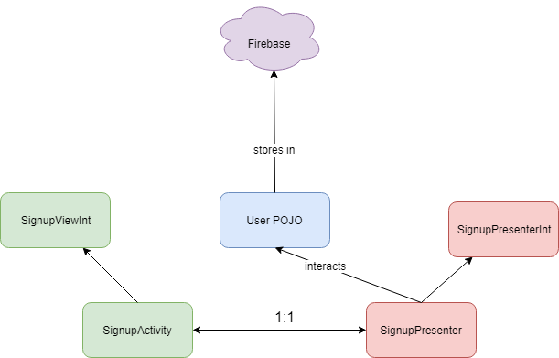

Slide 11
Questions?
Notes:
Team intro, what everyones contribution was/ or something about there experience

