Slide 1
Loan Approval-Consumer creditworthiness Analysis

Slide 2
Hypothesis Testing and visualization of the features given in the dataset
Each and every feature present in the dataset is analysed visually using the matplotlib and seaborn libraries.
The Null Hypothesis is generated for each feature and is tested using the Two sample T test (Continuous feature)and Chi2 test(Categorical feature) to reject or fail to reject the hypothesis.
The data set contains 521 records with 12 Independent feature and 1 target feature.
Loan ID: It is unique for each applicant. It will not have any effect on the target variable

Slide 3
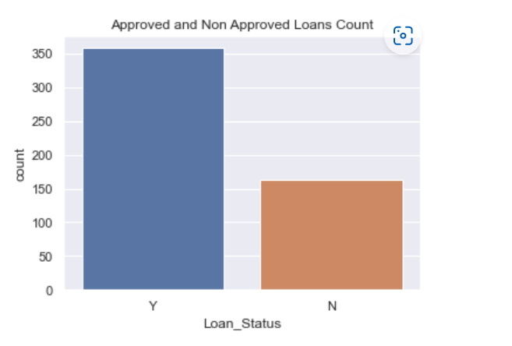
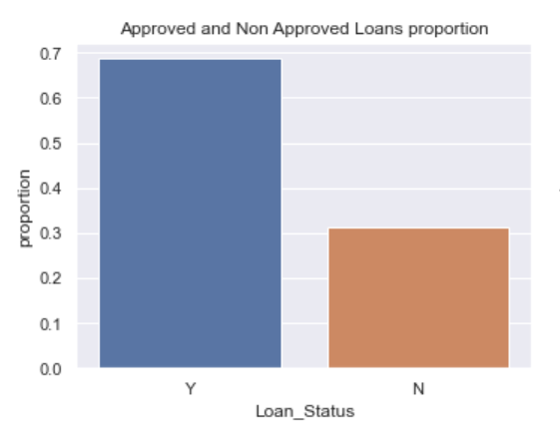


Loan Status:It is a target variable column which tells about whether the applicant application for loan approval is passed or not

Slide 4
Loan Status Inferences:
The number of approved loans is higher than the unapproved loans.
The Approved loans constitute 68% of total number of applications.
P(Loan Approval) without any independent variable = 0.68714

Slide 5
Categorical Features:
Nominal Variables
Gender
Married
Self Employed
Credit History
Ordinal variables
Dependents
Education
Property Area

Slide 6
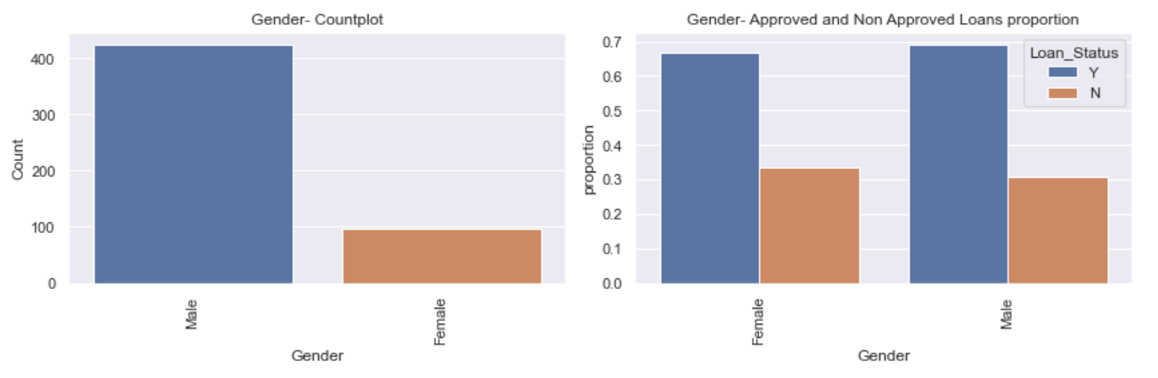
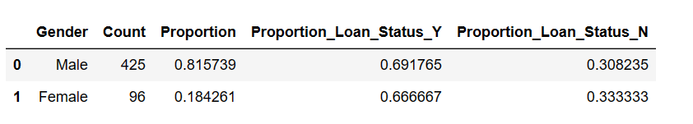
Gender: Gender of a applicant whether male or female

Slide 7

Gender Inferences:
There are more Male applicants(81.5%) than the Female applicants(18.4%).
The Approvals and rejections are almost similar for both the genders.
Hypothesis Testing:
We can use two chi square test to check if the Gender is associated with the target variable.
P1=P(Approval):0.68714
P2=P(Approval/Gender):
H0: P1=P2. There is no association between the independent variable and target variable.
Ha: P1 != P2
Significance level - alpha= 0.05
Result: 1. The P value is >0.05.
2. We fail to reject the Null Hypothesis.
3. There is no association between the independent variable and target variable.

Slide 8
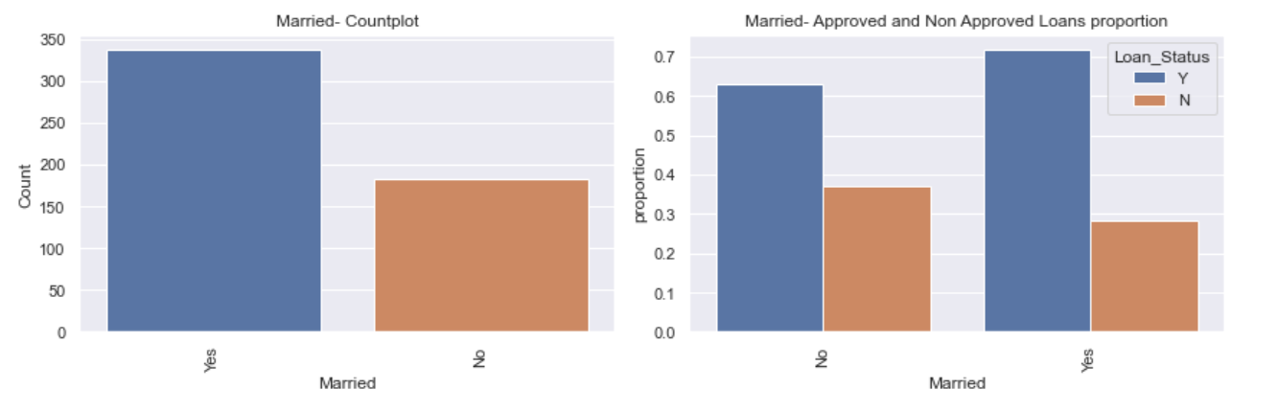
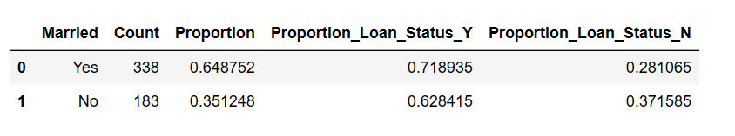
Married: Martial status of a applicant

Slide 9

Married Inferences:
There are more Married applicants(65%) than the unmarried applicants(35%).
The Proportion of Approvals are higher for married applicants.
Hypothesis Testing:
We can use two chi square test to check if the Married is associated with the target variable.
P1=P(Approval):0.68714
P2=P(Approval/ Married):
H0: P1 = P2. There is no association between the independent variable and target variable.
Ha: P1 != P2.
Significance level - alpha= 0.05
Result: 1. The P value is <0.05.
2. We reject the Null Hypothesis.
3. There is association between the independent variable and target variable.

Slide 10
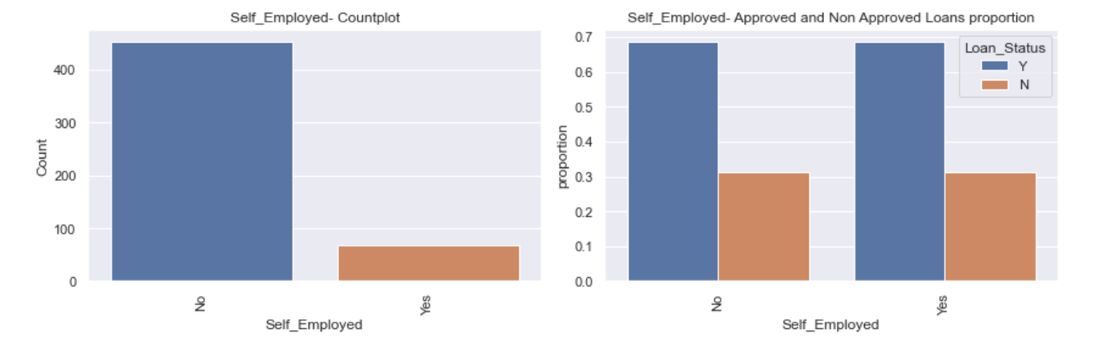
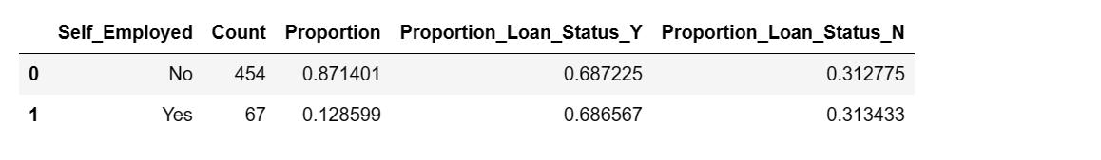
Self Employed: Whether the applicant is self employed or not

Slide 11

Self Employed Inferences:
There are more applicants(87%) who are not self employed than the self employed applicants(13%).
The Approvals and rejections are almost similar for both the self employed and not self employed.
Hypothesis Testing:
We can use two chi square test to check if the Self Employed is associated with the target variable.
P1=P(Approval):0.68714
P2=P(Approval/ Self Employed ):
H0: P1 = P2. There is no association between the independent variable and target variable.
Ha: P1 != P2.
Significance level - alpha= 0.05
Result: 1. The P value is >0.05.
2. We fail to reject the Null Hypothesis.
3. There is no association between the independent variable and target variable.

Slide 12
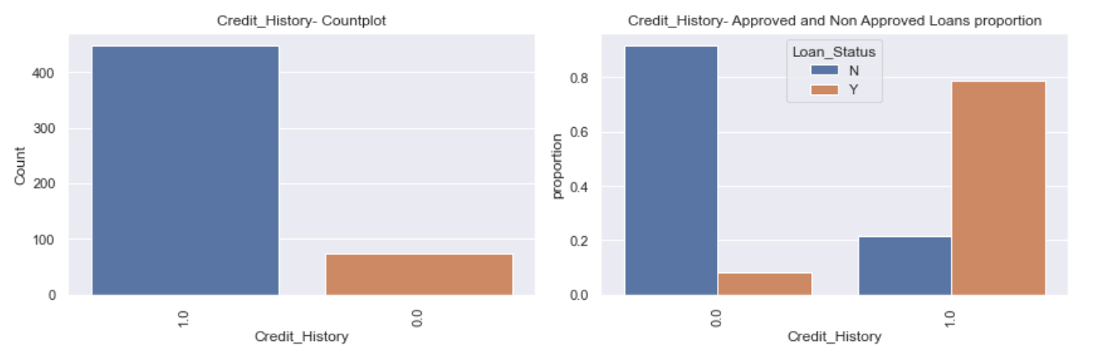
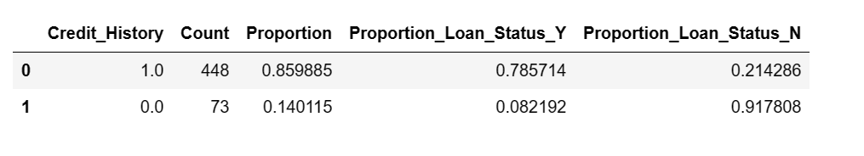
Credit History:It tells about the credit done in the past by the applicant.

Slide 13
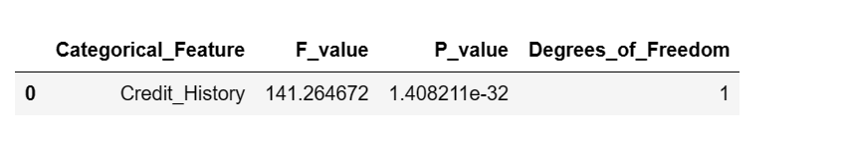
Credit History Inferences
There applicants who have credit history have higher chances for loan approvals.
Hypothesis Testing:
We can use two chi square test to check if the Credit History is associated with the target variable.
P1=P(Approval):0.68714
P2=P(Approval/ Credit History ):
H0: P1 = P2. There is no association between the independent variable and target variable.
Ha: P1 != P2.
Significance level - alpha= 0.05
Result: 1. The P value is <0.05.
2. We reject the Null Hypothesis.
3. There is association between the independent variable and target variable.

Slide 14
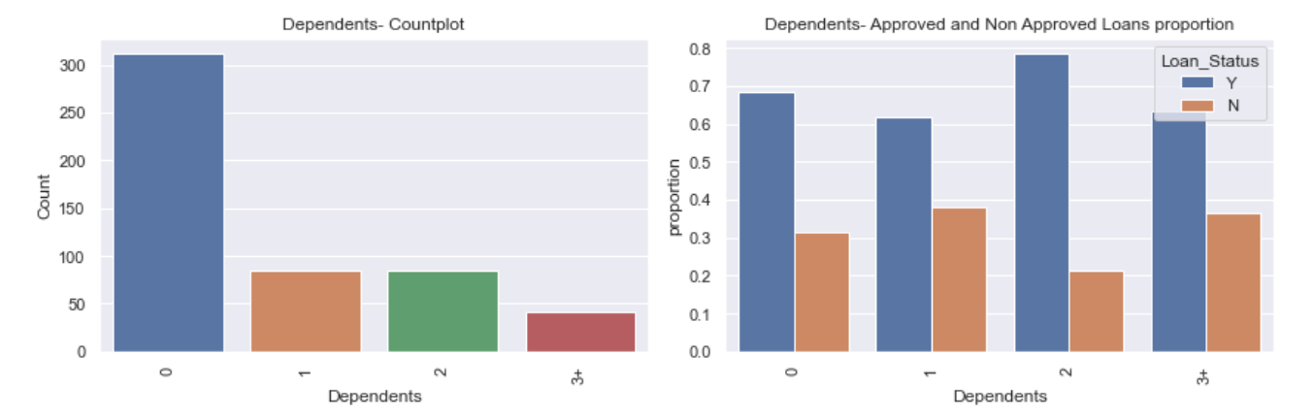
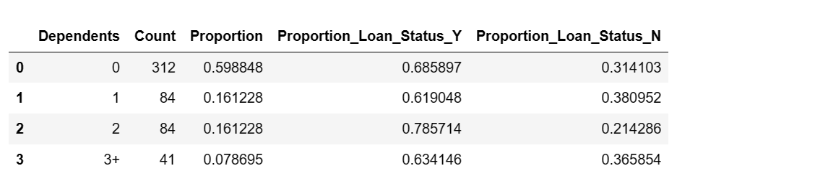
Dependents: Number of individuals who are financially dependent on applicant

Slide 15
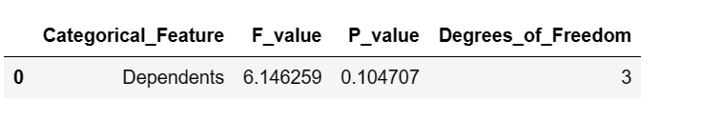
Dependents Inferences:
There are more applicants(60%) who do not have dependents.
The proportion of approvals and Not approvals is approximately 65% to 35%.
Hypothesis Testing:
We can use two chi square test to check if the dependents is associated with the target variable.
P1=P(Approval):0.68714
P2=P(Approval/ dependents):
H0: P1 = P2. There is no association between the independent variable and target variable.
Ha: P1 != P2.
Significance level - alpha= 0.05
Result: 1. The P value is >0.05.
2. We fail to reject the Null Hypothesis.
3. There is no association between the independent variable and target variable.

Slide 16
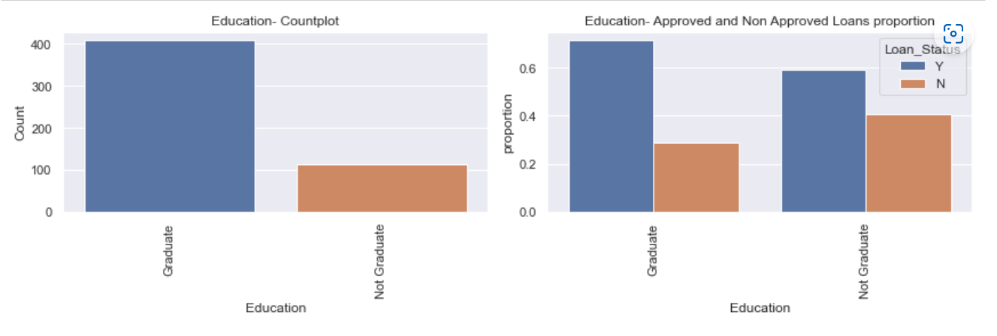
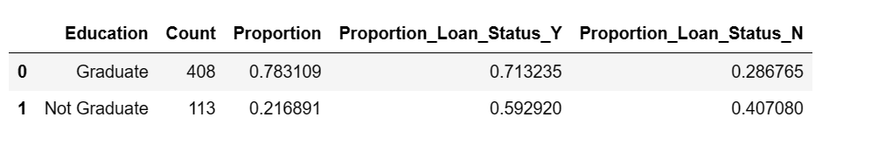
Education: Highest Education of applicant

Slide 17
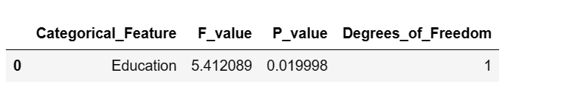
Education Inferences:
There are more applicants who are graduates(78.3%) than the Non Graduate applicants(21.6%).
The Approvals for the Loan are 10% higher for the Graduate applicants as compared to Non Graduate applicants.
Hypothesis Testing:
We can use two chi square test to check if the Education is associated with the target variable.
P1=P(Approval):0.68714
P2=P(Approval/ Education):
H0: P1 = P2. There is no association between the independent variable and target variable.
Ha: P1 != P2.
Significance level - alpha= 0.05
Result: 1. The P value is <0.05.
2. We reject the Null Hypothesis.
3. There is association between the independent variable and target variable.

Slide 18
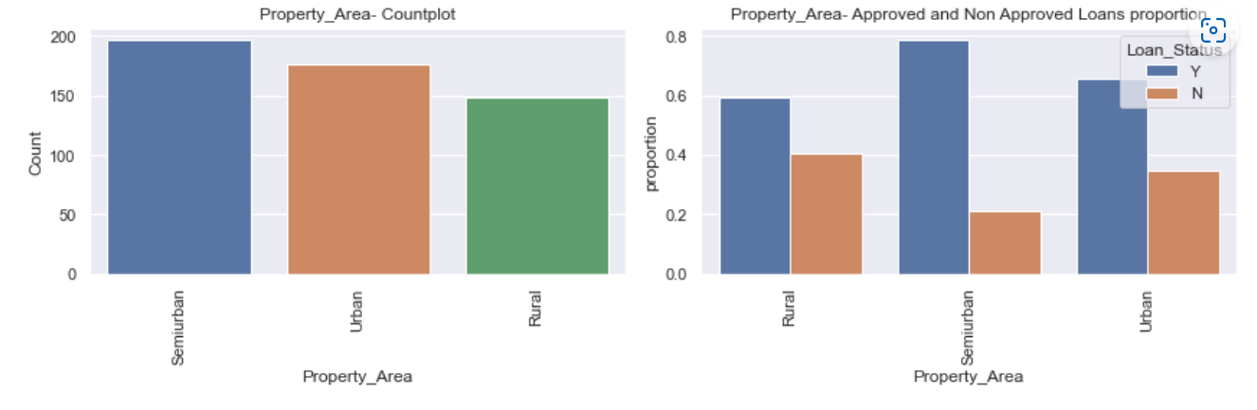
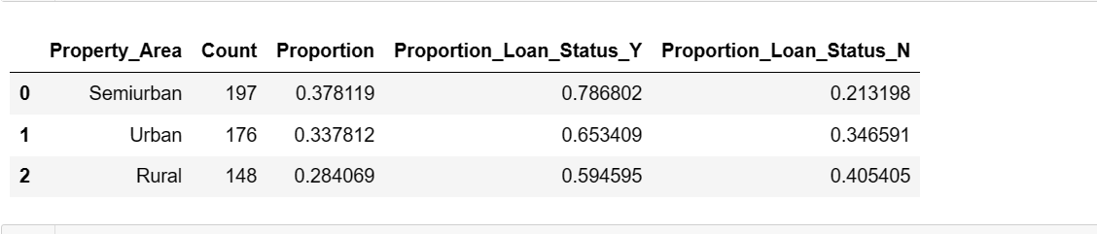
Property Area: This tells about the applicant property is in which area i.e., Rural or Urban

Slide 19

Property Area Inferences:
There are more applicants who live in Semiurban areas.
The Approvals for the Loan are 18% higher for the applicants in Semi urban areas as compared to Rural areas.
The Approvals for the Loan are 13% higher for the applicants in Semi urban areas as compared to Urban areas.
Hypothesis Testing:
We can use two chi square test to check if the Property Area is associated with the target variable.
P1=P(Approval):0.68714
P2=P(Approval/ Property Area ):
H0: P1 = P2. There is no association between the independent variable and target variable.
Ha: P1 != P2.
Significance level - alpha= 0.05
Result: 1. The P value is <0.05.
2. We reject the Null Hypothesis.
3. There is association between the independent variable and target variable.

Slide 20
Continuous Features:
Applicant Income
Co-Applicant Income
Loan Amount
Loan Amount Term
Total Income = Applicant Income + CoApplicant Income

Slide 21
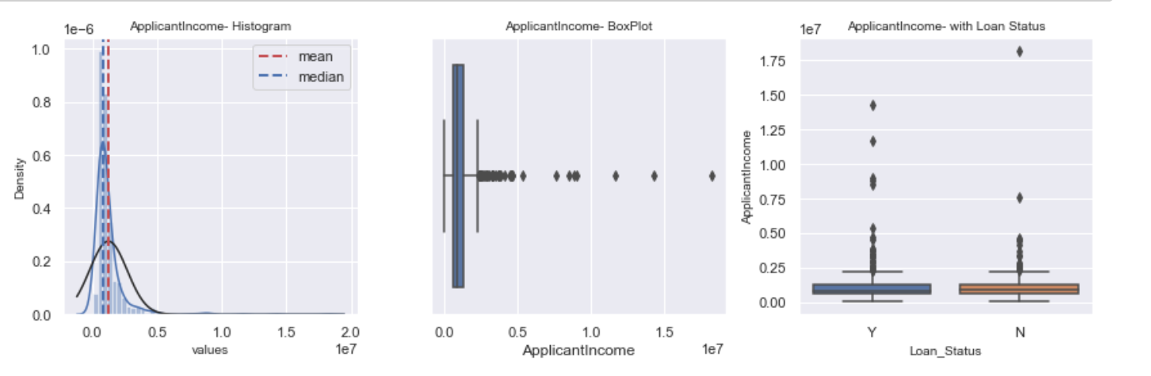
Applicant Income: Income of the applicant

Slide 22
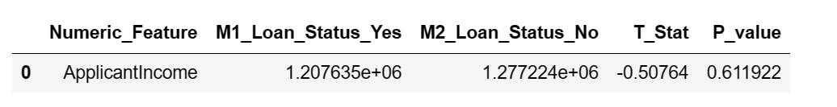
Applicant Income Inferences:
From the above plots it can be inferred that the Applicant Income for most of the applicants lies towards the left.
It is Highly skewed due to the presence of outliers.
Hypothesis Testing:
We can use two sample T test to check if the mean income of applicant for which loan is approved is different as compared to the mean income of applicant for which the loan is not approved.
M1:Mean of Applicant income when Loan Status='Y' Approved
M2:Mean of Applicant income when Loan Status='N' Not Approved
H0: M1=M2
Ha: M1 != M2
Significance level of alpha= 0.05
Result:
The P value is >0.05.
We fail to reject the Null Hypothesis.
The Applicant Income doesn’t have any impact on the Target variable

Slide 23
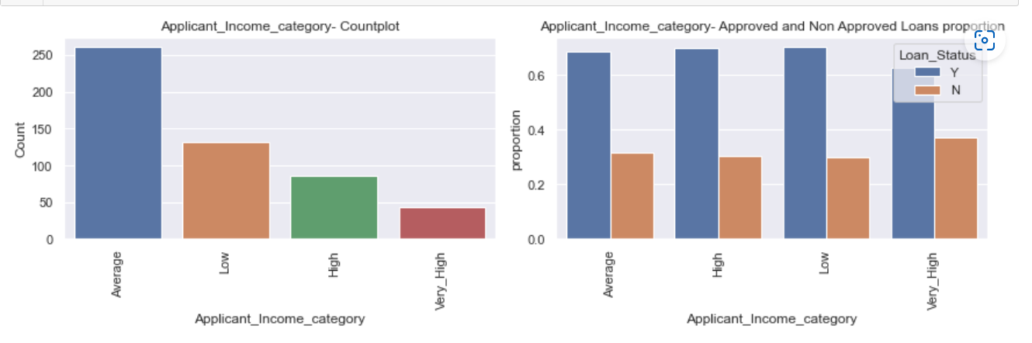
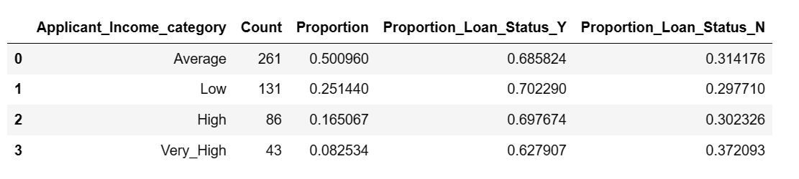
Applicant Income Category: The Applicants income is divided into bins based on different ranges of incomes

Slide 24
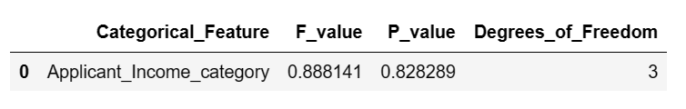
Applicant Income Category Inferences:
From the above plots it can be inferred that the most of the people have average income
Around 75% of the applicants fall under Low and Average category.
Hypothesis Testing:
We can use two chi square test to check if the Applicant Income Category is associated with the target variable.
P1=P(Approval):0.68714
P2=P(Approval/ Applicant Income Category ):
H0: P1 = P2. There is no association between the independent variable and target variable.
Ha: P1 != P2.
Significance level - alpha= 0.05
Result: The P value is >0.05.
We fail to reject the Null Hypothesis.
There is no association between the independent variable and target variable.

Slide 25
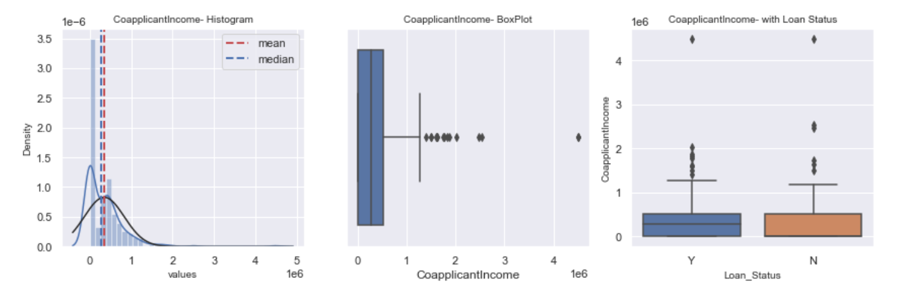
CoApplicant Income: Income of the applicant

Slide 26
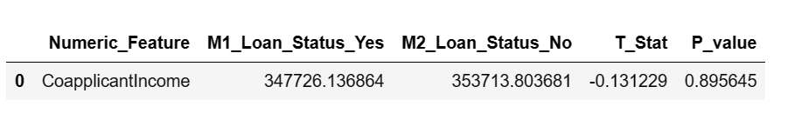
CoApplicant Income Inferences:
From the above summary and plots it can be inferred that the Co-Applicant Income for most of the applicants lies towards the left.
It is Highly skewed due to the presence of outliers.
There are more number of records where the co applicants income is zero.
Hypothesis Testing:
We can use two sample T test to check if the mean income of CoApplicant for which loan is approved is different as compared to the mean income of CoApplicant for which the loan is not approved.
M1:Mean of CoApplicant income when Loan Status='Y' Approved
M2:Mean of CoApplicant income when Loan Status='N' Not Approved
H0: M1=M2
Ha: M1 != M2
Significance level of alpha= 0.05
Result: P value is >0.05.
We fail to reject the Null Hypothesis.
The CoApplicant Income doesn’t have any impact on the Target variable

Slide 27
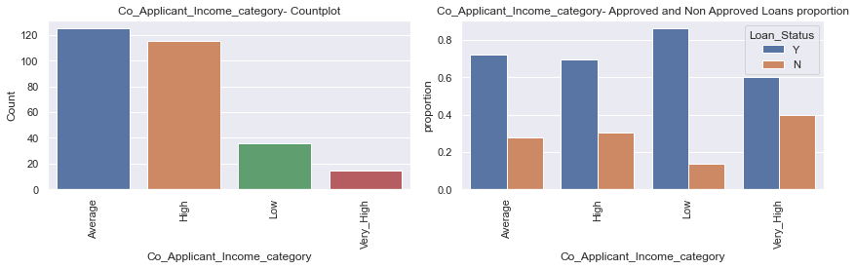
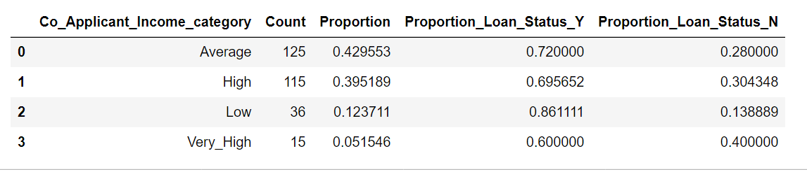
CoApplicant Income Category: The Applicants income is divided into bins based on different ranges of incomes

Slide 28
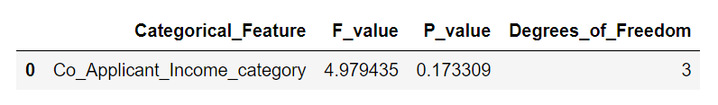
CoApplicant Income Category Inferences:
From the above plots it can be inferred that the most of the people have average income
Hypothesis Testing:
We can use two chi square test to check if the CoApplicant Income Category is associated with the target variable.
P1=P(Approval):0.68714
P2=P(Approval/ CoApplicant Income Category ):
H0: P1 = P2. There is no association between the independent variable and target variable.
Ha: P1 != P2.
Significance level - alpha= 0.05
Result: The P value is >0.05.
We fail to reject the Null Hypothesis.
There is no association between the independent variable and target variable.

Slide 29
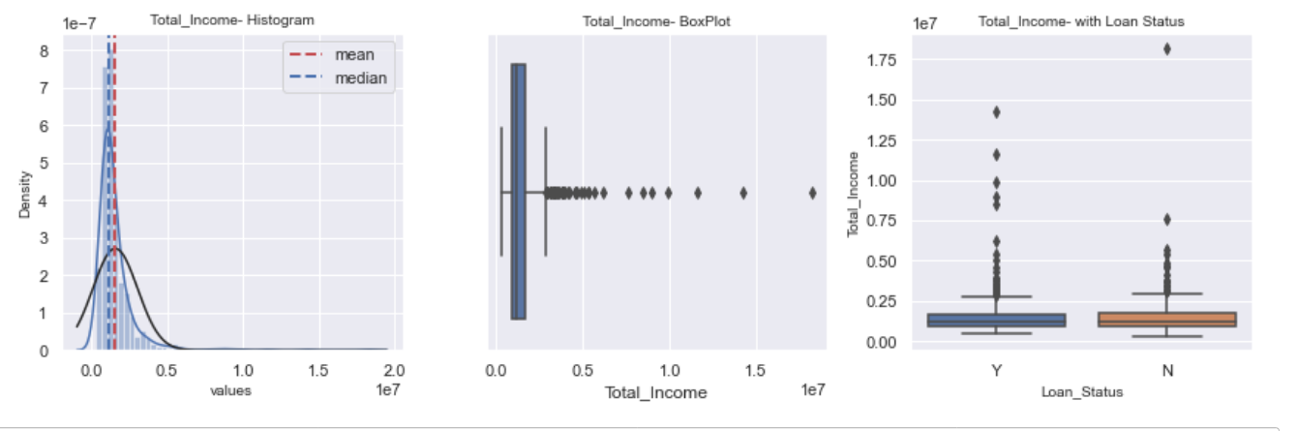
Total Income : Applicant Income + Co-Applicant Income

Slide 30
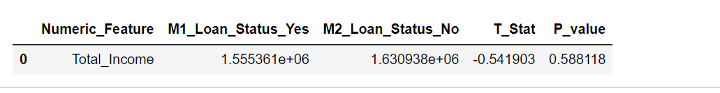
Total Income Inferences:
From the above summary and plots it can be inferred that the Total Income for most of the applicants lies towards the left.
It is Highly skewed due to the presence of outliers.
Hypothesis Testing:
We can use two sample T test to check if the mean of Total Income for which loan is approved is different as compared to the mean of Total Income for which the loan is not approved.
M1:Mean of Total Income income when Loan Status='Y' Approved
M2:Mean of Total Income income when Loan Status='N' Not Approved
H0: M1=M2
Ha: M1 != M2
Significance level of alpha= 0.05
Result: P value is >0.05.
We fail to reject the Null Hypothesis.
The Total Income doesn’t have any impact on the Target variable.

Slide 31
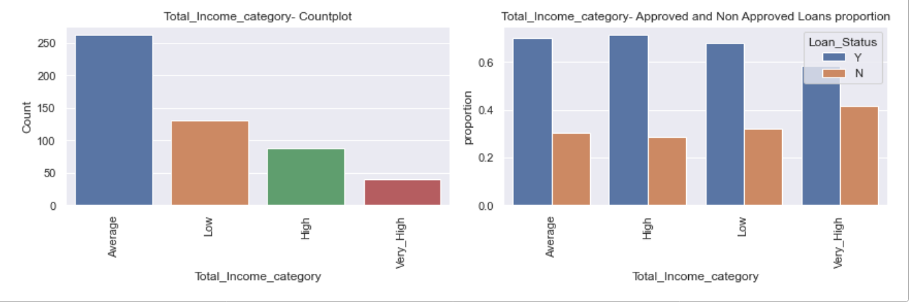
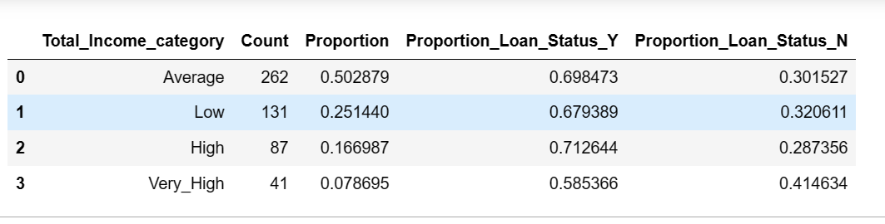
Total Income category: The total income is divided into bins

Slide 32
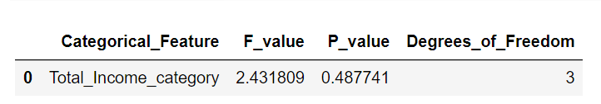
Total Income category Inferences:
There more applicants in the low and average income range.
Around 75% of the applicants fall under the low and average category.
The Percentage of approvals are almost similar for all ranges of applicants.
Hypothesis Testing:
We can use two chi square test to check if the Total Income Category is associated with the target variable.
P1=P(Approval):0.68714
P2=P(Approval/ Total Income Category ):
H0: P1 = P2. There is no association between the independent variable and target variable.
Ha: P1 != P2.
Significance level - alpha= 0.05
Result: The P value is >0.05.
We fail to reject the Null Hypothesis.
There is no association between the independent variable and target variable.

Slide 33
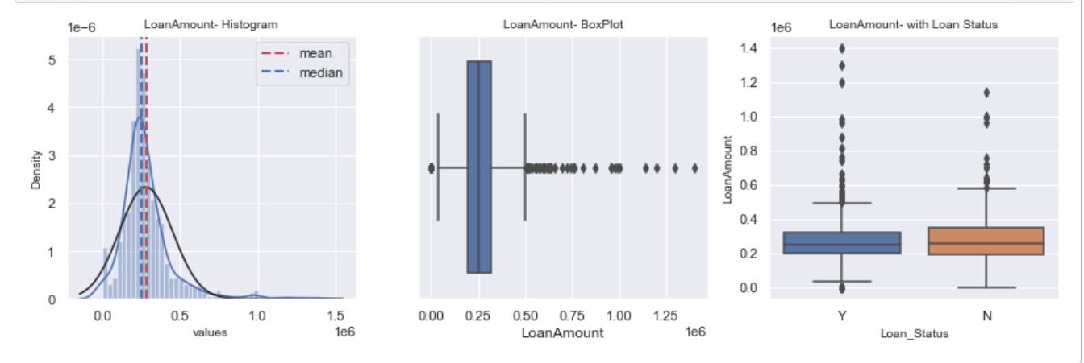
Loan Amount:Amount of loan applicant wants to issue from the bank.

Slide 34
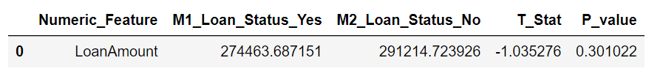
Loan Amount Inferences:
From the above summary and plots it can be inferred that the distribution is skewed and has outliers.
But the difference between the mean and median is not as huge as the applicants income
Hypothesis Testing:
We can use two sample T test to check if the mean of Loan Amount for which loan is approved is different as compared to the mean of Loan Amount for which the loan is not approved.
M1:Mean of Loan Amount when Loan Status='Y' Approved
M2:Mean of Loan Amount when Loan Status='N' Not Approved
H0: M1=M2
Ha: M1 != M2
Significance level of alpha= 0.05
Result: P value is >0.05.
We fail to reject the Null Hypothesis.
The Loan Amount doesn’t have any impact on the Target variable

Slide 35
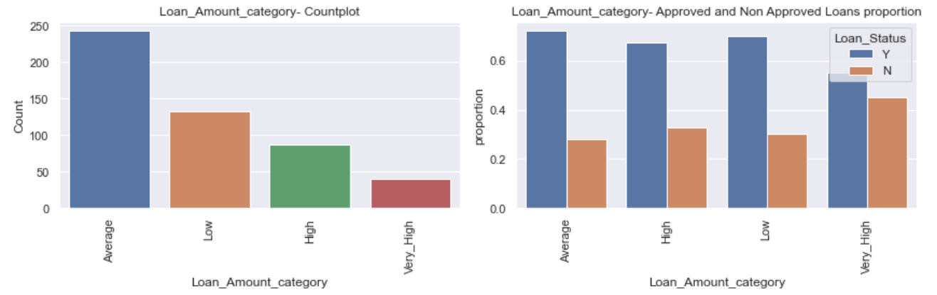
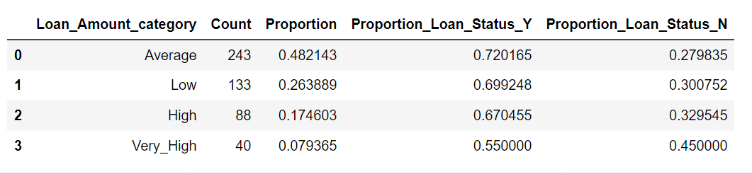
Loan Amount Category: Loan Amount divided into bins

Slide 36
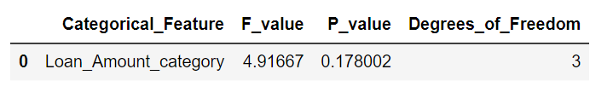
Loan Amount Category Inferences
Around 75% of the Loan amount is under the low and average category.
The approvals are almost similar for all the categories except Very High
Hypothesis Testing:
We can use two chi square test to check if the Loan Amount Category is associated with the target variable.
P1=P(Approval):0.68714
P2=P(Approval/ Loan Amount Category ):
H0: P1 = P2. There is no association between the independent variable and target variable.
Ha: P1 != P2.
Significance level - alpha= 0.05
Result: The P value is >0.05.
We fail to reject the Null Hypothesis.
There is no association between the independent variable and target variable.

Slide 37
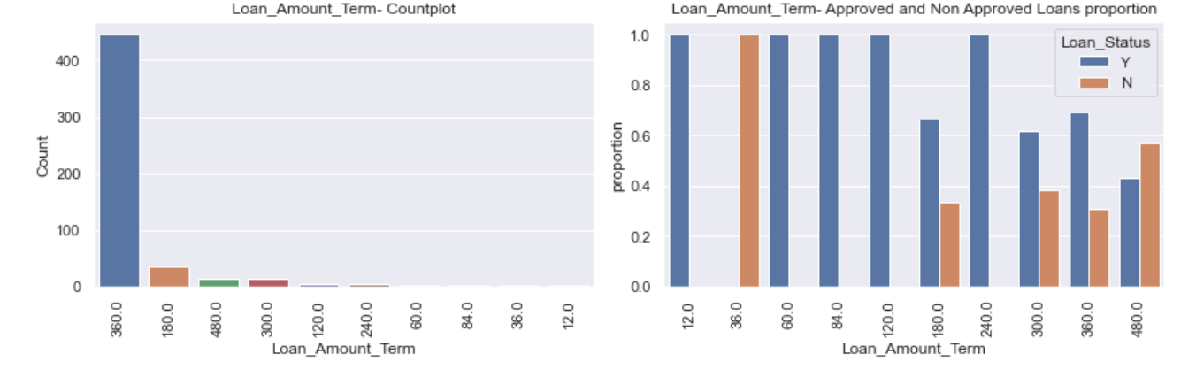
Loan Amount Term: Term in months

Slide 38
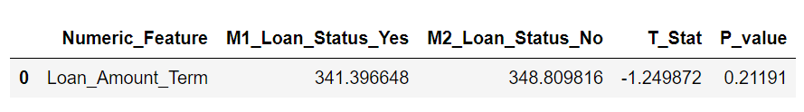
Loan Amount Term Inferences:
There are many applicants who applied for 3 years.
From the data we can observe that that the approvals will not increase with the loan terms .
Also there are very few applicants who applied for shorter duration like 12,36,60,84,120 and 240 months respectively.
Hypothesis Testing:
We can use two sample T test to check if the mean of Loan Amount Term for which loan is approved is different as compared to the mean of Loan Amount Term for which the loan is not approved.
M1:Mean of Loan Amount Term when Loan Status='Y' Approved
M2:Mean of Loan Amount Term when Loan Status='N' Not Approved
H0: M1=M2
Ha: M1 != M2
Significance level of alpha= 0.05
Result: P value is >0.05.
We fail to reject the Null Hypothesis.
The Loan Amount Term doesn’t have any impact on the Target variable

Slide 39
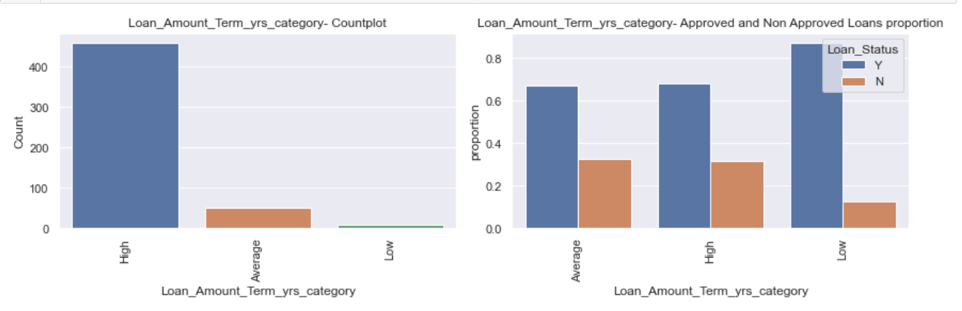
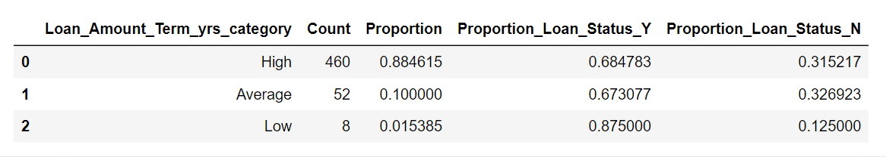
Loan Amount Term in years Category: Loan amount term converted to years and divided into bins

Slide 40
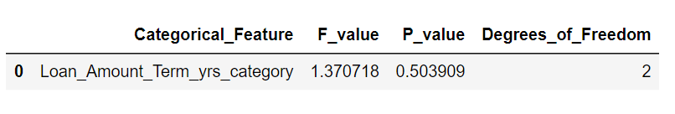
Loan Amount Term in years Category Inferences:
There are many applicants(88%) who applied for longer duration.
There is no big difference in the percentage of approvals for High and Average category.
There are very few applicants who applied for shorter duration. But they have higher approval percentage.
Hypothesis Testing:
We can use two chi square test to check if the Loan Amount Term in years Category is associated with the target variable.
P1=P(Approval):0.68714
P2=P(Approval/ Loan Amount Term in years Category ):
H0: P1 = P2. There is no association between the independent variable and target variable.
Ha: P1 != P2.
Significance level - alpha= 0.05
Result: The P value is >0.05.
We fail to reject the Null Hypothesis.
There is no association between the independent variable and target variable.

Slide 41
Conclusion
After looking at the plots and the results of hypothesis testing we have the following conclusions.
The categorical variables Credit History, Education, Married and Property Area have impact on the target variable.
None of the numeric features like Applicant Income, Co Applicant Income, Total Income, Loan Amount, Loan Amount Term don't have impact on the target variable.

