Slide 1
IoT Enhanced Sign Language Glove: Bridging Speech, Touch and Gestures
03-Mar-25
Department of CSE Jerusalem College of Engineering
1

Slide 2
OBJECTIVE
To design a wearable glove that translates hand gestures into text and speech for real-time communication.

Slide 3
PROJECT DOMAIN
IoT-Enabled Assistive Technology This project focuses on bridging the communication gap between hearing and non-hearing individuals using IoT-based wearable technology. The smart glove enables real-time translation of sign language into text and speech, making communication simple and accessible.
AI-Driven Smart Wearable Systems The system integrates AI and sensor-based gesture recognition with mobile applications to provide accurate, real-time communication support. Designed for comfort and inclusivity, it finds applications in education, healthcare, social interaction, and smart environments.
03-Mar-25

Slide 4
EXISTING SYSTEM
Bright Sign Glove – Sign language to speech/text using a mobile app.
Echolink Glove – Customizable gestures converted to real-time text.
SR Robotics Glove – Arduino-based glove displaying letters on LCD.
UCLA Wearable-Tech Glove – ASL to English speech via smartphone app.
03-Mar-25

Slide 5
LITERATURE SURVEY
Sl.No. | REFERENCE PAPER | WORK DONE IN REFERENCE PAPER | LIMITATIONS / DRAWBACKS
1. | Title: Position-Based Control of Dexmo Glove Authors: Liu & Wang Year: 2019 | Developed 3D lookup table control for Dexmo glove to map fingertip positions for VR haptic feedback. | Limited movement sensing; errors in complex poses; possible force feedback inaccuracy & latency.
2. | Title: Survey of Voice Pathology Systems Using IoT & ML Authors: Patel & Singh Year: 2020 | Reviewed IoT–ML approaches for voice pathology detection & remote diagnosis. | Distinguishes only healthy vs pathological; needs bigger datasets; low accuracy with noisy data.
3. | Title: A Systematic Review of Hand Gesture Recognition Authors: Kumar et al. Year: 2024 | Reviews advances in vision-, sensor-, and hybrid-based hand gesture recognition, focusing on sign language accuracy, feature extraction, and trends. | Relies on current data, needs high-quality sensors & stable internet; privacy concerns with continuous monitoring.
4. | Title: Facial & Vocal Expression-Based Student Stress Monitoring Authors: Jain & Rao Year: 2022 | Built IoT–Fog–Cloud system for real-time stress detection using facial, speech & text analysis with deep learning. | Depends on data, sensor quality & internet; privacy risks from continuous monitoring.
03-Mar-25
Departm
ent of CSE
5
Jerusalem College of Engineering

Slide 6
LITERATURE SURVEY
Sl.No. | REFERENCE PAPER | WORK DONE IN REFERENCE PAPER | LIMITATIONS / DRAWBACKS
5. | Title: Enhancing Object Detection in Assistive Technology for the Visually Impaired: A DETR-Based Approach Authors: Sunnia Ikram et al. Year: 2025 | Camera-based blind navigation system with YOLOv8/Faster R-CNN/DETR delivering real-time audio feedback; ~2000-image dataset, 20-epoch training, DETR hitting ~98% precision, ~99% confidence at ~40 ms/frame, optimized for edge via TFLite. | Limited to ~2000-image dataset, requires stable internet, constrained by mobile hardware, mostly tested in controlled outdoor settings, and low-light performance still camera-dependent.
6. | Title: Hand Gesture Recognition for Multi-Culture Sign Language Using Graph & Deep Learning Authors: Abu Saleh Musa Miah, M. A. M. Hasan, Yoichi Tomioka, Jungpil Shin Year: 2024. | Proposes GmTC, a two-stream model using GCNs & attention-based CNNs for multi-culture sign recognition; achieves high accuracy & generalizability. | Needs large, diverse datasets; high computational cost; challenges with lesser-used languages & real-time scaling.
7. | Title: An Adaptive, Affordable Open-Source Robotic Hand for Deaf & Deaf-Blind communication Using Tactile ASL Authors: Samantha Johnson, Geng Gao, Todd Johnson, Minas Liarokapis, Chiara Bellini Year: 2021 | 3D-printed tendon-driven 15-DOF robotic hand using ESP32 + cloud API performed full ASL alphabet, tested with deaf/deaf-blind users, achieving ~94.7% visual and ~71.7% tactile accuracy. | Only ~71% tactile accuracy, relies on cloud (not standalone), lacks elbow motion, struggles with similar handshapes (G/Q, U/V), and was tested on a very small participant group.
03-Mar-25
Departm
ent of CSE
6
Jerusalem College of Engineering

Slide 7
LITERATURE SURVEY
Sl.No. | REFERENCE PAPER | WORK DONE IN REFERENCE PAPER | LIMITATIONS /DRAWBACK
8. | Title: Perception Assistance for the Visually Impaired Through Smart Objects Authors: Jean Connier, Haiying Zhou, et al. Year: 2020. | Proposes SO2SEES IoT-cloud system linking visually impaired users to smart objects for spatial & non-spatial perception; validated in a prototype. | Limited real-world testing; interoperability & smart object adoption challenges; needs broader trials.
9. | Title: A Survey on Continuous Object Tracking and Boundary Detection Schemes in IoT Assisted Wireless Sensor Networks Authors: Ata Ullah, Nagina Ishaq, Muhammad Azeem, Humaira Ashraf, NZ Jhanjhi, Mamoona Humayun, Thamer A. Tabbakh & Zahrah A. Almusaylim Year: 2021 | A Survey on Continuous Object Tracking & Boundary Detection in IoT WSNs, IEEE Access, Vol. 9, Sept 2021. | A Survey on Continuous Object Tracking & Boundary Detection in IoT WSNs, IEEE Access, Vol. 9, Sept 2021.
10. | Title: Adaptive, Affordable Robotic Hand for Deaf & Deaf-Blind Communication Using Tactile ASL Authors: Samantha Johnson et al. Year: 2021. | Adaptive, Affordable Robotic Hand for Deaf & Deaf-Blind Communication Using Tactile ASL, IEEE EMBC, Nov 2021. | Adaptive, Affordable Robotic Hand for Deaf & Deaf-Blind Communication Using Tactile ASL, IEEE EMBC, Nov 2021.
03-Mar-25

Slide 8
PROPOSED SYSTEM
Smart Sign Language gloves with translation between sign and text/speech.
To enable the text to be displayed on an LCD, ensuring two-way interaction.
Flexible, fabric-based sensors for comfort and long-duration usability.
Integration with mobile applications and voice assistants for seamless operation.
03-Mar-25

Slide 9
SCOPE
Assists deaf, hard-of-hearing, blind and deafdumb communities.
Usable in education, daily communication, and social integration.
Enables smart home control and gesture-based accessibility.
Promotes inclusivity using wearable assistive technology.
03-Mar-25

Slide 10
HARDWARE AND SOFTWARE REQUIREMENTS
Software Components :-
1. Arduino IDE (or PlatformIO)
2. Arduino Libraries
3. Gesture Detection Logic
4. Audio Files (MP3 or .AD4)
5. Dataset Collection
6. Serial Monitor
Hardware components :-
1. Flex Sensors (x5)
2. MPU6050 (IMU sensor)
3. Microcontroller (Arduino Nano)
4. LCD Display
5. Audio Output Module
6. Speaker (8Ω 1W or similar)
7. Battery (Li-ion 3.7V) with TP4056 charging module
8. Voltage Regulator (e.g., AMS1117)
9. Jumper Wires, Breadboard/PCB, Glove, Velcro Straps
03-Mar-25

Slide 11
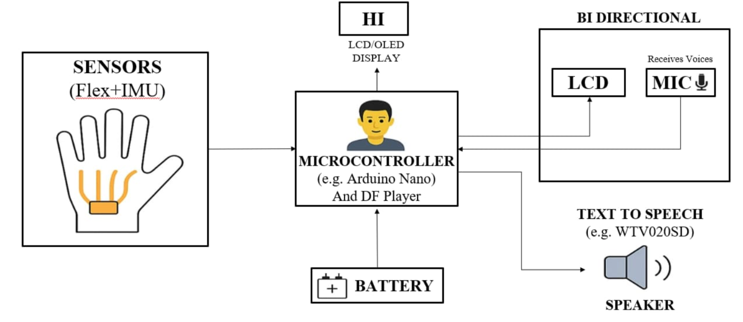
ARCHITECTURE DIAGRAM
03-Mar-25

Slide 12
PROJECT MODULES
Module 1: Hardware Setup & Integration
Module 2: Sensor Calibration
Module 3: Signal Processing
Module 4: Gesture Recognition
Module 5: Output to LCD Display
Module 6: Audio Output (Speech Conversion)
Module 7: Real-Time Testing & Applications
Module 8: Mobile Application Integration
03-Mar-25

Slide 13
MODULES DESCRIPTION
Module 1: Hardware Setup & Integration
This module involves assembling and integrating all hardware components on the glove. Flex sensors, IMU, microcontroller, display, audio modules, microphone, and power supply are interconnected, with the microcontroller acting as the central unit to enable seamless bidirectional communication.
Module 2: Sensor Calibration
This module ensures accurate sensor readings by calibrating flex sensors, IMU, and microphone. Baseline and threshold values are set to reduce noise and adapt the system to different users and hand movements.
Module 3: Signal Processing
In this module, raw sensor data is collected and processed to remove noise and inconsistencies. The processed data is normalized and relevant features are extracted to prepare it for gesture recognition.
Module 4: Gesture Recognition
This module identifies hand gestures by analyzing processed sensor data. The extracted features are compared with predefined thresholds or trained models to recognize the correct gesture and generate the corresponding output.
03-Mar-25

Slide 14
MODULES DESCRIPTION
Module 5: Output to LCD Display
This module displays the recognized gesture or converted speech as readable text on the LCD. It provides visual feedback to both hearing-impaired and hearing users for clear communication.
Module 6: Audio Output (Speech Conversion)
This module converts recognized gestures into audible speech using a text-to-speech mechanism. The DFPlayer module and speaker produce real-time voice output for effective communication with hearing individuals.
Module 7: Real-Time Testing & Applications
This module focuses on testing the system under real-time conditions to verify accuracy, speed, and reliability. It also demonstrates the practical usage of the glove in everyday communication, education, and healthcare environments.
Module 8: Mobile Application Integration
This module enables wireless communication between the glove and a mobile application using Bluetooth or Wi-Fi. The app displays text, provides audio output, stores communication history, and supports additional features such as multilingual translation.
03-Mar-25

Slide 15
MODULE - I
Module 1 - Hardware Setup & Integration
Glove Sensors – Flex sensors on fingers + IMU (MPU6050) capture hand gestures and motion.
Microcontroller (Arduino) – Collects sensor data, processes gestures, and controls input/output devices.
LCD Display – Shows recognized gestures as text and also displays converted speech input.
Text-to-Speech Module (DFPlayer) – Converts recognized gestures into pre-recorded voice output.
Microphone Module – Captures voice input for speech-to-text conversion.
Speaker – Outputs spoken words for hearing users.
Power Supply (Li-ion Battery + Regulator) – Provides stable power to all components.
System Integration – Microcontroller acts as the hub, linking sensors, display, mic, TTS, and speaker for seamless bi-directional communication.
03-Mar-25

Slide 16
MODULE - II
Module 2 – Sensor Caliberation
Flex Sensors – Set baseline (straight) and bent values, map to % bend.
IMU – Zero reference on flat surface, filter noise, normalize angles.
Microphone – Adjust sensitivity, filter background noise.
Gestures – Collect samples, set thresholds/train model, recalibrate if needed.
03-Mar-25

Slide 17
MODULE - III
Module 3 - Signal Processing
Data Acquisition – Collect raw signals from flex sensors and IMU.
Preprocessing – Filter noise, normalize sensor values, and smooth readings.
Feature Extraction – Identify key patterns (finger bends, hand orientation, speech features).
Classification/Recognition – Match processed data to predefined gestures or words.
Output Mapping – Convert recognized signals into text on LCD.
03-Mar-25

Slide 18
MODULES - IV
Module 4 - Gesture Recognition
Input Capture – Flex sensors detect finger bends, IMU tracks hand orientation.
Preprocessing – Normalize sensor data and remove noise.
Feature Extraction – Identify bending patterns and motion parameters.
Classification – Compare features with stored thresholds or ML model.
Output Generation – Recognized gesture is displayed as text.
03-Mar-25

Slide 19
MODULES - V
Module 5 - Output to LCD Display
Gesture Recognition Result – Detected sign is converted into text.
Display Module – LCD (I2C) shows real-time text output.
03-Mar-25

Slide 20
MODULES - VI
Module 6: Audio Output (Speech Conversion)
Converts recognized gestures into audible speech.
Uses Text-to-Speech (TTS) technique.
DFPlayer Mini used for voice playback.
Speaker outputs real-time audio.
Enables communication with hearing users.
03-Mar-25

Slide 21
MODULES - VII
Module 7: Real-Time Testing & Applications
Tested under real-time usage conditions.
Validates accuracy and response time.
Ensures stable text and speech output.
Tested with different gestures and speeds.
Applicable in daily communication, education, and healthcare.
03-Mar-25

Slide 22
MODULES - VIII
Module 8:Mobile Application Integration
Wireless connectivity via Bluetooth.
Displays recognized gestures as text.
Provides audio output through mobile device.
Stores communication history.
Supports multilingual translation and customization.
03-Mar-25

Slide 23
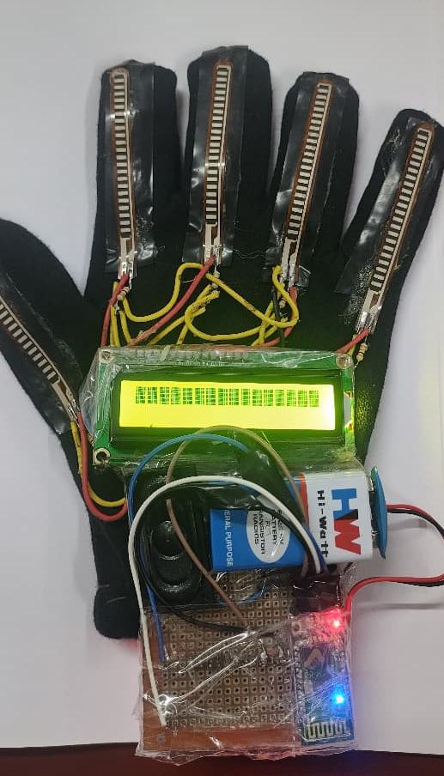
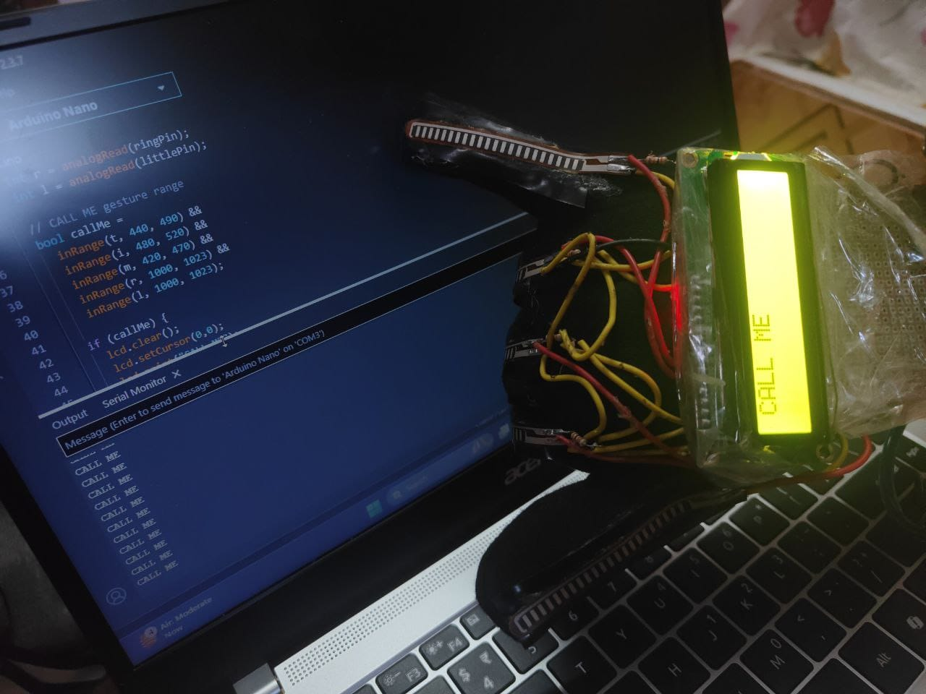
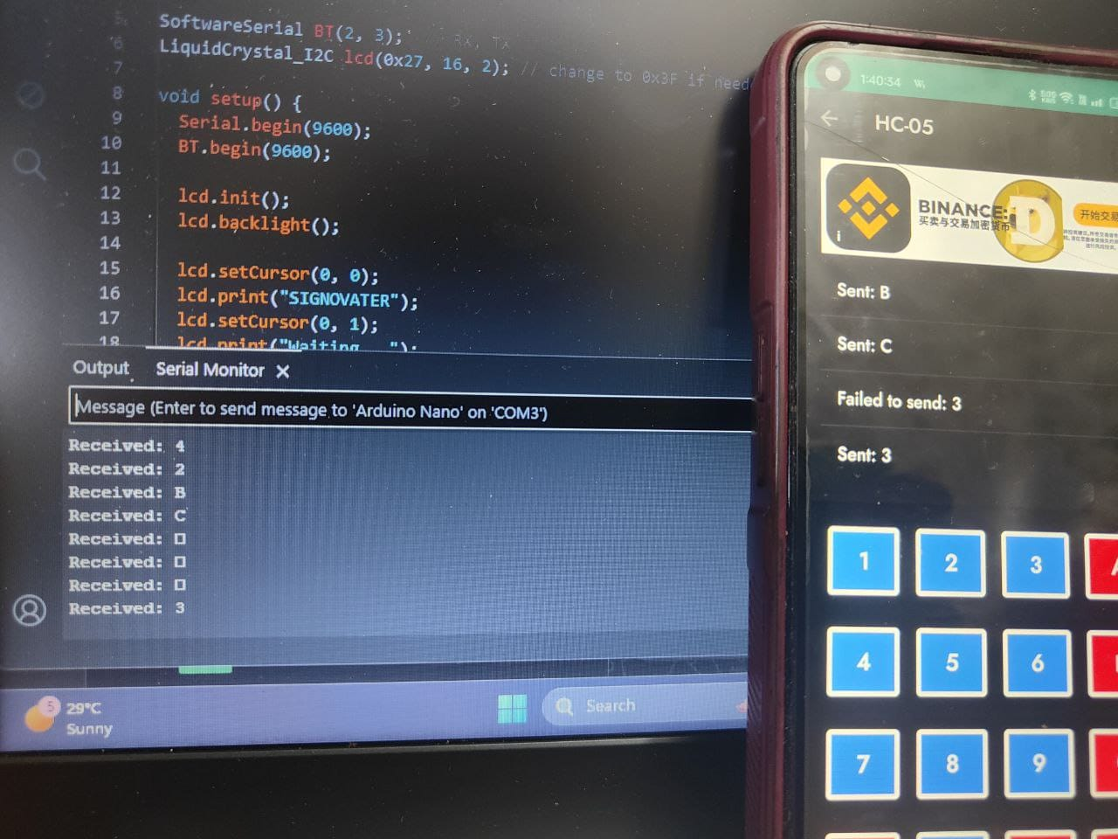
IMPLEMENTATION
Glove
Hand Gestures to LCD Display
Mobile to Serial Monitor
03-Mar-25

Slide 24
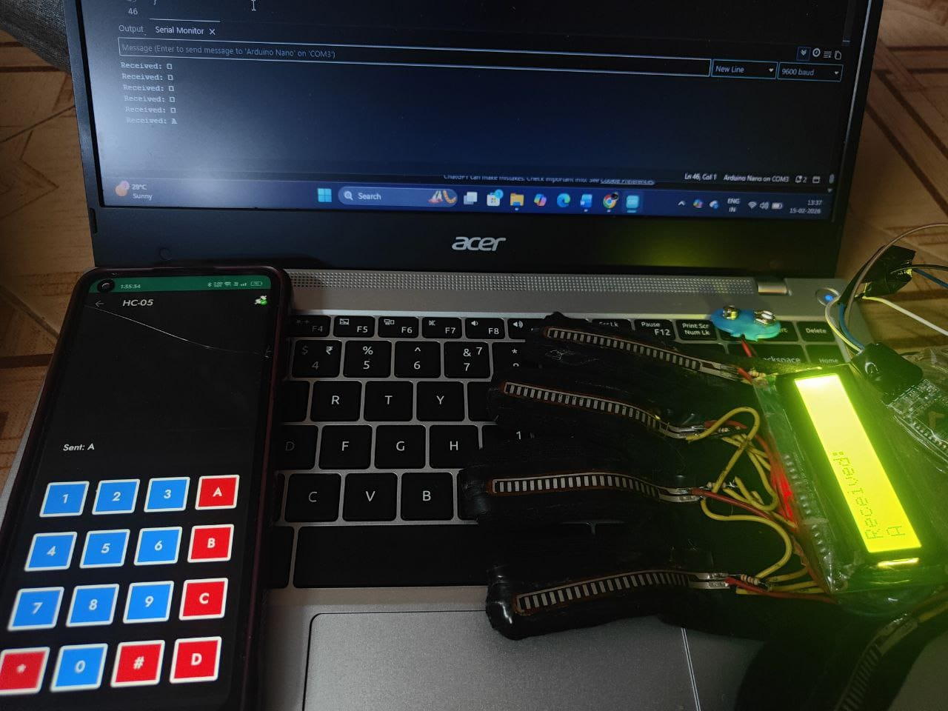
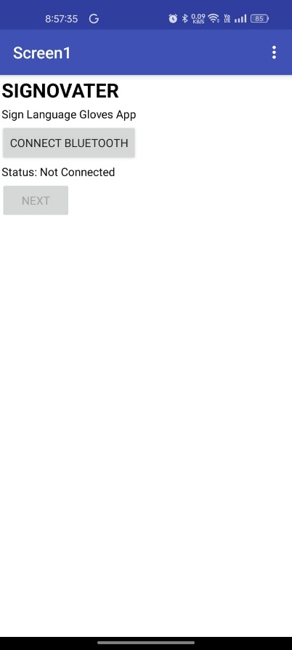
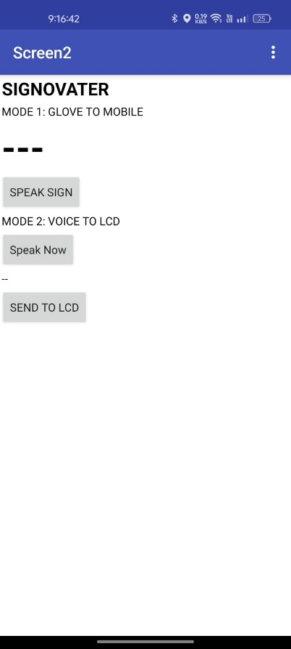
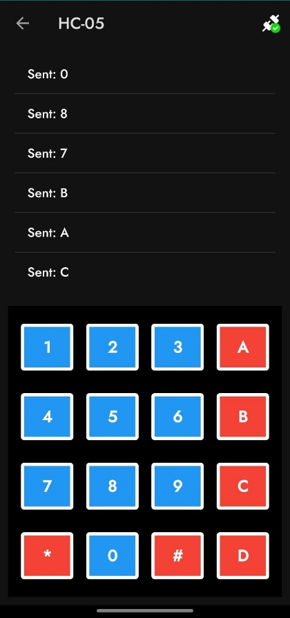
IMPLEMENTATION
Mobile Application to Glove
USER INTERFACE
(MOBILE APPLICATION DISPLAY)
03-Mar-25

Slide 25
FUTURE ENHANCEMENT
Advanced Gesture Recognition Implement deep learning models (CNN/LSTM) to recognize complex and continuous sign language gestures with higher accuracy.
Multilingual Support Extend the system to support multiple spoken and sign languages for wider accessibility across regions. Miniaturization & Wearable Design Reduce hardware size and improve glove ergonomics for comfort, durability, and daily use.
Smart Home & IoT Integration Integrate the glove with smart home devices to enable gesture-based control of lights, appliances, and assistants.
Battery Optimization Improve power management for longer battery life and faster charging.
Bidirectional Communication Enhance the system to support complete two-way communication by improving speech-to-text accuracy and real-time feedback for the glove user.
03-Mar-25

Slide 26
REFERENCES
[1]Al-Dhief, F. T., Abdul Latiff, N. M., Abd. Malik, N. N. N., Salim, N. S., Baki, M. M., Albadr, M. A. A., & Mohammed, M. A. A Survey of Voice Pathology Surveillance Systems Based on Internet of Things and Machine Learning Algorithms(2020).
[2]Friston, S., Griffith, E., Swapp, D., Marshall, A., & Steed, A. Position-Based Control of Under-Constrained Haptics: A System for the Dexmo Glove.(2019).
[3]Hashi, A. O., Hashim, S. Z. M., & Asamah, A. B. A Systematic Review of Hand Gesture Recognition: An Update From (2024).
[4]Singh, M., Bharti, S., Kaur, H., Arora, V., Saini, M., Kaur, M., & Singh, J. A Facial and Vocal Expression-Based Comprehensive Framework for Real-Time Student Stress Monitoring in an IoT-Fog-Cloud Environment(2022).
[5]Ullah, A., Ishaq, N., Azeem, M., Ashraf, H., Jhanjhi, N. Z., Humayun, M., Tabbakh, T. A., & Almusaylim, Z. A. (2021). A Survey on Continuous Object Tracking and Boundary Detection Schemes in IoT Assisted Wireless Sensor Networks.
[6]Zeshan, F., Ahmad, A., Babar, M. I., Hamid, M., Hajjej, F., & Ashraf, M. An IoT-Enabled Ontology-Based Intelligent Healthcare Framework for Remote Patient Monitoring(2023).

Slide 27
THANK YOU

