Slide 1

Game Demand Analysis & Tiering Recommendations
- Data Analyst Case Study
Name: Sri Lakshmi Swetha Addepalli

Slide 2
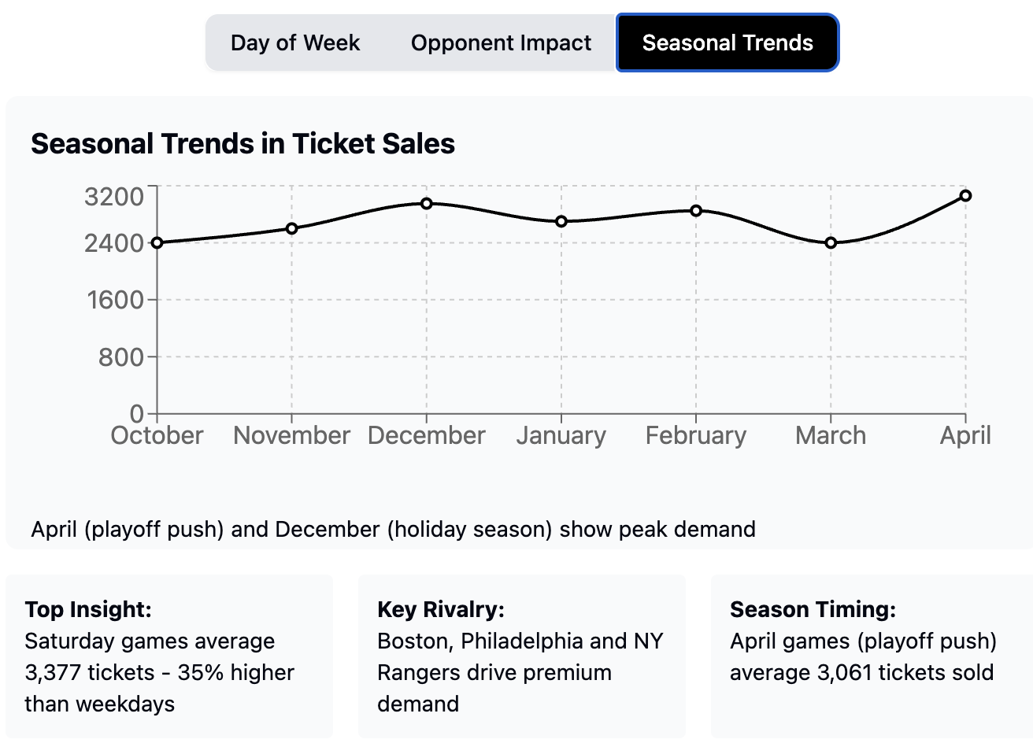
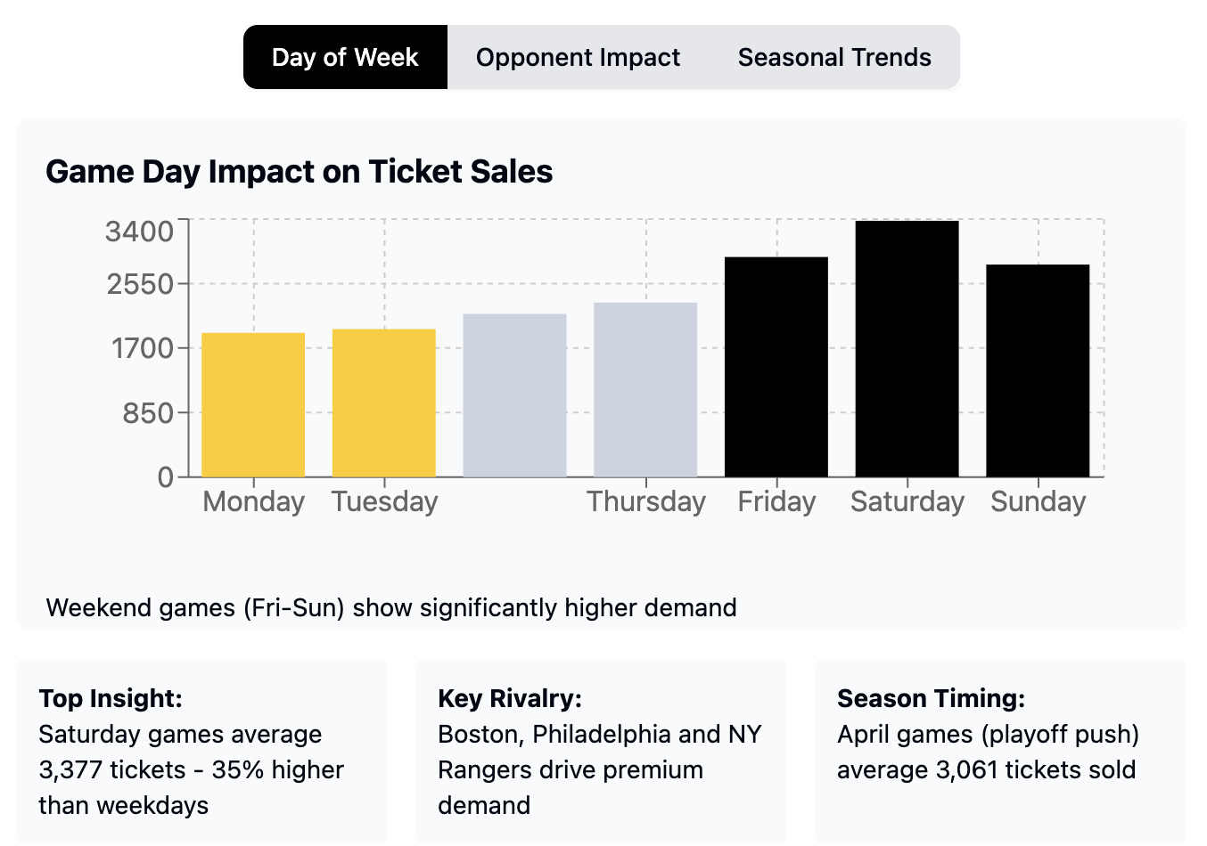
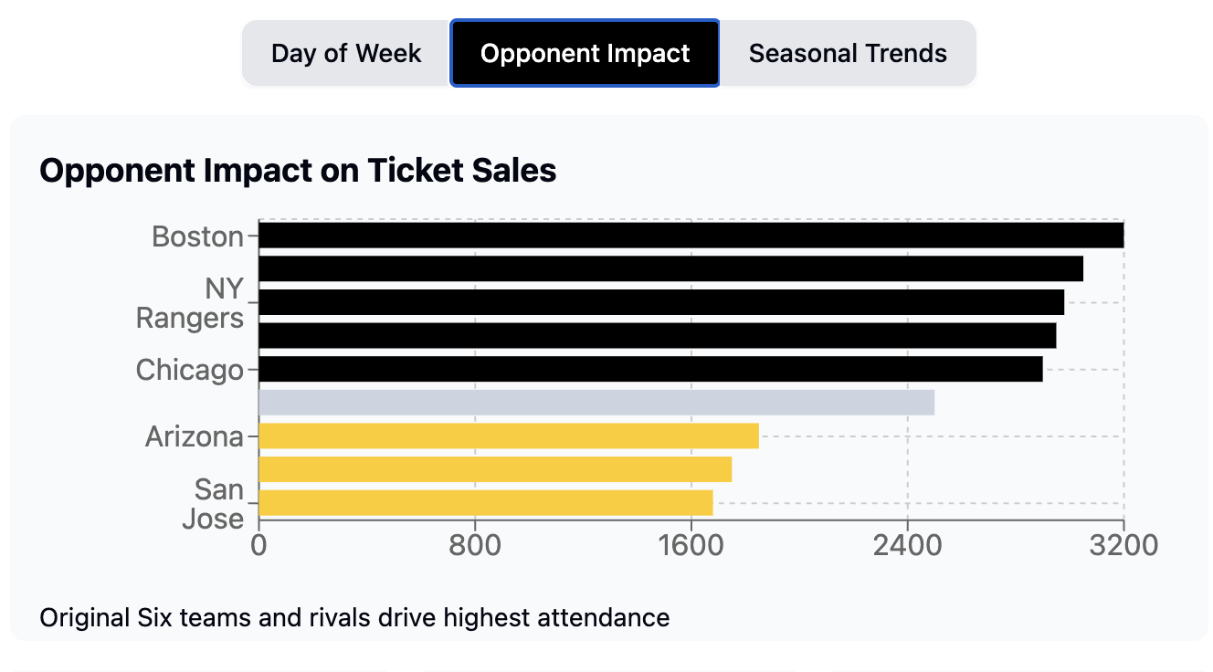
Key Factors Affecting Game Demand
Game Timing: a. Weekend games (Friday-Sunday) have higher demand (Avg. ~3,377 tickets on Saturdays) b. Weekday games (Monday-Tuesday) have lower demand (~1,900 tickets)
Opponent Strength & Rivalry: a. High-demand teams: Boston, Philadelphia, NY Rangers, Chicago b. Low Demand teams: Arizona, Columbus, San Jose.
Seasonal Trends: April games (playoff push) have highest Demand (~3,061 avg.) b. October & March games have lower demand (~2,400 avg.)

Slide 3
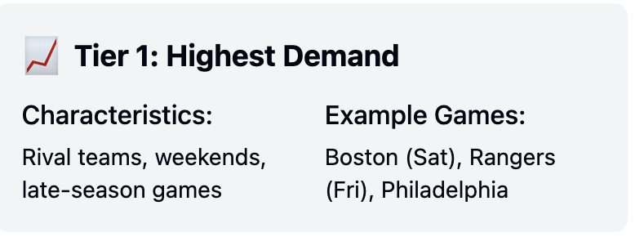
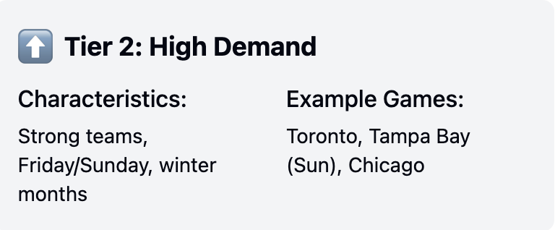
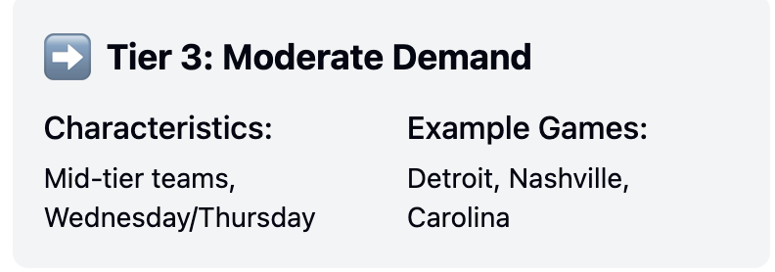
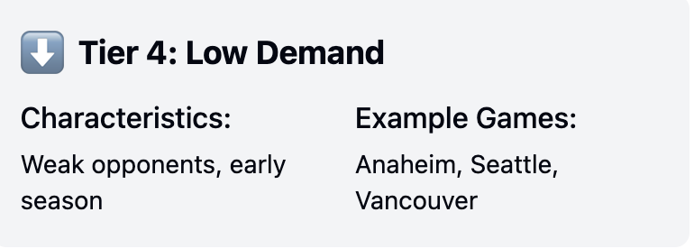
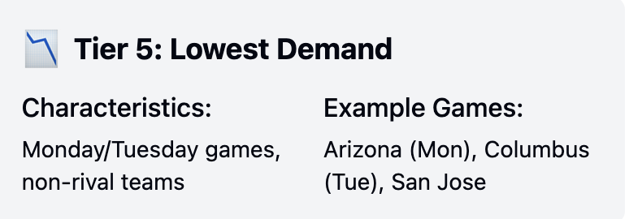
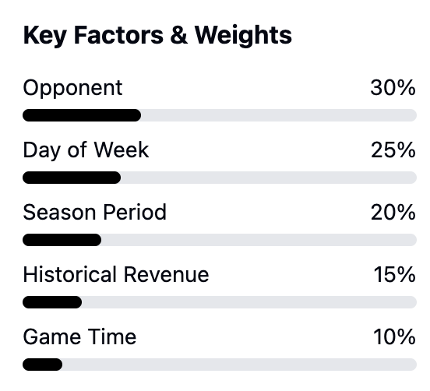
Tiering Methodology & Process
How did I assign tiers? ✔️ Used ticket sales, revenue, opponent strength, day of the week, and seasonality ✔️ Created 5-tier system to reflect demand-based pricing
2. Tier System Explanation
Tier 1 (Highest Demand) 📈 – Rival teams, weekends, late-season games
Tier 2 (High Demand) ⬆️ – Strong teams, Friday/Sunday games, winter months
Tier 3 (Moderate Demand) ➡️ – Mid-tier teams, Wednesday/Thursday
Tier 4 (Low Demand) ⬇️ – Weak opponents, early season
Tier 5 (Lowest Demand) 📉 – Monday/Tuesday games, non-rival teams

Slide 4
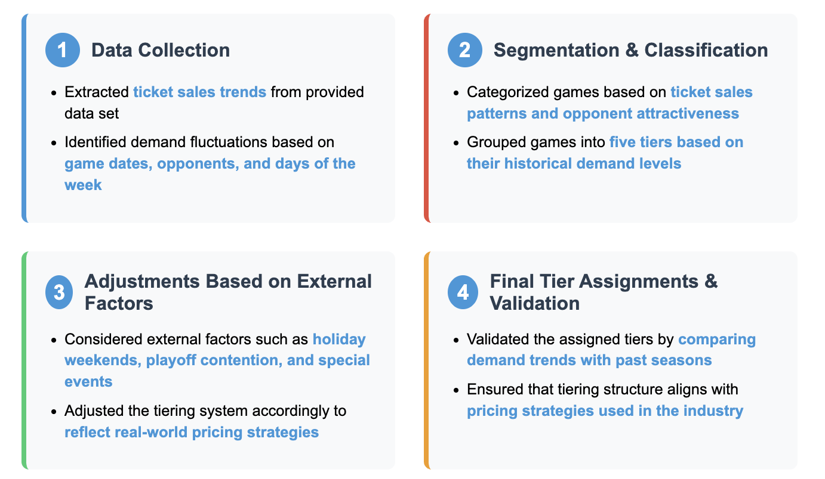
Methodology & Process for Tiering Analysis
Step 1: Data Collection
Extracted ticket sales trends from provided data set
Identified demand fluctuations based on game dates, opponents, and days of the week
Step 2: Segmentation & Classification
Categorized games based on ticket sales patterns and opponent attractiveness
Grouped games into five tiers based on their historical demand levels
Step 3: Adjustments Based on External Factors
Considered external factors such as holiday weekends, playoff contention, and special events
Adjusted the tiering system accordingly to reflect real-world pricing strategies
Step 4: Final Tier Assignments & Validation
Validated the assigned tiers by comparing demand trends with past seasons
Ensured that tiering structure aligns with pricing strategies used in the industry

Slide 5
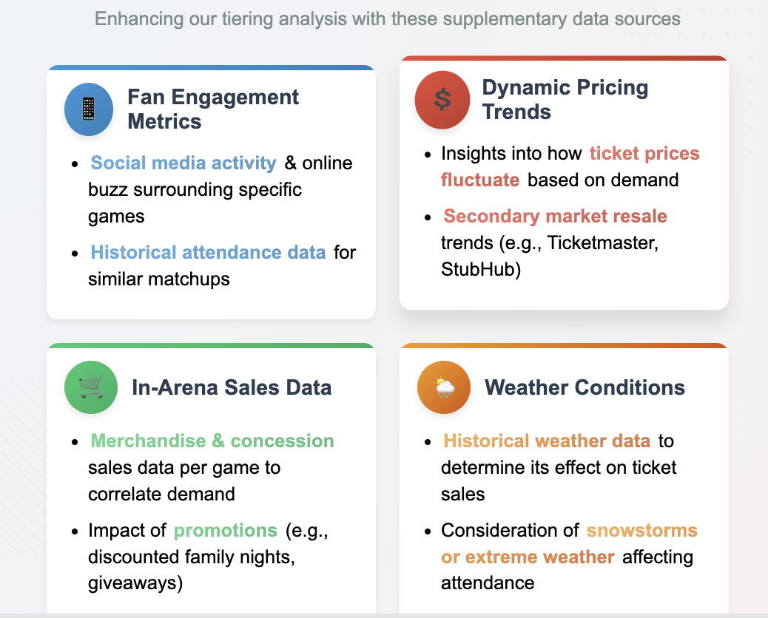
Additional Data That Would Improve Analysis
Fan Engagement Metrics:
Social media activity & online buzz surrounding specific games
Historical attendance data for similar matchups
Dynamic Pricing Trends:
Insights into how ticket prices fluctuate based on demand
Secondary market resale trends (e.g., Ticketmaster, StubHub)
In-Arena Sales Data:
Merchandise & concession sales data per game to correlate demand
Impact of promotions (e.g., discounted family nights, giveaways)
Weather Conditions:
Historical weather data to determine its effect on ticket sales
Consideration of snowstorms or extreme weather affecting attendance
Marketing & Promotional Campaigns:
The effect of special promotions (e.g., free jersey night) on demand
How targeted marketing strategies impact ticket sales for lower-tier games

