Slide 1
Expanding Market Reach and Profit: A Data Powered Approach
BDM Capstone Project
By
Swetha Suravajjula

Slide 2
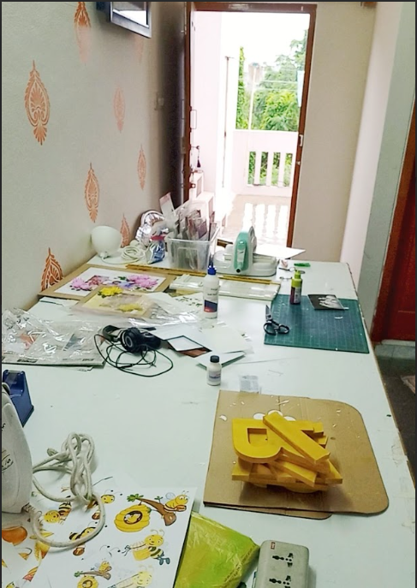
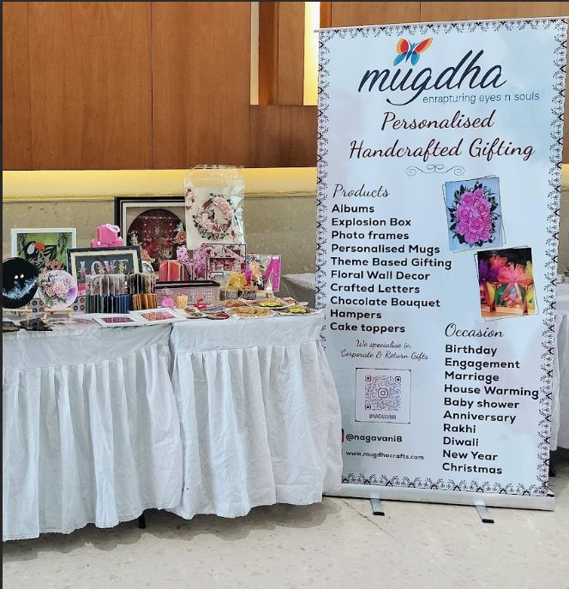
About Mugdha Crafts
B2C type Business
Personalised Online Gifting Shop
Artistic Gift Store
Founder: Nagavani Mopidevi
About Founder
Did her Masters in Microbiology
Founded Mugdha Crafts in 2020 while doing masters
Now working full-time in Mugdha Crafts
Achievements:
Listed in INDIA BOOK OF RECORDS for making 1000 handmade flowers.
Awarded as BEST YOUNGEST WOMEN ENTREPRENEUR
Website Link: https://www.mugdhacrafts.com/
Proof of Originality: https://drive.google.com/drive/folders/19Eb2zJB5H3EpzMaJDc2hftD69z5IiCe8?usp=drive_link

Slide 3
Problem Statements
Market Expansion: Expanding Beyond Telangana and Andhra Pradesh
Workforce Growth: Acquiring Skilled Employees
Profit Improvement: Review Pricing Strategy to Address High Production Costs

Slide 4
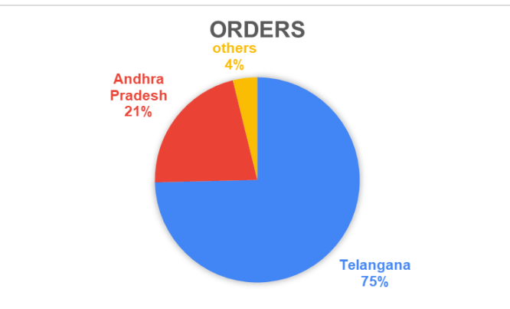
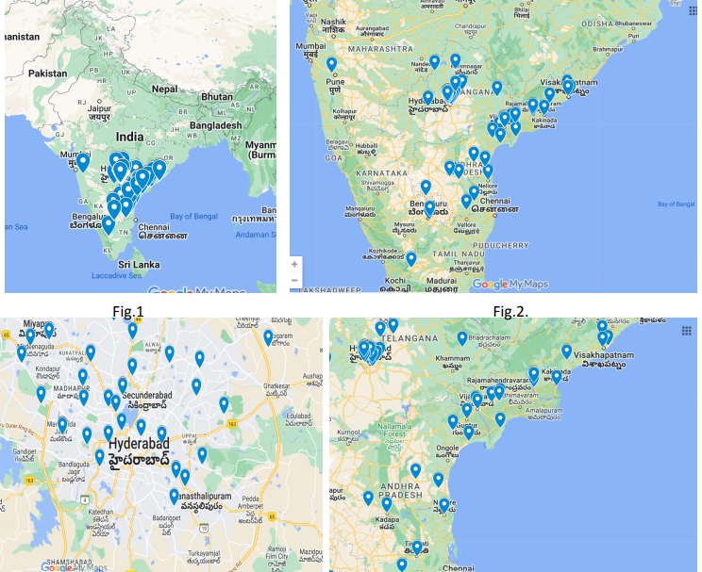
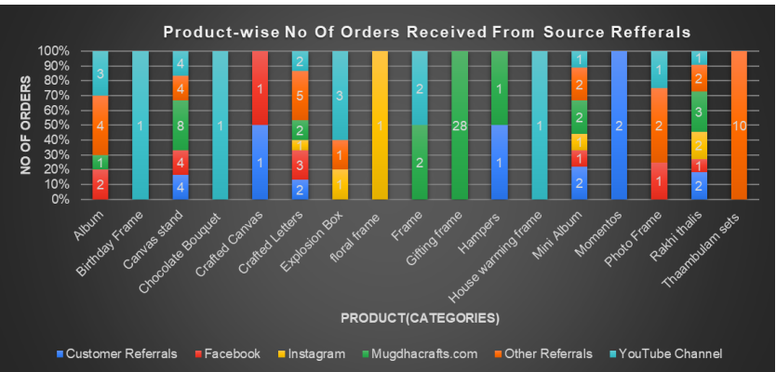
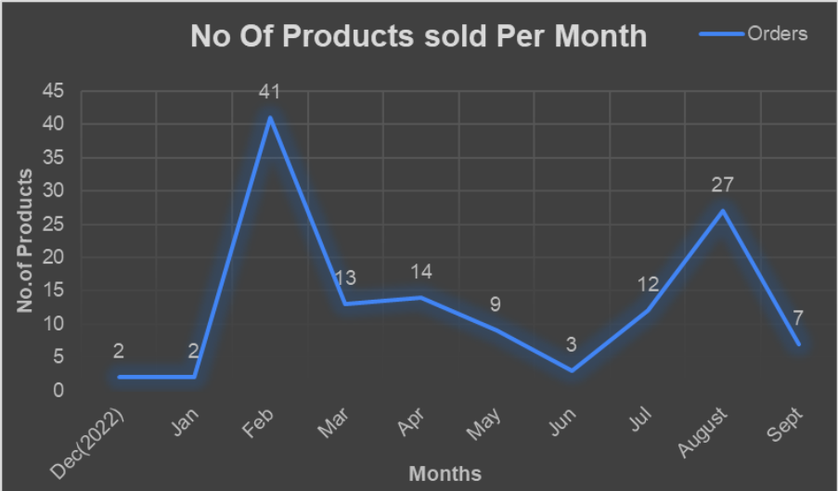
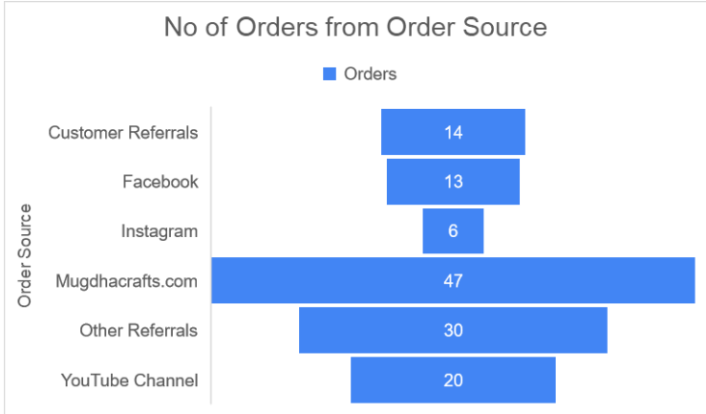
Analysis Method for Market Expansion
Geospatial Analysis
Customer Segmentation analysis
Source Orders Graph
Time Series Analysis

Slide 5
Recommendations For Market Expansion
Prioritizing Strong Regions
. Exploring New Market areas
.Putting up Platform-Optimized Offers
Adaptability to Market Changes

Slide 6
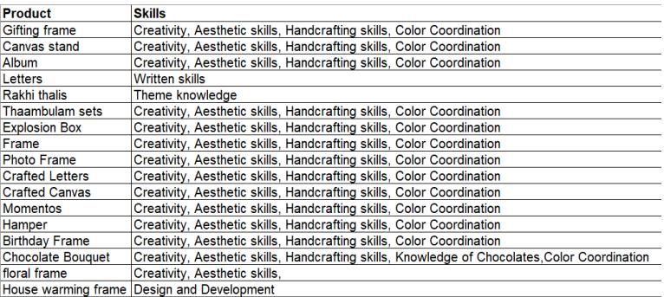
Analysis Method for Workforce Growth
Approaches for Man-Power Management
Skillset Table
The common skills expected from the candidate eligible for the employability in this company
Handcrafting skills
Color Coordination Creativity
Aesthetic skills

Slide 7
Recommendations for Workforce Growth
Employee Training Programs
Make them engaged in interactive workshops and observe expert demonstrations.
online tutorials and educational resources .
Distribute certifications upon program completion

Slide 8
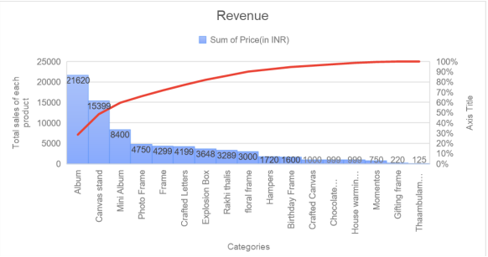
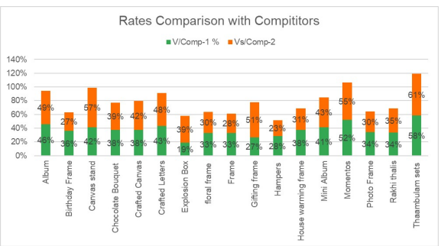
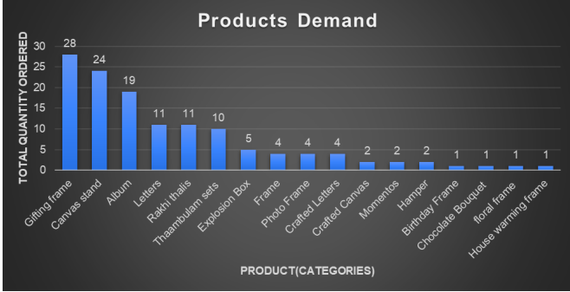
Analysis Method for Profit Improvement
Approaches for Profit enhancement
Profit-Demand Assessment
Mugdha Crafts Pricing Data vs Competitors Data

Slide 9
Recommendations for Profit Improvement
Strategic Focus on Top-Selling Product
Reevaluate the Lowest-Selling Product
Diversify Product Range
Leverage Competitive Pricing Strategies
Continuous Monitor and Adaptation

Slide 10
THANK YOU

