Slide 1
1. Virtualization
Virtualization is the process of running a virtual instance of a computer system in a layer abstracted from the actual hardware.
It is the ability to run multiple operating systems on a single physical system and share the underlying hardware resources.
It is the process by which one computer hosts the appearance of many computers.

Slide 2
2.High Availability:
High availability is a quality of a system or component that assures a high level of operational performance for a given period of time.
The way that it works is quite simple conceptually but typically requires some specialized software and configuration.

Slide 3
3.API : (Application programming interface)
An Application Programming Interface (API) is a tool set that programmers can use in helping them create software. A good API will have clear and concise commands that a programmer can use and reuse, so they don't have to build everything over again. API’s just allow applications to communicate with one another

Slide 4
4.Endpoints
Endpoints are remote computing devices that connect to a network and communicates back and forth with the network. An endpoint is a remote computing device that communicates back and forth with a network to which it is connected.
Examples of endpoints : Desktops

Slide 5
5. Virtual machine
A virtual machine is a computer file, typically called an image, which behaves like an actual computer. In other words, creating a computer within a computer.
Virtual machines are created to perform specific tasks that are risky to perform in a host environment, such as accessing virus-infected data and testing operating systems.

Slide 6
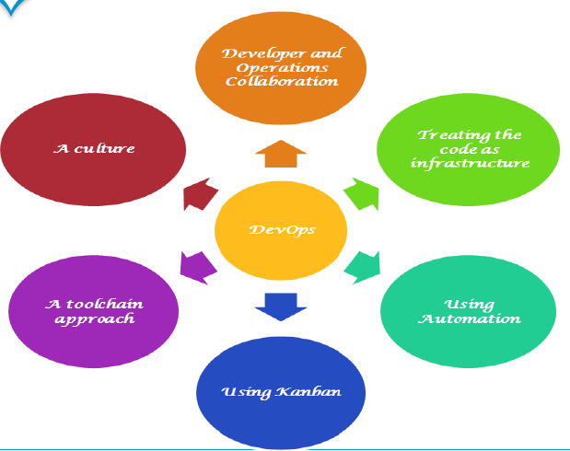
6.Devops
A combination of practices and tools that increases an organization’s ability to deliver applications at high velocity. This speed enables organizations to better serve their customers and compete more effectively in the market.

Slide 7
7.Continuous Deployment:
It is an approach of releasing software on the production servers continuously in an automated fashion. So, once a code passes through all the stages of compiling the source code, validating the source code, reviewing the code, performing unit testing & integration testing, packaging the application continuously, it will then be deployed onto the test serves to perform User Acceptance tests. Once that is done, the software will be deployed onto the production servers for release and this is said to be Continuous Deployment.

Slide 8
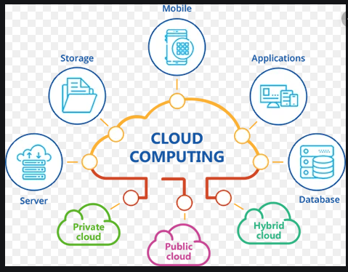
8.Cloud :
Cloud computing is a term referred to storing and accessing data over the internet. It doesn't store any data on the hard disk of your personal computer. In cloud computing, you can access data from a remote server.
Instead of accessing files and data from a local or personal computer, you are accessing them online from any Internet-capable device ,the information will be available anywhere you go and anytime you need it.

Slide 9
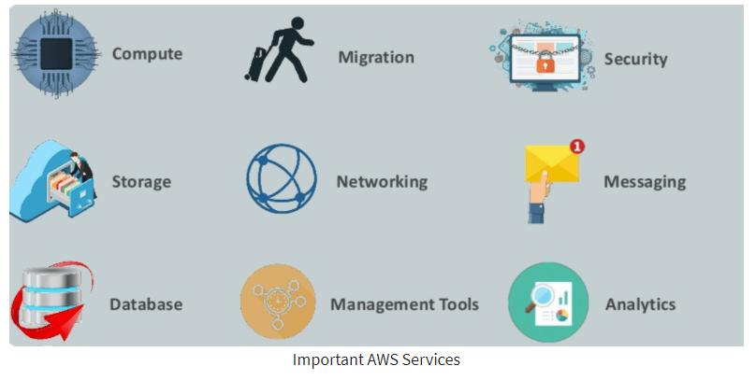
9.AWS
Amazon web service is a platform that offers flexible, reliable, scalable, easy-to-use and cost-effective cloud computing solutions.
AWS is a comprehensive, easy to use computing platform offered Amazon. The platform is developed with a combination of infrastructure as a service (IaaS), platform as a service (PaaS) and packaged software as a service (SaaS) offerings.

Slide 10
10.Microservices
In this applications are simpler to build and maintain when broken down into smaller pieces that work seamlessly together. When using microservices, you isolate software functionality into multiple independent modules that are individually responsible for performing precisely defined, standalone tasks. These modules communicate with each other through simple, universally accessible application programming interfaces (APIs).

Slide 11
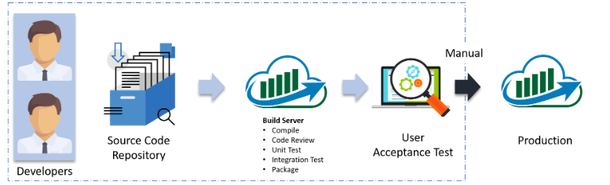
11.Continuous Delivery
It is a process where you build software in such a way that it can be released to production at any time.
In this the code changes are automatically built, tested, and prepared for a release to production.

Slide 12
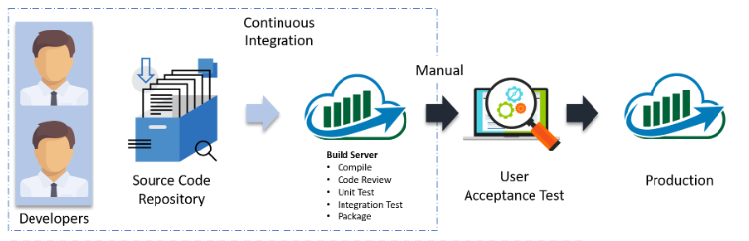
12.Continuous Integration
A practice that requires developers to integrate code in a code repository (e.g. Github, SVN) several times a day. Each check-in (commit) is then verified by an automated build and testing, allowing teams to detect problems early.
In Continuous Integration, every code commit is build and tested, but, is not in a condition to be released. I mean the build application is not automatically deployed on the test servers in order to validate it using different types of Blackbox testing like – User Acceptance Testing (UAT).

Slide 13
13.Software Integration
Software Integration is a process of merging two or more diverse software systems either mono-directional or bi-directional so that data/functionality flows between that system smoothly.
Software Integration tools:
MuleSoft Anypoint Platform
IBM Enterprise BUS
Dell Boomi
APIGEE
Jitterbit
WSO2
FUSE ESB

Slide 14
14.Configuration management
It is a process of tracking and controlling the changes in software in terms of the requirements, design, functions and development of the product.

Slide 15
15.Load balancer
A load balancer is a device that acts as a reverse proxy and distributes network or application traffic across a number of servers. Load balancers are used to increase capacity (concurrent users) and reliability of applications. They improve the overall performance of applications by decreasing the burden on servers associated with managing and maintaining application and network sessions, as well as by performing application-specific tasks.
Load balancers are generally grouped into two categories: Layer 4 and Layer 7. Layer 4 load balancers act upon data found in network and transport layer protocols (IP, TCP, FTP, UDP). Layer 7 load balancers distribute requests based upon data found in application layer protocols such as HTTP.

Slide 16
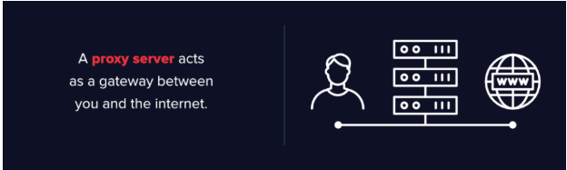
16.Proxy server
A proxy server acts as a gateway between you and the internet. It’s an intermediary server separating end users from the websites they browse. Proxy servers provide varying levels of functionality, security, and privacy depending on our use case, needs, or company policy.
If we’re using a proxy server, internet traffic flows through the proxy server on its way to the address we requested. The request then comes back through that same proxy server (there are exceptions to this rule), and then the proxy server forwards the data received from the website to us

Slide 17
17.Failover
Failover is a backup operational mode that automatically switches to a standby database, server or network if the primary system fails, or is shut down for servicing.
Failover is an extremely important function for critical systems that require always-on accessibility.
The main purpose of failover is to eliminate, or at least reduce, the impact on users when a system failure occurs.

Slide 18
18.Fault tolerance
Fault tolerance is the way in which an operating system (OS) responds to a hardware or software failure. The term essentially refers to a system’s ability to allow for failures or malfunctions, and this ability may be provided by software, hardware or a combination of both. To handle faults gracefully, some computer systems have two or more duplicate systems

Slide 19
19.Disaster recovery
Disaster recovery is a set of policies and procedures which focus on protecting an organization from any significant effects in case of a negative event, which may include cyberattacks, natural disasters or building or device failures. Disaster recovery helps in designing strategies that can restore hardware, applications and data quickly for business continuity.

Slide 20
20.RPO & RTO
RPO: Recovery Point Objective
Recovery Point Objective (RPO) describes the interval of time that might pass during a disruption before the quantity of data lost during that period exceeds the Business Continuity Plan’s maximum allowable threshold or “tolerance.”
RTO: Recovery Time Objective
The Recovery Time Objective (RTO) is the duration of time and a service level within which a business process must be restored after a disaster in order to avoid unacceptable consequences associated with a break in continuity. In other words, the RTO is the answer to the question: “How much time did it take to recover after notification of business process disruption?“

