Slide 1
Employee data analysis using excel
Student Name: G. Nithiyasree
Register No: 312214925
Department: commerce
College: Annai veilankanni’s college for women
NMID: ASUNM1483312214925

Slide 2
Project Title
Employee performance analysis using Excel

Slide 3
Agenda
Project Overview
End user
Problem statement
Modelling approach
Data set description
Conclusion

Slide 4
Problem statement
Accurately evaluate employee performance
Identify strength, weakness, opportunity and threads (SWOT analysis)
Develop targeted interventions and programs
Inform talent management decision (promotion, succession)

Slide 5
Project Overview
Analysis employee performance data to identify key drivers of performance and areas for improvement
Develop targeted Interventions and training program
Focus on identifying key predictors of Performance areas of improvement and opportunities for growth and development
Develop data-driven insights to inform talent management decision, training program and leadership development initiatives.

Slide 6
Who Are The End Users?
Line manager
Hr business partners
Senior leadership
Employee development teams
Compensation and benefits teams
Talents acquisition teams
Employee

Slide 7
Our solution and its value proposition
Solution: Empower AI – employee performance insight
value proportion:
Identify top performance
Pinpoint skill gaps
Enhance employee engagement
Inform data-driven decision
Boast productivity

Slide 8
Dataset Description
Description:
This data set contains information on employee performance, emographics and development activities
Fields
Employee ID
Name
FTE
Department

Slide 9
The “wow” in our solution
AI driven predictive analytics for accurate forecasting and insights
Automated performance scoring for unbaised evaluation
Personalised development plans for traget growth and improvement
Real-time feedback and coaching for continuous development

Slide 10
Modelling
Regression analysis
Decision trees
Clustering analysis
Predictive modeling
Survival analysis
Network analysis
Machine learning algorithms
Simulation modelling
Bayesian networks

Slide 11
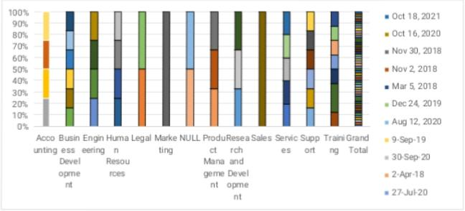
Result

Slide 12
Conclusion
Employee performance analysis is a critical component of tanlent management enabling organization to make data driven decision, drive business outputs and enhance employees experience. By leveraging advanced analytics modelling techniques.

