Slide 1
Employee Data Analysis using Excel
STUDENT NAME: SWETHAMARY S
REGISTER NO: 312220123
DEPARTMENT: B.COM GENERAL
COLLEGE: SRI BALAJI ARTS AND SCIENCE COLLEGE

Slide 2
PROJECT TITLE
Employee Performance Analysis using Excel

Slide 3


AGENDA
Problem Statement
Project Overview
End Users
Our Solution and Proposition
Dataset Description
Modelling Approach
Results and Discussion
Conclusion
3/21/2024 Annual Review

Slide 4

PROBLEM STATEMENT
Lack of a standardized performance evaluation process leading to inconsistencies in performance assessments.
Insufficient metrics and tools to effectively measure and analyze employee performance.
Limited feedback mechanisms causing delays in identifying and addressing performance issues.
Challenges in aligning individual performance goals with organizational objectives.
Difficulty in identifying training needs and career development opportunities for employees.

Slide 5

PROJECT OVERVIEW
Purpose: Evaluate and improve employee performance to align with organizational goals.
Objectives: Assess individual performance, identify strengths and areas for improvement, align performance with organizational goals, enhance employee development, support informed HR decisions.
Benefits: Improved overall performance, enhanced employee
development and career growth, informed HR decisions on promotions and compensation, increased employee engagement and motivation.
Challenges: Ensuring objectivity and reducing bias, accurate and comprehensive data collection, managing employee resistance to feedback.

Slide 6

WHO ARE THE END USERS?
Employees
Executives/Senior Leadership
HR Department
Managers/Supervisors
Training and Development Teams

Slide 7

OUR SOLUTION AND ITS VALUE PROPOSITION
A robust and integrated system designed to streamline and enhance the evaluation, management, and development of employee performance within the organization. The system incorporates standardized evaluation frameworks, advanced metrics, continuous feedback mechanisms, and development planning tools.

Slide 8
Dataset Description
Employee data set taken from the KAGGLE.
In dataset, out of 26 data I took only 9 features out of it.
The selected 10 features are listed below:
Employee ID
First name
Last name
Business unit
Employee Type
Employee Status
Employee classification type
Gender Code
Performance Score
Current employee rating

Slide 9
MODELLING
1) DATA COLLECTION
The data has been collected through Edunet dash board.
2) FEATURE COLLECTION
The listed 10 features were taken for the analyses of data.
3) DATA CLEANING
Identifying the missing values.
Filtering of those missing values.
4)CALCULATION OF PERFORMANCE LEVEL
By considering the current employee rating, I found the performance level using the formula.
5)SUMMARY OF PIVOT LEVEL
Segregating od certain features to rows, columns, heading and so on.
6)VISUALIZATION:
Once completed with pivot table, created the graph for precise visualization.
9

Slide 10

THE "WOW" IN OUR SOLUTION
Personalized Insights:
Custom feedback tailored to individual strengths and career goals.
Development plans with clear, actionable steps for growth.
Real-Time Analytics:
Instant performance tracking and feedback.
Predictive insights to anticipate future trends and needs.
Engaging Experience:
Gamified elements to motivate and reward high performance.
Intuitive, mobile-friendly interface for on-the-go access.
Holistic Approach:
360-degree feedback for a comprehensive evaluation.
Integration of employee wellness into performance metrics.
3/21/2024 Annual Review
10

Slide 11
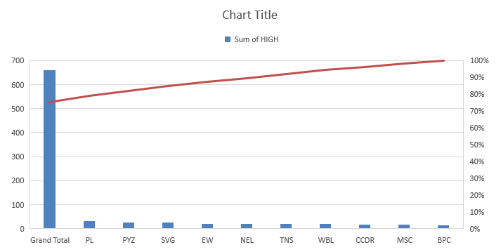
RESULTS
FORMULAS:
=IFS(Z8>=5,"VERY HIGH",Z8>=4,"HIGH",Z8>=3,"MED",TRUE,"LOW")
11

Slide 12
conclusion
Our employee performance analysis solution empowers individuals with deep, personalized insights, enabling them to clearly understand their strengths and areas for growth. By offering real-time analytics and predictive tools, it allows for data-driven decisions that foster continuous improvement. The engaging experience, enhanced by gamification and mobile accessibility, boosts both motivation and productivity. Additionally, our holistic approach, which integrates 360-degree feedback and wellness considerations, ensures a comprehensive evaluation of performance. Ultimately, this solution provides a strategic advantage, aligning individual contributions with organizational goals and driving overall business success. Our innovative approach not only meets expectations but delivers a "WOW" experience that transforms how organizations and employees achieve success together.

