Slide 1
USER GUIDE

Slide 2
ABSTRACT

Slide 3
Every person wants to refer others for some help or information about his life or experiences. Rather than reaching out the person personally, this project provides the information of a person which he posts as public.
This include his personal experiences in interviews, jobs etc and his biodata .
In our busy times of our work, I as a student, or any individual forget some of the things which are important, that things might include passwords, bank account details and our day to day transactions.
Through this, we can make it easy by looking at it whenever we want, make changes if required and do some calculations too. This project has a rigid login system .

Slide 4
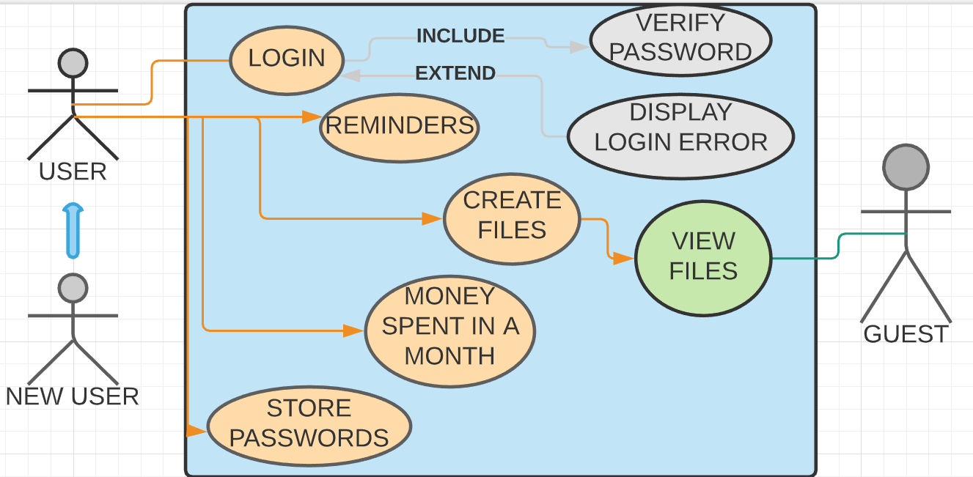
USE CASE DIAGRAM

Slide 5
TECHNOLOGY USED
All computer software needs certain hardware components or other software components resources to be present.
In order to use User Guide the following are the prerequisites,
a. Software Requirements:
a. Operating System – Windows 7 and above
b. C Compiler – GNU Compiler
c. Editor – Any basic editor is preferable (Example: Notepad++)
b. Hardware Requirements:
a. Processor - Intel Core i5 and above
b. Memory – 4GB Ram

Slide 6
RESULTS

Slide 7
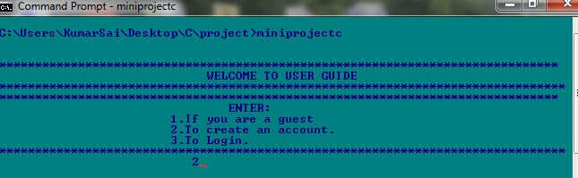
//LOGGING IN TO CREATE ACCOUNT AND SET USERNAME AND PASSWORD

Slide 8
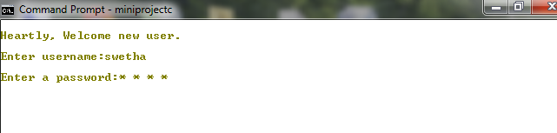

Slide 9
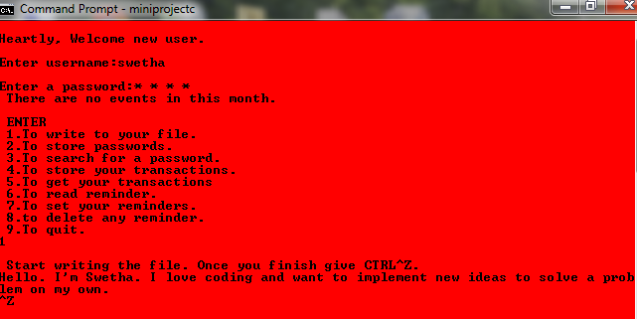
//Writing into a public file

Slide 10
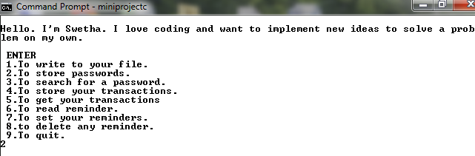

Slide 11
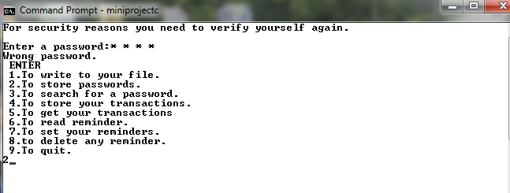
//STORING PASSWORDS

Slide 12
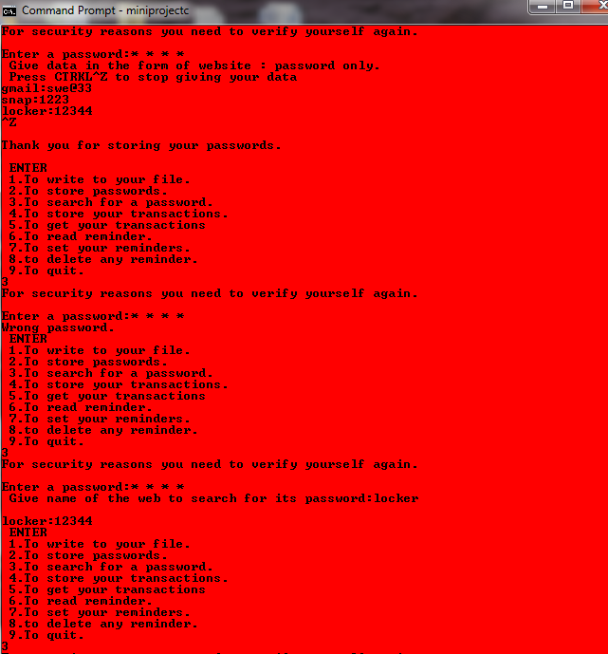
//TO SEARCH FOR A WEBSITE’S PASSWORD BY ENTERING 3

Slide 13
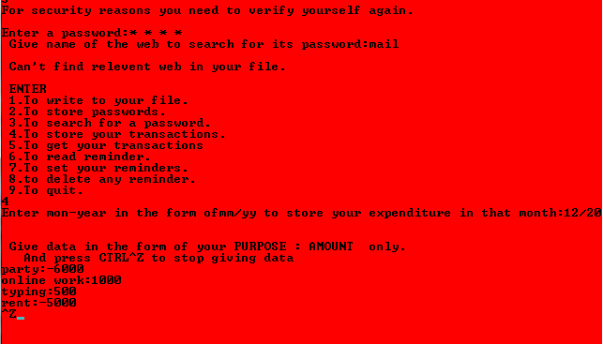
//ENTERED 4 TO STORE TRANSACTIONS(‘-’ IF USED AND ‘+’ FOR CREDITTED)

Slide 14
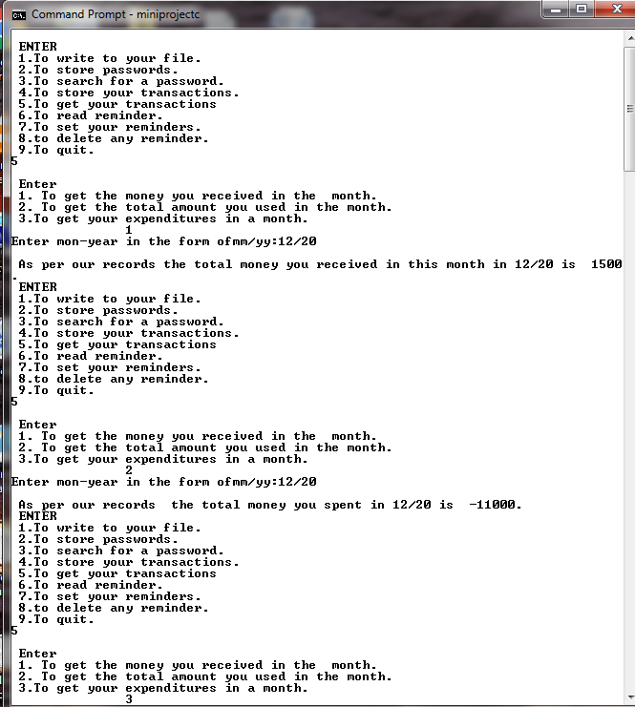
//GETTING DETAILS OF THE MONTH’S TRANSACTIONS BY ENTERING 5

Slide 15
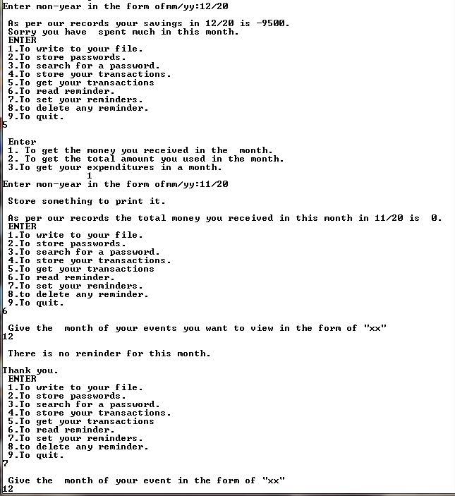

Slide 16
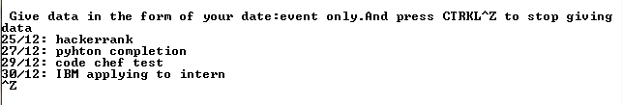
//SETTING REMINDERS

Slide 17
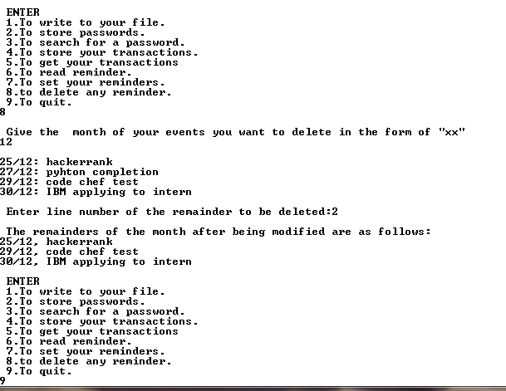

Slide 18
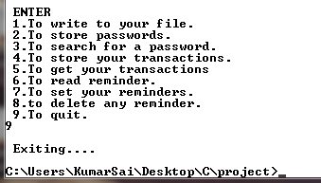

Slide 19

//WHEN A REGISTERED USER LOGINS INTO HIS ACCOUNT

Slide 20
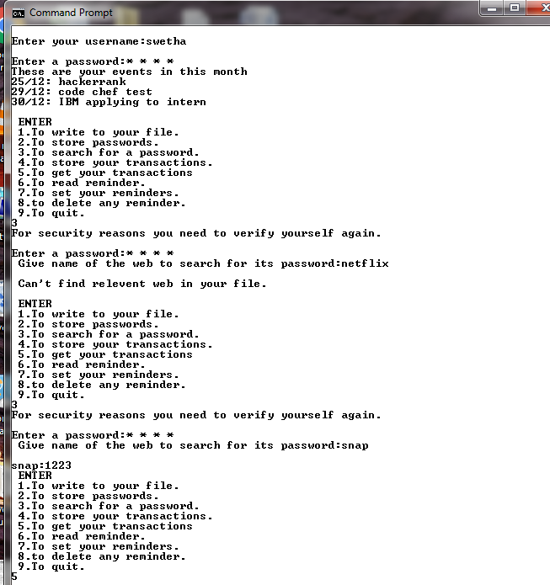
//When a registered user logs in, all his reminders in that month are displayed.

Slide 21
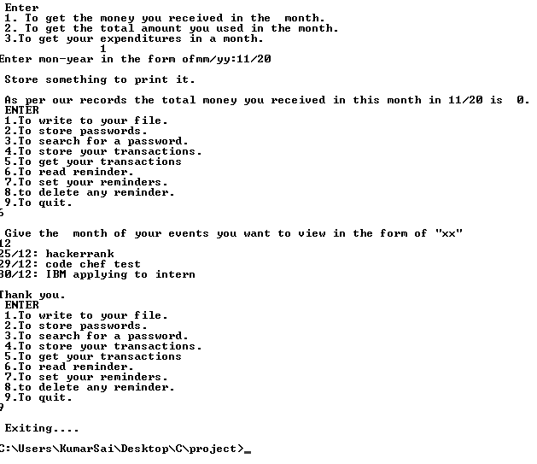

Slide 22
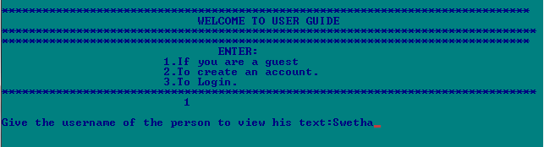
//If guest requests for an unknown user

Slide 23
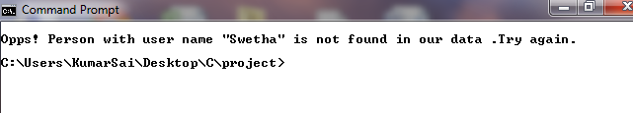

Slide 24
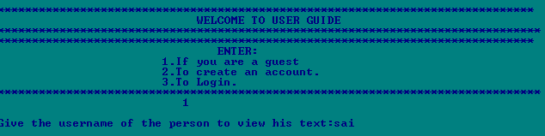
//If our registered user didn’t yet share his experiences with us

Slide 25
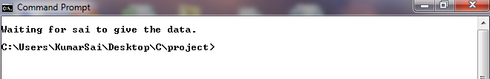

Slide 26
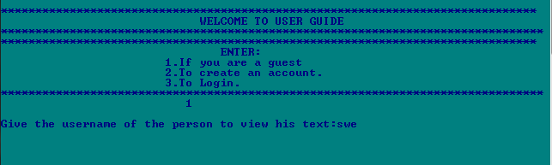
//If you are a guest and asks for a user who has shared his experiences with us

Slide 27
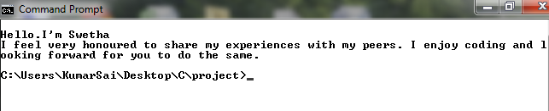

Slide 28
CONCLUSION AND FUTURE WORK
We conclude that this can be helpful to every one.
In future, we want to add more graphic features to mark the reminders and in reminding them.
We even want to arrange a virtual meet through chat to our guest with our registered user based on his request to help people even when they are away.
And, we want to help our guest by showing the fields in which our users are present and help him choose easily without much lag.

