Slide 1
Integration + Downstream Analysis Whole Workflow
October 2026
Notes:
These are the two functions from the LIGER’s ATAC module that we have previously discussed. Today, I will cover how each of these works, and then describe how I was able to tinker with the code and come up with the opposite direction – the current method uses the ATAC-seq dataset as the reference, and then imputes peaks on to the gene expression, and we want to be able to do the opposite.

Slide 2
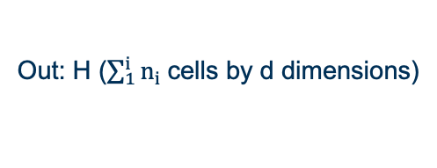
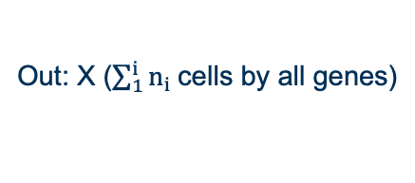
Workflow 1
In: H (from Step 1)
RNA-seq reference dataset
ATAC cells that need imputed expr. values
In: Dataset Matrices: n_{i} cells by f_{i} features
In: X (from Step 2)
TF List
Integration
Imputation
GRN
Out: H ($\sum_{1}^{i}{n_{i} }$cells by d dimensions)
Out: X ($\sum_{1}^{i}{n_{i} }$cells by all genes)
Out: Network
Notes:
So from our last meeting, these were our three main task that we had.

Slide 3
Step 1: Integration
Method | What you get out | ATAC goes in as | Citation
scSAGA | joint embedding (30-d) + the matching it came from | peaks — raw
Pamona | joint embedding + matching; labels cells shared vs dataset-specific | peaks — raw | Cao et al., Bioinformatics 2021
SCOT | matching + one dataset rewritten in the other's feature space — no embedding | peaks — raw | Demetci et al., RECOMB 2020
LIGER | joint embedding + per-dataset gene loadings | gene activity | Welch et al., Cell 2019
Seurat v5 | joint embedding; can also predict the other modality | gene activity | Hao et al., Nat Biotechnol 2024
Harmony | joint embedding, nothing else | gene activity | Korsunsky et al., Nat Methods 2019
scGT | joint embedding | peaks — raw | Bioinformatics 2025
scMODAL | joint embedding, built from a few known linked features | peaks — raw | Nat Commun 2025
scHPGT | joint embedding, built with a regulatory prior | peaks — raw | Bioinformatics 2026

Slide 4
Step 1: Integration -- Validation
Metric | What it asks | Truth needed | Good looks like
FOSCTTM | for each cell, what fraction of other cells are closer to it than its true cross-modal partner is? | paired cells, held out | 0 = perfect, 0.5 ≈ random. Published: 0.14–0.16 (MMD-MA), 0.22 (UnionCom), 0.39 (unnormalized)
label conservation | are cell types still separated? ARI, NMI, cLISI, silhouette, isolated-label F1, graph connectivity | cell-type labels | close to unintegrated labels, far from a shuffled control
batch correction | are datasets mixed? kBET, iLISI, batch silhouette | dataset IDs | improves while the label metrics hold
label transfer | can a label learned on RNA be assigned to the ATAC half? | paired cells + labels | > 0.85 on major lineages

Slide 5
Step 2: Imputation –
Method | What it consumes | What it returns | ATAC → RNA? | Citation
reverse-imputeKNN (this repo) | H, the measured RNA reference block, and the query rows that need values | one expression row per ATAC cell: a weighted average of its k nearest reference cells | yes — based off of Liger’s ImputeKNN | run.py, impute()
LIGER imputeKNN | H.norm and the reference's peaks | imputed PEAKS for the query cells | no — modal is hard-coded to ATAC | Welch et al., Cell 2019

Slide 6
Step 2: Imputation -- Validation
Metric | What it asks | Source, and how it was used | Good looks like
pFCS | is the gene–gene correlation structure preserved? Pearson of the two correlation matrices over the top-100 variable genes | Liu et al., Nat Methods 2025 — one of their three data-structure metrics | high, and above the control
MSE | how far is the guess from the hidden value? | Liu et al. 2025, as sMSE — ranks methods on held-out truth | low, and below the control
pDES | are differential-expression statistics preserved? (limma, per cell type) | Liu et al. 2025 — DE statistics recomputed after imputation | high
gene-wise ρ | per-gene Pearson or Spearman against the hidden RNA | Polarbear 2022 and BABEL 2021, on SNARE-seq — per-gene Pearson | 0.155–0.22; the published ATAC → RNA ceiling
densification | nonzero fraction of guessed rows vs measured rows | Andrews & Hemberg 2019 — zeros created, and the false positives after | no inflation
downstream | 5 classification and 5 clustering metrics on the imputed matrix | Liu et al. 2025 — classifier and clustering on the imputed data | as the benchmark defines

Slide 7
Step 3: GRN Matrix
Method | What it does | What you get | Citation
GRNBoost2 (arboreto) | gradient boosting, one regression per target gene | ranked TF→target importances, unsigned | Moerman et al., Bioinformatics 2019
GENIE3 | random-forest importance, one regression per target | ranked TF→target importances | Huynh-Thu et al., PLoS ONE 2010
SCENIC | GRNBoost2 or GENIE3, then motif pruning (RcisTarget) | regulons: a TF + its targets, scored per cell | Aibar et al., Nat Methods 2017
PIDC | partial information decomposition over triplets; no direction | undirected TF–target association | Chan et al., Cell Systems 2017
SCODE | linear ODE along pseudotime, low-rank | signed TF→target coefficients | Matsumoto et al., Bioinformatics 2017
DeepSEM | structural equation model with a linear decoder | directed TF→target weights | Shu et al., Nat Comput Sci 2021

Slide 8
Step 3: GRN Matrix -- Validation
Metric | What it asks | Good looks like
AUPRC | of all possible TF→target pairs, how well are the true ones ranked? | above the negative control
precision | precision among the top-ranked edges | the headline metric in BEELINE
stability | Jaccard of the top-10k edges across 3 seeds and subsamples | any reported difference must exceed it
topology | are hubs and degree structure recovered? | comparable to the planted network
perturbation | does the network predict a measured knockout? | positive agreement
regulon activity | AUCell score of the top regulons, per cell type | cell-type specific, not global

Slide 9
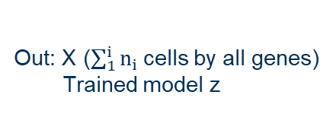
Workflow 2
In: Dataset Matrices: n_{i} cells by f_{i} features
Modality labels for each cell
In: X (from Step 1)
TF List
Integration + Imputation together
GRN
Out: X ($\sum_{1}^{i}{n_{i} }$cells by all genes)
Trained model z
Out: Network
Notes:
So from our last meeting, these were our three main task that we had.

Slide 10
Step 1: Integration + Imputation Together
Method | Kind of model | What it takes in | What you get out | Citation
MultiVI | joint VAE; a per-cell mask says which modality is missing | raw counts for both — RNA per gene, ATAC per peak — plus the mask. No gene activity. | joint embedding + imputed expression for the ATAC cells | Ashuach et al., Nat Methods 2023
GLUE / scGLUE | VAE aligned through a peak–gene guidance graph | raw counts for both — RNA per gene, ATAC per peak — plus the prior graph. No gene activity. | joint embedding + imputed expression for the ATAC cells | Cao & Gao, Nat Biotechnol 2022
Notes:
So from our last meeting, these were our three main task that we had.

Slide 11
Step 1: Integration + Imputation Together -- Validation
Metric | What it asks | Good looks like
held-out MSE | how far is the decoded expression from the hidden RNA? | low, and clearly below the shuffled control
pFCS | is the gene–gene correlation structure preserved? | high, and clearly above the control
gene-wise ρ | per-gene Pearson or Spearman against the hidden RNA | 0.155–0.22; higher suggests leakage
FOSCTTM on the exported z | is each cell nearest its true partner in the model's own space? | 0.14–0.22 if z was saved — otherwise this check does not exist
run-to-run agreement | do two fits give the same network? | reported differences must exceed it
(In addition to the methods that are mentioned in slide 4)

Slide 12
Step 2: GRN Matrix (same as previous workflow)
Method | What it does | What you get | Citation
GRNBoost2 (arboreto) | gradient boosting, one regression per target gene | ranked TF→target importances, unsigned | Moerman et al., Bioinformatics 2019
GENIE3 | random-forest importance, one regression per target | ranked TF→target importances | Huynh-Thu et al., PLoS ONE 2010
SCENIC | GRNBoost2 or GENIE3, then motif pruning (RcisTarget) | regulons: a TF + its targets, scored per cell | Aibar et al., Nat Methods 2017
PIDC | partial information decomposition over triplets; no direction | undirected TF–target association | Chan et al., Cell Systems 2017
SCODE | linear ODE along pseudotime, low-rank | signed TF→target coefficients | Matsumoto et al., Bioinformatics 2017
DeepSEM | structural equation model with a linear decoder | directed TF→target weights | Shu et al., Nat Comput Sci 2021

Slide 13
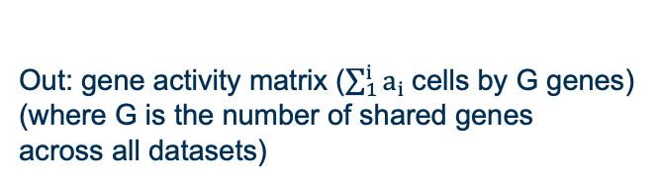
Workflow 3
In: Gene activity matrix from step 1
RNA-seq datasets
In: X (from Step 2)
TF List
In: ATAC Dataset Matrices: a_{i} cells by f_{i} peaks
Gene activity matrix
Stacking Datasets + Normalization
GRN
Out: gene activity matrix ($\sum_{1}^{i}{a_{i} }$cells by G genes)
(where G is the number of shared genes
across all datasets)
Out: X ($\sum_{1}^{i}{n_{i} }$cells by all genes)
Out: Network

Slide 14
Step 1 and 2: GAM and Stacking
Method | What it computes | What you get out | Citation
ArchR addGeneScoreMatrix | accessibility weighted across the gene body and promoter, distance-decayed | gene activity, genes × cells | Granja et al., Nat Genet 2021
Signac GeneActivity | promoter extended by 2 kb; works from fragments or from a peak matrix | gene activity, genes × cells | Stuart et al., Nat Methods 2021
ArchR addPeak2GeneLinks | distal enhancers added by accessibility correlation instead of a fixed window | peak → gene links, to be folded into the score | Granja et al., Nat Genet 2021

Slide 15
Step 3: GRN (same as previous)
Method | What it does | What you get | Citation
GRNBoost2 (arboreto) | gradient boosting, one regression per target gene | ranked TF→target importances, unsigned | Moerman et al., Bioinformatics 2019
GENIE3 | random-forest importance, one regression per target | ranked TF→target importances | Huynh-Thu et al., PLoS ONE 2010
SCENIC | GRNBoost2 or GENIE3, then motif pruning (RcisTarget) | regulons: a TF + its targets, scored per cell | Aibar et al., Nat Methods 2017
PIDC | partial information decomposition over triplets; no direction | undirected TF–target association | Chan et al., Cell Systems 2017
SCODE | linear ODE along pseudotime, low-rank | signed TF→target coefficients | Matsumoto et al., Bioinformatics 2017
DeepSEM | structural equation model with a linear decoder | directed TF→target weights | Shu et al., Nat Comput Sci 2021

