Slide 1
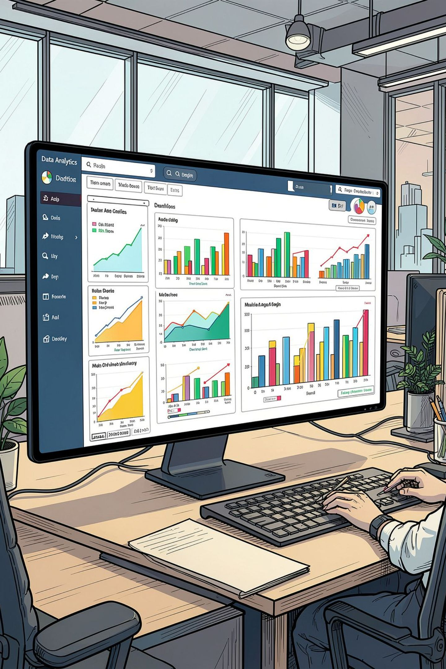
Customer Shopping Behavior Analysis
End-to-End Data Analytics Project Report
PYTHON
PANDAS
MYSQL
SQL
POWER BI

Slide 2
Executive Summary
This project analyzes 3,900 purchase records through a complete analytics pipeline — Python for cleaning, MySQL for querying, and Power BI for visualization — uncovering purchasing patterns, customer segments, revenue drivers, and demographic trends.
3,900
$233K
$59.76
Customer Records
Total Revenue
Avg. Purchase
3.75
25
Avg. Rating /5
Unique Products

Slide 3


Dataset & Project Files
Dataset Overview
Project Files
The raw CSV contains 3,900 rows and 18 columns covering customer demographics, purchase details, product attributes, seasonality, ratings, subscription behavior, shipping preferences, discounts, payment methods, and purchase frequency.
customer_shopping_behavior_formatted.csv
import_to_sql.ipynb
Python/Pandas cleaning & MySQL load
Primary dataset
4 CATEGORIES
25 PRODUCTS
18 FIELDS
Customer_Behaviour_analysis.sql
Customer.pbix
Power BI dashboard
SQL business queries

Slide 4
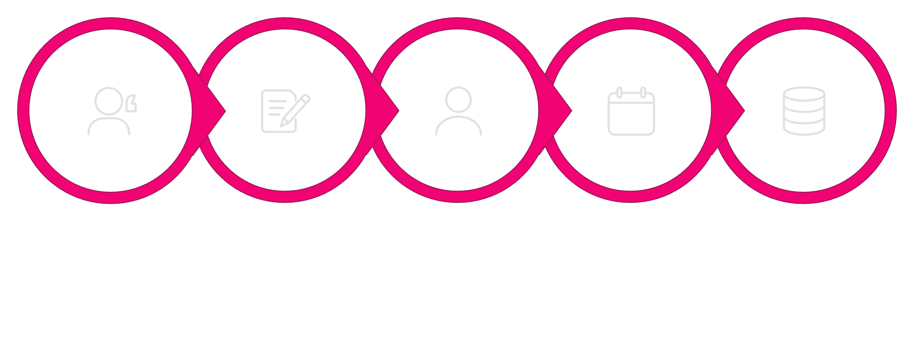
Data Cleaning & Transformation
The Python notebook performs all preparation required before SQL analysis. 37 missing values in Review Rating were filled using the median rating within each product category, preserving category-level patterns.
Standardize Names
Rename Column
Create Age Group
Map Frequency
Remove & Load
The transformed DataFrame was loaded into the MySQL customer_behaviour database as table mytable.

Slide 5
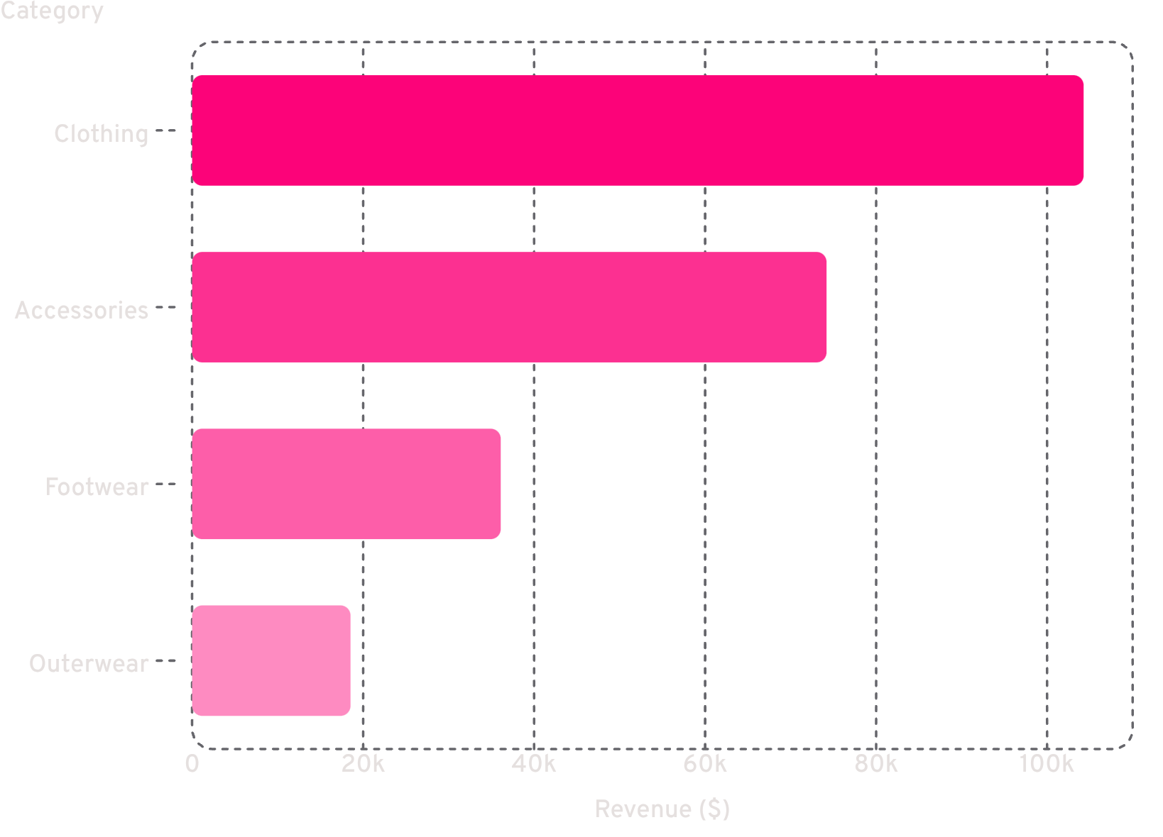
Revenue & Category Performance
Key Insights
Clothing dominates with $104,264 in revenue and 1,737 transactions. Accessories follows at $74,200. Together they drive the majority of total revenue.
Male customers generate more total revenue due to volume; females have a slightly higher average spend ($60.25 vs $59.54).
Male Revenue
Female Revenue
$157,890 (2,652 customers)
$75,191 (1,248 customers)

Slide 6
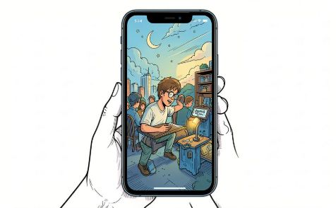
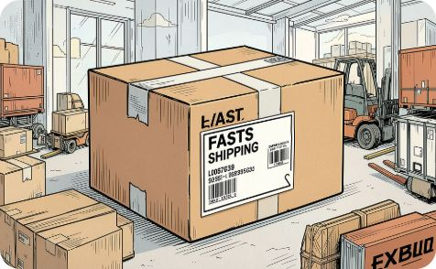
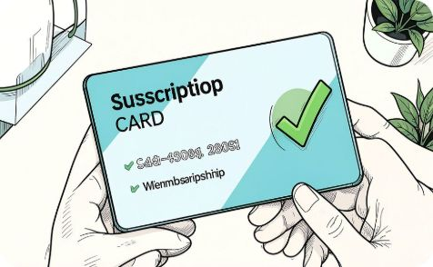
Ratings, Shipping & Subscriptions
Top-Rated Products
Express vs Standard
Subscription Gap
Gloves lead at 3.86/5, followed by Sandals (3.84) and Boots (3.82). Ratings are tightly clustered across products.
Express shipping orders average $60.48 vs $58.46 for Standard — a modest but consistent premium.
Non-subscribers generate $170,436 vs $62,645 for subscribers. Average spend is nearly identical — a clear opportunity to strengthen subscription value.

Slide 7
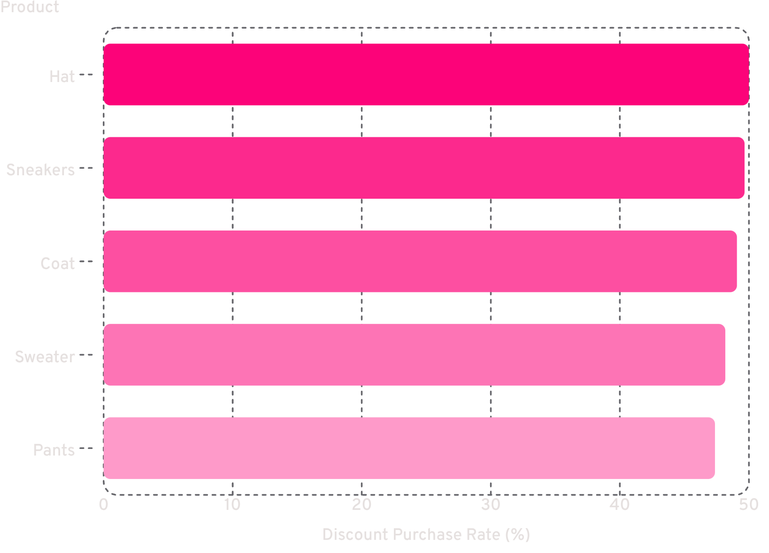
Discounts & Customer Segmentation
Discount Dependence
Hats have the highest discount-purchase rate at 50%. High reliance on promotions may erode margins without driving incremental sales.
Customer Loyalty Segments
Loyal (10+ purchases)
Returning (2–10)
New (1 purchase)
3,116 customers
701 customers
83 customers

Slide 8
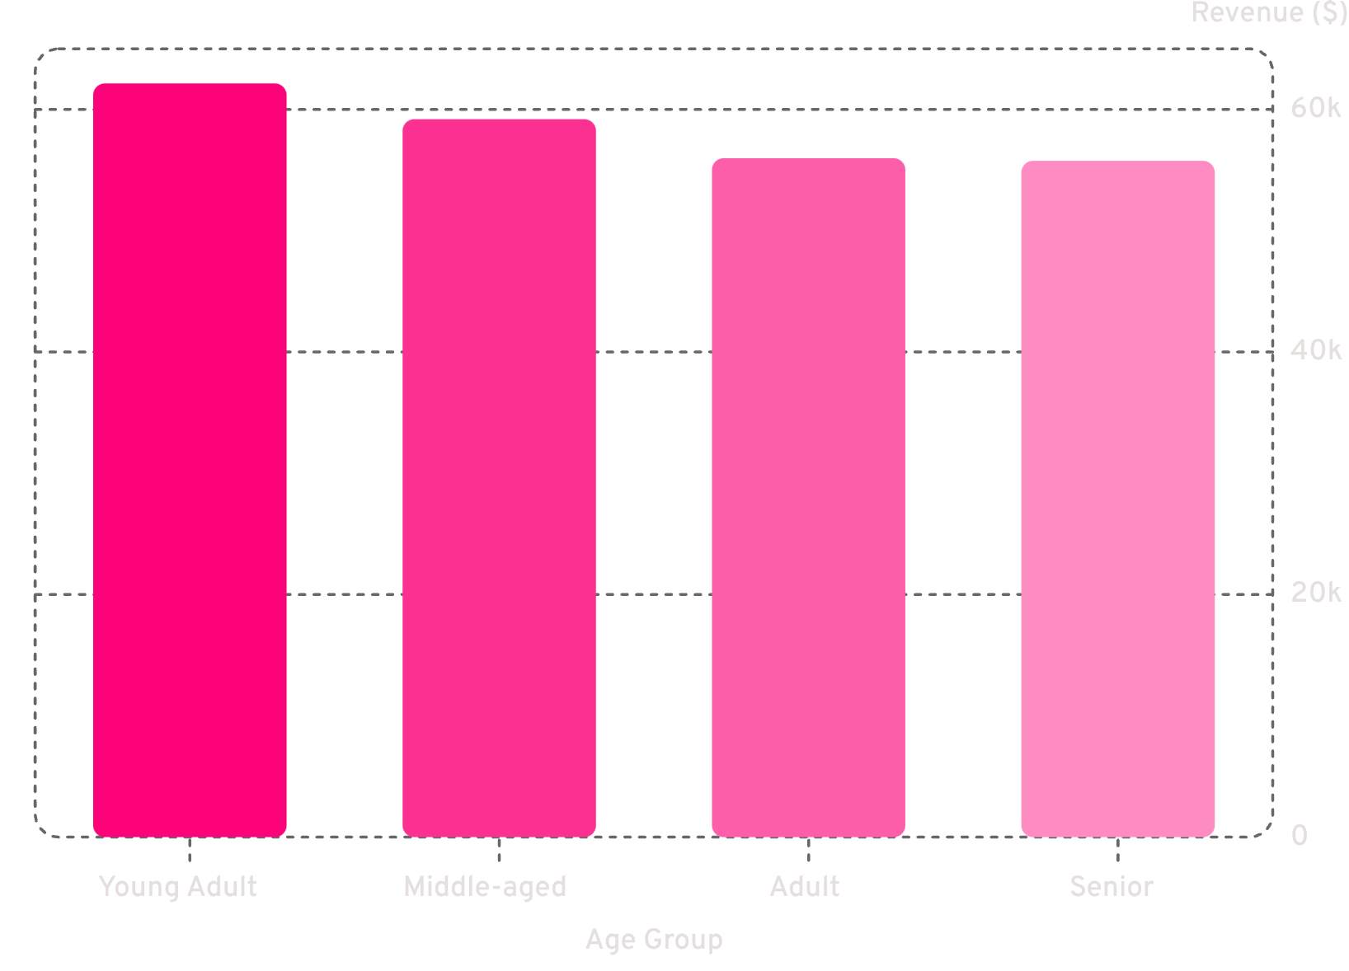

Age Group Revenue & Power BI Dashboard
Power BI Dashboard
One interactive report page combining KPI cards, charts, and slicers for exploring behavior by subscription, gender, category, and shipping type.
KPI Cards
Charts
Slicers
Avg. purchase, rating, customer count
Revenue & customers by category and age group
Subscription, gender, category, shipping

Slide 9
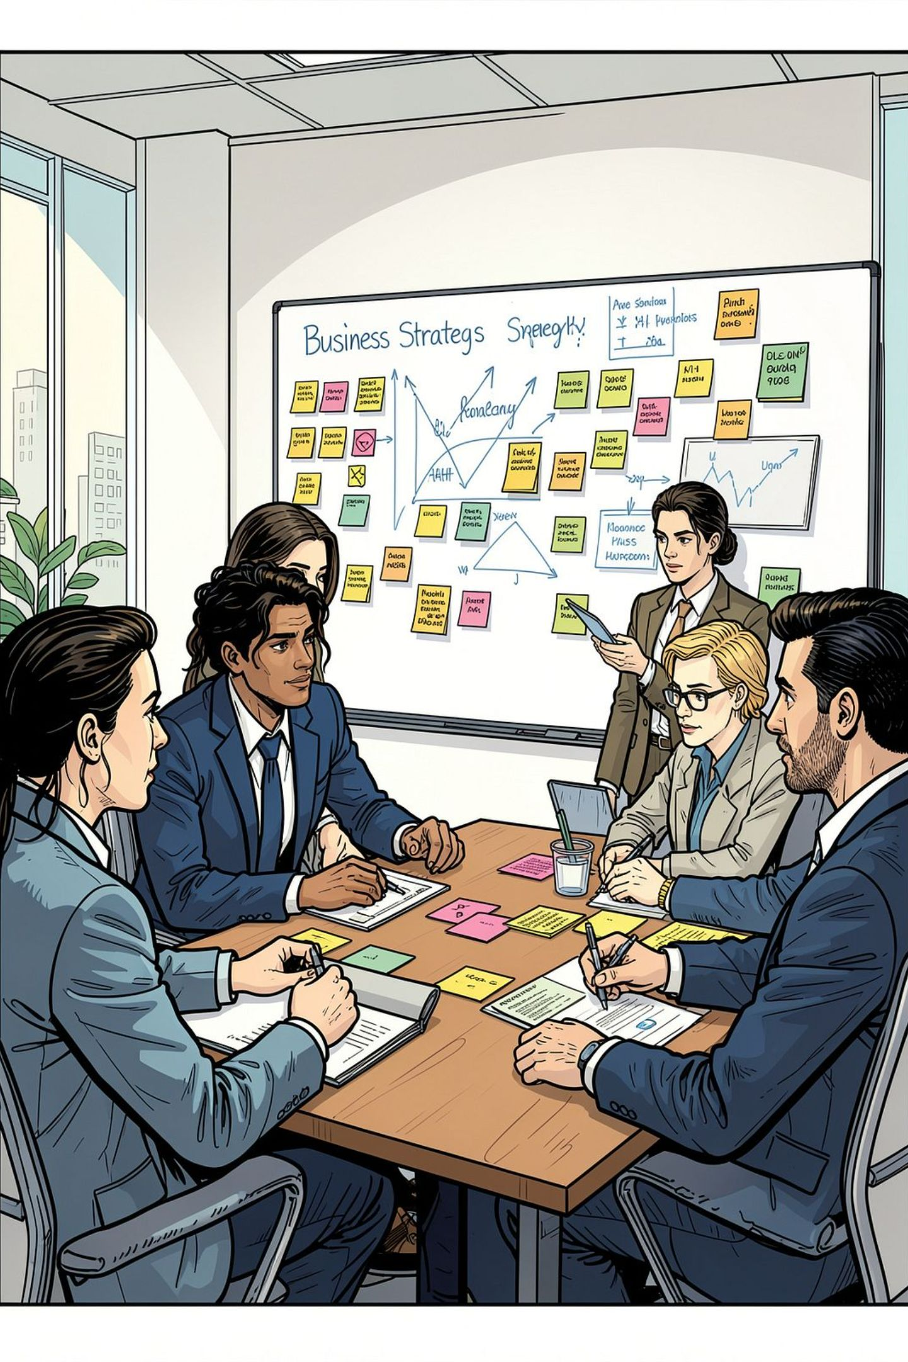




Key Findings
$233,081 Total Revenue
Avg. purchase $59.76; Fall highest season at $60,018
Clothing Dominates
$104,264 revenue — largest category by far
Loyal Customer Base
80% of customers are Loyal segment; Young Adults lead age-group revenue at $62,143
Subscription Opportunity
Subscribers spend nearly the same as non-subscribers — value proposition needs strengthening

Slide 10
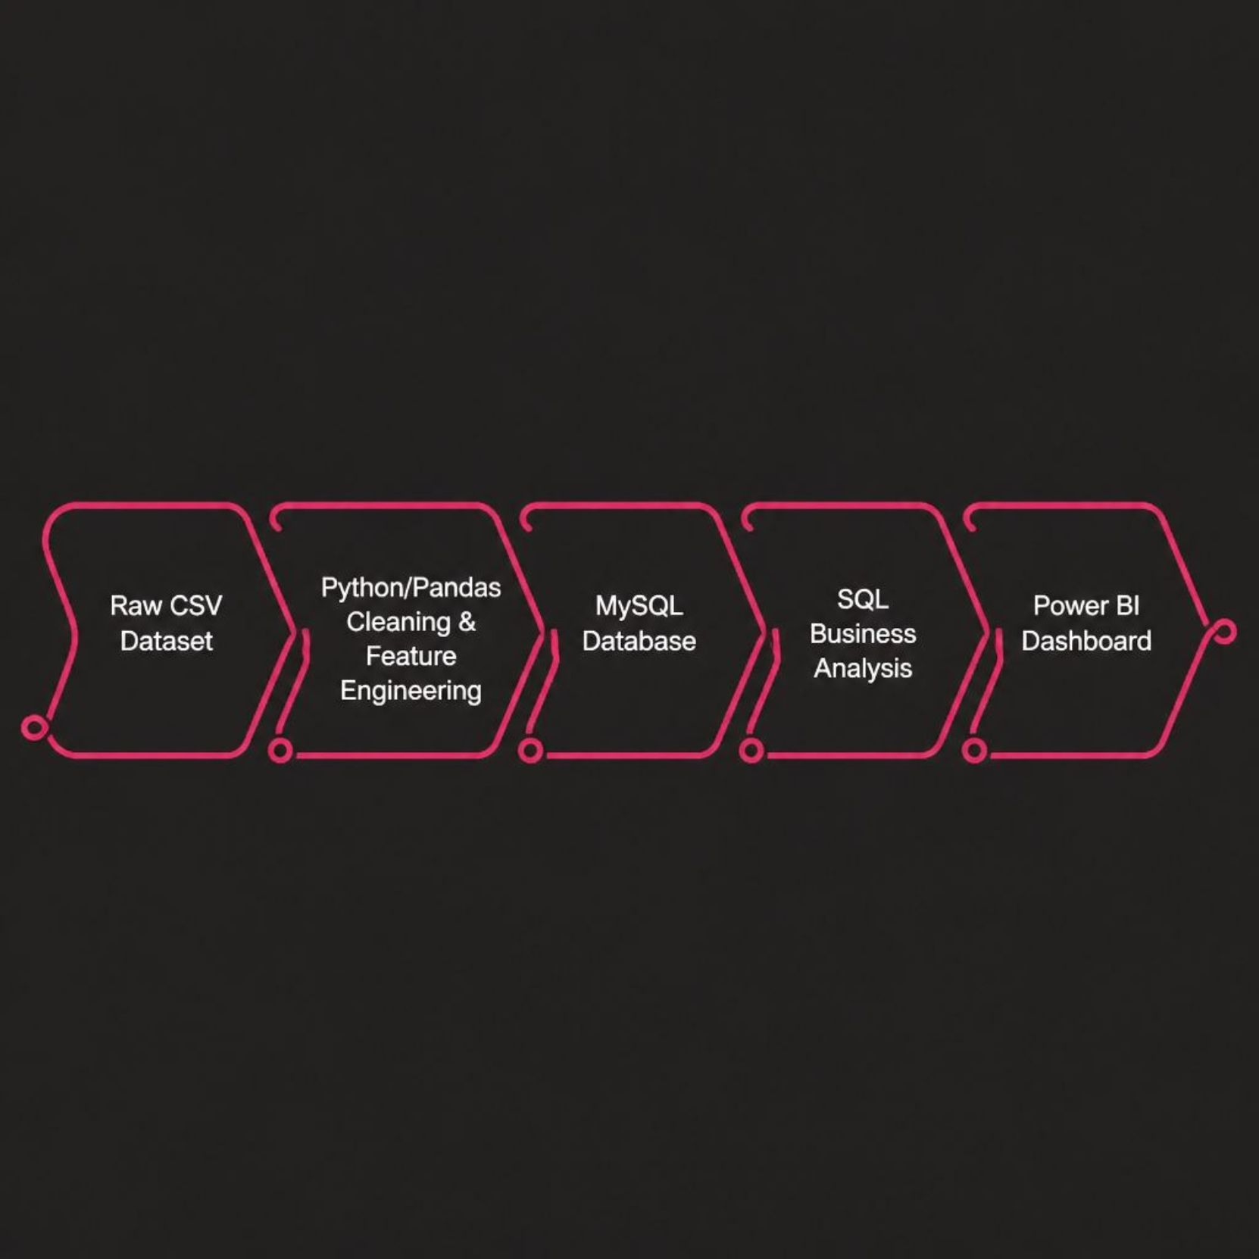
Recommendations & Conclusion
Project Architecture
Business Recommendations
1
Strengthen subscription benefits
Subscribers don't spend more — improve the value proposition.
2
Prioritize Clothing & Accessories
They drive the majority of revenue.
3
Leverage top-rated products
Use Gloves, Sandals, Boots in cross-selling strategies.
4
Review discount dependence
Ensure promotions drive incremental sales, not just margin erosion.
5
Target loyalty campaigns
Retain the large repeat-customer base; separate strategies for New/Returning.
This end-to-end workflow demonstrates a complete analytics pipeline — from raw data to interactive insights — providing a practical foundation for customer-focused retail decisions.

