Slide 1

Python for Data Science (3150713)

Slide 2
Introduction
Project title: Primevideo Data analysis.
Name: Patel Swet V.
Enrollment no: 200050131110
Branch: Computer Science Engineering
Divison: CSE-2

Slide 3
Description of Project
Data Analysis with amazon prime video Data analysis dataset from starting. The dataset contains file called primevideo.csv and there is all data about the movies and next TV show. In this project we determine relation between show and audience and we try to predict that will the show be hit or not.

Slide 4
About Data Set
Data available in data set:
1. release year
2. duration
3. description
4. genre
5. year
6. mode
7. quality data
8. premium subscruption

Slide 5
Continuous
8. cast
9. duration
10. type
11. title
12. director
13. country
14. show id
15. data added

Slide 6
Things Analysed from Data Set
1. Most watch movies in each year.
2. movies duration.
3. Most subscribed actor.
4. Most accessible show.
5. Most like show.
6. Show played in each city.
7. No. of show added in watchlist.
9. Top 10 show based on interest.

Slide 7
Continuous
10. Particular time when people watch show.
11. Most visited show.
12. Most follow genre.
13. Most follow actor.
14. Most awarded actor.
15. Best Show for every year.

Slide 8




Python Libraries we Have Used
1. NumPy
2. pandas
3. Matplotlib
4. seaborn

Slide 9
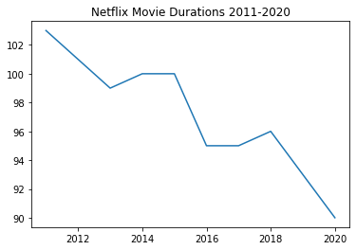
Some Result from Data Set
Prime video movie duration.

Slide 10
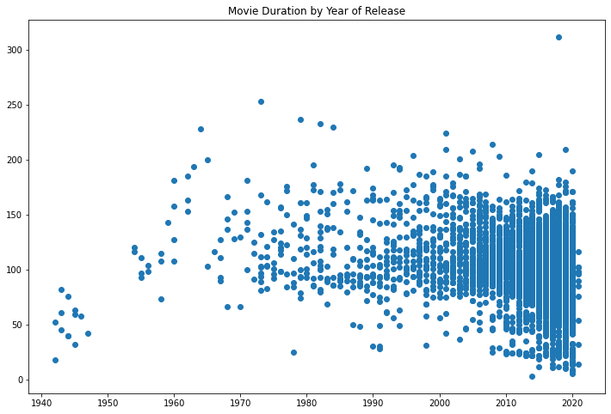
Continuous

Slide 11
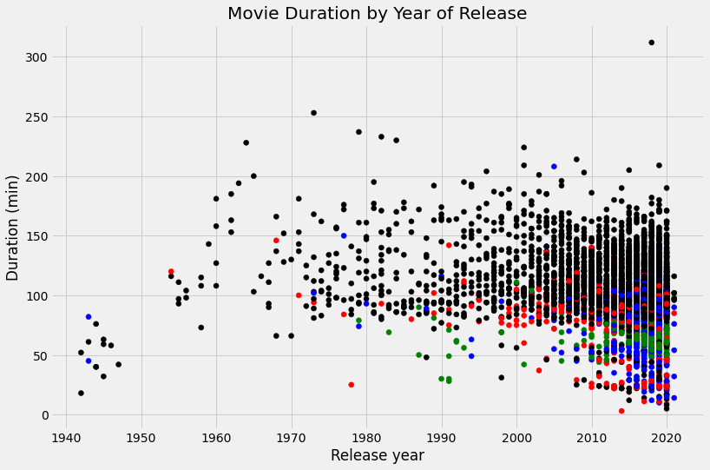
Continuous

Slide 12


Use full links
https://github.com/Swetpatel9802/primevideo-data-analysis
https://colab.research.google.com/drive/13YDCd_ItJPX-1YOjpo0b2AUYCUTsE-op

Slide 13
Thank you

