Slide 1
PathFinder

Slide 2
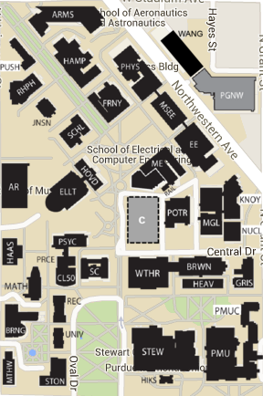
Image Transformation
width divided by 6, height divided by 6.
Cut in half
Binary 2-D Matrix

Slide 3
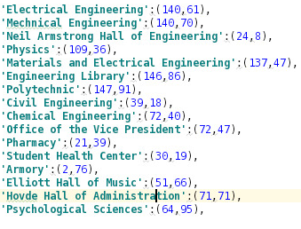
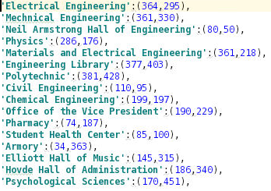
PathFinder Algorithm (Dijkstra)
Mapped building coordinates with respect to GUI and 2-D matrix
2-D matrix represents an adjacency matrix of each pixels of the image. (Road 1, others 0)

Slide 4
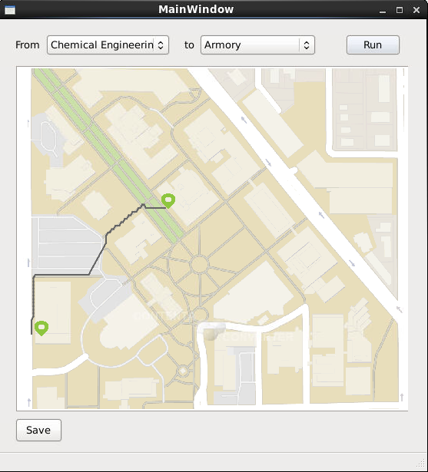
Python GUI
QtDesigner Library
Class inheritance
Class overloading
Functionality
Find shortest path between two points and draw the path on image
Save the path alone with the image as users’ will

