Slide 1

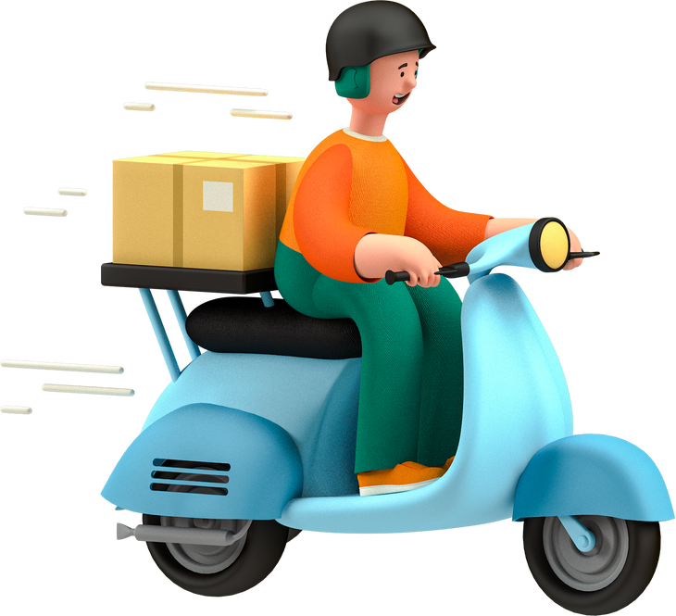
Amazon Delivery Time Prediction
Machine Learning Regression Project

Slide 2
Problem Statement
E-commerce giants face customer dissatisfaction due to unpredictable delivery times.😒
Goal: Predict delivery time based on order, traffic, and environmental data.
Business Impact: Improved logistics, better planning, and customer satisfaction.

Slide 3
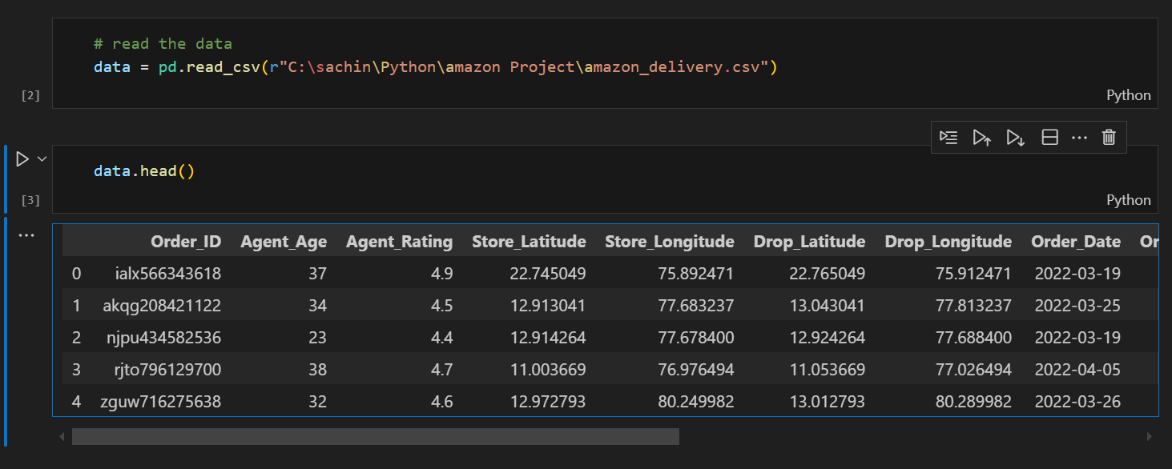
Dataset Overview
🔤 Features: Order details, Agent rating, Traffic, Weather, Location
🎯 Target: Delivery_Time (in minutes)

Slide 4
Data Preprocessing
Handled missing values:
Agent_Rating: mean imputation
Weather: mode imputation
Extracted time features:
From Order_Date, Order_Time, and Pickup_Time
Dropped irrelevant columns like Order ID, original time/date strings
Encoded categorical variables using LabelEncoder

Slide 5
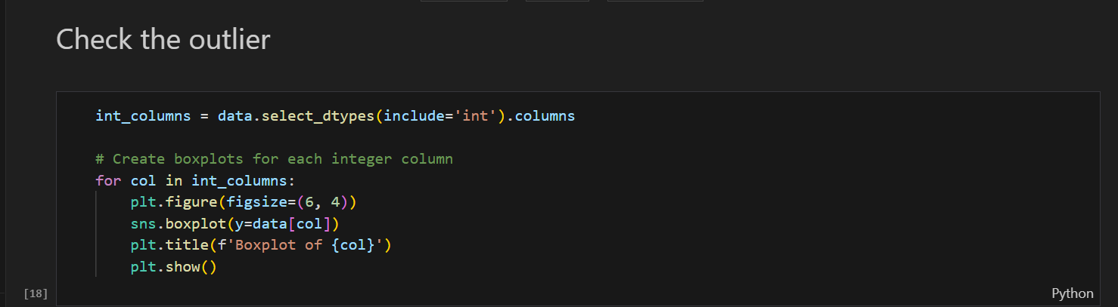
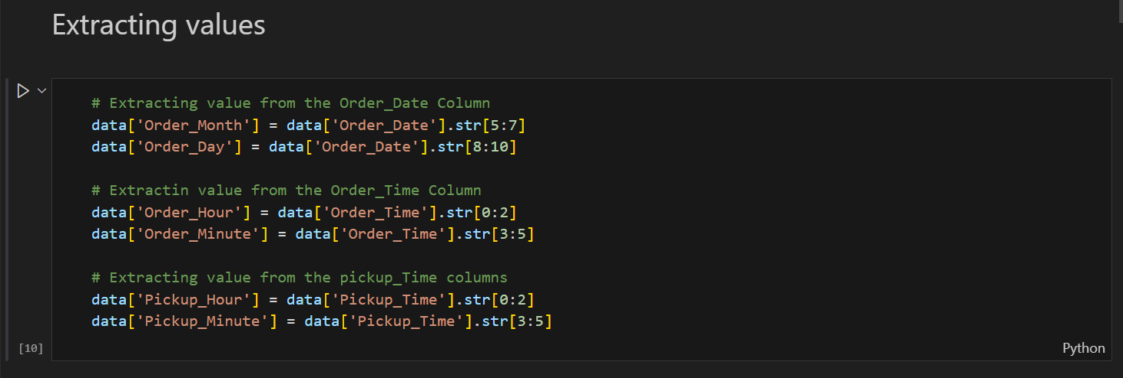

Slide 6
Exploratory Data Analysis
📦 Distribution of Delivery Time (Boxplot)
🌦️ Impact of Weather on Delivery Time (Barplot)
🛣️ Traffic and Area comparisons
🧭 Correlation with Drop Latitude & Longitude (Heatmap)
⭐ Agent Performance (Boxplot vs Rating)

Slide 7
Feature Engineering
Scaled numerical features using StandardScaler
Created polynomial features (for Linear Regression variant)
Ensured all features were numeric and clean before modeling

Slide 8
Regression Models Used
Model Description
Random Forest Ensemble, non-linear, high accuracy
Decision Tree Simple and interpretable
XGBoost Boosted Trees, high performance
Linear Regression Basic baseline
Ridge / Lasso Regularized linear models
ElasticNet Combo of Ridge & Lasso
Bayesian Ridge Probabilistic linear regression

Slide 9
Key Findings
Weather and Traffic significantly affect delivery times
Agent Rating correlates inversely with delay
XGBoost and Random Forest consistently performed best
Models generalized well with minimal overfitting

Slide 10
Improvement Suggestions
Factor | Insight | Improvement Strategy
Agent Rating | High-rated agents are faster | Assign top agents to high-priority deliveries
Weather | Bad weather slows delivery | Adjust ETA + dispatch experienced agents
Traffic | Traffic slows down delivery time | Use traffic-aware routing algorithms
Drop Location | Some areas cause more delay | Optimize with clustering and micro-fulfillment hubs
Features & Modeling | Useful features already applied | Add pickup delay time, calculate Haversine distance
Customer Experience | Can increase trust and satisfaction | Show agent rating, ETA adjustments, and real-time info

Slide 11
Streamlit app

Slide 12
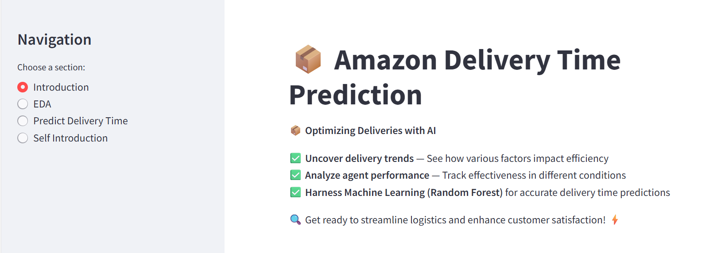
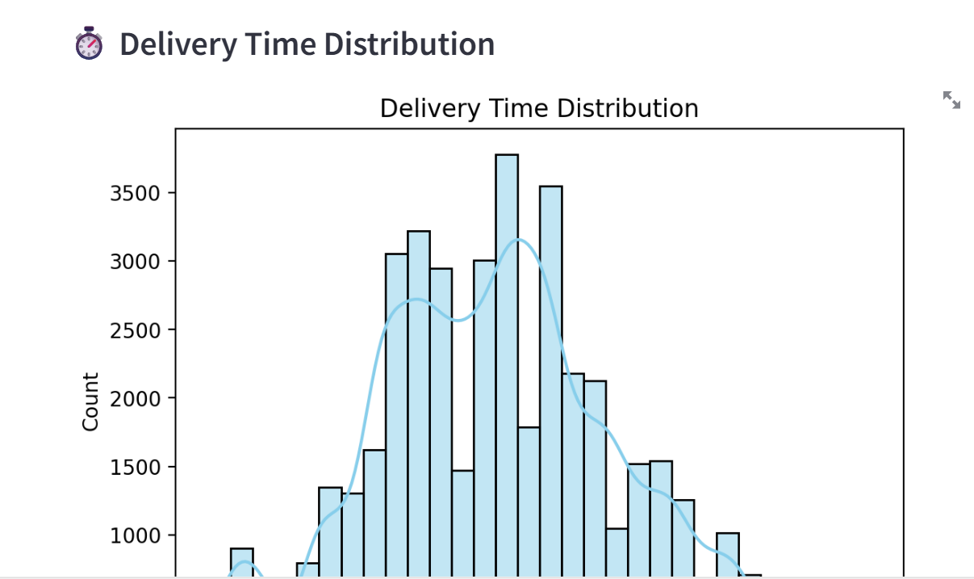

Slide 13
