Slide 1


🎤 Voice Gender Classification using Machine Learning
A classification project using multiple ML models with feature engineering, clustering, and MLflow tracking

Slide 2
Dataset Overview
Contains acoustic features extracted from voice recordings
Target: label (Gender: 0 = Male, 1 = Female)
Features: Numeric sound characteristics like MFCCs, RMS energy, etc.

Slide 3
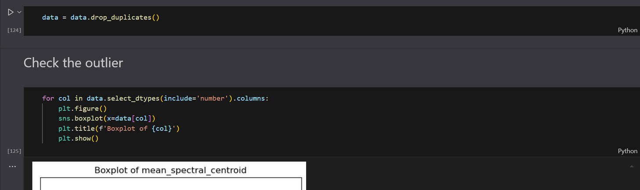
Data Preprocessing
Removed duplicates
Handled missing values (if any)
Outlier treatment using IQR capping
Feature selection using Variance Threshold (threshold = 0.01)
Final shape after selection:
➤ From original_features → selected_features

Slide 4
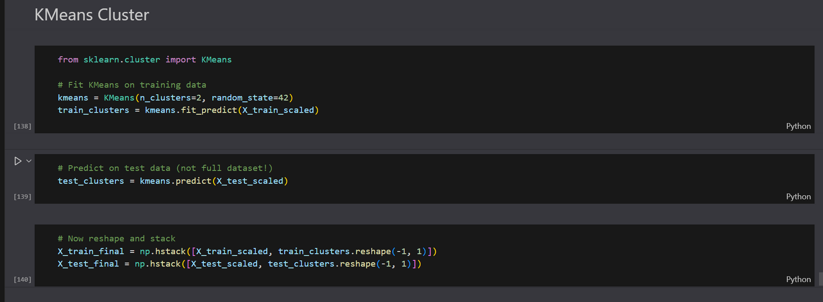
Clustering with KMeans
Applied KMeans clustering with n_clusters=2 on scaled data

Slide 5
Machine Learning Models Used
Logistic Regression
K-Nearest Neighbors (KNN)
Support Vector Machine (SVM)
Decision Tree
Random Forest
Gradient Boosting
Naive Bayes

Slide 6
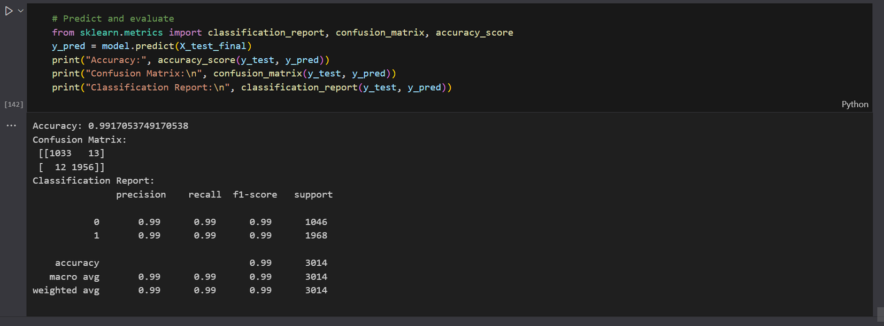
Evaluation Metrics

Slide 7
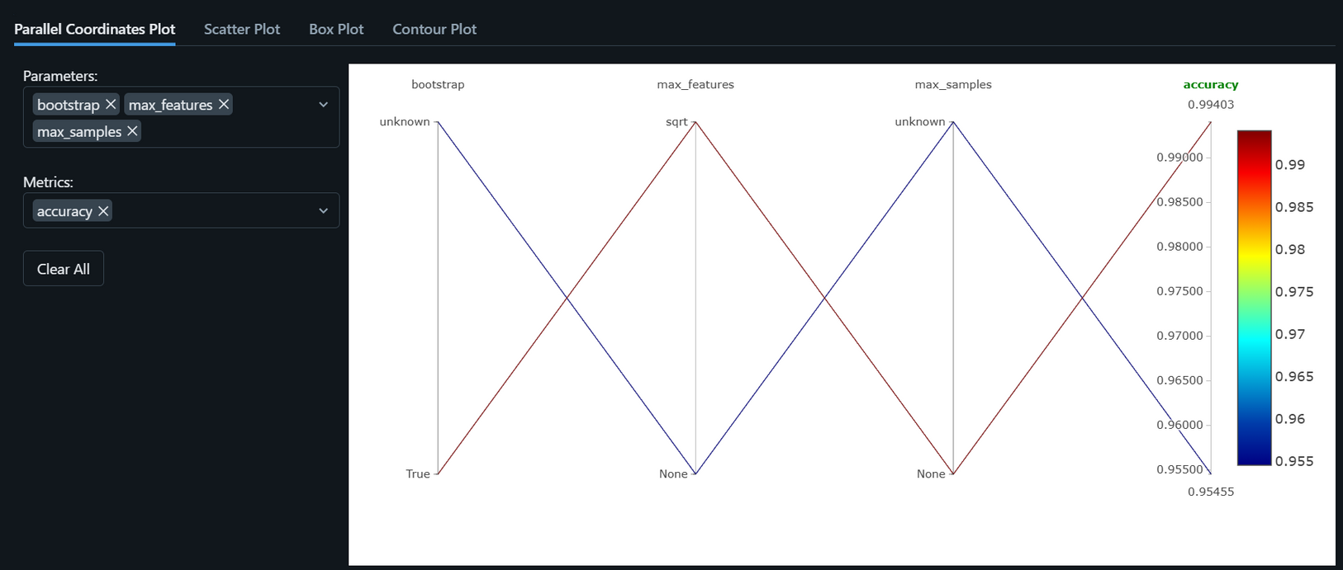
MLflow Integration

Slide 8
SUMMARY
Complete Pipeline: Covers data loading → cleaning → EDA → feature selection → model building → evaluation → tracking → deployment.
Outlier Handling: Used IQR-based capping which is safer than removing rows.
Feature Selection: Used VarianceThreshold, a good start for dimensionality reduction.
Clustering: Integrating KMeans as a new feature is a smart way to capture latent patterns.
MLflow: Great use of experiment tracking.
Multiple Models: You tested a range of models and saved the best.
Model Saving: Included joblib-based model saving — crucial for real-time use.

Slide 9
💡 Potential Applications
Industry | Use Case
Call Centers | Automatically detect caller's gender to route to gender-specific services.
Voice Assistants | Personalize responses based on gender predictions.
Security Systems | Add gender layer to voice-based authentication.
Healthcare | Analyze vocal biomarkers — potentially correlate gender with disease risk (research use).

Slide 10
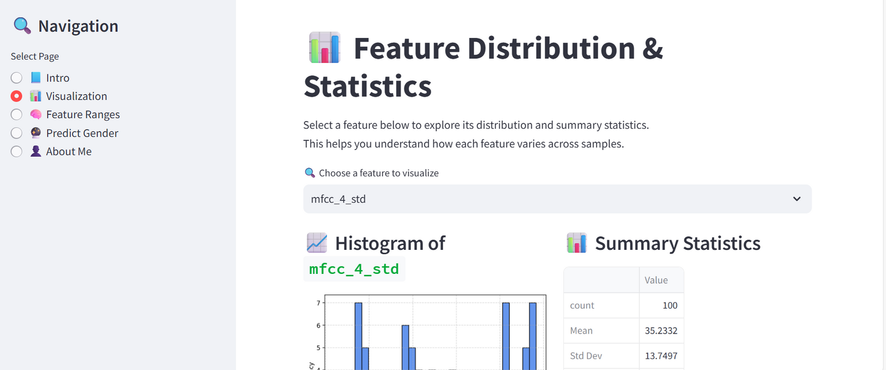
Streamlit App

Slide 12
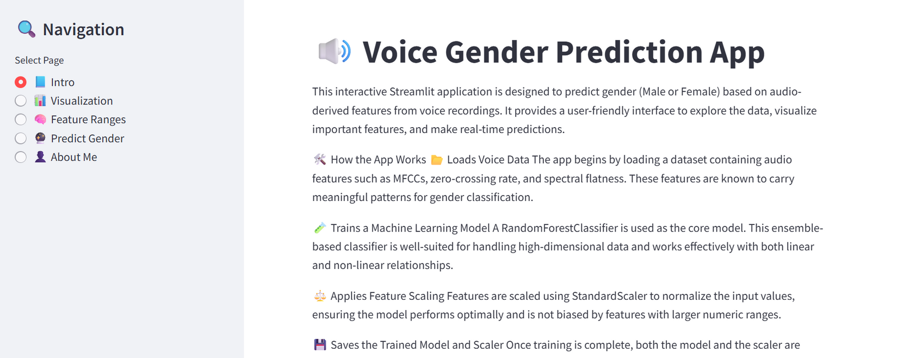

Slide 13
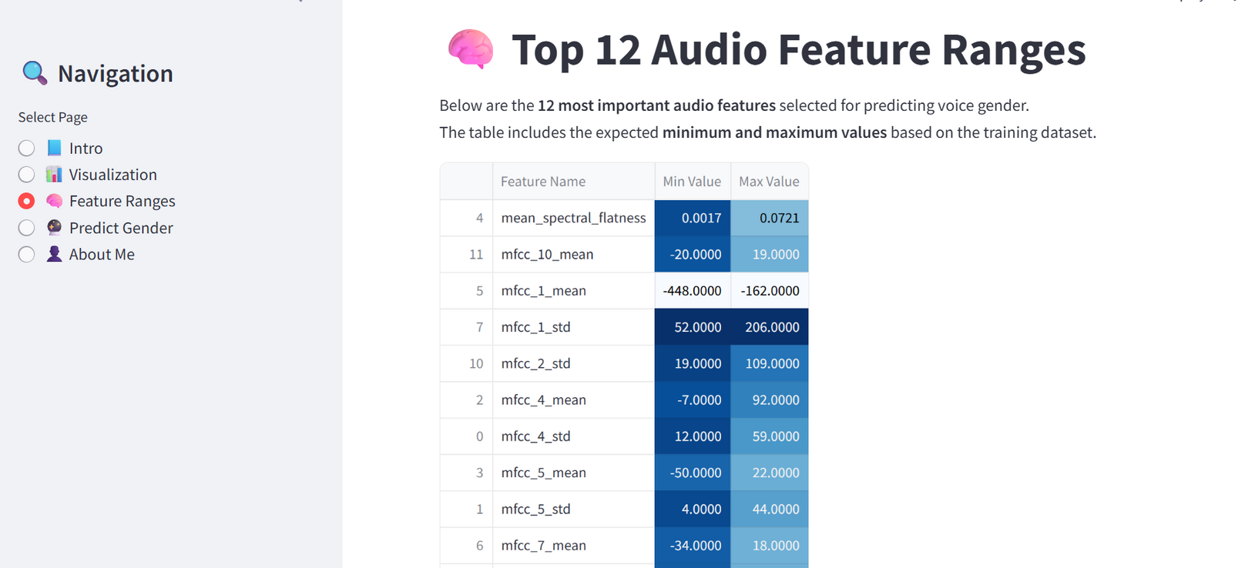

Slide 14
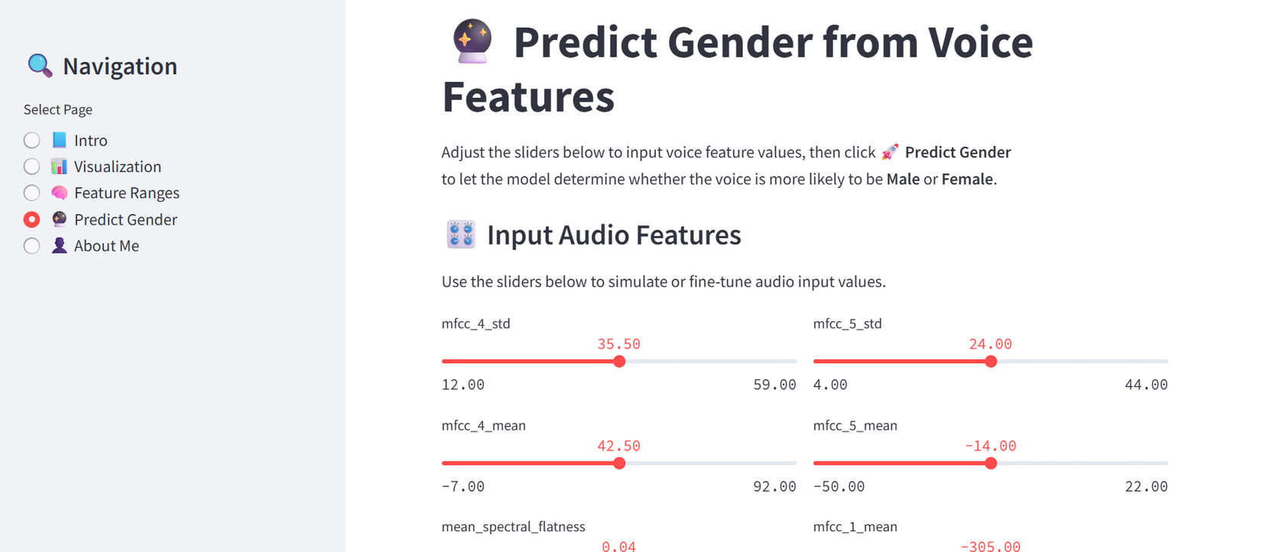

Slide 15
