Slide 1
High Performance Sparse Polynomial Multiplication on Chiplet Architecture
Presenter: Xiangyu Liu
Supervisor: Alex Brandt
August 15th 2024

Slide 2
CONTENTS
Introduction to Chiplet
Serial: Heap-based Multiplication
Parallel: Chiplet Multiplication (SDMP&TRIP)
Experimentation
Improvements and Future Work

Slide 3
Introduction to Chiplet
/01

Slide 4
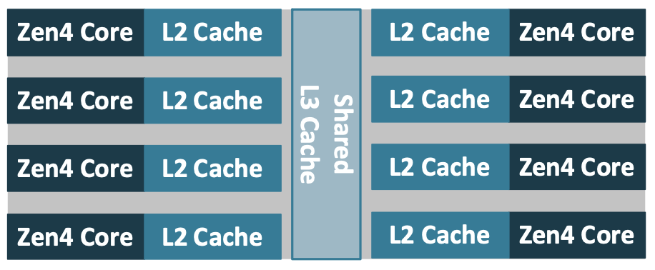
What is Chiplet?
An unpackaged integrated circuit (IC) that can be packed with other chiplets to form a single, larger IC, sometimes called a multi-chip module.
AMD calls a chiplet containing CPU cores CCD
each CCD has its own L3 cache, which is significantly different from traditional multi-core designs that have a single L3 cache shared across all cores.
Eight compute cores sharing an L3 cache within a Core Complex Die (CCD)

Slide 5
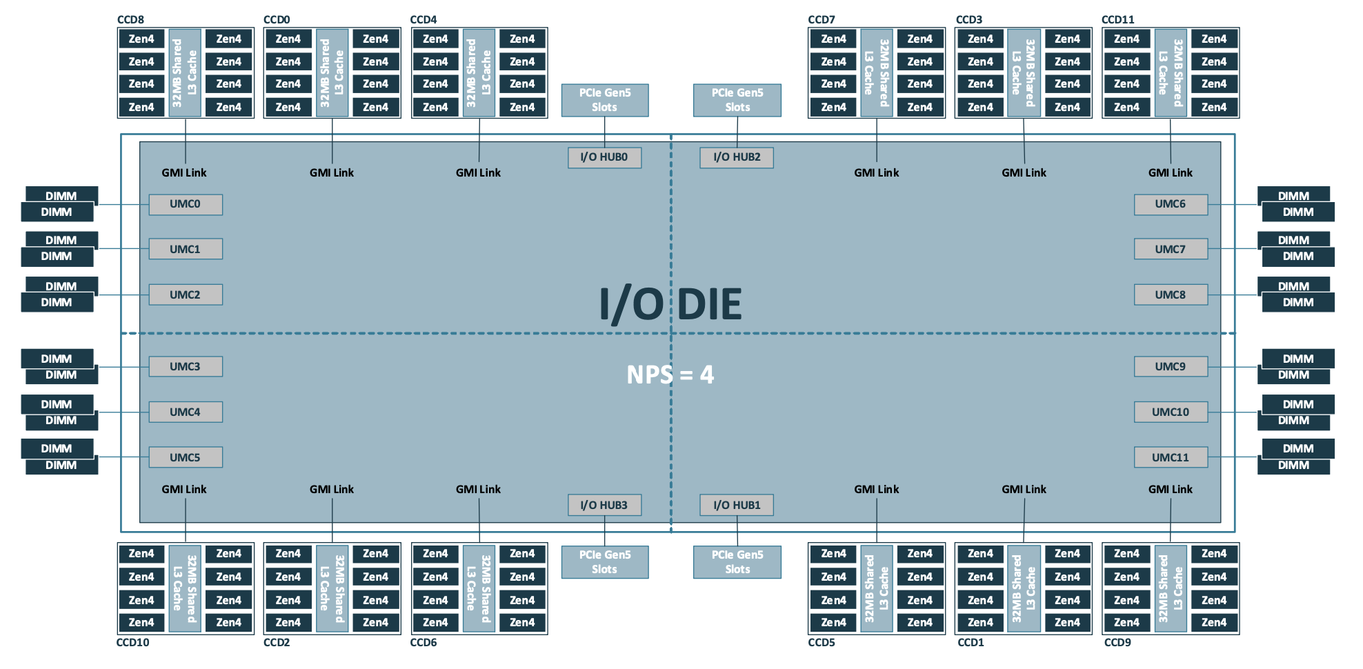
A Multi-chiplet Integration
AMD EPYC 9004 IC multi-chiplet integration

Slide 6
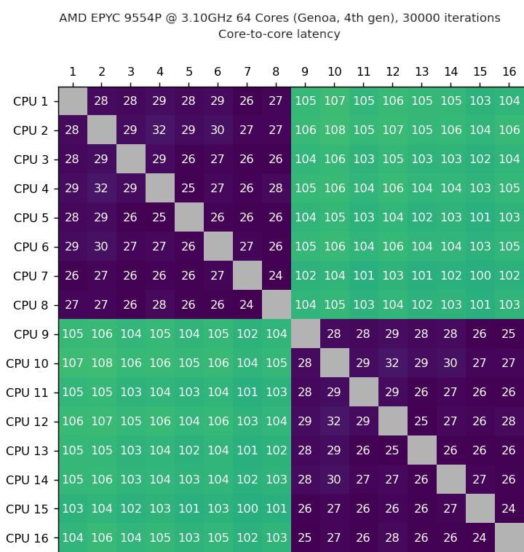
Core to Core Latency in Chiplet
Core to core latency for the first 16 cores on the AMD EPYC 9554P. Note the improved communication times among cores on the same chiplet compared to across chiplets.
Intra-chiplet communication
Vs.
Inter-chiplet communication

Slide 7
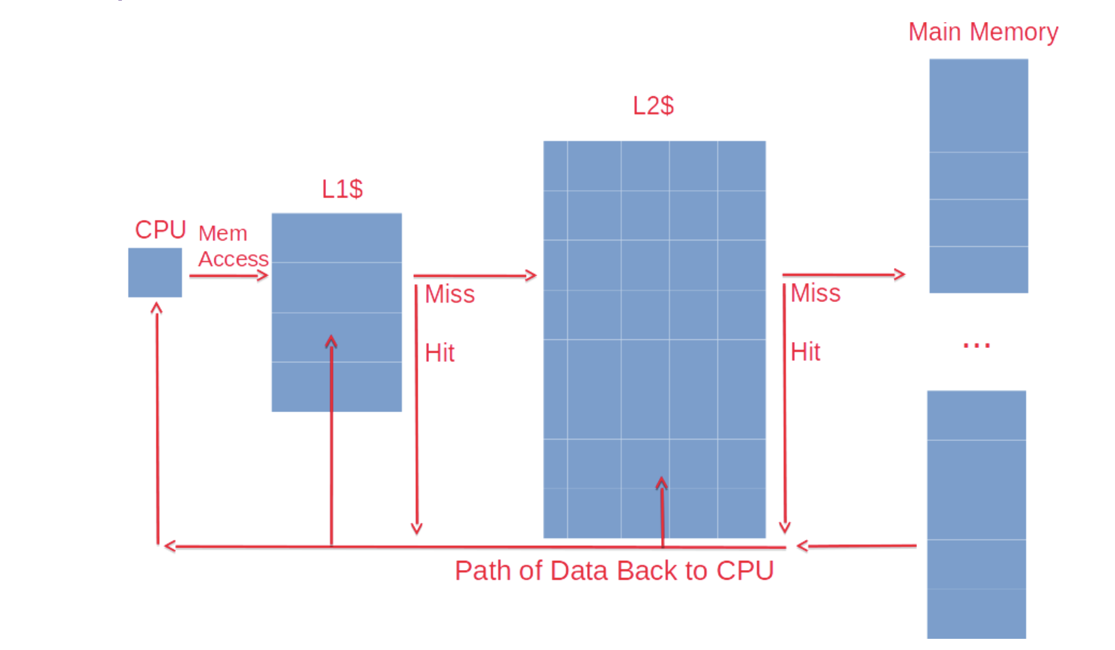
Data Locality & Cache Miss
Multiple Cache Levels
Cache Miss and Hit: A cache hit occurs when data requested by the CPU is found in a cache layer, significantly speeding up processing. A cache miss, on the other hand, forces the CPU to fetch data from a slower cache level or main memory, increasing delay.
One goal of the chiplet algorithm is to maximize data locality, ensuring that frequently accessed data is stored closer to the CPU within the faster L1, L2, and L3 caches, thereby reducing cache misses.
While cache levels are numbered 1, 2, etc.

Slide 8
Serial: Heap-based Multiplication
/02
Johnson in 1974

Slide 9
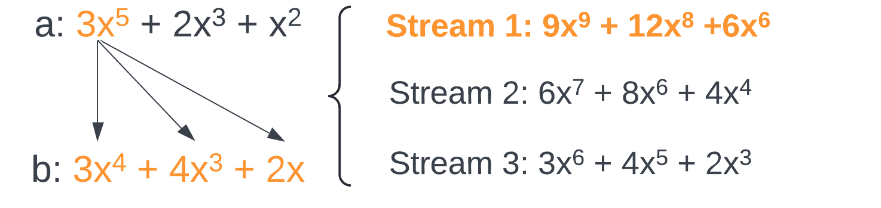
Heap-based Multiplication
We want to compute the product term-by-term in order
An n-way merge of ‘streams’ where each stream is one term of a expanded over b
Since b is sorted, each stream is also sorted
Use a heap (priority queue) to choose maximum among the heads of each stream

Slide 10
Heap-based Multiplication
Result Polynomial:
9x⁹
+
12x⁸
+
6x⁷
+
17x⁶
+
4x⁵
+
4x⁴
+
2x³

Slide 11
Parallel: Chiplet Multiplication (SDMP&TRIP)
/03
SDMP: Monagan and Pearce in 2009
TRIP: Gastineau and Laskar in 2013

Slide 12
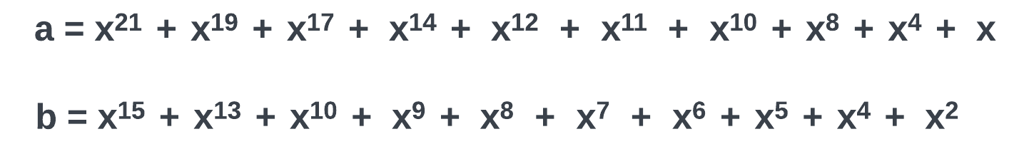
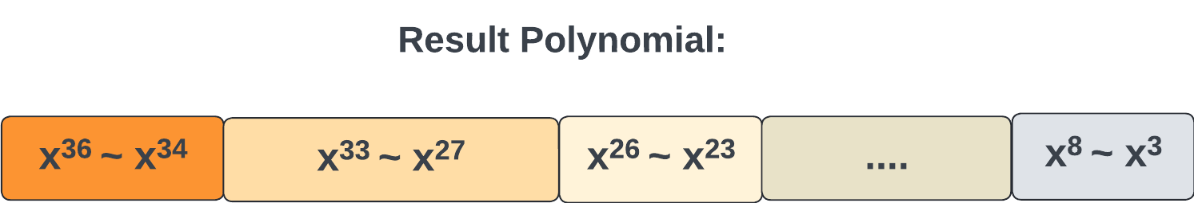
The Initial Ideas of the Parallel Agorithm

Slide 13
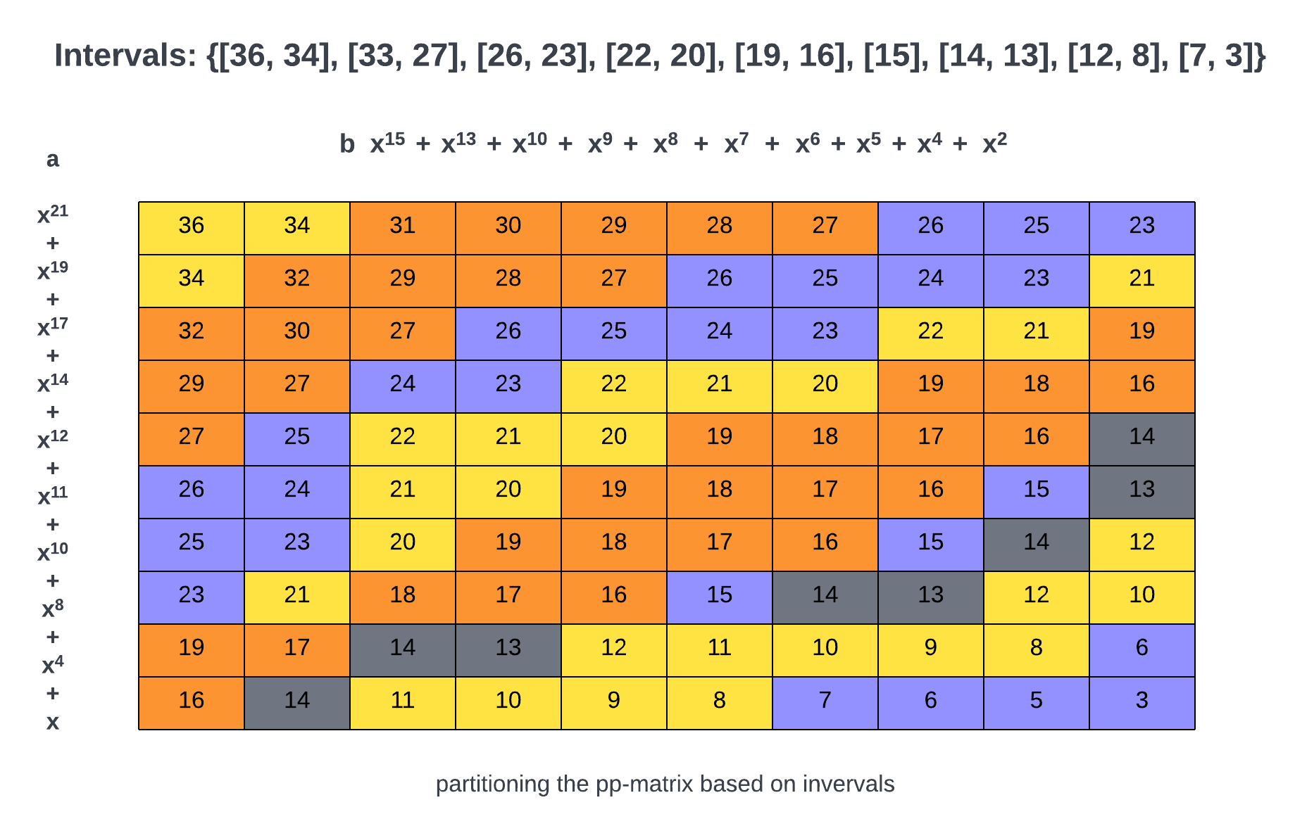
Intervals & PP-Matrix (TRIP Algorithm)
Divide the result polynomial into multiple intervals
Based on the intervals, partition the pp-matrix into different independent regions, where all like terms are contained in the same region.
Input polynomial are sparse; thus, region’s shapes are irregular.
Each region has its own ID and is assigned to a single chiplet to run in parallel.
Partial result polynomial is stored in a container based on the region ID.
The number of regions should be much more than the number of chiplets, so once the chiplet has done computing a region, it will go find another region to work on.

Slide 14
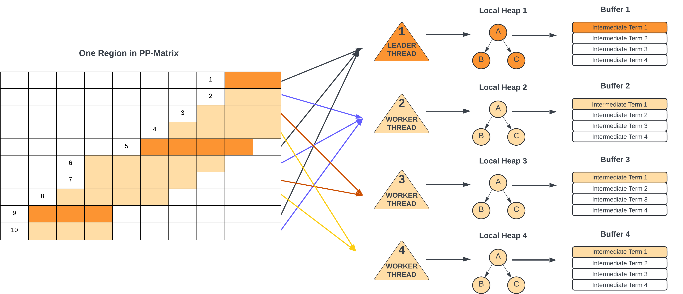
Local Heap Merge (SDMP Algorithm)
Assume there are 4 cores within a chiplet sharing a L3 cache

Slide 15
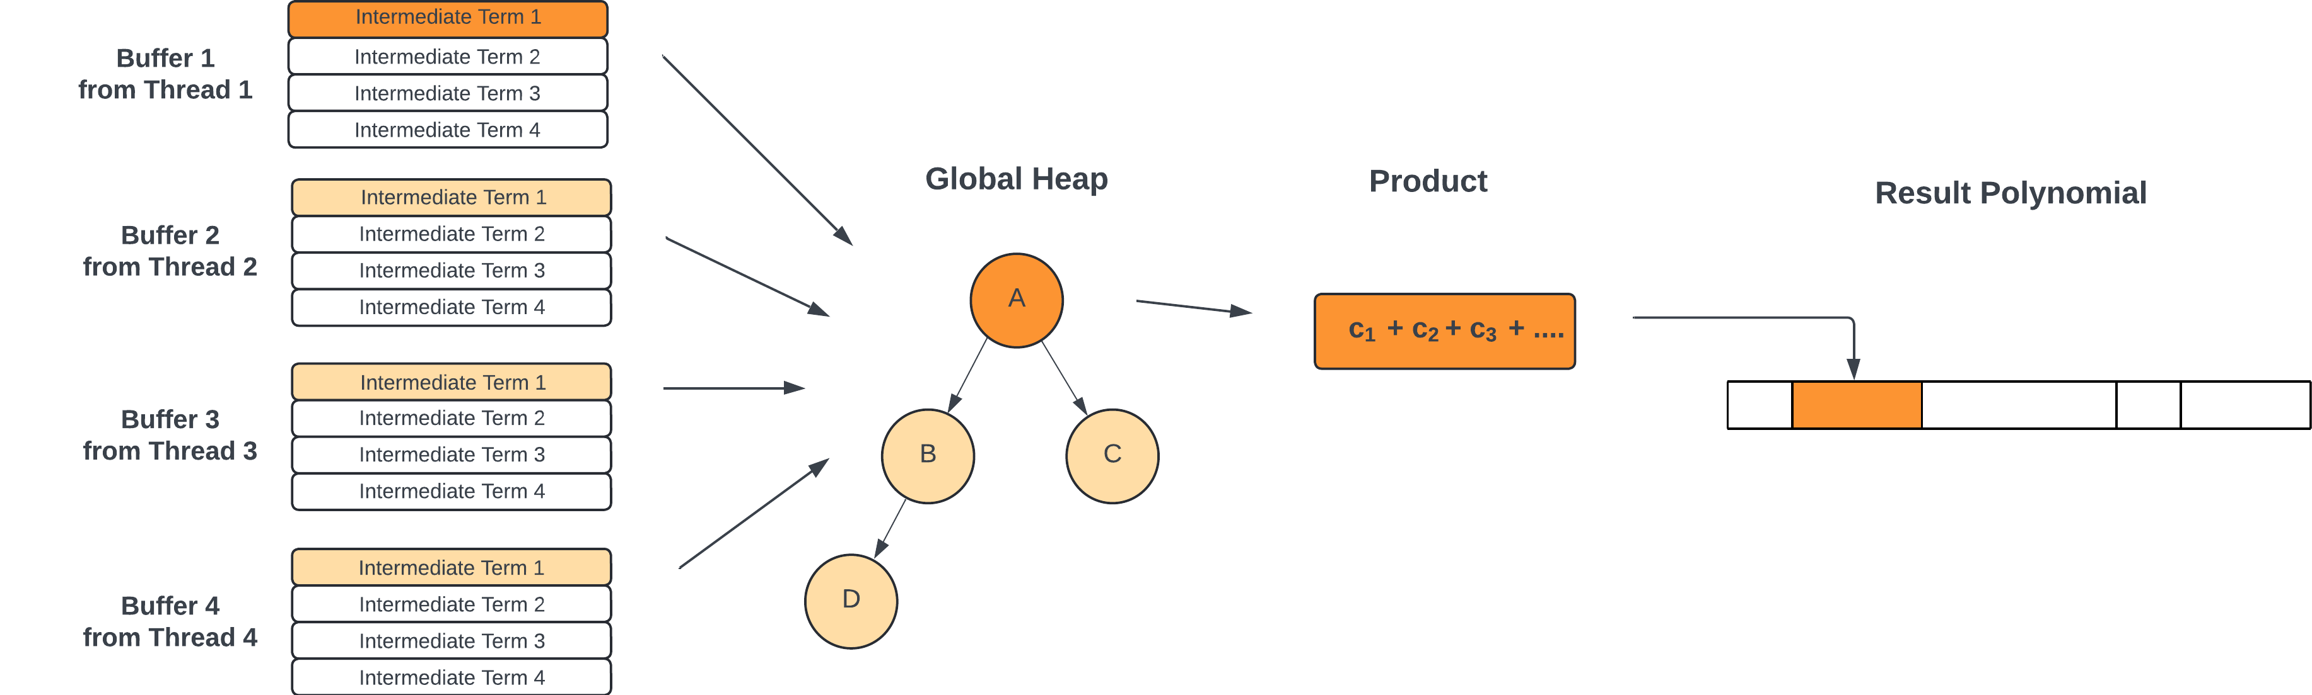
Global Heap Merge (SDMP Algorithm)

Slide 16
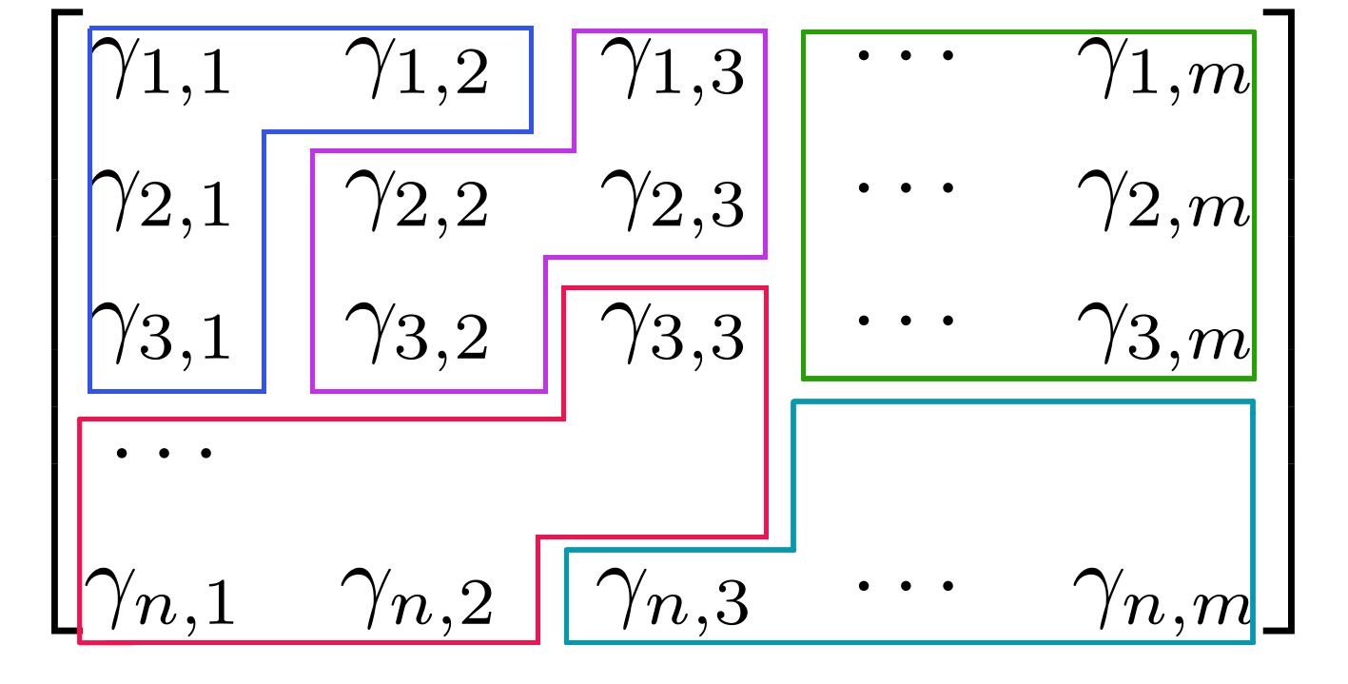
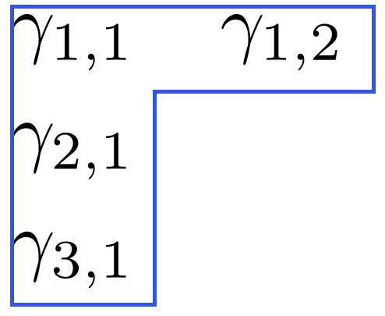
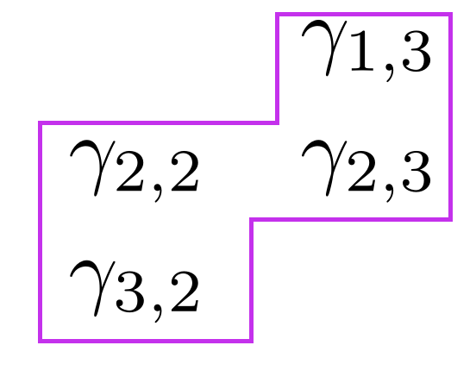
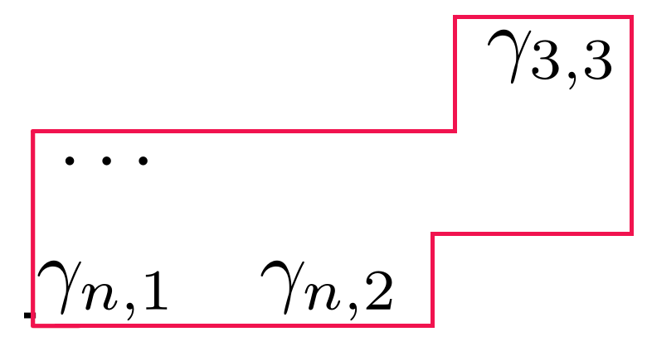
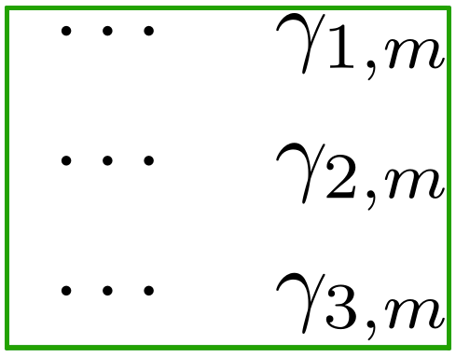
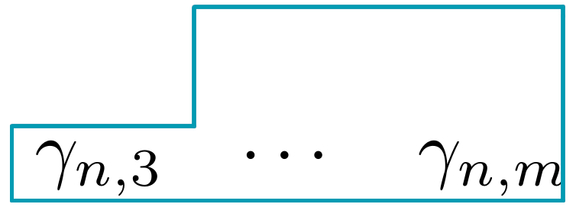
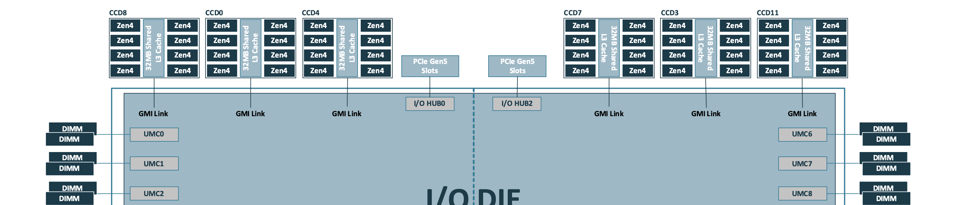
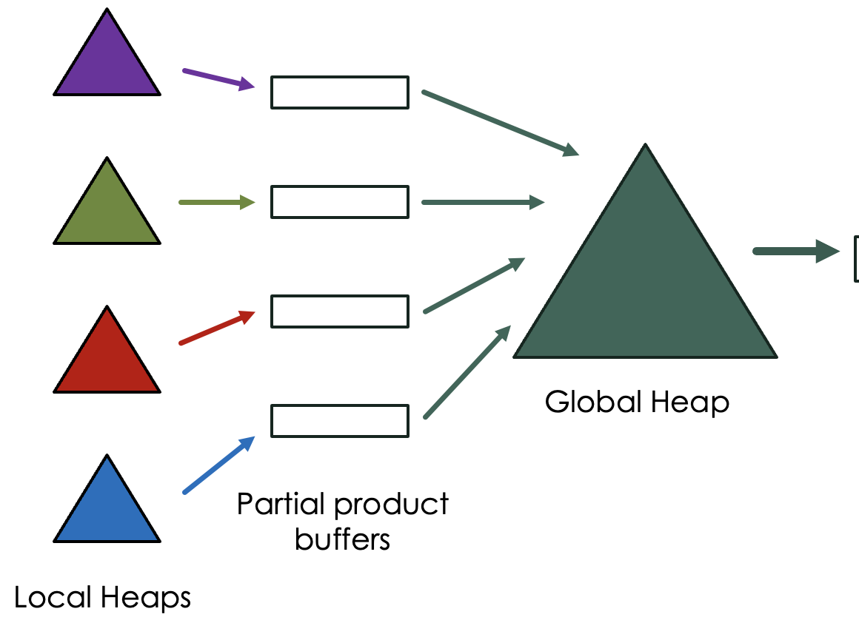
Overview of Chiplet Algorithm

Slide 17
Experimentation
/04

Slide 18
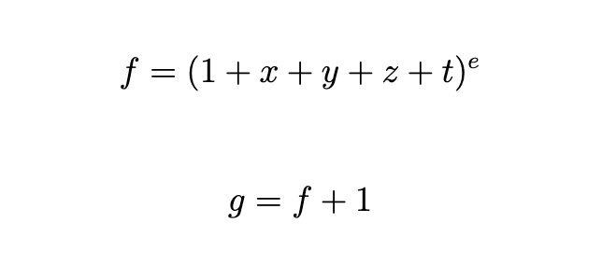
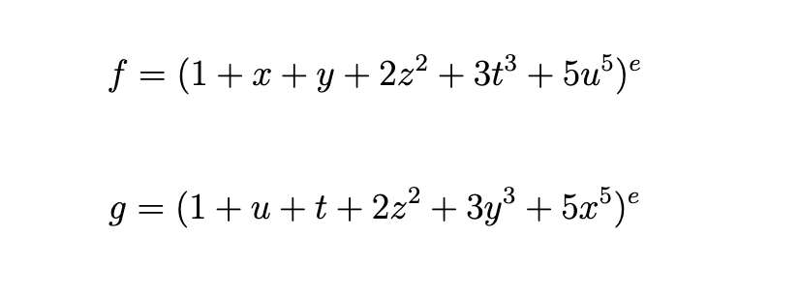
Benchmarks
Fateman’s benchmark
More computational work to do!
“Very sparse” benchmark
I/O-bound

Slide 19
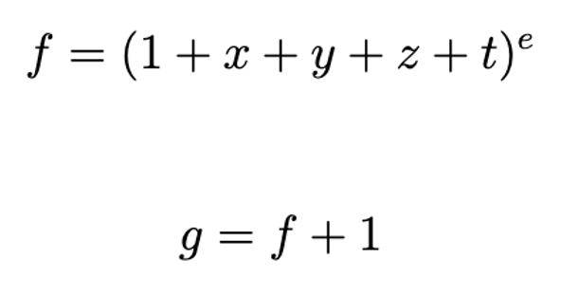
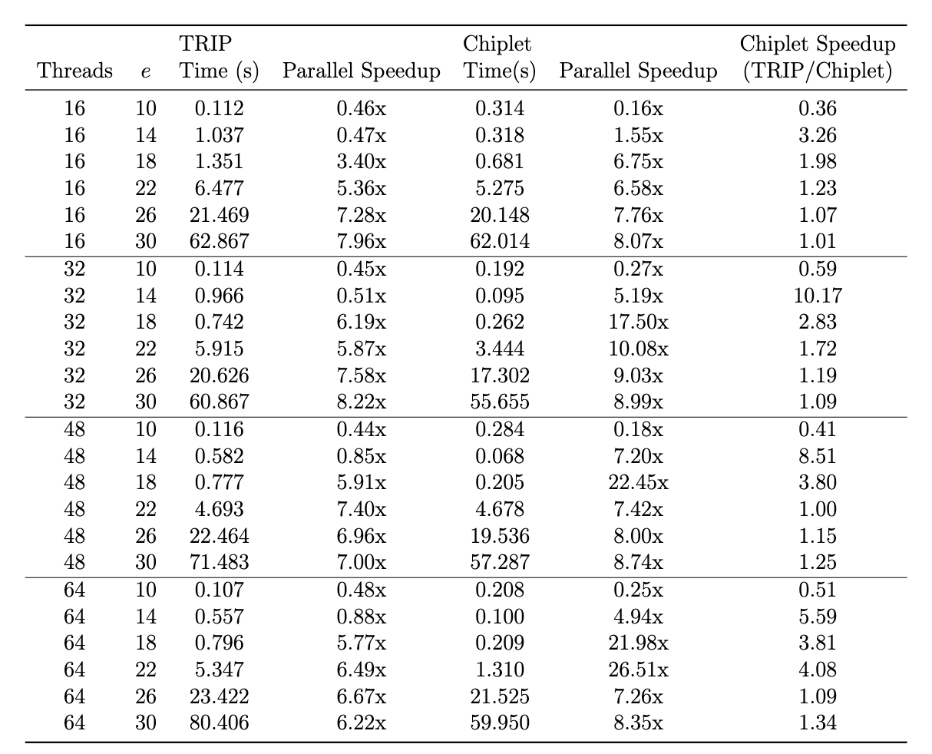
TRIP vs. Chiplet Algorithm: Fateman’s Benchmark
Comparing execution time and parallel speedup for the Fateman benchmark between the TRIP algorithm and our Chiplet algorithm for various values of the exponent e.
Parallel speedup for both algorithms is compared to the standard heap based serial algorithm, not simply executing either algorithm with only 1 thread.
The final column shows the speedup ratio between the algorithms: TRIP over Chiplet.

Slide 20
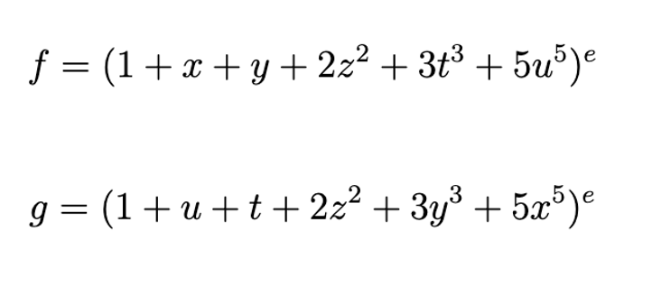
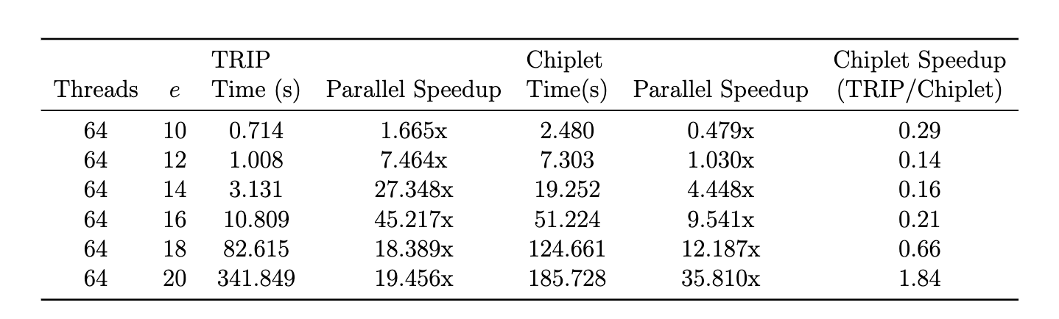
TRIP vs. Chiplet Algorithm: ‘Very Sparse’ Benchmark
Comparing execution time and parallel speedup for the very sparse benchmark between the TRIP algorithm and our Chiplet algorithm for various values of the exponent e.
Parallel speedup for both algorithms is compared to the standard heap-based serial algorithm, not simply executing either algorithm with only 1 thread.
The final column shows the speedup ratio between the algorithms: TRIP over Chiplet.

Slide 21
Improvements and Future Work
/05

Slide 22
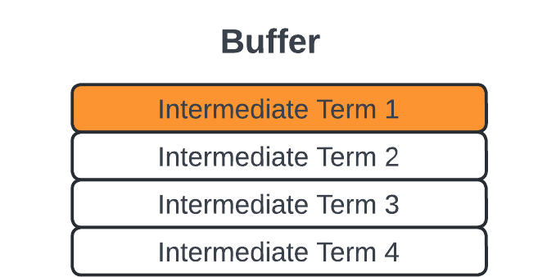
Three Primary Areas for Future Exploration
Evaluate dynamically defining number of intervals and interval sizes for partitioning pp-matrix
Explore performance improvements for the “producer-consumer” buffer linking local heap and global heap
Examine different thread groupings. Perhaps 8 threads per interval is too much or not enough. A dynamic and heuristic organization of threads should be examined

Slide 23
Thanks for Listening! Question?

Slide 24
REFERENCE
[1] A. Brandt. High Performance Sparse Multivariate Polynomials: Fundamental Data Structures and Algorithms. The University of Western Ontario, 2024, pp. 9-65. [2] S. C. Johnson, “Sparse polynomial arithmetic,” ACM SIGSAM Bulletin, vol. 8, no. 3, pp. 63–71, 1974. [3] M. Monagan and R. Pearce. Parallel Sparse Polynomial Multiplication Using Heaps. Proceedings of the ISSAC 2009 - ACM International Symposium on Symbolic and Al- gebraic Computation, 2009. [4] M. Monagan and R. Pearce, “Sparse polynomial division using a heap,” Journal of Symbolic Computation, vol. 46, no. 7, pp. 807–822, 2011. [5] M. Gastineau and J. Laskar. TRIP – A Computer Algebra System Dedicated to Celestial Mechanics and Perturbation Series. IMCCE-CNRS UMR8028, Observatoire de Paris, UPMC, 2013. [6] M. Gastineau and J. Laskar. Fast Sparse Multivariate Polynomial Multiplication Using Burst Tries. In V.N. Alexandrov et al. (Eds.), ICCS 2006 Part II LNCS 3992, pp. 446–453, Springer-Verlag Berlin Heidelberg, 2006. [7] M. Gastineau and J. Laskar, “Highly Scalable Multiplication for Distributed Sparse Mul- tivariate Polynomials on Many-Core Systems,” Lecture Notes in Computer Science, vol. 8136, pp. 100–115, 2013, Springer International Publishing. [8] J. von zur Gathen, and J. Gerhard. Modern Computer Algebra (3rd ed.). Cambridge University Press, pp. 29-43. [9] R. P. Filho, “What is a Chiplet, and Why Should You Care?”, Keysight Blog, Feb. 8, 2024. Available: https://www.keysight.com/blogs/en/tech/sim-des/2024/2/8/ what-is-a-chiplet-and-why-should-you-care
[10] K. Mayo, S. Rajasekaran, I. Pasichnyk, and A. Kashyap, High Performance Computing (HPC) Tuning Guide for AMD EPYCTM 9004 Series Processors, Publication No. 58002, Revision 1.5, Advanced Micro Devices, Inc., 2024. Available:

Slide 25
REFERENCE
[11] S. Naffziger, N. Beck, T. Burd, K. Lepak, G. H. Loh, M. Subramony, and S. White, Pioneering Chiplet Technology and Design for the AMD EPYCTM and RyzenTM Pro- cessor Families, 2021 ACM/IEEE 48th Annual International Symposium on Computer Architecture (ISCA). [12] C. Tardi, What Is Moore’s Law and Is It Still True?, Investopedia, Apr. 2, 2024. Avail- able: https://www.investopedia.com/terms/m/mooreslaw.asp [13] Y. Han, H. Xu, M. Lu, H. Wang, J. Huang, Y. Wang, Y. Wang, F. Min, Q. Liu, M. Liu, and N. Sun, The Big Chip: Challenge, Model and Architecture, Fundamental Research, 2024. Available: https://doi.org/10.1016/j.fmre.2023.10.020 [14] X, Li, High-Performance FPGA-accelerated Chiplet Modeling, University of California, Berkeley, Technical Report No. UCB/EECS-2022-145, May 2022. http://www2.eecs. berkeley.edu/Pubs/TechRpts/2022/EECS-2022-145.html [15] The Julia Language, The @threads Macro, https://docs.julialang.org/en/v1/ manual/multi-threading/#The-@threads-Macro [16] R. Fourquet, XInts.jl: Extended Precision Integers for Julia, GitHub repository, Avail- able at: https://github.com/rfourquet/XInts.jl/blob/master/src/XInts.jl. [17] C. Bauer, ThreadPinning.jl, GitHub repository, Available at: https://github.com/ carstenbauer/ThreadPinning.jl/blob/main/src/ThreadPinning.jl. [18] G. Dalle, BenchmarkTools.jl, GitHub repository, 2023, https://github.com/JuliaCI/ BenchmarkTools.jl/blob/master/benchmark/benchmarks.jl
[19] R. Fateman, Comparing the speed of programs for sparse polynomial multiplication. ACM SIGSAM Bulletin, 37(1):4–15, 2003. [20] Concyclics and N. Viennot, Core to Core Latency Measurements, Available at: https: //github.com/nviennot/core-to-core-latency.

Slide 26
Key Points in SDMP
Local Heap Merge
What’s the time to call global heap merge: N/p, a minimum frequency proportional to the number of cores
Each thread is responsible for the global merge work, so the global heap merge function is protected by a lock.
If lock is not acquired: go back compute more if B is not full, go sleep few microseconds then try again if B is full
If lock is acquired, after releasing the lock, the next workload: k = min(N − |B|, N/p)
For each thread, if no more terms need to be computed and local heap is empty, call close(B) to notify everyone.
Global Heap Merge
To initialize the global heap, the thread has to read one term from every buffer
After all threads complete their computation, the leader thread needs to call global heap merge again, to clean up buffers and global heap in case some terms are left.

Slide 27
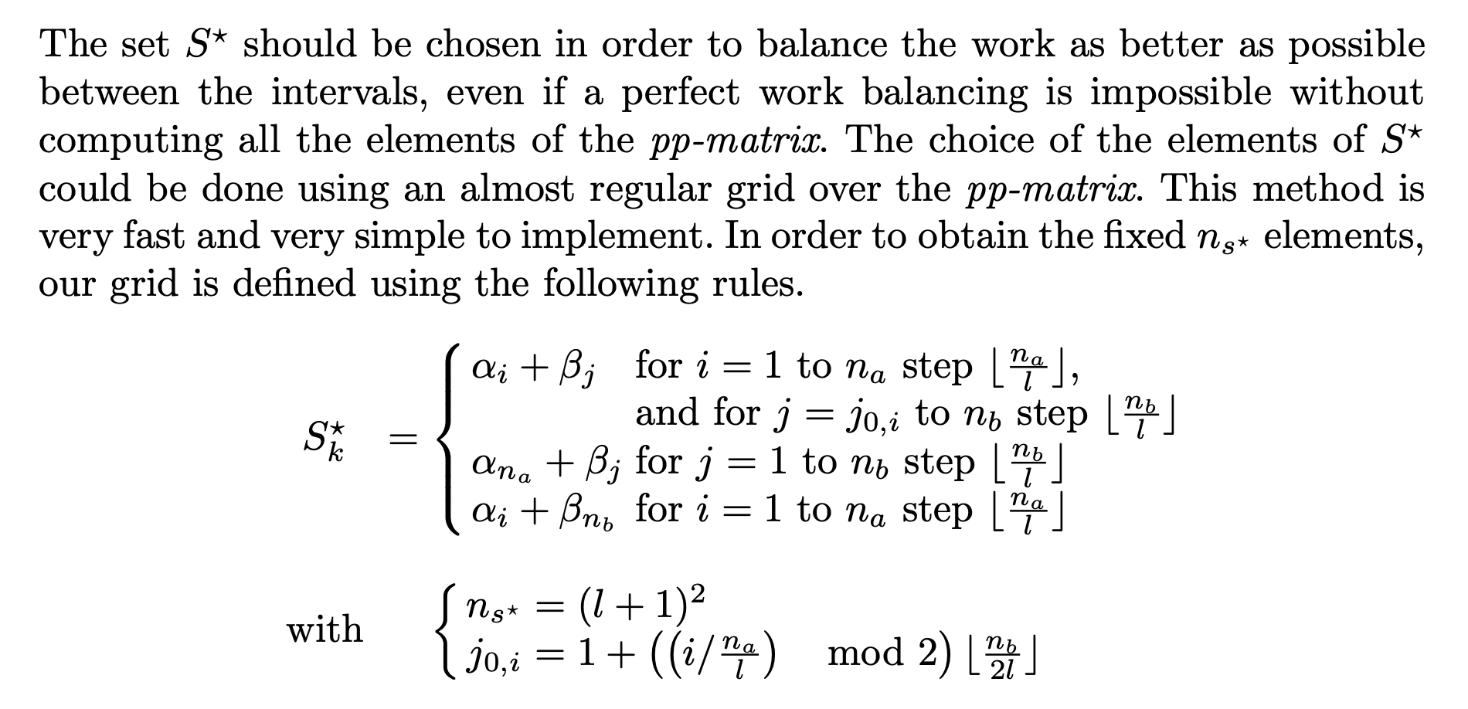
The Choice of Set S*

