Slide 1
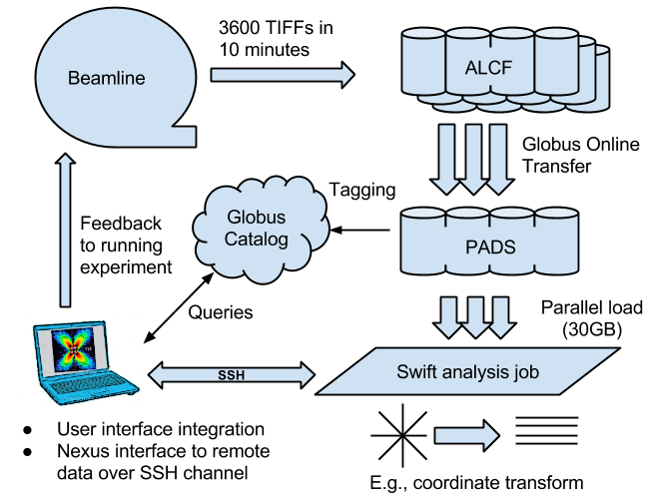
APS: Data ingest/analysis/archive

Slide 2
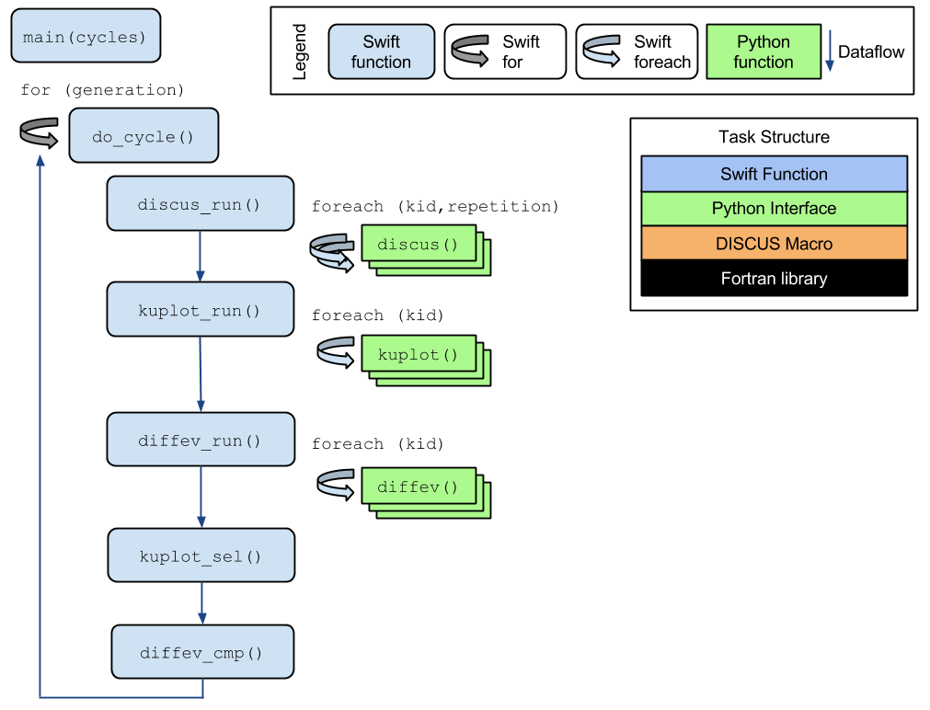
DIFFEV: Genetic algorithm via dataflow
Novel application composed from existing libraries by domain expert!
Potential concurrency: 100,000 cores
Application by Reinhard Neder

